Slide 1
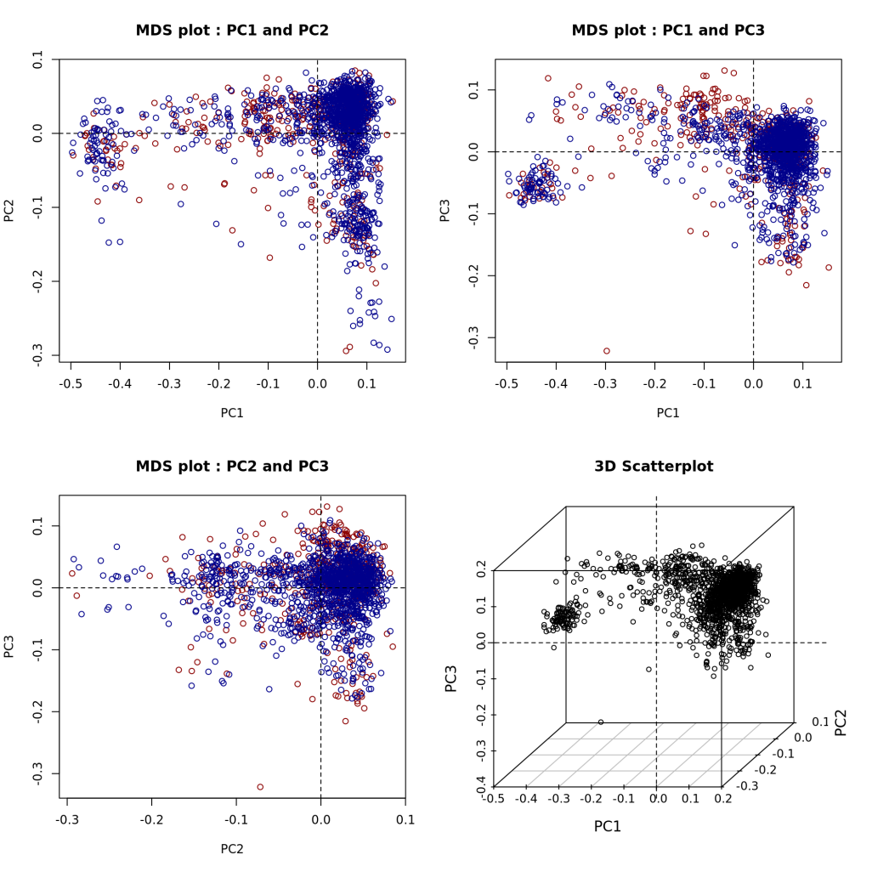
MDS plot
1. Discovery data만 이용했을 때
붉은색 : case
푸른색 : control
1. 빨간 동그라미 (case) outlier로
의심되어 제거
2. Matching 하기 이전의 MDS plot

Slide 2
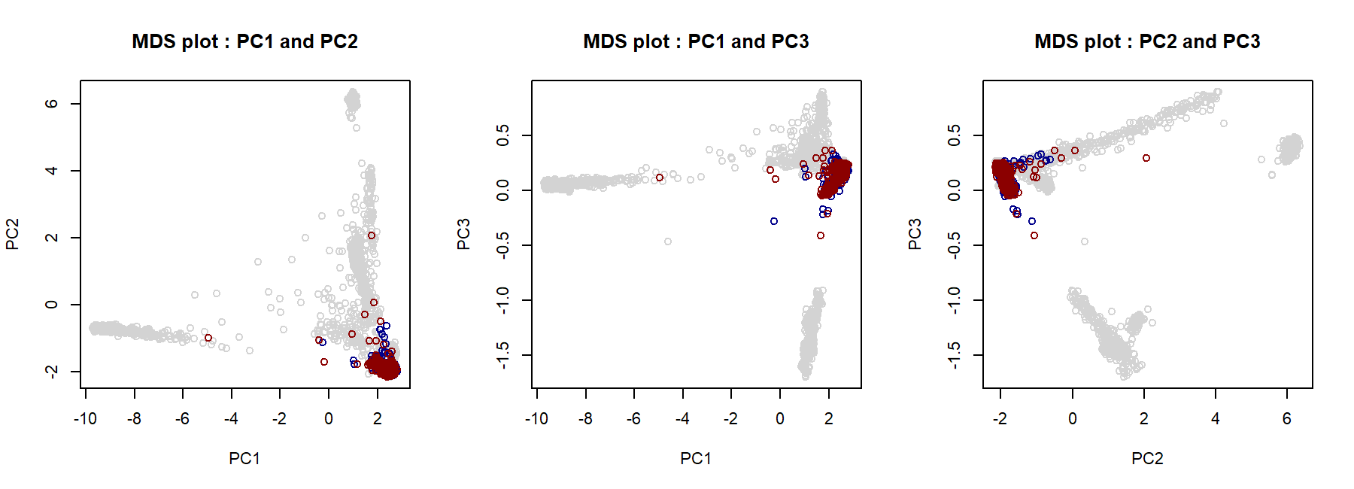
MDS plot
Discovery data + 1000 Genome
회색 : 1000G, 붉은색 : case, 푸른색 : control
matching 후의 case, control + 1000G 이용하여 PC score계산
이 그림 상에서는 두 개의 case가 다른 값에 비하여 동떨어져 있음 -> 제거

Slide 3
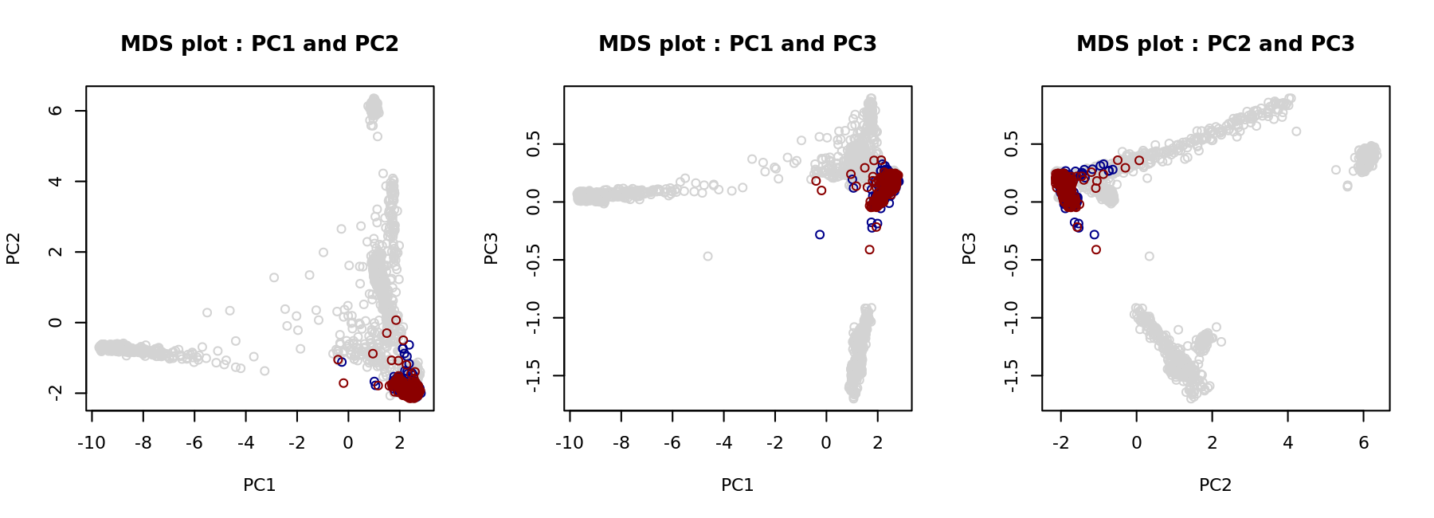
MDS plot
3. 2개 subject 제거 한 후

Slide 4
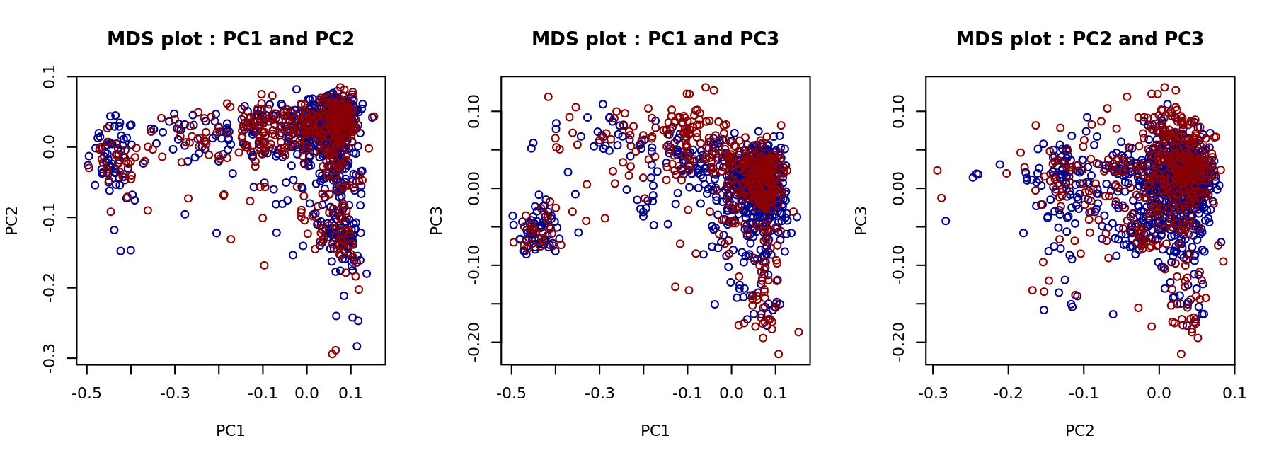
MDS plot
4. Conditional logistic에 사용된 sample
Case 426, control 852
1000G 제외하고 discovery로만 PC score 계산

Slide 5
ND SNPs
Exclude SNPs associated with nicotine dependence (ND) or nicotine use (NU).
GWAS Catalog : total 27 SNPs (21 ND SNPs + 6 NU SNPs)
Exclude 27 SNPs and all SNPs with strong LD with 27 SNPs based on the 1000 Genome EUR data (27 + 8 SNPs)
Among 35 SNPs, there were 8 SNPs in the discovery data.
Workflow of QC was updated.

Slide 6
ND SNPs
CLR results for 8 SNPs
CHR | SNP | P-value
1 | rs1060061 | 0.4885
6 | rs9503551 | 0.0840
7 | rs4285401 | 0.3263
8 | rs804292 | 0.8145
8 | rs6470120 | 0.1152
9 | rs10491551 | 0.7217
4 | rs10517300 | 0.6066
15 | rs1051730 | 0.9759
21 | rs2836823 | 0.1560

Slide 7
MAF & CA test
SNP | Case |  |  | Control |  |  | P-value (CA Test)
 | Data | N | MAF (95% CI) | Data | N | MAF (95% CI)
rs4544201 | LAM Replication | 186 | 0.1429 (0.107 – 0.178) | COPDGene (NHW Male) | 1,224 | 0.2774 (0.260 – 0.295) | 3.28×10⁻¹¹
 |  |  |  | MESA (EUR Female) | 1,153 | 0.2563 (0.238 – 0.274) | 1.32×10⁻⁸
 |  |  |  | 1000GP (EUR Female) | 263 | 0.2357 (0.215 – 0.257) | 3.43×10⁻⁴
 |  |  |  | ECLIPSE (EUR Female) | 792 | 0.2563 (0.235 – 0.278) | 8.88×10⁻⁸
 |  |  |  | UKBiobank (EUR) | 337,199 | 0.2605 (0.259 – 0.262) | 9.28×10⁻¹¹
 |  |  |  | GnomAD (EUR) | 1,745 | 0.3424 (0.327 – 0.358) | 8.85×10⁻²⁴
rs2006950 | LAM Replication | 186 | 0.1148 (0.082– 0.147) | COPDGene (NHW Male) | 1,226 | 0.2557 (0.238 – 0.273) | 5.36×10⁻¹⁴
 |  |  |  | MESA (EUR Female) | 1,128 | 0.2283 (0.211 – 0.246) | 1.40×10⁻⁹
 |  |  |  | 1000GP (EUR Female) | 263 | 0.2186 (0.198 – 0.239) | 2.19×10⁻⁵
 |  |  |  | ECLIPSE (EUR Female) | 792 | 0.2431 (0.222 – 0.264) | 7.91×10⁻¹¹
 |  |  |  | UKBiobank (EUR) | 337,199 | 0.2432 (0.242– 0.244) | 8.18×10⁻¹⁵
 |  |  |  | GnomAD (EUR) | 1,747 | 0.3060 (0.289 – 0.323) | 1.28×10⁻²⁵

Slide 8
MAF : US vs non US
428명의 discovery case의 country 정보를 이용하여 USA, non USA 사이의 MAF의 차이를 비교
 | USA |  | Non USA |  | P-value (CA test)
 | N | MAF (95% CI) | N | MAF (95% CI)
rs4544201 | 190 | 0.1684 (0.131 - 0.206) | 233 | 0.1631 (0.130 - 0.197) | 0.8367
rs2006950 | 190 | 0.1474 (0.112 - 0.183) | 236 | 0.1377 (0.107 - 0.169) | 0.6877

