Slide 1
Development of Liability Threshold Model for Family-based Samples and Its Application to Genetic Data
이학박사 학위논문 1차 예비심사 – 2018. 6. 19
Wonji Kim
Interdisciplinary Program of Bioinformatics Seoul National University

Slide 2
Contents
Introduction
Methods
Risk prediction model
Sampling informative individuals
Simulation Analysis
Real Data Analysis
Discussion

Slide 3
Introduction

Slide 4






What makes people different
Human Genome consists of 23 pairs of chromosomes and about 3 billion nucleotide sequences.
All of human has 99.9% of same nucleotide and 0.1% of different nucleotide, and it makes the genetic difference among the people.
Thus, DNA sequencing is the most basic step to examine biological phenomenon.
Notes:
생물의 특성을 결정하는 정보는 유전자에 있고, 이 유전자는 DNA 염기서열에 따라 결정됨.
인간의 경우, 23쌍으로 구성된 46개의 염색체를 통해 유전정보가 저장되는데 이 중 99.9%는 동일하여, 약 0.1%에 의해서 개인의 유전적 특성이 결정되는 것으로 알려져 있음.
따라서 생명 현상을 구명하기 위해서는 이 DAN 염기서열 분석이 가장 기본적인 과정임.

Slide 5
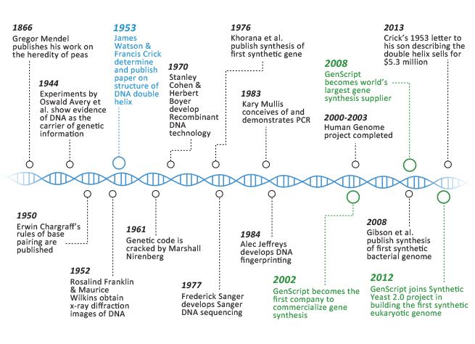


History of DNA Sequencing Tech.
2009
$48,000 Illumina
“Cost will fall from $ 48,000 to under $1,000 during 5 years”
2000 - 2003
Human Genome
project Completed
$100 Million
2012
$6,995 Gene by Gene, Ltd.
2014
$1,000 Illumina
1900 - 2005
Conventional Seq. Tech.
$1 Billon ~ $3 Billon
2011
$5,000 Illumina
2000
2014
X 1
X 1,000,000
Notes:
n October 2006, the X Prize Foundation, working in collaboration with the J. Craig Venter Science Foundation, established theArchon X Prize for Genomics,^{[44]} intending to awardUS$10 million to "the first Team that can build a device and use it to sequence 100 human genomes within 10 days or less, with an accuracy of no more than one error in every 1,000,000 bases sequenced, with sequences accurately covering at least 98% of the genome, and at a recurring cost of no more than $1,000 per genome".

Slide 6



Informative Indiv. Selection
aa (0)
Aa (1)
AA (2)
Disease history of family members has been largely used to GWASs, and phenotyping is relatively easy to obtain and cheap.
It is unclear which individuals should be genotypted.
⇒ False negative finding rate ↓
Disease (1)
Disease-free (0)

Slide 7


Informative Indiv. Selection
aa (0)
Aa (1)
AA (2)
Disease history of family members has been largely used to GWASs, and phenotyping is relatively easy to obtain and cheap.
It is unclear which individuals should be genotypted.
⇒ False negative finding rate ↓
Disease (1)
Disease-free (0)

Slide 8

Informative Indiv. Selection
Who is more likely to get disease?
Who does have causal variants?

Slide 9
Methods
Risk Prediction Model

Slide 10
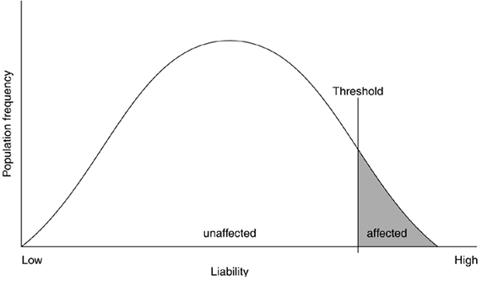
Liability Threshold Model
Our risk prediction model is based on the liability threshold model, which assumes a latent continuous liability underlying each disease.
In GLM, it is identical to Probit model.

Slide 11

Liability Threshold Model
L : liability of target individual
L_{i} : liability of i^{th} family member
T : threshold
L₁
L₂
L
L₃
Risk prediction based on family history

Slide 12
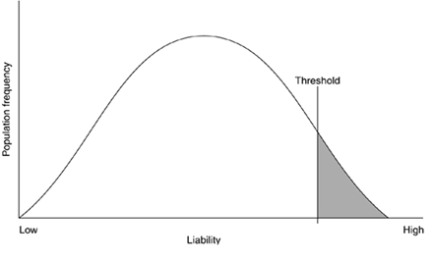
Liability Threshold Model
Notations
Prevalence

Slide 13
Liability Threshold Model
Model Assumption
Liability distribution of whole family
Liability distribution without target individual

Slide 14
Truncated Normal Dist.
The conditional distribution of L
Then we can define the absolute risk based on the family history.
L is truncated at a and b such that
Truncated Normal Distribution

Slide 15
Truncated Normal Dist.
Moment Generating Function of truncated normal
- Let denote
- Exponential term
- If we denote

Slide 16
Truncated Normal Dist.
Moment Calculation (1st Moment)

Slide 17
Truncated Normal Dist.
Moment Calculation (2nd Moment)

Slide 18
Truncated Normal Dist.
Moment Calculation (2nd Moment)

Slide 19
Truncated Normal Dist.
The absolute risk of disease for the individual is the probability that the individual liability exceeds the threshold, T.

Slide 20

Absolute Risk for Disease
With h²=0.2 and prevalence=0.2,
: 0.23400
: 0.13442
: 0.20503
: 0.32417

Slide 21
Methods
Sampling Informative Individuals

Slide 22
Informative Individuals
 |  | Number of affected family members |  | Total
Number of minor alleles |  | <3 | ≥3
 | 0 | 3,773 | 466 | 4,239
 | ≥1 | 2,064 | 364 | 2,428
 | Total | 5,837 | 830 | 6,667
The relative risk of getting minor alleles associated with number of affected family members would be

Slide 23
Informative Individuals
 |  | Number of affected family members |  | Total
Number of minor alleles |  | <3 | ≥3
 | 0 | 3,773 | 466 | 4,239
 | ≥1 | 2,064 | 364 | 2,428
 | Total | 5,837 | 830 | 6,667
control
case
Case with HIGH absolute risk
Control with LOW absolute risk

Slide 24
Simulation Analysis

Slide 25

Simulation Model
Goal
: Finding the most powerful model for sampling methods based on an absolute risk.
Fig. Simple Family used in simulations
Model List
 | Random Sample | Model1 | Model2 | Model3 | Model4
Case (500) | Random | High Risk | High Risk | Random | Low Risk
Control (500) | Random | Random | Low Risk | Low Risk | High Risk

Slide 26
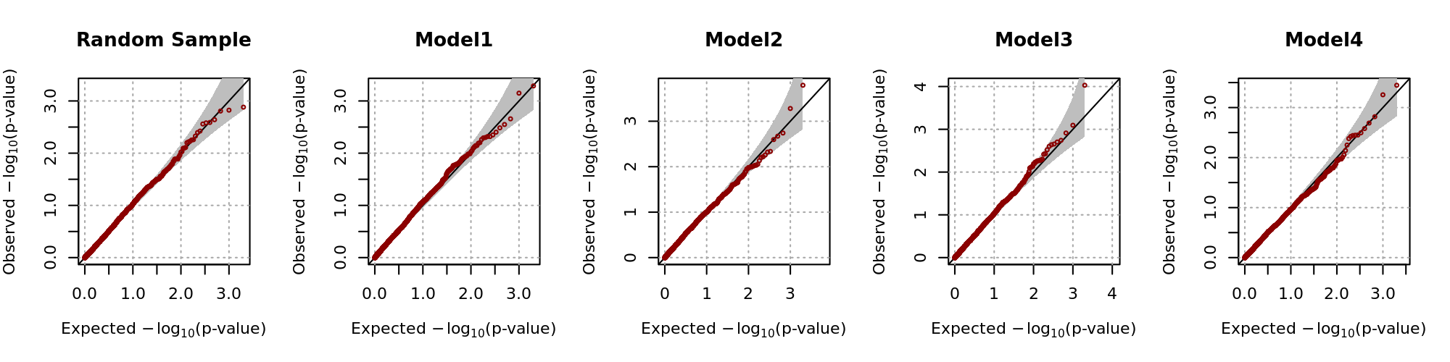
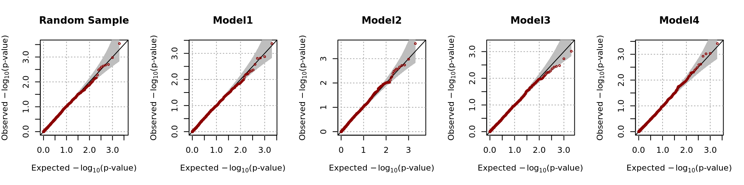
Simulation Analysis Result
Empirical Size
Effect Size : 0 , Number of Replicate : 2,000, prevalence : 0.2 , maf : 0.2
h²=0.2
h²=0.4

Slide 27
Simulation Analysis Result
Empirical Power
Effect Size : 0.005 , Number of Replicate : 2,000, prevalence : 0.2 , maf : 0.2
h² | Sig. level | Random Sample | Model 1 | Model 2 | Model 3 | Model 4
0.2 | 0.01 | 0.285 | 0.5905 | 0.8220 | 0.5520 | 0.0095
 | 0.05 | 0.503 | 0.8045 | 0.9460 | 0.7900 | 0.0580
 | 0.1 | 0.634 | 0.8730 | 0.9720 | 0.8690 | 0.1065
0.4 | 0.01 | 0.2595 | 0.5105 | 0.7525 | 0.5070 | 0.0080
 | 0.05 | 0.4890 | 0.7405 | 0.8955 | 0.7350 | 0.0480
 | 0.1 | 0.6275 | 0.8370 | 0.9460 | 0.8265 | 0.1075
⇒ Model 2 is the most powerful sampling criteria
(Case with high absolute risk, Control with low absolute risk)

Slide 28
Simulation Analysis Result
Empirical Power
Effect Size : 0.005 , Number of Replicate : 2,000, prevalence : 0.2 , maf : 0.2
h² | Sig. level | Random Sample | Model 1 | Model 2 | Model 3 | Model 4
0.2 | 0.01 | 0.285 | 0.5905 | 0.8220 | 0.5520 | 0.0095
 | 0.05 | 0.503 | 0.8045 | 0.9460 | 0.7900 | 0.0580
 | 0.1 | 0.634 | 0.8730 | 0.9720 | 0.8690 | 0.1065
0.4 | 0.01 | 0.2595 | 0.5105 | 0.7525 | 0.5070 | 0.0080
 | 0.05 | 0.4890 | 0.7405 | 0.8955 | 0.7350 | 0.0480
 | 0.1 | 0.6275 | 0.8370 | 0.9460 | 0.8265 | 0.1075
⇒ Model 2 is the most powerful sampling criteria
(Case with high absolute risk, Control with low absolute risk)

Slide 29
Simulation Model
Model List
 | Case (500) | Control (500)
Random Sample | Random | Random
Minimum Model | Low Risk | Low Risk
Maximum Model | High Risk | Low Risk
Fig. Extended Family used in simulations

Slide 30
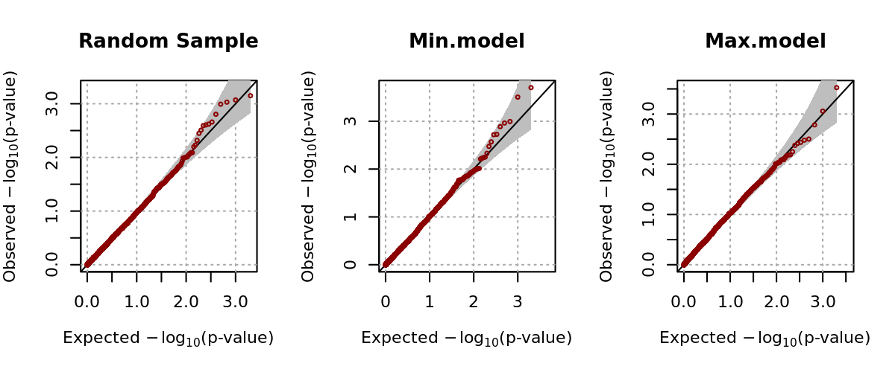
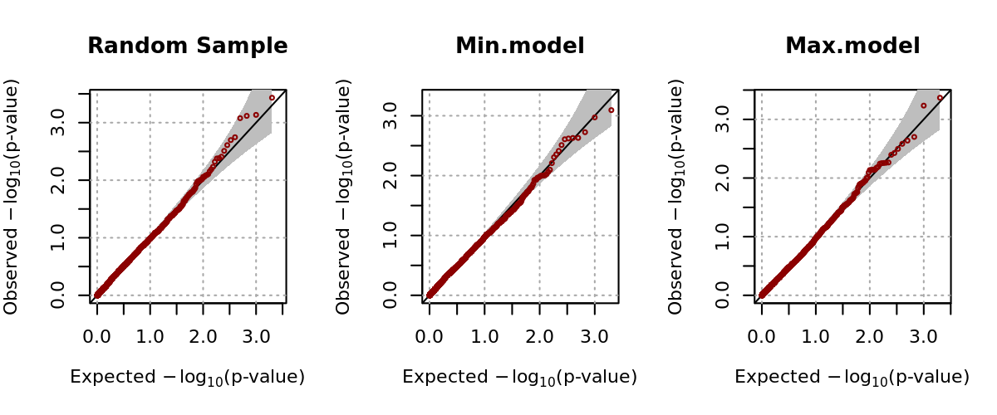
Simulation Analysis Result
Empirical Size
Effect Size : 0 , Number of Replicate : 2,000, prevalence : 0.2 , maf : 0.2
h²=0.2
h²=0.4

Slide 31
Simulation Analysis Result
Empirical Power
Effect Size : 0.005 , Number of Replicate : 2,000, prevalence : 0.2 , maf : 0.2
h² | Sig. level | Random Sample | Minimum Model | Maximum Model
0.2 | 0.01 | 0.2840 | 0.2175 | 0.9645
 | 0.05 | 0.5235 | 0.4590 | 0.9955
 | 0.1 | 0.6445 | 0.5815 | 0.9985
0.4 | 0.01 | 0.2550 | 0.2050 | 0.8965
 | 0.05 | 0.5050 | 0.4315 | 0.9715
 | 0.1 | 0.6390 | 0.5655 | 0.9815
⇒ Under the assumption that there are sufficient controls with low
absolute risk, case selection is important to improve statistical power.

Slide 32
Real Data Analysis

Slide 33
Real Data Analysis
Data : 안성/안산 코호트(8,842명) + T2d Patients(681명)
Case(300) / Control(300) were selected.
Significant SNPs list
Random Sample |  |  | Ascertained Sample
Chr | SNP | P value | Chr | SNP | P value
6 | rs2056907 | 2.33x10⁻⁴ | 6 | rs911540 | 3.80x10⁻⁵
6 | rs6457200 | 2.82x10⁻⁴ | 6 | rs9381266 | 5.07x10⁻⁵
6 | rs790259 | 3.50x10⁻⁴ | 6 | rs4959749 | 6.53x10⁻⁵
6 | rs790260 | 3.50x10⁻⁴ | 6 | rs200080 | 7.88x10⁻⁵
6 | rs839556 | 4.96x10⁻⁴ | 6 | rs2500083 | 7.95x10⁻⁵
6 | rs187810 | 6.50x10⁻⁴ | 6 | rs346307 | 1.09x10⁻⁴

Slide 34
Discussion

Slide 35
Discussion
In many GWASs, there is no efficient strategy for informative individual selection.
Our results show that individual selection based on an absolute risk improves statistical power. Moreover, it has similar effect that enlarge the number of samples.
Even though the proposed method makes ascertained individuals more homogeneous, there still exists heterogeneity between individuals.
⇒ Weighted score statistics seems to be an efficient
choice.

