Slide 1
“Singleton Variants Dominate the Genetic Architecture of Human Gene Expression” and its application
Mar 7, 2019
Wonji Kim

Slide 2
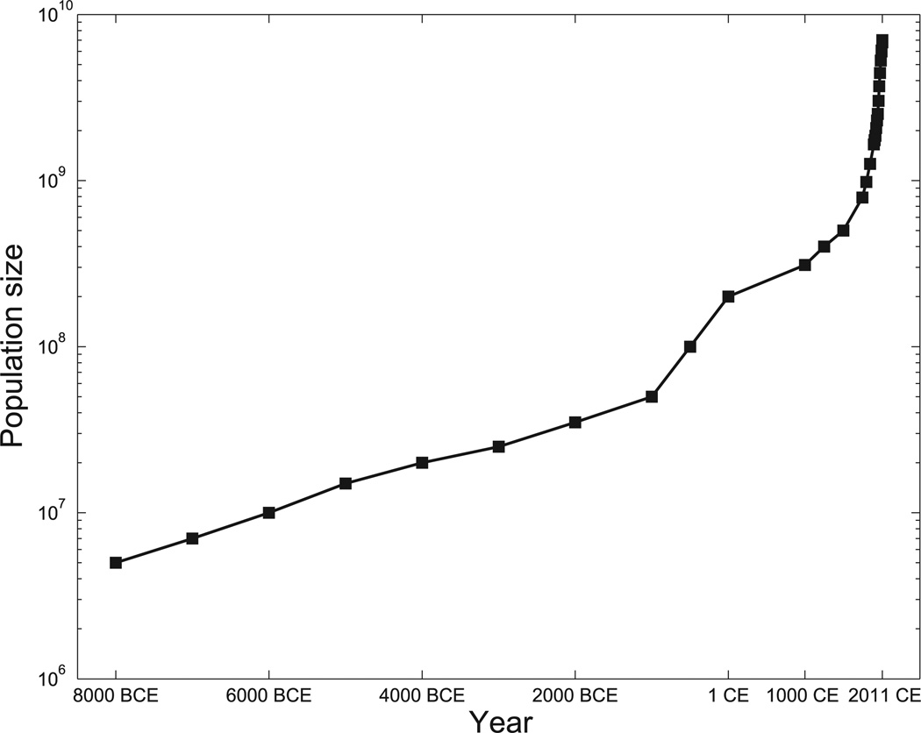
Introduction
Keinan, A., & Clark, A. G. (2012). Recent explosive human population growth has resulted in an excess of rare genetic variants. science, 336(6082), 740-743.
Recent explosive growth of human populations
Abundance of genetic variants with MAF < 1%
Role of rare variants
Mendelian diseases vs complex diseases
Improvement in imputation services
Imputation quality of rare variants
However, these studies excluded the rarest variants or included only well-imputed variants
Notes:
The recent explosive growth of human populations has produced an abundance of genetic variants with MAF less than 1%.
While many rare variants underlying Mendelian diseases have been found, their role in complex disease remains unknown.
The recent improvement in imputation services such as service in imputation server and big reference panel has improved imputation quality of rare variants, and it enabled researchers to estimate the independent contributions of low and high frequency alleles to complex traits.

Slide 3
Introduction
Goal
Development of an approach for inferring the relative phenotypic contributions of all variants, from singletons to high frequency
Application
Narrow-sense heritability of gene expression
Evaluation of robustness to
Genotyping errors
Read mapping errors
Population structure
Rare variant stratification
Wide range of possible genetic architecture
Notes:
In this study, they

Slide 4
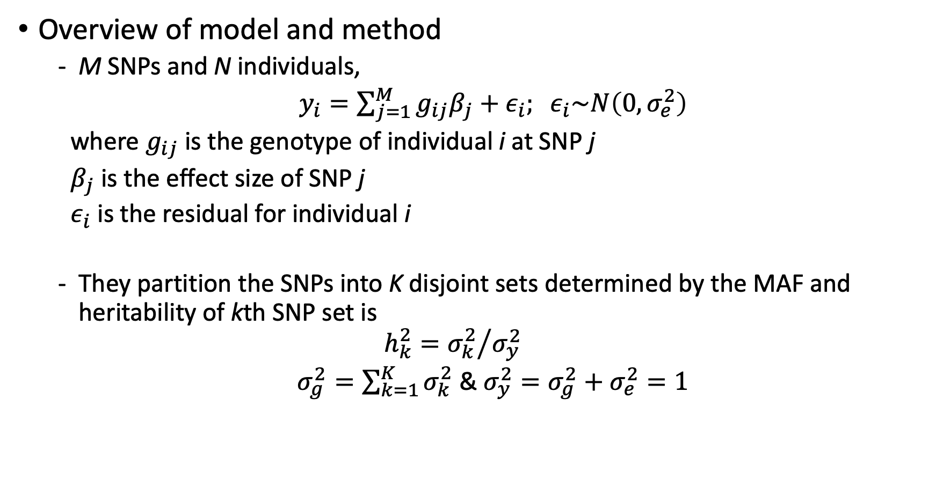
Partitioning heritability by MAF
Overview of model and method
M SNPs and N individuals,
$y_{i}=\sum_{j=1}^{M}{g_{ij}β_{j}}+ε_{i}; ε_{i}\sim N\left(0,σ_{e}^{2}\right)$
where $g_{ij}$ is the genotype of individual i at SNP j
$β_{j}$ is the effect size of SNP j
$ε_{i}$ is the residual for individual i
They partition the SNPs into K disjoint sets determined by the MAF and heritability of kth SNP set is
$$h_{k}^{2}={σ_{k}^{2}}/{σ_{y}^{2}}$$
$σ_{g}^{2}=\sum_{k=1}^{K}{σ_{k}^{2}}$ & $σ_{y}^{2}=σ_{g}^{2}+σ_{e}^{2}=1$
Notes:
The model used to the proposed method is based on the simple linear model.
To assess contribution of

Slide 5
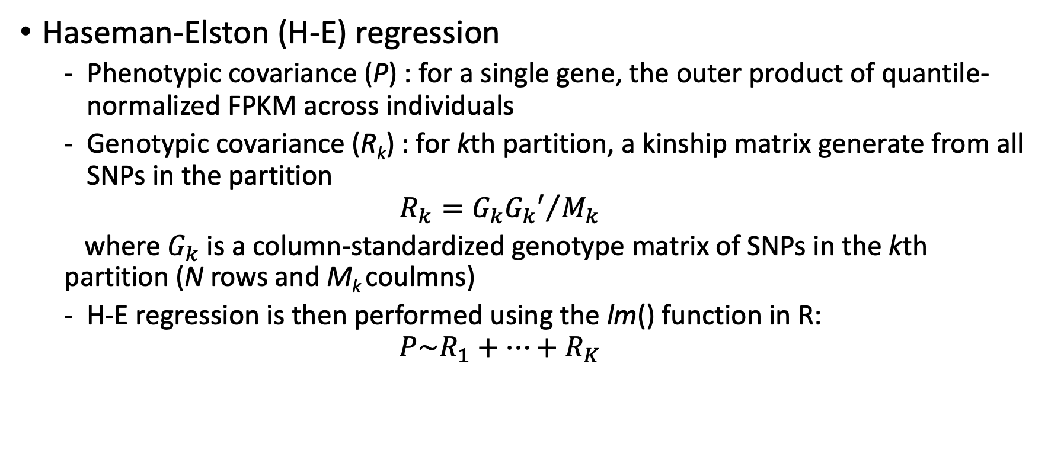
Partitioning heritability by MAF
Haseman-Elston (H-E) regression
Phenotypic covariance (P) : for a single gene, the outer product of quantile-normalized FPKM across individuals
Genotypic covariance (R_{k}) : for kth partition, a kinship matrix generate from all SNPs in the partition
$$R_{k}={G_{k}G_{k}′}/{M_{k}}$$
where $G_{k}$ is a column-standardized genotype matrix of SNPs in the kth partition (N rows and M_{k} coulmns)
H-E regression is then performed using the lm() function in R:
$$P\sim R_{1}+…+R_{K}$$
Notes:
For computational and statistical reasons, they used H-E regression for estimating heritability rather than LMM.
HE regression is kind of a variance component analysis for quantitative traits, so it is usually used for estimating heritability.
They did extensive simulation studies to compare the results between LMM and HE, and concluded HE outperformed computationally, and in case of small sample sizes.
The premise of HE regression is that heritability can be estimated by the correlation between the phenotypic covariance across individuals and the genotypic covariance across individuals.
Quantile-normalized why?
To be conservative, we apply quantile normalization in the observed data anyway, since there is potential concern for non-normality in the observed gene expression patterns.

Slide 6
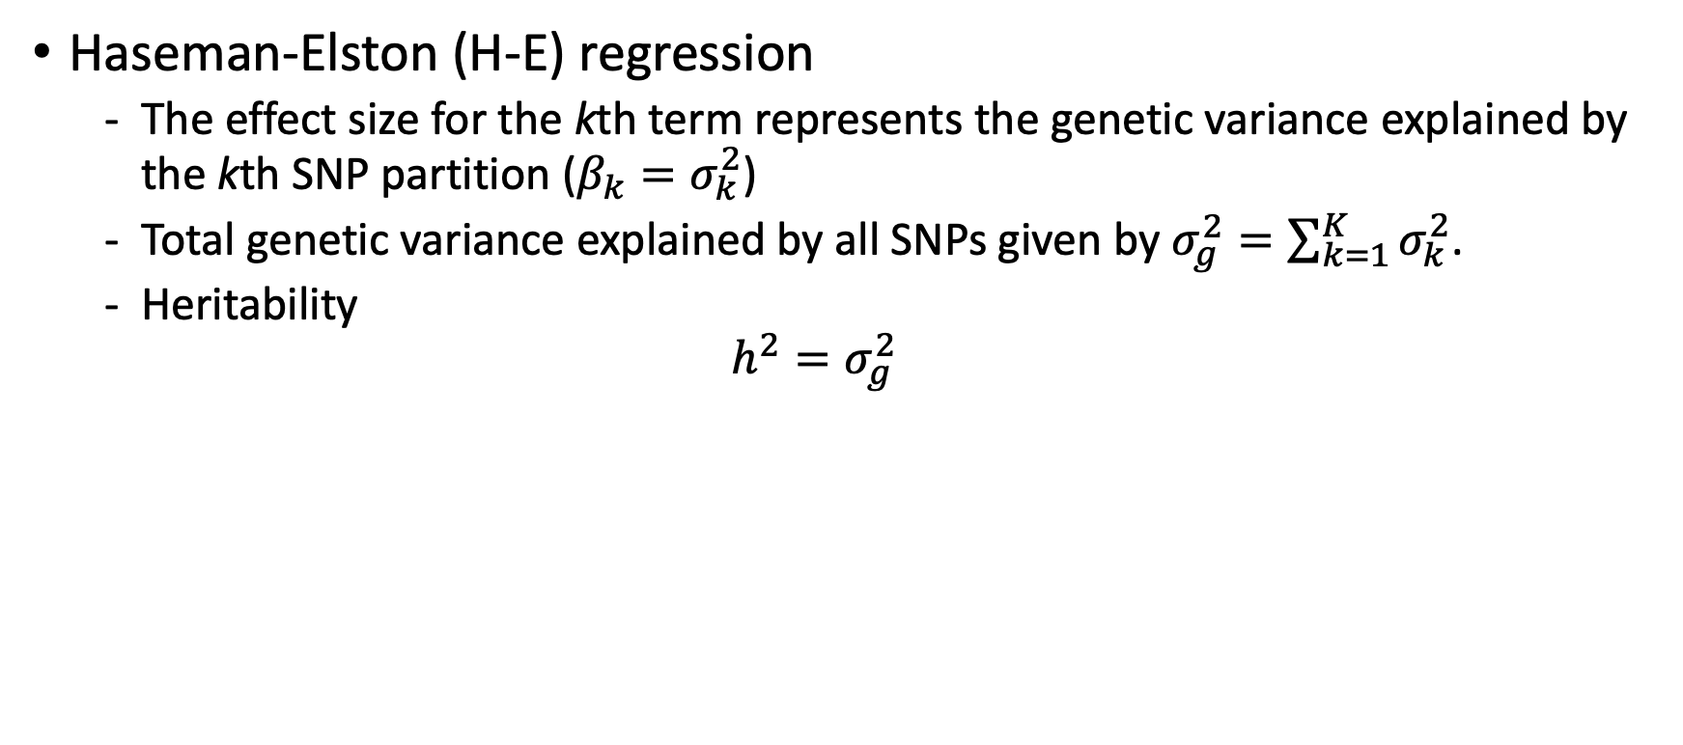
Partitioning heritability by MAF
Haseman-Elston (H-E) regression
The effect size for the kth term represents the genetic variance explained by the kth SNP partition ($β_{k}=σ_{k}^{2}$)
Total genetic variance explained by all SNPs given by $σ_{g}^{2}=\sum_{k=1}^{K}{σ_{k}^{2}}$.
Heritability
$$h^{2}=σ_{g}^{2}$$

Slide 7
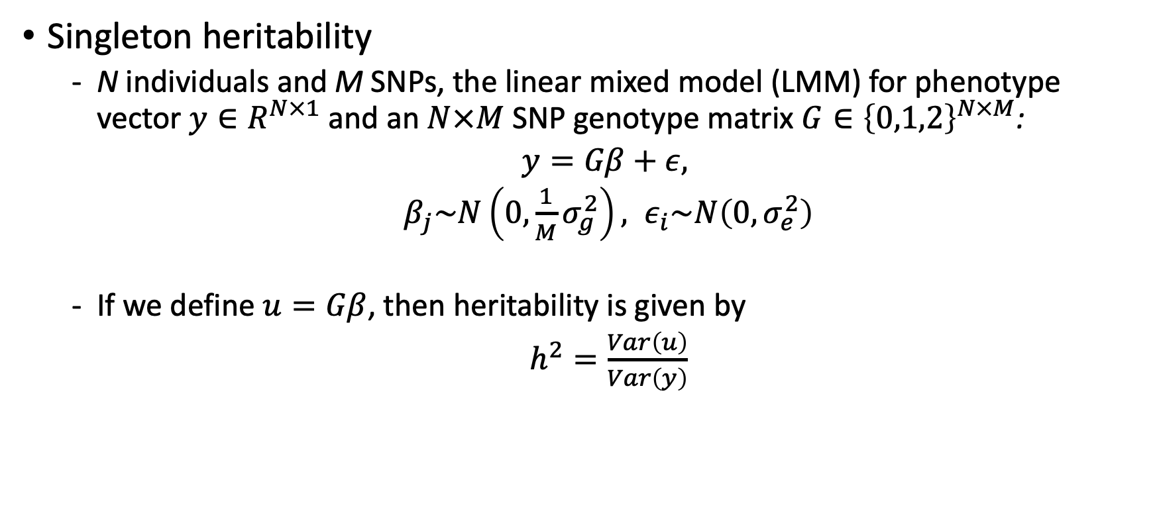
Partitioning heritability by MAF
Singleton heritability
N individuals and M SNPs, the linear mixed model (LMM) for phenotype vector $y∈R^{N×1}$ and an $N×M$ SNP genotype matrix $G∈{\left\{0,1,2\right\}}^{N×M}$:
$y=Gβ+ε,$
$β_{j}\sim N\left(0,\frac{1}{M}σ_{g}^{2}\right), ε_{i}\sim N\left(0,σ_{e}^{2}\right)$
If we define $u=Gβ$, then heritability is given by
$h^{2}=\frac{Var\left(u\right)}{Var\left(y\right)}$

Slide 8
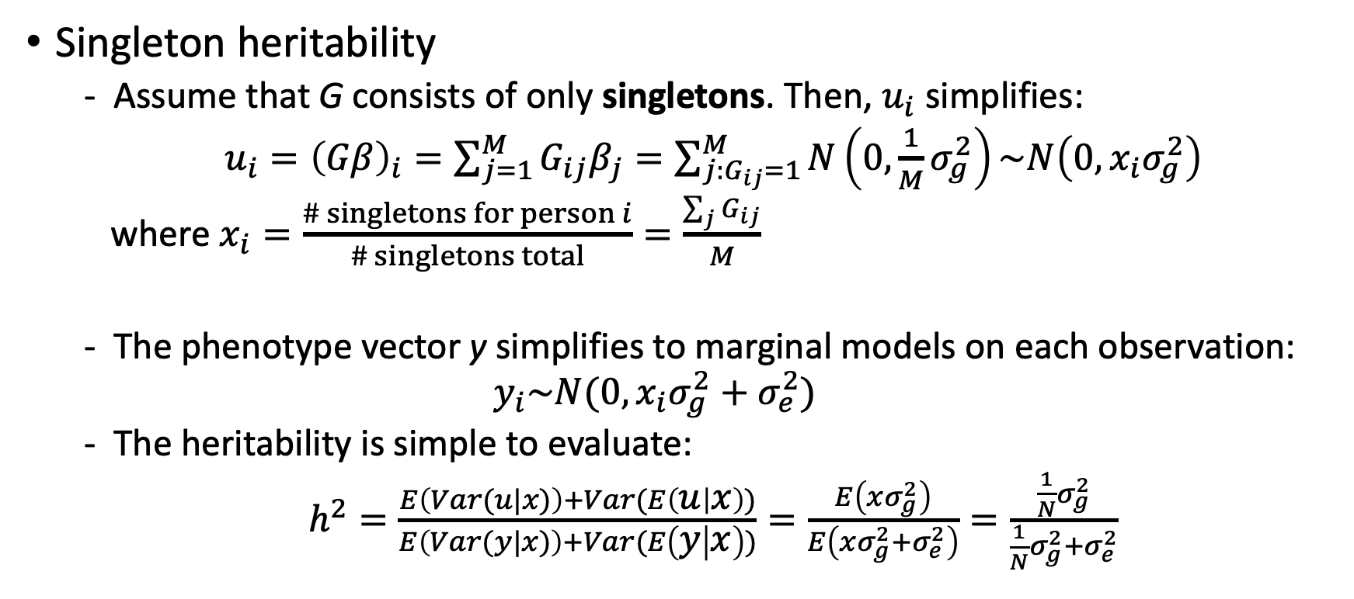
Partitioning heritability by MAF
Singleton heritability
Assume that G consists of only singletons. Then, $u_{i}$ simplifies:
$u_{i}={\left(Gβ\right)}_{i}=\sum_{j=1}^{M}{G_{ij}β_{j}}=\sum_{j:G_{ij}=1}^{M}{N\left(0,\frac{1}{M}σ_{g}^{2}\right)}\sim N\left(0,x_{i}σ_{g}^{2}\right)$
where $x_{i}=\frac{\# singletons for person i}{\# singletons total}=\frac{\sum_{j}{G_{ij}}}{M}$
The phenotype vector y simplifies to marginal models on each observation:
$$y_{i}\sim N(0,x_{i}σ_{g}^{2}+σ_{e}^{2})$$
The heritability is simple to evaluate:
$h^{2}=\frac{E\left(Var(u|x)\right)+Var(E\left(u | x\right))}{E\left(Var(y|x)\right)+Var(E\left(y | x\right))}=\frac{E\left(xσ_{g}^{2}\right)}{E\left(xσ_{g}^{2}+σ_{e}^{2}\right)}=\frac{\frac{1}{N}σ_{g}^{2}}{\frac{1}{N}σ_{g}^{2}+σ_{e}^{2}}$
Notes:
This means that each column j of G will have N-1 zeros and 1 one, and so has mean and variance 1/N

Slide 9
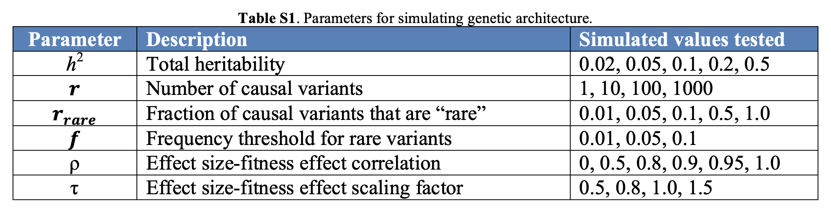
Simulation studies
Simulation data
Real genotype data by randomly sampling genes
All genetic variants within 1 Mb of transcription start and end sites of genes
Simulation parameters

Slide 10
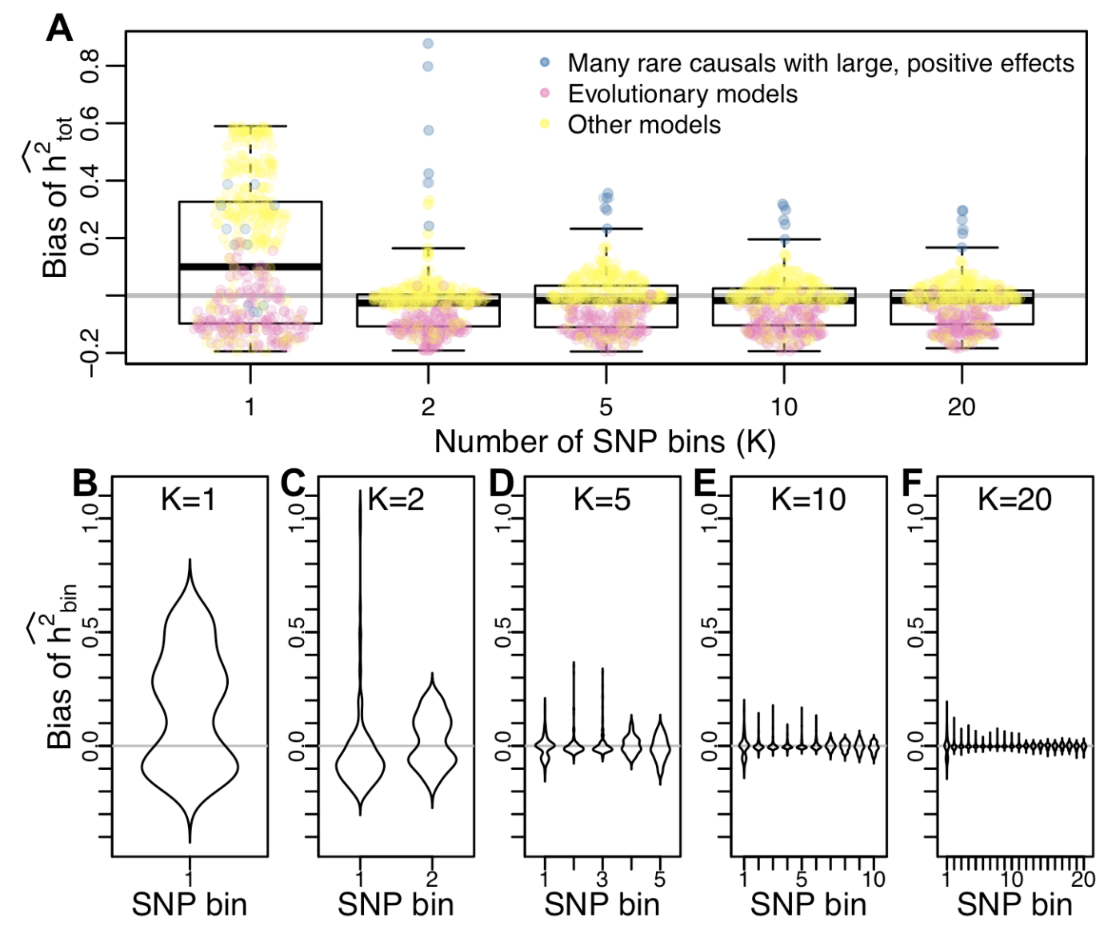
Simulation studies
Across a broad range of parameters, the accuracy of heritability interference improves as the number of SNP bins increases.
Notes:
In figure A, if SNPs are not partitioned then the bias of total heritability is very large. However, if we partitioned SNPs into more than two, than the bias is effectively reducded.

Slide 11
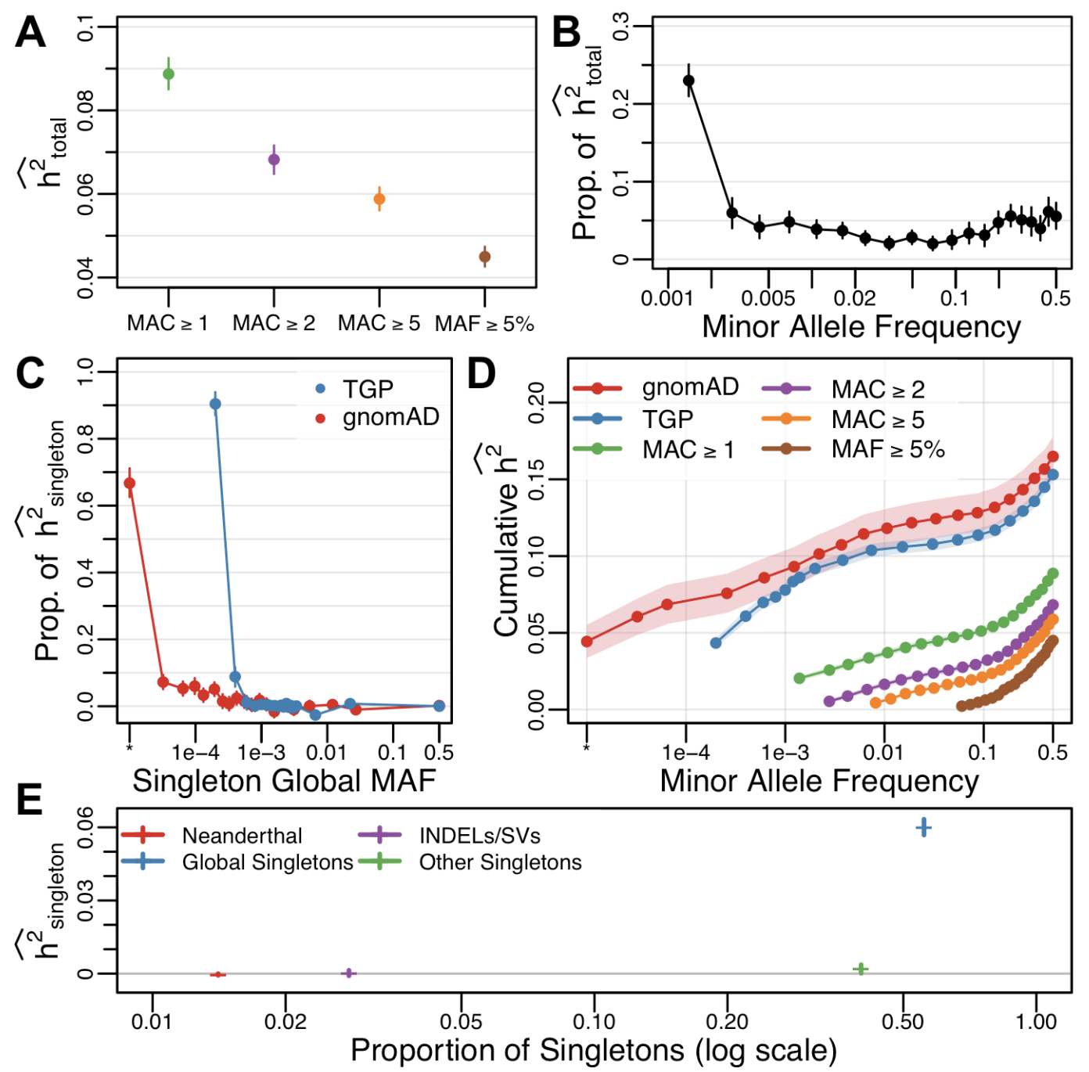
Simulation studies
Characterizing the genetic architecture of human gene expression
Average total heritability inferred across genes for different frequency filters
The proportion of heritability attributed to each MAF bin
Partitioning singletons by global MAF based on TGP and gnomAD
Cummulative heritability
Singleton heritability for type of singletons
Notes:
Excluding low frequency variants results in substantial “missing heritability”
Singletons represent >20% of the total inferred heritability
It demonstrats the vast majority of singleton heritability is due to sites that are globally very rare.
Including all SNPs and partitioning by global MAF results in a substantially increased level of heritability
Global singleton SNPs represent 56% of all singletons, but contribute the vast majority of singleton heritability

Slide 12
Software availability
Three open source software tools are available by request to the authors
SingHer.R – Singleton Heritability inference with REML implementation in R of the unbiased singleton-based LMM
HEplay.R – H-E regression simulation in R that implements all the genotype-phenotype maps
HEh2.R – H-E regression implementation in R that performs all H-E analyses

Slide 13
Preliminary SingHer analysis for COPDGene

Slide 14
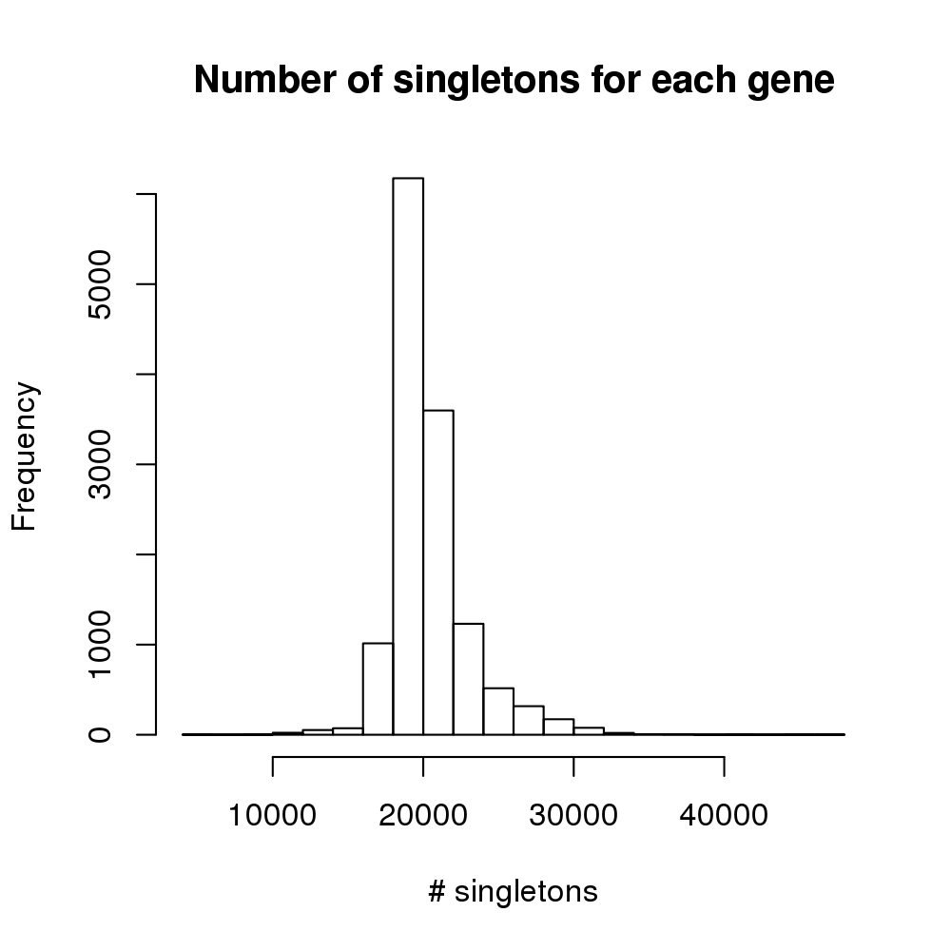
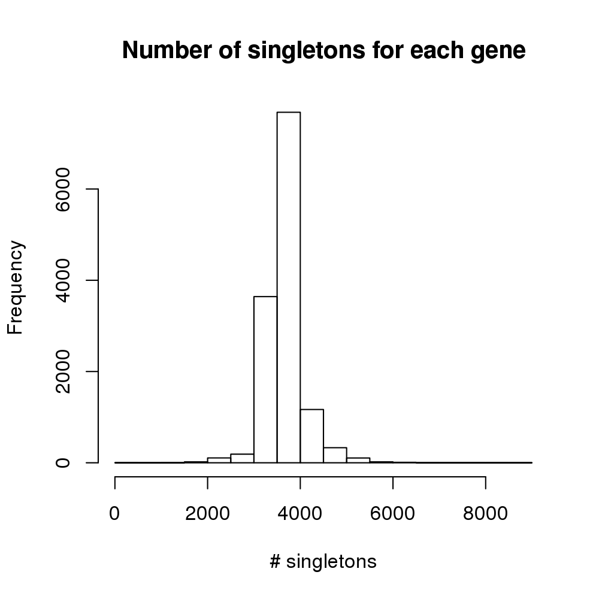
COPDGene dataset and QC
Genotype data : WGS
Phenotype data : Gene expression
The number of genes for which the proportion of individuals (x) has log(CPM) >Y. (Row : X, Column : Y)
Freeze 5b
54,499 indivs.
Freeze 2
1,211 indivs. & 65,987 genes
 | 1 | 1.5 | 2 | 2.5 | 3 | 4
0 | 27805 | 24088 | 20993 | 18430 | 16318 | 12936
0.1 | 19167 | 17030 | 15203 | 13650 | 12223 | 9507
0.2 | 17873 | 15946 | 14346 | 12867 | 11524 | 8892
0.3 | 16951 | 15239 | 13714 | 12335 | 11028 | 8480
0.4 | 16179 | 14560 | 13130 | 11818 | 10553 | 8054
0.5 | 15306 | 13820 | 12431 | 11188 | 9986 | 7603
0.6 | 14714 | 13271 | 11972 | 10732 | 9568 | 7278
0.7 | 14097 | 12747 | 11511 | 10320 | 9167 | 6899
0.8 | 13447 | 12179 | 10998 | 9848 | 8741 | 6528
0.9 | 12583 | 11429 | 10314 | 9240 | 8198 | 6036
Only overlapping individuals
1,052 indivs.
1,052 indivs. & 65,987 genes
- non-expressed genes
- genes on sex chromosome
+ high quality genes
+ Only singletons
Global SGT : 207,548,334
Observed SGT : 27,497,488
1,052 indivs. & 13,284 genes
Apply transcriptome-wide SingHer analysis
for each gene and singletons within 1 Mb of the transcription start or end sites of a gene

Slide 15
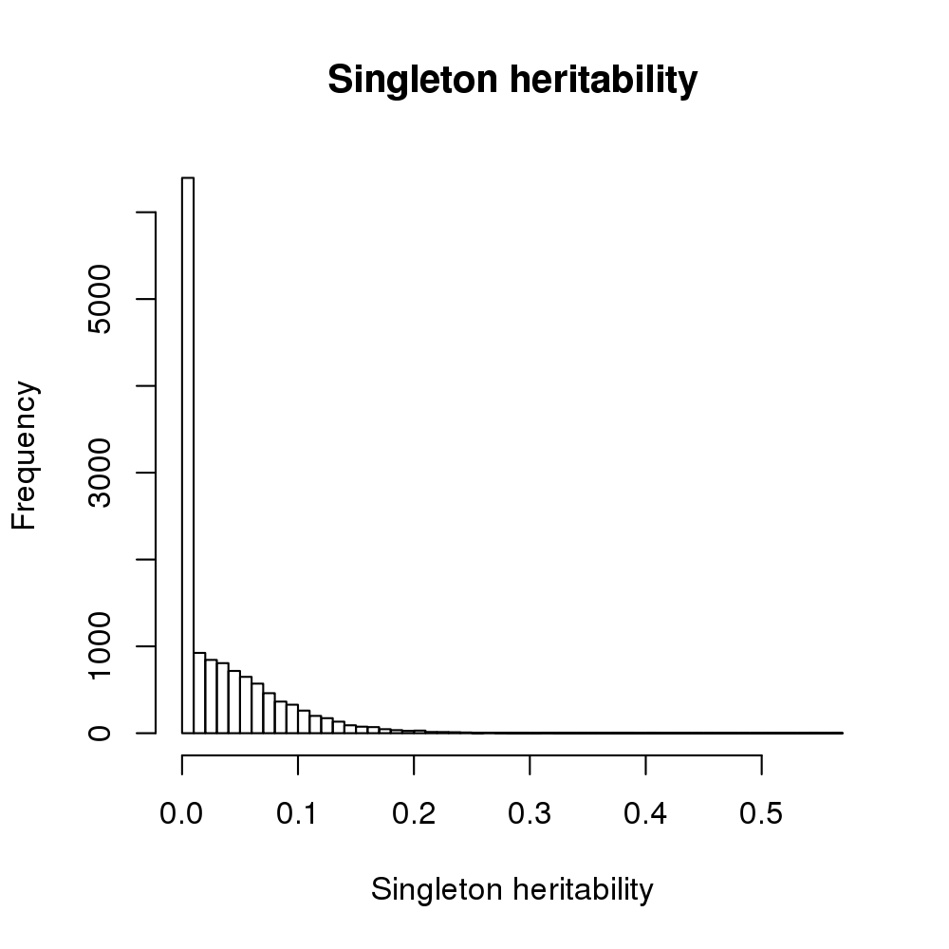
SingHer analysis – observed singletons
Gene_Name | CHR | Start_bp | End_bp | Gene_Type | h2
MYOM1 | 18 | 3066807 | 3220108 | protein_coding | 0.5690
MTCO1P12 | 1 | 631074 | 632616 | unprocessed_pseudogene | 0.5475
ABCA5 | 17 | 69244311 | 69327244 | protein_coding | 0.4044
AL008721.2 | 22 | 25476218 | 25479971 | sense_intronic | 0.3857
HEBP2 | 6 | 138403531 | 138422197 | protein_coding | 0.3820
LINC00937 | 12 | 8295986 | 8396803 | lincRNA | 0.3813
RNF182 | 6 | 13924446 | 13980302 | protein_coding | 0.3731
HERC2P9 | 15 | 28589492 | 28685264 | transcribed_unprocessed_ pseudogene | 0.3634
ST6GALNAC2 | 17 | 76565379 | 76586956 | protein_coding | 0.3586
MIR646HG | 20 | 60087840 | 60527458 | lincRNA | 0.3523
VWDE | 7 | 12330885 | 12403941 | protein_coding | 0.3442
CDC27 | 17 | 47117703 | 47189422 | protein_coding | 0.3330
1-Mar | 1 | 220786759 | 220819657 | protein_coding | 0.3320
CNTNAP3 | 9 | 39072767 | 39288315 | protein_coding | 0.3278
LRRC6 | 8 | 132571953 | 132675617 | protein_coding | 0.3222
AC011472.2 | 19 | 11300777 | 11324441 | 3prime_overlapping_ncRNA | 0.3185
CRYBB2P1 | 22 | 25448105 | 25520854 | transcribed_unprocessed_ pseudogene | 0.3135
FCAR | 19 | 54874248 | 54890472 | protein_coding | 0.3134
RBP7 | 1 | 9997206 | 10016020 | protein_coding | 0.3117

Slide 16
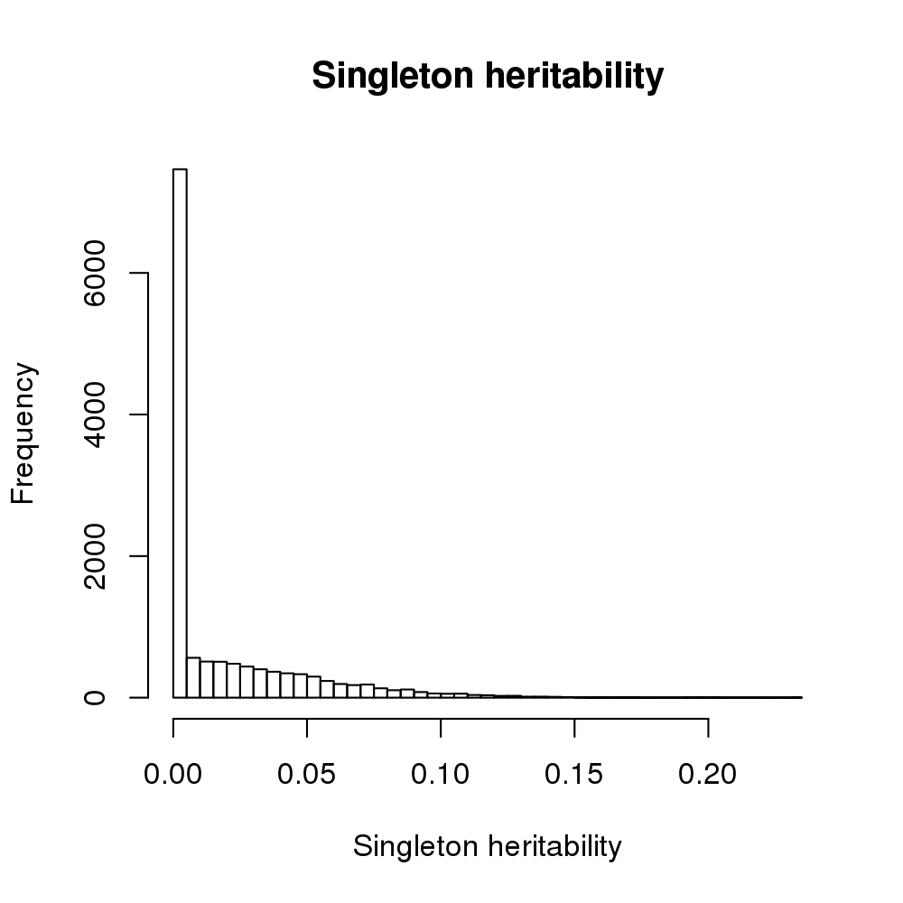
SingHer analysis – global singletons
Gene_Name | CHR | Start_bp | End_bp | Gene_Type | h2
APOPT1 | 14 | 103562962 | 103607523 | protein_coding | 0.2321
LARGE1 | 22 | 33162226 | 33922841 | protein_coding | 0.2017
SFT2D1 | 6 | 166319728 | 166342591 | protein_coding | 0.1957
ZNF622 | 5 | 16451519 | 16465792 | protein_coding | 0.1925
ZNF658 | 9 | 66856426 | 66932141 | protein_coding | 0.1708
SCAF1 | 19 | 49642125 | 49658642 | protein_coding | 0.1703
DMWD | 19 | 45782947 | 45792802 | protein_coding | 0.1680
COL4A3 | 2 | 227164565 | 227314792 | protein_coding | 0.1643
METTL18 | 1 | 169792529 | 169794966 | protein_coding | 0.1632
GMFB | 14 | 54474484 | 54489196 | protein_coding | 0.1621
IL17RA | 22 | 17084954 | 17115694 | protein_coding | 0.1609
ZMAT2 | 5 | 140698680 | 140706676 | protein_coding | 0.1570
NUTM2B-AS1 | 10 | 79663088 | 79826594 | antisense | 0.1561
TMED4 | 7 | 44577894 | 44582287 | protein_coding | 0.1559
TRIM24 | 7 | 138460334 | 138589993 | protein_coding | 0.1532
ENPP3 | 6 | 131628442 | 131747418 | protein_coding | 0.1525
ARRDC5 | 19 | 4890437 | 4902867 | protein_coding | 0.1523
TIPRL | 1 | 168178933 | 168202114 | protein_coding | 0.1514
NUCB1 | 19 | 48900050 | 48923372 | protein_coding | 0.1511

Slide 17
Further works…
Using global singletons using TOPMed WGS data
Considering missingness rate for quality control of genotype data (and comparing the results)
Applying to other quantitative traits such as FEV₁, FEV₁/FVC …

Slide 18
Thank you

