Slide 1
Separating Genetics Effects of Lung Function vs. COPD
Wonji Kim

Slide 2
COPDGene dataset and QC
Genotype data : WGS
Cumulative logistic regression of GOLD 0, 1, 2, 3 and 4 stage with covariates of Age, Sex, Pack-years and 10 PC scores
Look at association of COPD GWAS SNPs with quantitative FEV1 (as absolute level and as % predicted) within tertiles of lung function.
Assess association of COPD and lung function GWAS variants across levels of quantitative emphysema as an independent COPD-related disease characteristic.
Freeze 6a
107,047 indivs.
<Variant QC>
- missing rate > 0.05
- Pvalue of HWE < 10⁻⁵
- MAF < 0.05
+ Filter : PASS & Biallelic SNP
<Subject QC>
+ COPDGene subjects
- no phenotype
- missing rate > 0.05
10,055 indivs. & 916,293 SNPs
<NHW>
6,725 indivs. &
916,293 SNPs
<AA>
3,330 indivs. &
916,293 SNPs
Generalized logistic regression
Association of COPD variants with FEV1
Association of COPD & ung function GWAS variants with emphysema

Slide 3
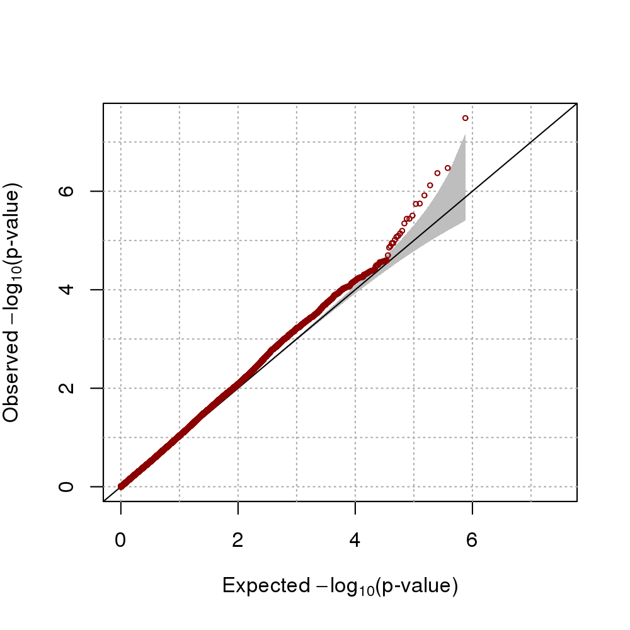
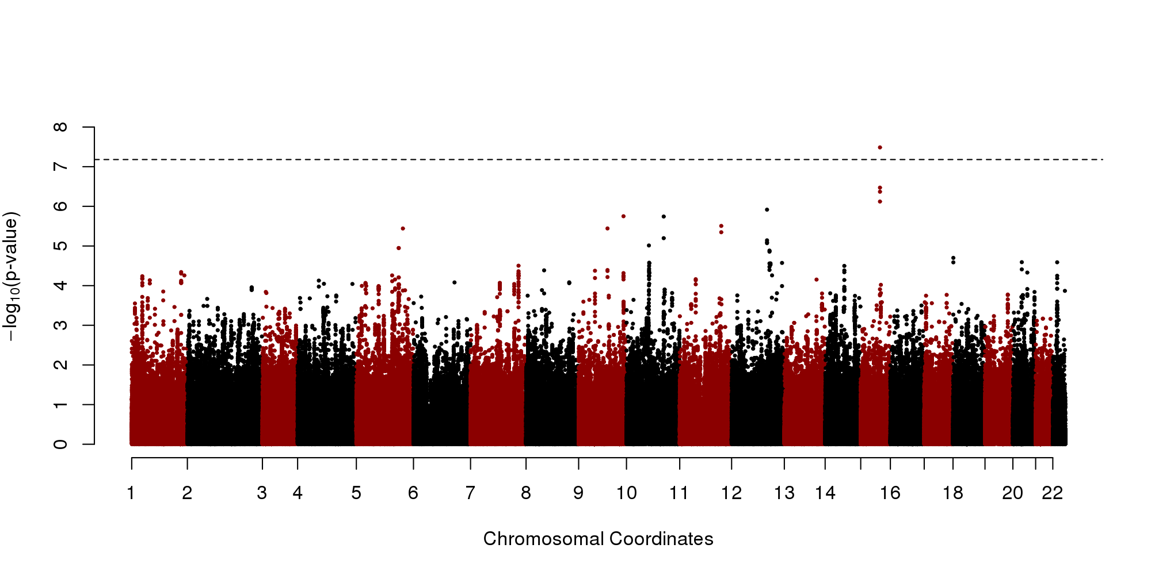
Analysis #1
Cumulative logistic regression – NHW
https://www.ebi.ac.uk/gwas/variants/rs8040868
rs8040868 | GOLD 1 | GOLD 2 | GOLD 3 | GOLD 4
Effect size | -0.1865 | -0.1977 | -0.2421 | -0.2733
Notes:
-0.1865239923148 -0.197702999398854 -0.242079369098879 -0.273297762802988

Slide 4
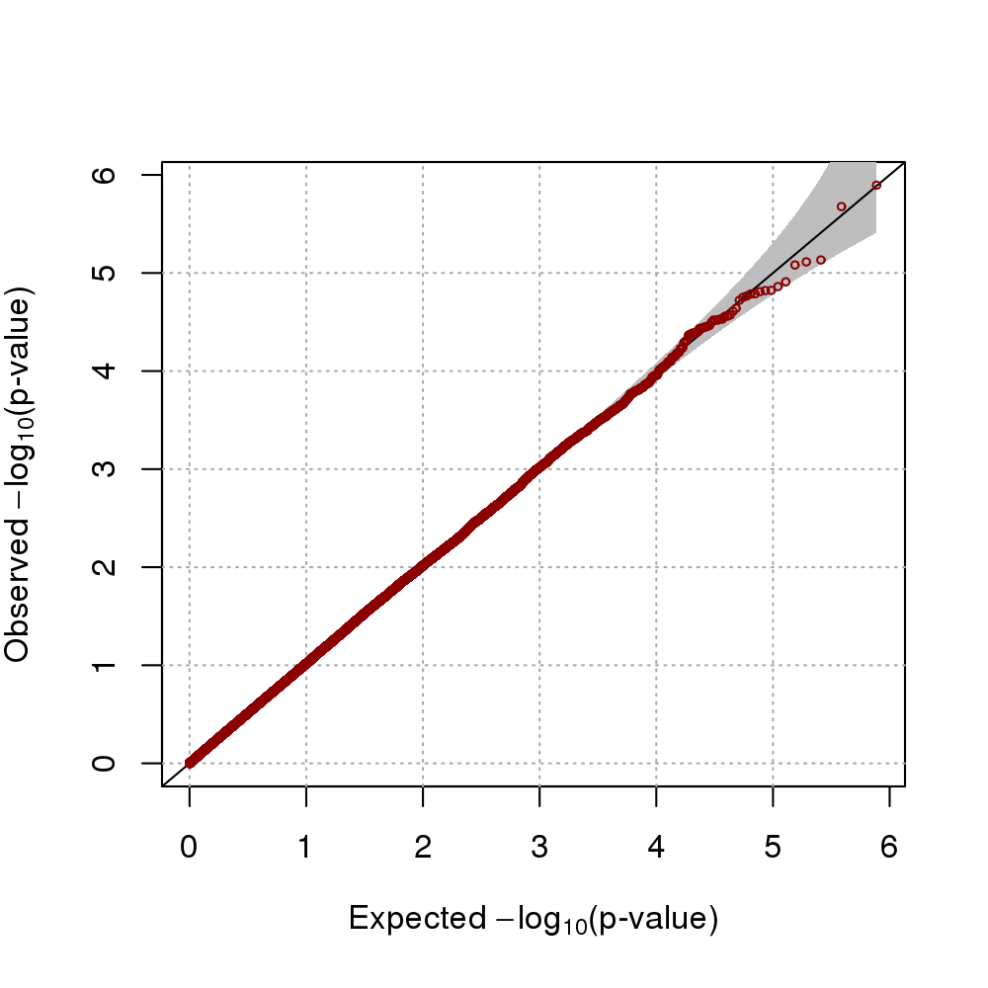
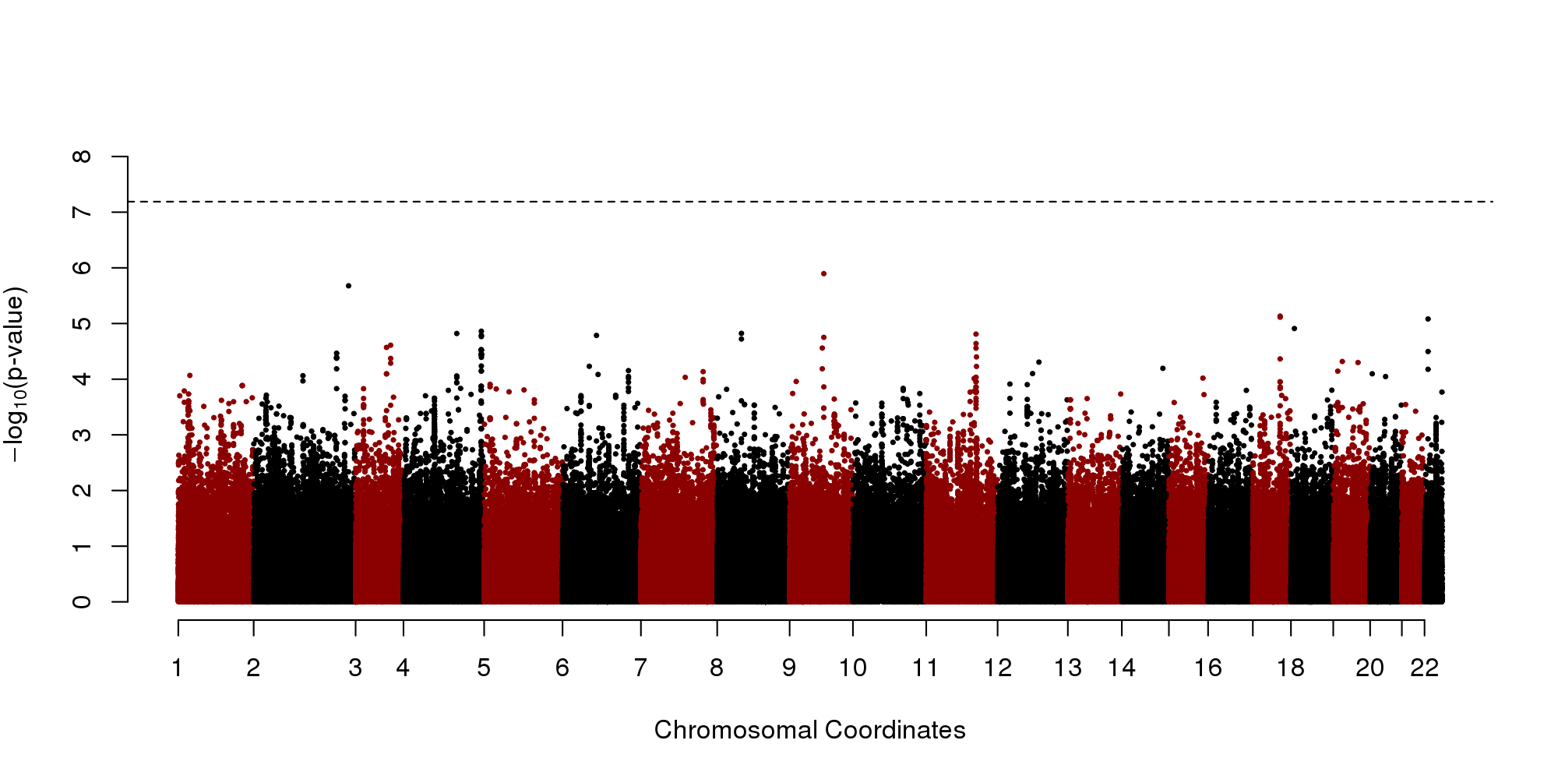
Analysis #1
Cumulative logistic regression – AA

Slide 5
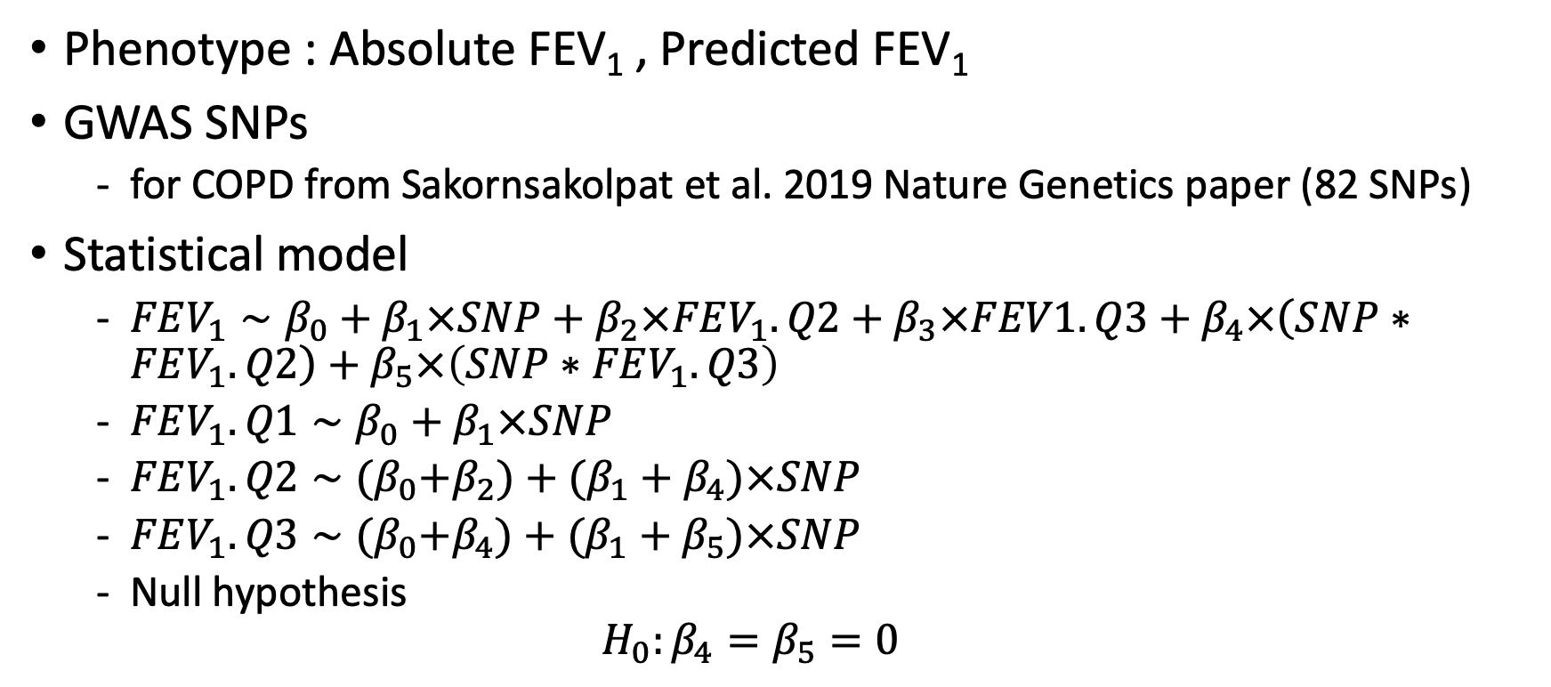
Analysis #2
Phenotype : Absolute FEV₁ , Predicted FEV₁
GWAS SNPs
for COPD from Sakornsakolpat et al. 2019 Nature Genetics paper (82 SNPs)
Statistical model
$FEV_{1}∼β_{0}+β_{1}×SNP+β_{2}×FEV_{1}.Q2+β_{3}×FEV1.Q3+β_{4}×\left(SNP∗FEV_{1}.Q2\right)+β_{5}×\left(SNP∗FEV_{1}.Q3\right)$
$FEV_{1}.Q1∼β_{0}+β_{1}×SNP$
$FEV_{1}.Q2∼{(β}_{0}+β_{2})+(β_{1}+β_{4})×SNP$
$FEV_{1}.Q3∼{(β}_{0}+β_{4})+(β_{1}+β_{5})×SNP$
Null hypothesis
$$H_{0}:β_{4}=β_{5}=0$$

Slide 6
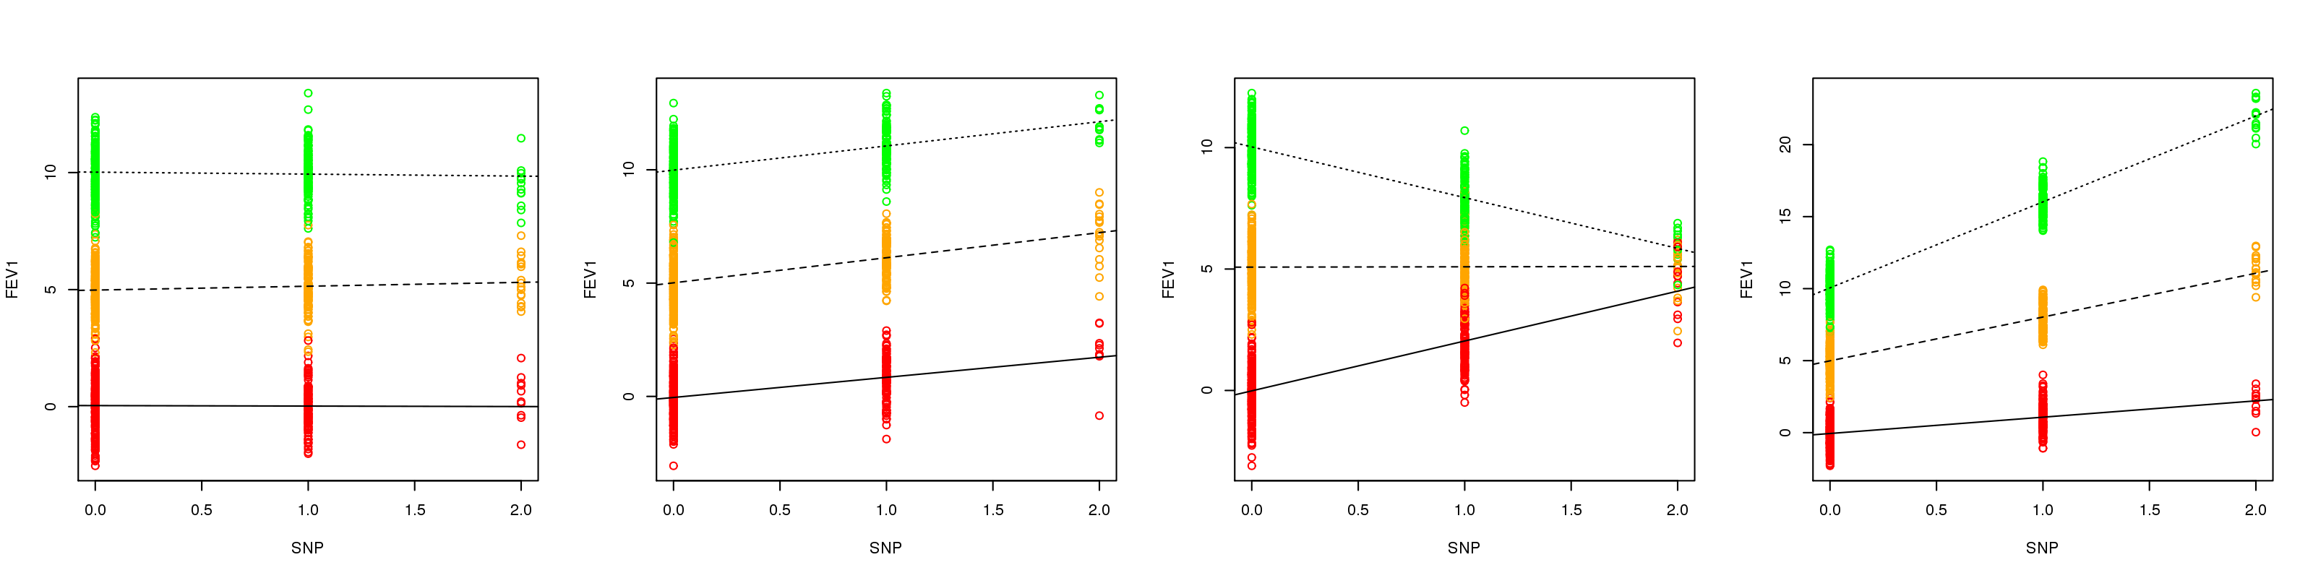
Toy example
Significance
SNP : X
Interaction : X
Significance
SNP : O
Interaction : X
Significance
SNP : X
Interaction : O
Significance
SNP : O
Interaction : O

Slide 7
Analysis #2
Phenotype : Absolute FEV₁ , Predicted FEV₁
GWAS SNPs
for COPD from Sakornsakolpat et al. 2019 Nature Genetics paper (82 SNPs)
Among 82 SNPs, there were 9 SNPs in Freeze 6a
CHR | SNP | Position_hg38 | Absolute FEV₁ |  | Predicted FEV₁
 |  |  | NHW | AA | NHW | AA
1 | rs4660861 | 45480964 | 0.6831 | 0.6748 | 0.2510 | 0.2048
2 | rs10929386 | 15766055 | 0.2354 | 0.4287 | 0.6227 | 0.0503
2 | rs16825267 | 228705203 | 0.0295 | 0.8755 | 0.2190 | 0.5962
3 | rs2955083 | 128242335 | 0.1116 | 0.3591 | 0.0447 | 0.3155
3 | rs7642001 | 169028357 | 0.2773 | 0.8125 | 0.2440 | 0.0898
6 | rs9350191 | 19842430 | 0.1097 | 0.8379 | 0.9437 | 0.9767
6 | rs1631199 | 116938510 | 0.1599 | 0.9578 | 0.3679 | 0.7116
6 | rs9399401 | 142347764 | 0.6336 | 0.9529 | 0.1233 | 0.7398
22 | rs9617650 | 18006117 | 0.7669 | 0.0198 | 0.6009 | 0.4794

