Slide 1
Rare Variance Heritability
Wonji Kim

Slide 2
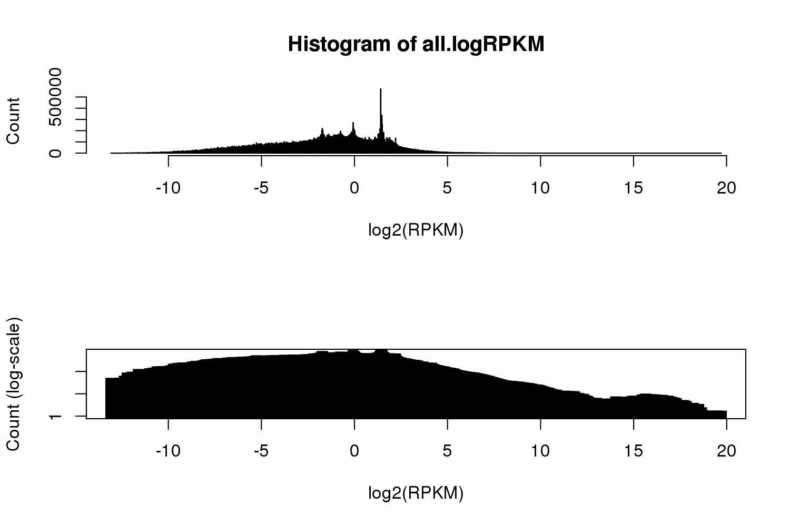
COPDGene dataset and QC
Genotype data : WGS
Phenotype data : Gene expression
Freeze 5b
54,499 indivs.
Freeze 2
1,211 indivs. & 65,987 genes
Only overlapping individuals
1,052 indivs.
1,052 indivs. & 65,987 genes
+ Filter : PASS
+ Biallelic SNPs
- non-expressed genes
- genes on sex chromosome
+ high quality genes
The number of genes for which the proportion of individuals (x) has log(RPKM) >Y. (Row : X, Column : Y)
- missing rate > 0.05
1,052 indivs. &
46,356,530 SNPs
1,052 indivs. &
46,340,398 SNPs
1,052 indivs. & 7,335 genes
 | 1 | 1.5 | 2 | 2.5 | 3 | 4
0 | 22950 | 19269 | 15825 | 12355 | 9179 | 4743
0.1 | 14923 | 10951 | 7961 | 5621 | 3860 | 1735
0.2 | 13715 | 9785 | 6851 | 4603 | 3141 | 1406
0.3 | 12820 | 8935 | 6098 | 3971 | 2673 | 1178
0.4 | 12084 | 8171 | 5375 | 3446 | 2276 | 981
0.5 | 11210 | 7335 | 4603 | 2839 | 1840 | 775
0.6 | 10578 | 6756 | 4127 | 2452 | 1562 | 665
0.7 | 10035 | 6161 | 3632 | 2104 | 1348 | 554
0.8 | 9404 | 5603 | 3168 | 1760 | 1149 | 465
0.9 | 8664 | 4927 | 2608 | 1367 | 880 | 365
Apply transcriptome-wide SingHer analysis
for each gene and singletons within 1 Mb of the transcription start or end sites of a gene

Slide 3
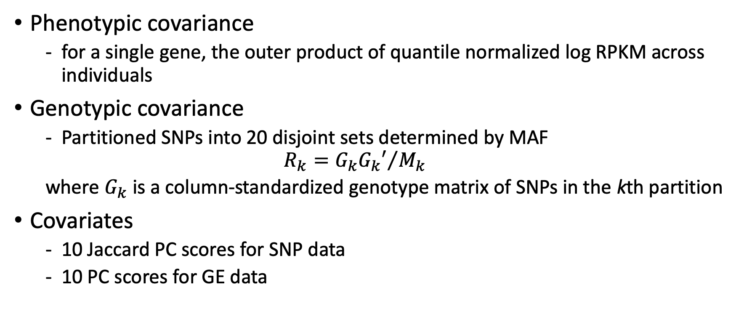
Variables
Phenotypic covariance
for a single gene, the outer product of quantile normalized log RPKM across individuals
Genotypic covariance
Partitioned SNPs into 20 disjoint sets determined by MAF
$$R_{k}={G_{k}G_{k}′}/{M_{k}}$$
where $G_{k}$ is a column-standardized genotype matrix of SNPs in the kth partition
Covariates
10 Jaccard PC scores for SNP data
10 PC scores for GE data

Slide 4
Singletons
# Previous SNP bins
SNP Bin1 | SNP Bin2 | SNP Bin3 | … | SNP Bin19 | SNP Bin20
0 – 0.025 | 0.025 – 0.05 | 0.05 – 0.075 |  | 0.45 - 0.475 | 0.475 – 0.5
0 | 0.001 | … | 0.005 | … | 0.05 |  | … |  | 0.5
Model 1
Bin1 | Bin2 | Bin3 | Bin4 | Bin5 | Bin6 | Bin7 | Bin8 | … | Bin19 | Bin20
0 | 0.001
Model 2
Bin1
Observed SGT | Others
0 | 0.001
Model 3
Bin1
Global SGT | Others
0 | 0.001
Model 4
Bin1
Global SGT | Observed | Others

Slide 5
Analysis workflow
1. Extract SNPs within 1Mb of Gene
2. Partition SNPs into 20+ Bins based on MAF
3. Phenotypic covariance
- quantile normalization
- Outer product
- Scaling (sd = 1)
4. Genotypic covariance
5. Covariance for PCs
- WGS PCs
- GE PCs
6. H-E regression
lm(Phe.cov ~ PC.wgs + PC.GE + Geno.cov.bin1 + … + Geno.cov.bin20

Slide 6
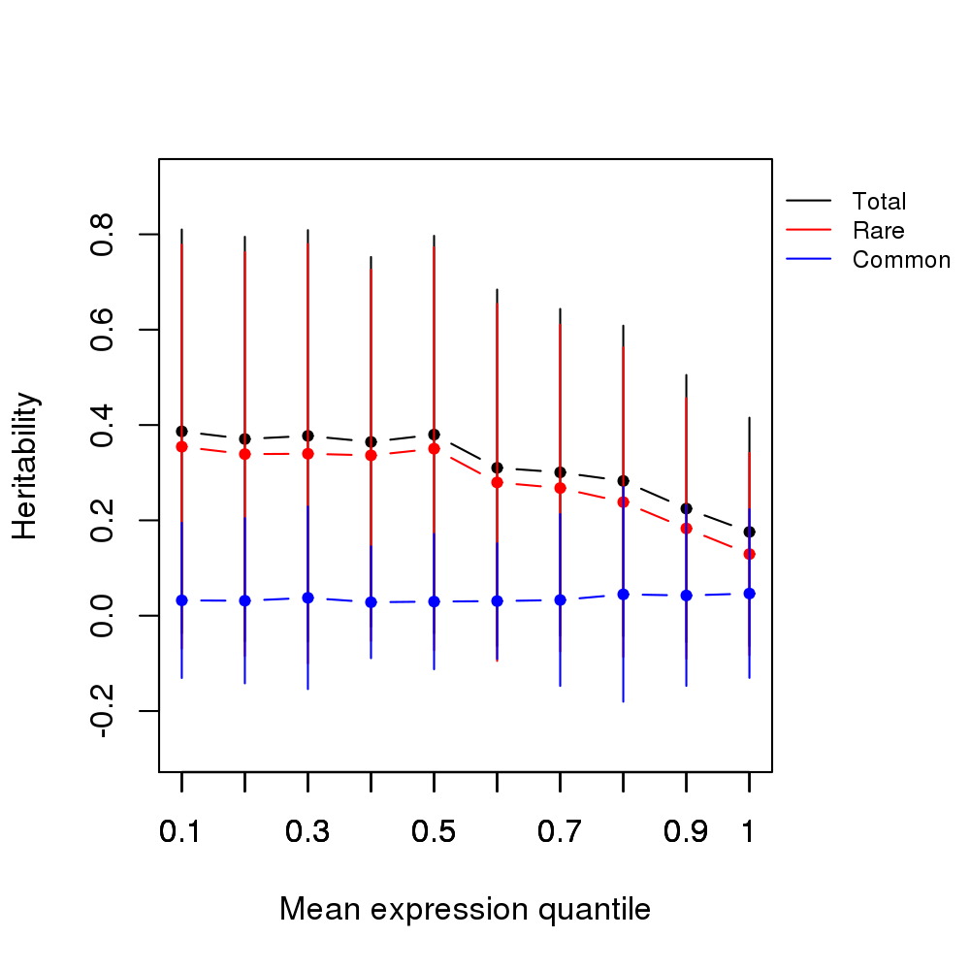
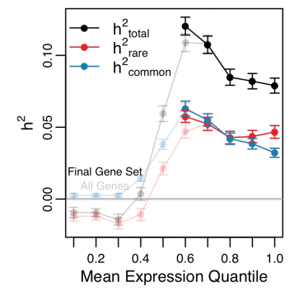

Slide 7
Other quantitative traits
FeatureName | Category | Age_Enroll | gender | ATS_PackYears | Height_CM | SmokCigNow | SmokCigPhase2 | scannerType | scannerCenter | Variable name | file
BDR | LungFunction | 1 | 1 | 1 | 1 |  |  |  |  | BDR | Final10000_Phase1_Rev_28oct16.txt
BDR_pct_FEV1 | LungFunction | 1 | 1 | 1 |  |  |  |  |  | BDR_pct_FEV1 | Final10000_Phase1_Rev_28oct16.txt
BDR_pct_FVC | LungFunction | 1 | 1 | 1 |  |  |  |  |  | BDR_pct_FVC | Final10000_Phase1_Rev_28oct16.txt
BMI | Demographics | 1 | 1 | 1 |  |  |  |  |  | BMI | Final10000_Phase1_Rev_28oct16.txt
Fibrinogen__mg_dL_ | Biomarker | 1 | 1 | 1 |  | 1 |  |  |  | Fibrinogen__mg_dL_ | COPDGeneBiomarker_QBR.csv
hsCRP__mg_L_ | Biomarker | 1 | 1 | 1 |  | 1 |  |  |  | hsCRP__mg_L_ | COPDGeneBiomarker_QBR.csv
Ig_E__kU_L_or_IU_ml_ | Biomarker | 1 | 1 | 1 |  | 1 |  |  |  | Ig_E__kU_L_or_IU_ml_ | COPDGeneBiomarker_19Mar2014.csv
pctEmph_Slicer | Imaging | 1 | 1 | 1 |  | 1 |  | 1 |  | pctEmph_Slicer | Final10000_Phase1_Rev_28oct16.txt
pctEmph_UpperThird_Slicer | Imaging | 1 | 1 | 1 |  | 1 |  |  |  | pctEmph_UpperThird_Slicer | Final10000_Phase1_Rev_28oct16.txt
pctGasTrap_Slicer | Imaging | 1 | 1 | 1 |  | 1 |  |  | 1 | pctGasTrap_Slicer | Final10000_Phase1_Rev_28oct16.txt
pi10 | Imaging | 1 | 1 | 1 | 1 | 1 |  | 1 |  | Pi10_SRWA | Final10000_Phase1_Rev_28oct16.txt
prm_airtrapping | Imaging | 1 | 1 | 1 |  | 1
prm_emphysema | Imaging | 1 | 1 | 1 |  | 1
prm_normal | Imaging | 1 | 1 | 1 |  | 1
RAGE__pg_mL_ | Biomarker | 1 | 1 | 1 |  | 1 |  |  |  | RAGE__pg_mL_ | COPDGeneBiomarker_QBR.csv
Slicer_15pctIn_Total | Imaging | 1 | 1 | 1 |  | 1 |  | 1 |  | Slicer_15pctIn_Total | Final10000_Phase1_Rev_28oct16.txt
SPD__ng_mL_ | Biomarker | 1 | 1 | 1 |  | 1 |  |  |  | SPD__ng_mL_ | COPDGeneBiomarker_QBR.csv
UpperThird_LowerThird_Slicer | Imaging | 1 | 1 | 1 |  | 1 |  |  |  | UpperThird_LowerThird_Slicer | Final10000_Phase1_Rev_28oct16.txt
WallAreaPct_seg | Imaging | 1 | 1 | 1 | 1 | 1 |  | 1 |  | WallAreaPct_seg | Final10000_Phase1_Rev_28oct16.txt
FEV1pp |  | 1 | 1 | 1 |  |  |  |  |  | FEV1pp_utah | Final10000_Phase1_Rev_28oct16.txt
FEV1 |  | 1 | 1 | 1 | 1 |  |  |  |  | FEV1_utah | Final10000_Phase1_Rev_28oct16.txt
FEV1/FVC |  | 1 | 1 | 1 |  |  |  |  |  | FEV1_FVC_utah | Final10000_Phase1_Rev_28oct16.txt
height_cm |  | 1 | 1 |  |  |  |  |  |  | Height_CM | Final10000_Phase1_Rev_28oct16.txt

