Slide 1
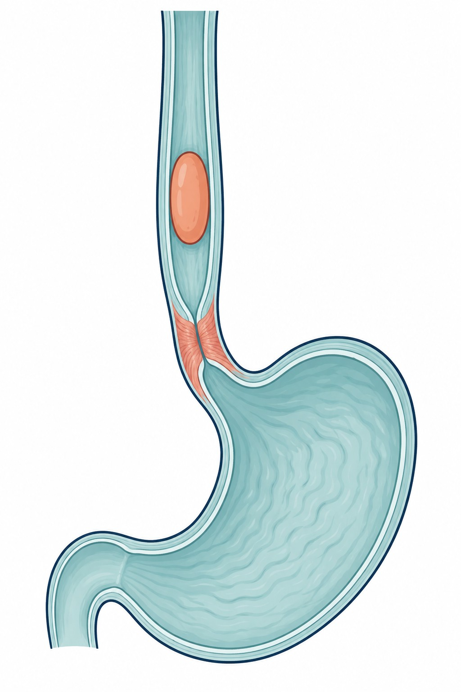
JNM
Journal of Neurogastroenterology and Motility
EDITORIAL SAMPLE
Dysphagia in ineffective esophageal motility
228
patients with IEM
High-resolution manometry
with impedance
Single-center retrospective study, 2010–2013 [1]
COMBINED FINDINGS
ASSOCIATION WITH DYSPHAGIA
Patients with both findings [1]
Defective bolus transit
P = 0.006
Liquid and viscous swallows
+
Poor LES relaxation
Elevated integrated
relaxation pressure (IRP)
15/51 patients
20/155 patients
Conceptual illustration
IRP data available for 206 of 228 patients
Dysphagia was associated with the combination of impaired bolus transit
and poor LES relaxation in patients with IEM. [1]
[1] Abdel-Jalil A, Koo TH, Fass R. J Neurogastroenterol Motil. 2026;32(2):217–227.
doi:10.5056/jnm25058
Notes:
Source: Abdel-Jalil A, Koo TH, Fass R. J Neurogastroenterol Motil. 2026;32(2):217–227. DOI 10.5056/jnm25058. Supplied source: JNM sample/jnm-32-2-217.pdf. Cohort and study design: p.217 and Methods. Main comparison: p.223, Table 4. Percentages are as reported (29 and 13), denominators 51 and 155, reported P=0.006. This is the prevalence of coexisting abnormal bolus transit and elevated IRP within each symptom group, not dysphagia prevalence within physiological subgroups. Original article CC BY-NC 4.0. The anatomical illustration was created with OpenAI image generation on 2026-09-17 and is conceptual; it is not measured patient anatomy. Text and chart are native editable PowerPoint elements. LES: lower esophageal sphincter. IEM: ineffective esophageal motility.

