Slide 1
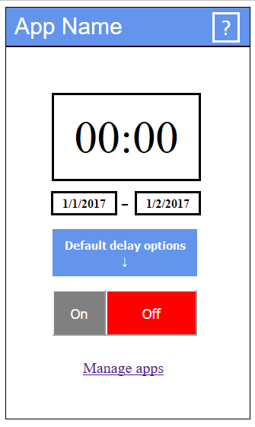
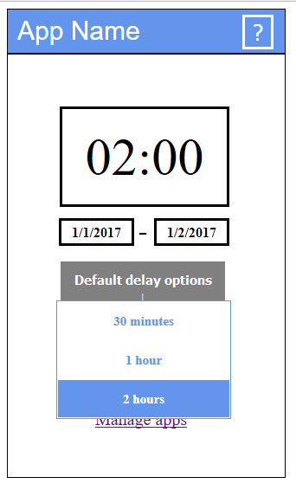
Notification Management

Slide 2
Quick Overview
Android application using AWARE framework
Notifications shall be delayed up to an user indicated time.
Delaying notifications is a desired feature

Slide 3
State of the art
Notifications are a source of disruptions
Recovering from distractions is costly
Good opportunities to push notifications have been studied.
General notification processing have been available only since 2013 in Android and iPhone
Many patents covers already notification managers

Slide 4
The purpose of the project
We want to push to our limits as a group and as individuals
We are implementing the feature what previously mentioned participants desired

Slide 5
Design process
The design have been improved after feedback
It have been a iterative process

Slide 6
Analysis
The annoyance of push notifications is scientifically known subject
Similar applications exists in the Play-store
We want to offer an app for everyday use

