Slide 1
Application of ML algorithms for predicting Next Lever

Slide 2
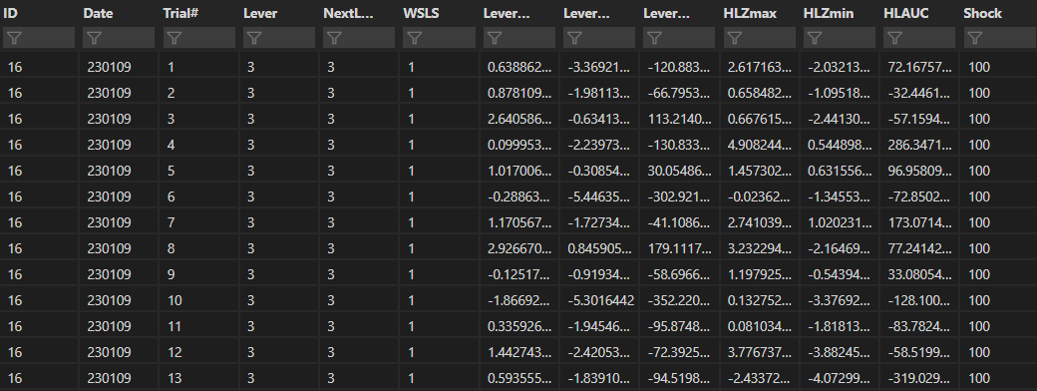
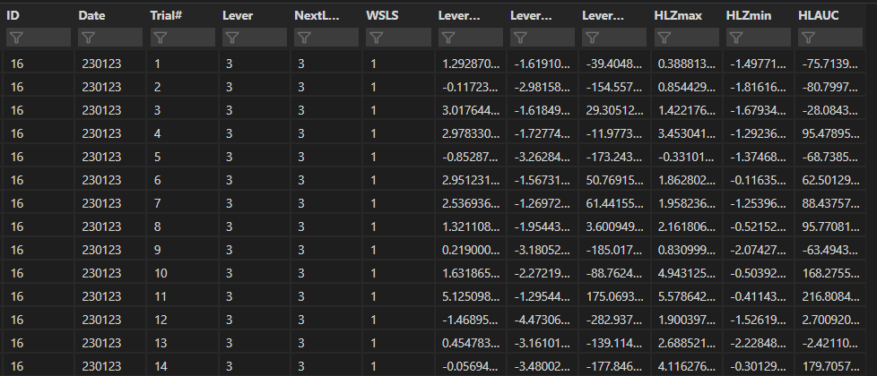
Input data
100to300behavior.csv
300behavior.csv
4983 by 13 dataframe from 5-days of 100-300uA RDT behavior from 6 rats
Block 1 is removed to train model on changes in signal w/ shock
WSP29 is removed for low signal
Trials where NextLever is omitted are removed
Last trials in a block are removed
Lever press is binarized (0=small, 1=large)
Results in a 2345 by 13 dataframe
Small=179, Large = 2166
1677 by 12 dataframe from 5-days of 100-300uA RDT behavior from 6 rats
Block 1 is removed to train model on changes in signal w/ shock
WSP29 is removed for low signal
Trials where NextLever is omitted are removed
Last trials in a block are removed
Lever press is binarized (0=small, 1=large)
Results in a 787 by 12 dataframe
Small=109, Large = 678

Slide 3
Input data
Trial# = Trial number for free choice trials [Block 1 = 1-20, Block 2 = 21-40, Block 3 = 41-60]
Lever = lever selection in current trial (1 = Small, 2 = Punished, 3 = Unpunished)
NextLever = lever selected in next trial ( 0 = Omit, 1 = Small, 2 = Punished, 3 = Unpunished after binarization: 0 = Small, 1 = Large)
WSLS = Win-Stay/Lose-Shift code (1 = Win-Stay, 2 = Lose-Shift, 3 = Win-Shift, 4 = Lose-Stay, 9 = N/A
LeverZmax = Z-score maximum at 1-second window after lever press
LeverZmin = Z-score minimum at 1-second window after lever press
LeverAUC = Area-under-the-curve for 1-second window after lever press
HLZmax = Z-score maximum at 1-second window after houselight
HLZmin = Z-score minimum at 1-second window after houselight
HLAUC = Area-under-the-curve for 1-second window after houselight
Shock = Shock intensity in uA

Slide 4
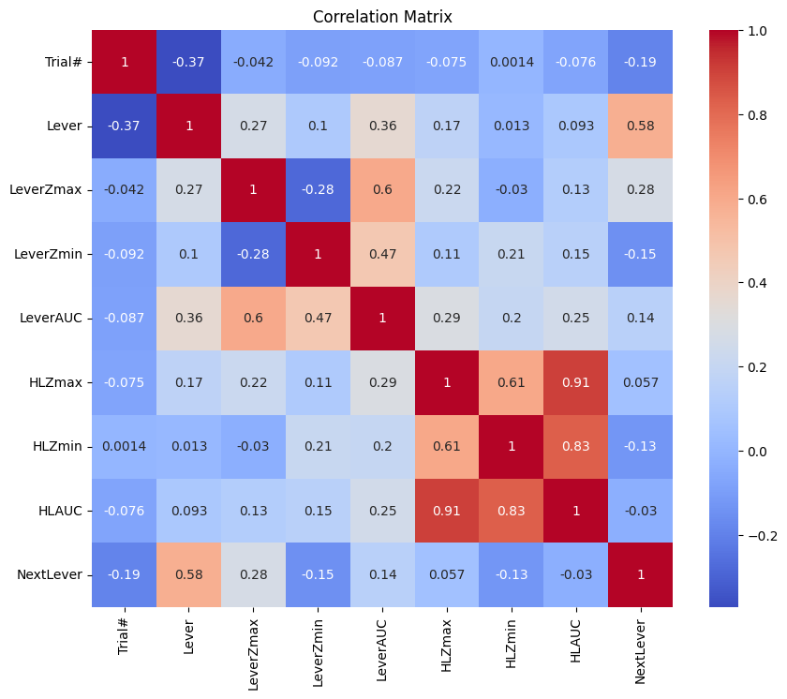
Collinearity in features can drive model overfitting
Correlation matrix to check for collinearity
High collinearity (R >0.7)
Houselight Area Under Curve (HLAUC)
HL Z-score maximum
HL Z-score minimum
Moderate collinearity (0.7 > R >0.3)
Trial#
Lever press
Lever press
Next Lever press
Lever Area Under Curve
Lever Area Under Curve (LeverAUC)
Lever Z-score maximum
Lever Z-score minimum

Slide 5
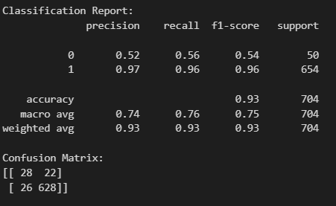
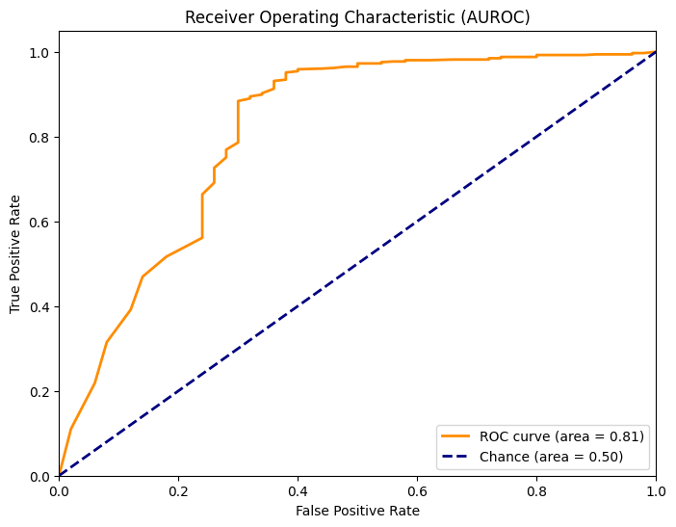
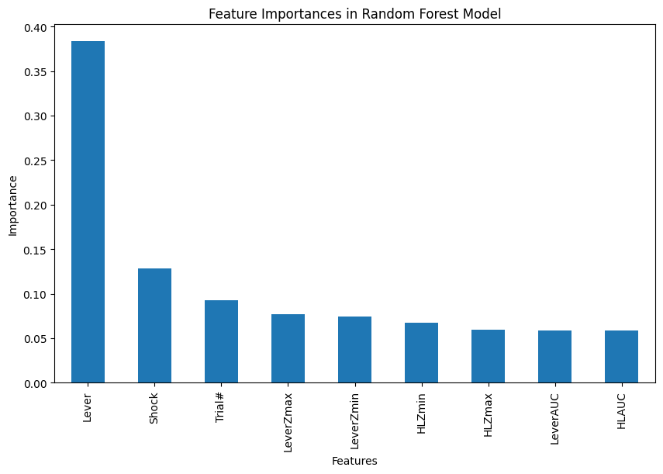
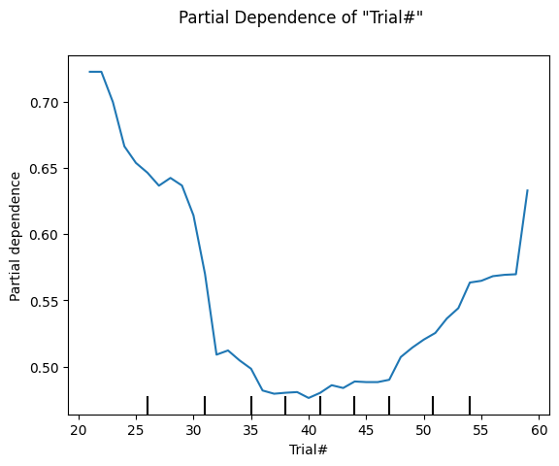
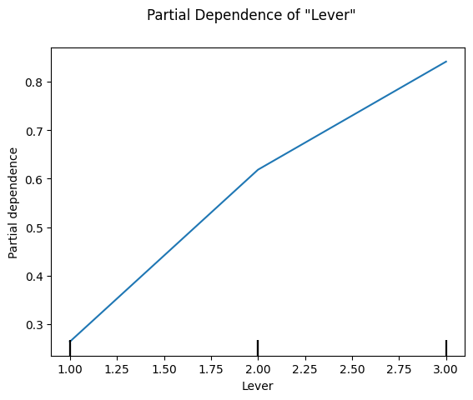
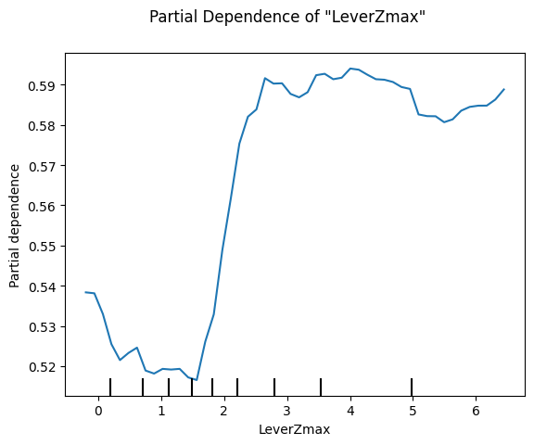
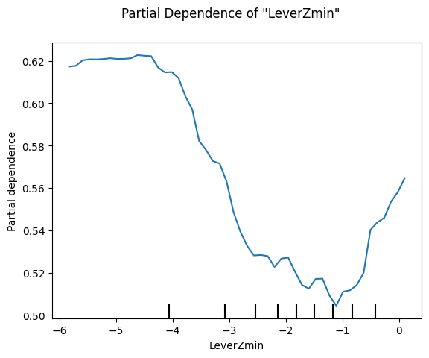
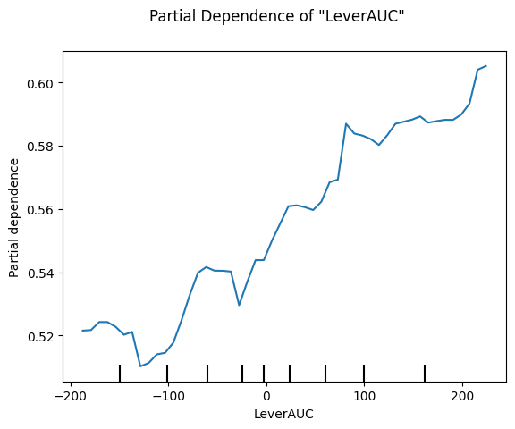
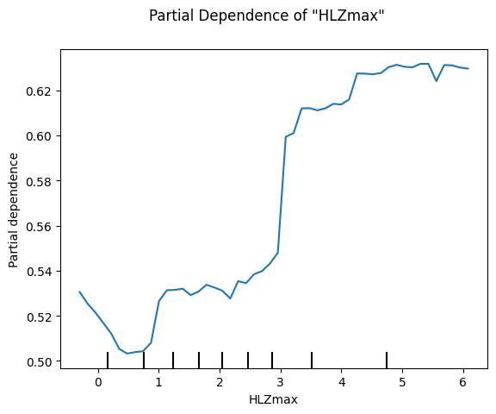
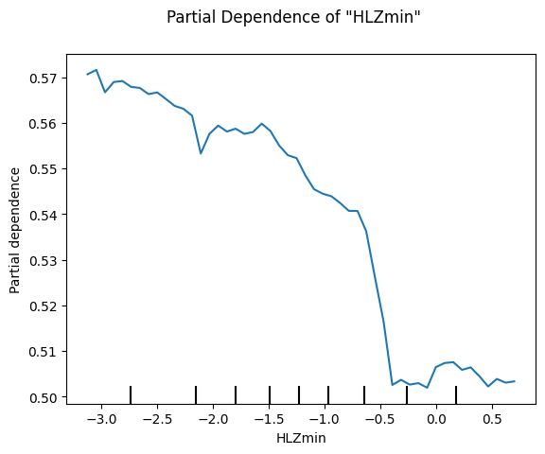
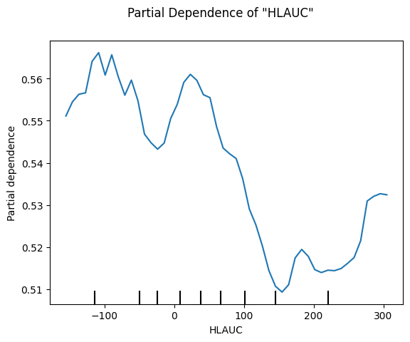
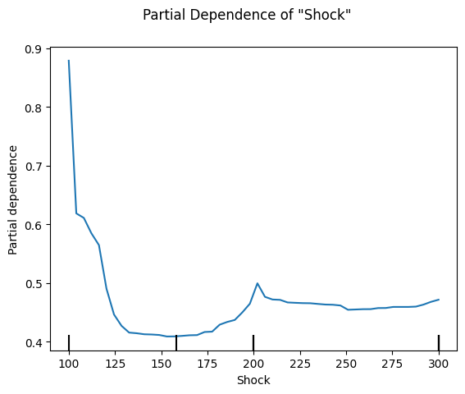
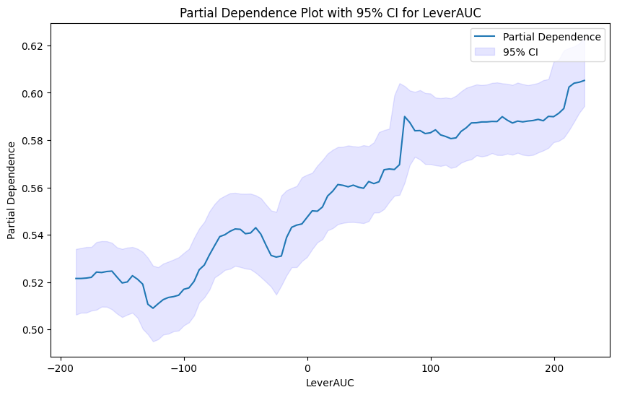
Random Forest w/ SMOTE [df = 100to300]
Features: ['Trial#','Lever','LeverZmax','LeverZmin','LeverAUC','HLZmax','HLZmin','HLAUC','NextLever','Shock']
Due to imbalance within the NextLever classes (small=179, large = 2166), I opted for Random Forest + SMOTE oversampling

Slide 6
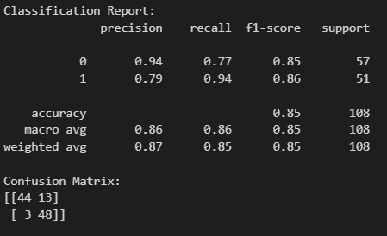
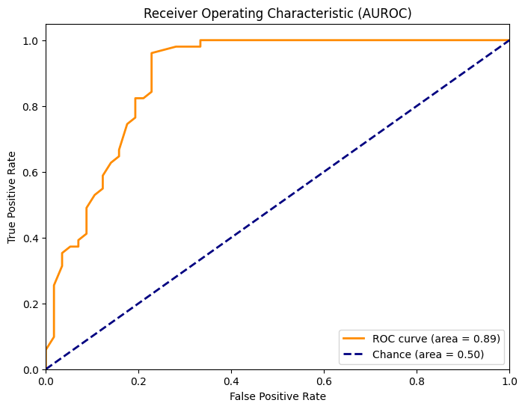
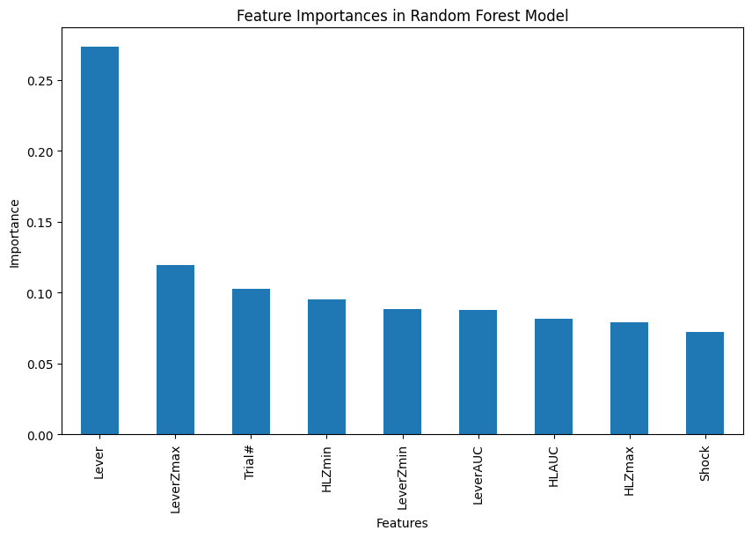
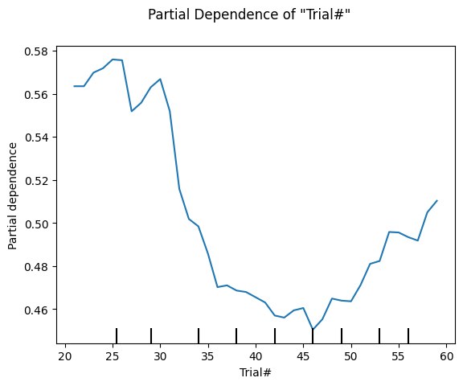
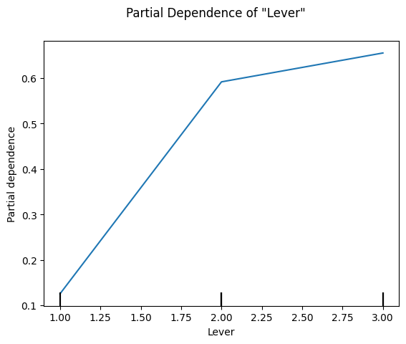
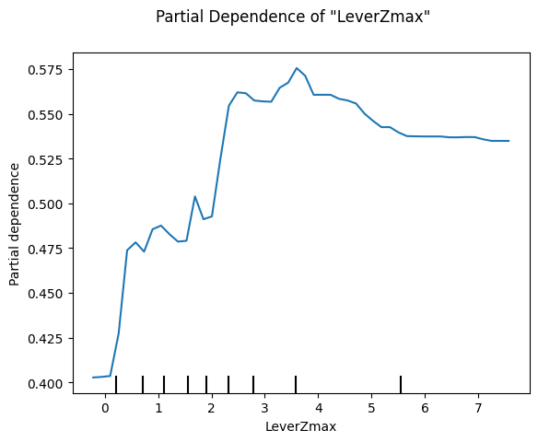
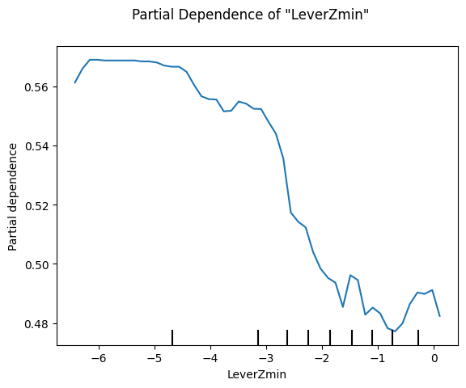
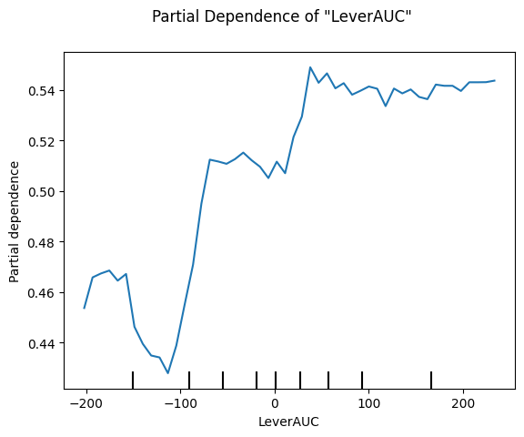
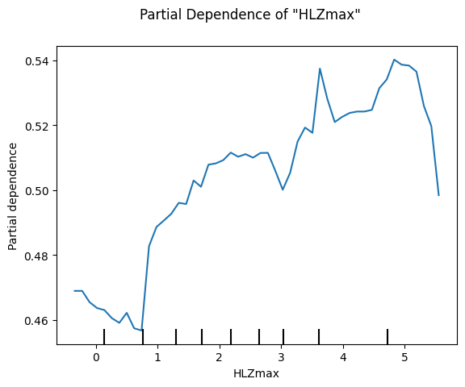
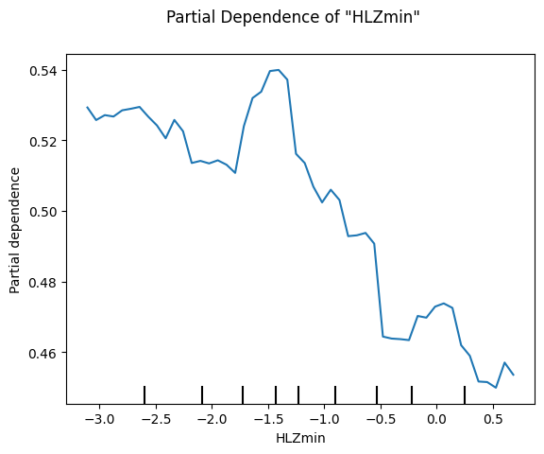
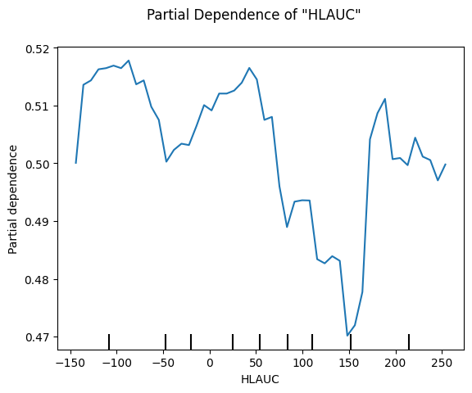
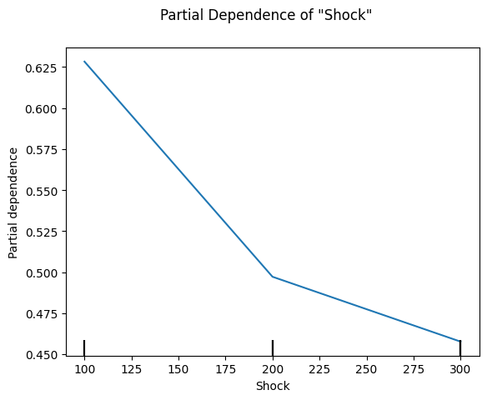
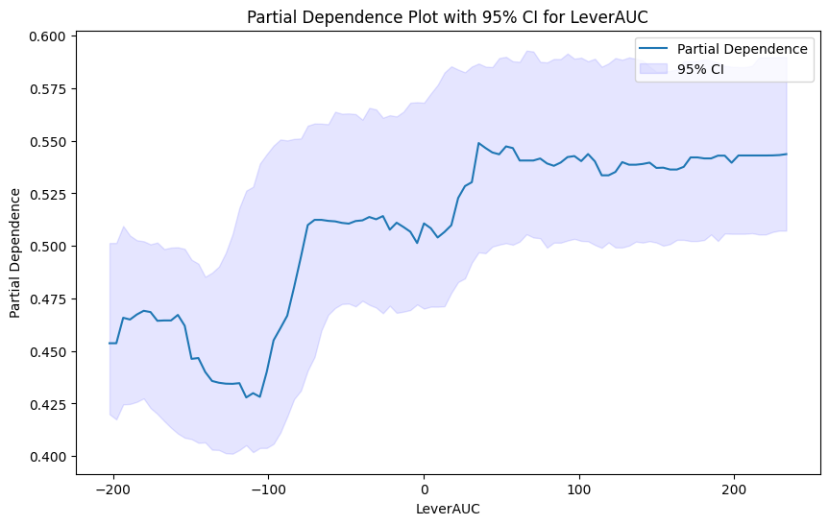
Random Forest w/ manual resampling to minority class [df = 100to300uA]
Features: ['Trial#','Lever','LeverZmax','LeverZmin','LeverAUC','HLZmax','HLZmin','HLAUC','NextLever','Shock']
Due to imbalance within the NextLever classes (small=179, large = 2166), I downsampled NextLever=1 to be the size of NextLever=0 (179)

Slide 7

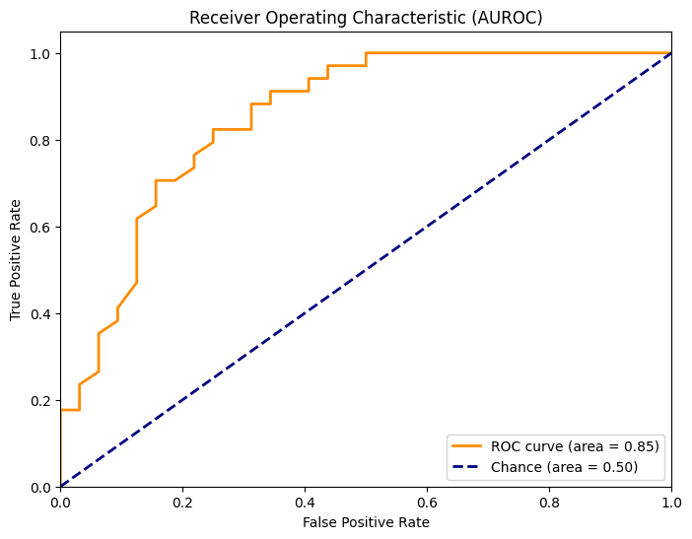
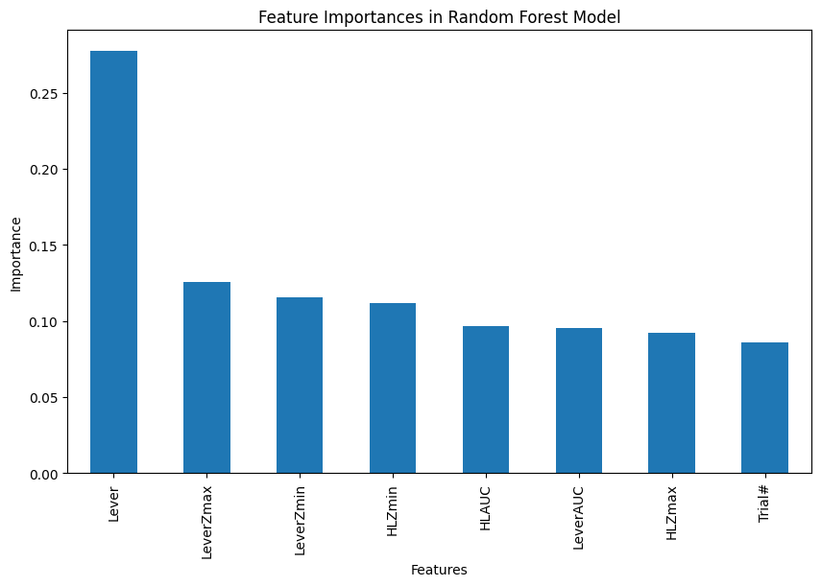
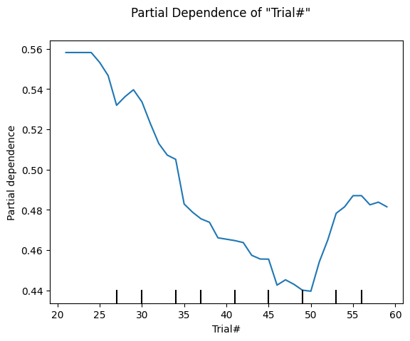
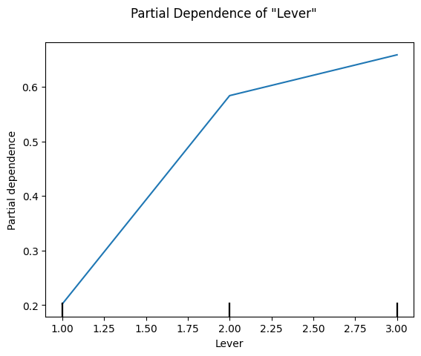
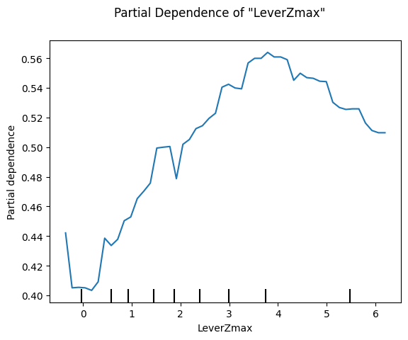
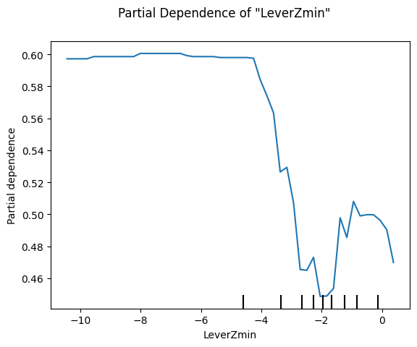
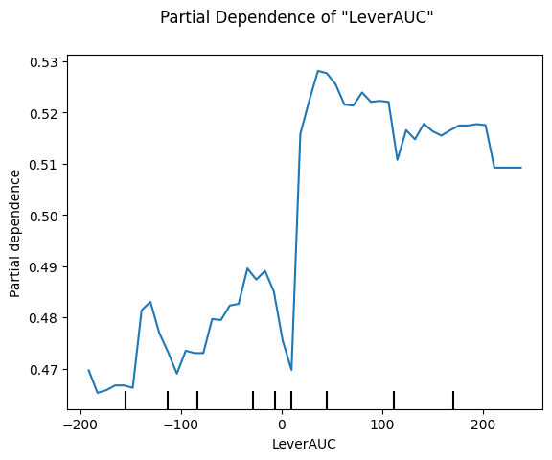
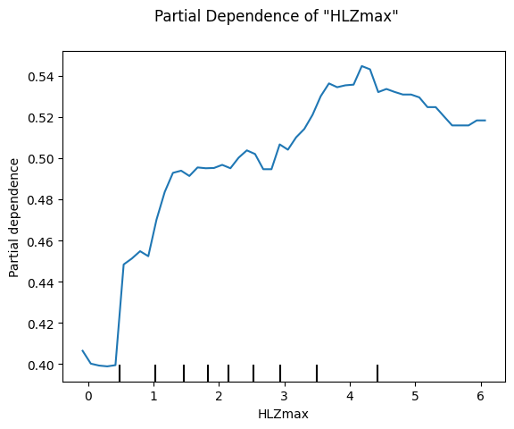
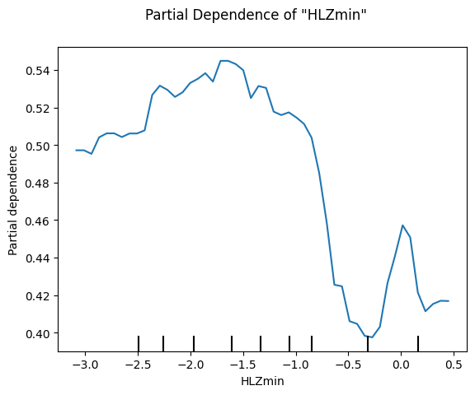
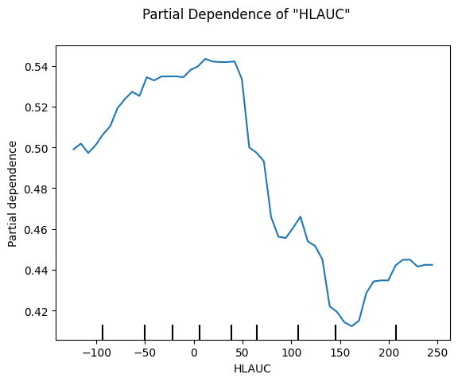
Random Forest w/ manual resampling to minority class [df = 300uA]
Features: ['Trial#','Lever','LeverZmax','LeverZmin','LeverAUC','HLZmax','HLZmin','HLAUC','NextLever’]
Due to imbalance within the NextLever classes (small=109, large = 678), I downsampled NextLever=1 to be the size of NextLever=0 (109)
rf = RandomForestClassifier(n_estimators=100, random_state=42, class_weight='balanced')

Slide 8
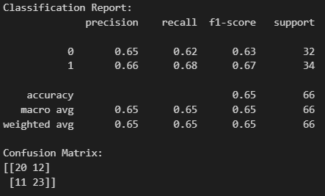
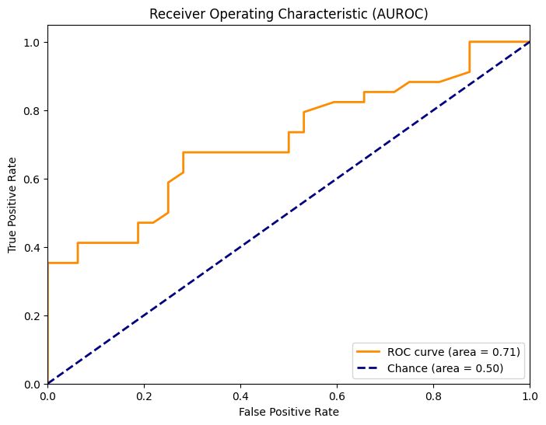
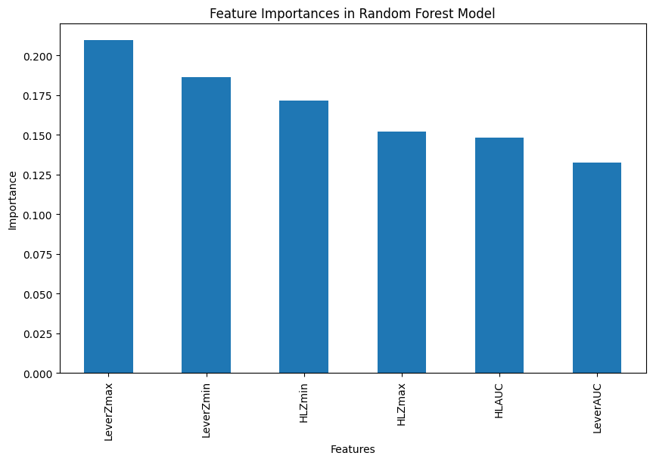
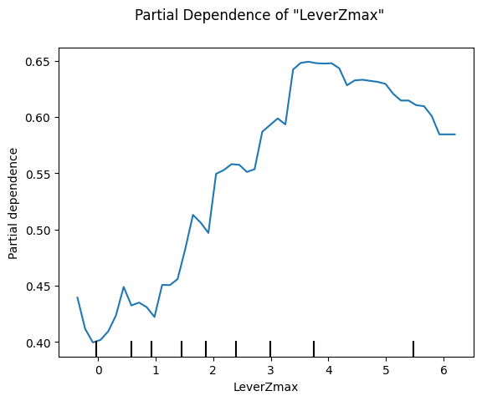
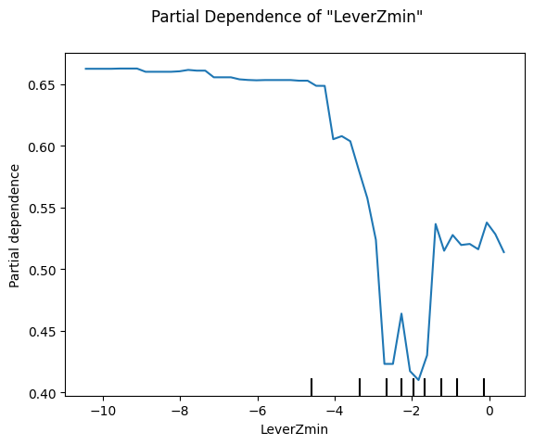
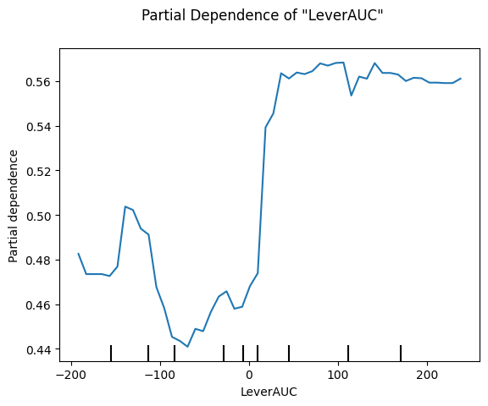
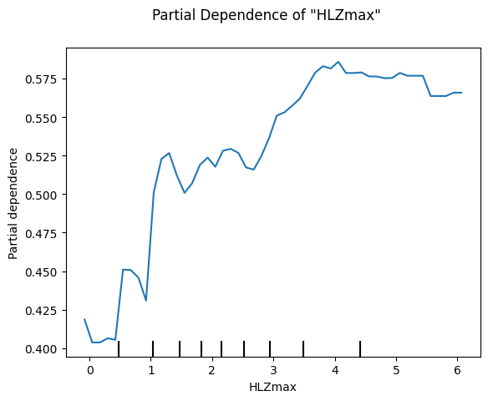
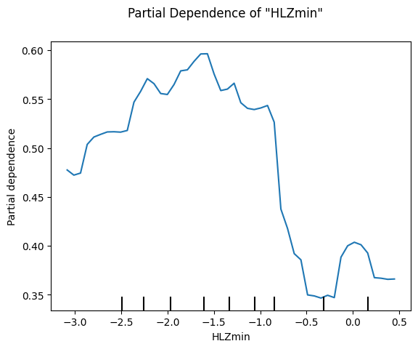
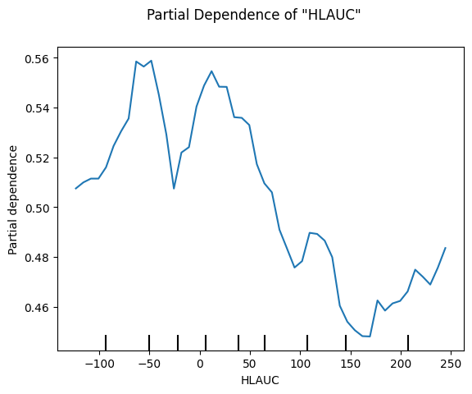
Random Forest w/ manual resampling to minority class [df = 300uA]
Features: ['LeverZmax','LeverZmin','LeverAUC','HLZmax','HLZmin','HLAUC','NextLever’]
Due to imbalance within the NextLever classes (small=109, large = 678), I downsampled NextLever=1 to be the size of NextLever=0 (109)
rf = RandomForestClassifier(n_estimators=100, random_state=42, class_weight='balanced')

Slide 9
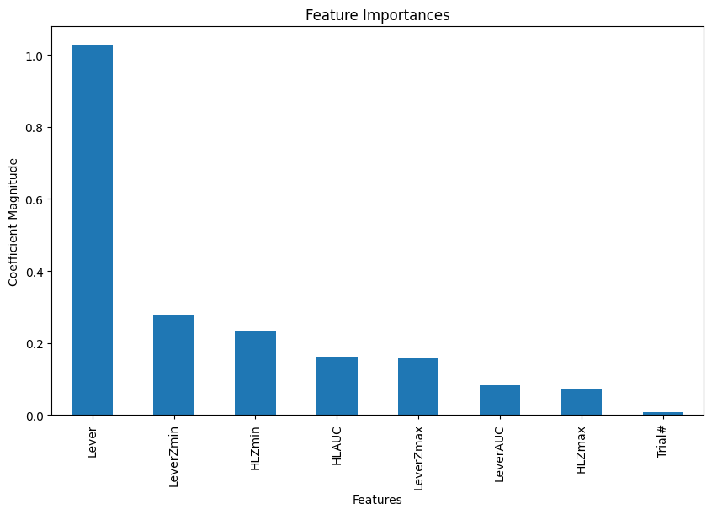
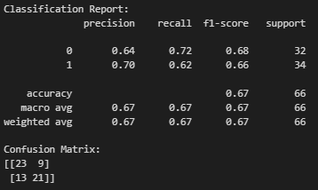




SVM w/ manual resampling to minority class [df = 300uA]
feature_names = ['LeverZmax','HLZmax','NextLever’] (‘Trial#’ excluded due to concerns of overfitting (too specific to this data))
Due to imbalance within the NextLever classes (small=109, large = 678), I downsampled NextLever=1 to be the size of NextLever=0 (109)
Dataframe was normalized (StandardScaler()) prior to model training
svm_model = SVC(kernel='linear', class_weight='balanced', probability=True)

