Slide 1
A Linear Time Algorithm for Consecutive Permutation Pattern Matching
M. Kubica, T. Kulcynski, J. Radoszewski, W. Rytter, T. Walen
이원석, 장원재

Slide 2
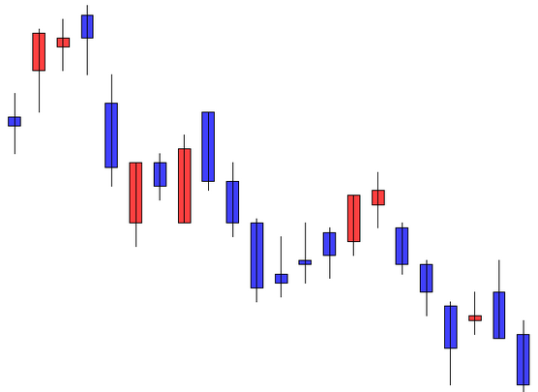
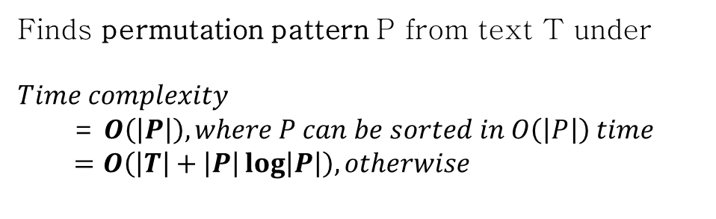
Problem Description
Kubica, Marcin, et al. "A linear time algorithm for consecutive permutation pattern matching." Information Processing Letters 113.12 (2013): 430-433.
Finds permutation pattern P from text T under
$$Time complexity$$
= $O\left(\left|P\right|\right), where P can be sorted in O\left(\left|P\right|\right) time$
$$=O\left(\left|T\right|+\left|P\right|\log\left|P\right|\right), otherwise$$
Figure 1. Candle chart you want to analyze
The same patterns...
5 → 3 → 4 → 1 → 2
99 → 33 → 82 → 17 → 20
1820 → 1720 → 1800 → 1700 → 1701
Figure 2. Pattern you want to find

Slide 3
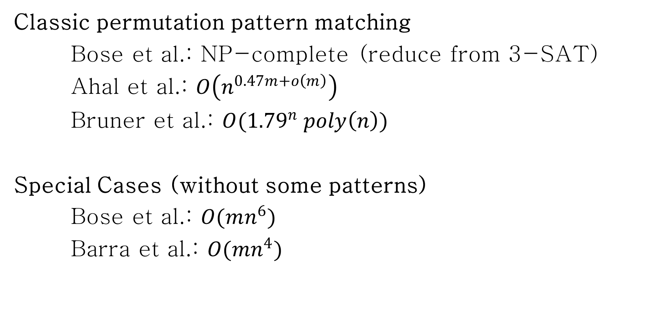
Related Work
Classic permutation pattern matching
Bose et al.: NP-complete (reduce from 3-SAT)
Ahal et al.: $O\left(n^{0.47m+o\left(m\right)}\right)$
Bruner et al.: $O({1.79}^{n} poly\left(n\right))$
Special Cases (without some patterns)
Bose et al.: $O(mn^{6})$
Barra et al.: $O(mn^{4})$

Slide 4
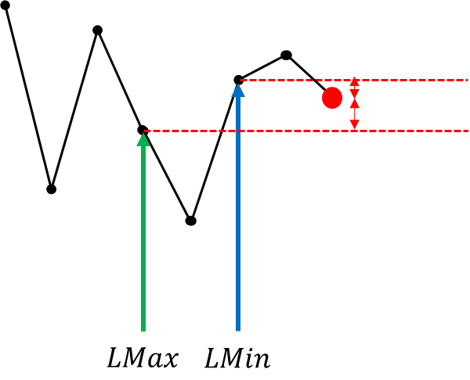
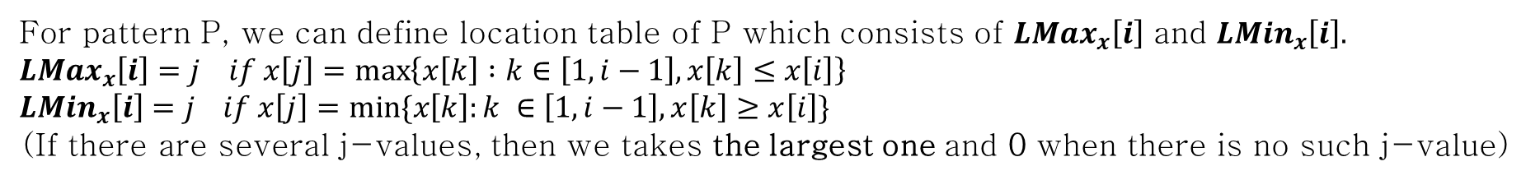
Formal Definitions
1. Order-isomorphic
Two sequences x, y of the same length are called order-isomorphic and written $x≈y.$
$$if \left(∀1≤i,j≤\left|x\right|=\left|y\right|\right) x\left[i\right]≤x\left[j\right]⇔y\left[i\right]≤y[j]$$
Ex> Order-isomorphic patterns...
5 → 3 → 4 → 1 → 2
99 → 33 → 82 → 17 → 20
1820 → 1720 → 1800 → 1700 → 1701
2. Location Table
For pattern P, we can define location table of P which consists of $LMax_{x}\left[i\right]$ and $LMin_{x}\left[i\right].$
$$LMax_{x}\left[i\right]=j if x\left[j\right]=\max\left\{x\left[k\right] :k∈\left[1, i−1\right], x\left[k\right]≤x\left[i\right]\right\} \\ LMin_{x}\left[i\right]=j if x\left[j\right]=min⁡\{x\left[k\right]:k ∈\left[1,i−1\right], x\left[k\right]≥x\left[i\right]\}$$
(If there are several j-values, then we takes the largest one and 0 when there is no such j-value)
Ex> Location table of pattern 414735234
i | 1 | 2 | 3 | 4 | 5 | 6 | 7 | 8 | 9
P[i] | 4 | 1 | 4 | 7 | 3 | 5 | 2 | 3 | 4
LMax[i] | 0 | 0 | 1 | 3 | 2 | 3 | 2 | 5 | 3
LMin[i] | 0 | 1 | 1 | 0 | 3 | 4 | 5 | 5 | 3
← The largest index of the largest lower bound on the left
← The largest index of the smallest upper bound on the left

Slide 5

Proposed Approach
Lemma 1.
Let $x$ be a sequence of length $m$, and $sort(x)$ be the time required to sort $x$.
Then location tables of $x$ can be computed in $O(sort\left(x\right))$ time.
i | 1 | 2 | 3 | 4 | 5 | 6 | 7 | 8 | 9
x[i] | 4 | 1 | 4 | 7 | 3 | 5 | 2 | 3 | 4
LMax[i] | 0 | 0 | 1 | 3 | 2 | 3 | 2 | 5 | 3
LMin[i] | 0 | 1 | 1 | 0 | 3 | 4 | 5 | 5 | 3
1. Sorting: $O\left(sort\left(x\right)\right)$
2. Lmax: $O\left(m\right)$
3. Lmin: $O\left(m\right)$
i | 2 | 7 | 5 | 8 | 1 | 3 | 9 | 6 | 4
x[i] | 1 | 2 | 3 | 3 | 4 | 4 | 4 | 5 | 7
LMax[i]
4
9
6
8
5
7
3
0
2
2
5
0
1
3
3
3
2
1
“All nearest smaller values” Problem
Stack

Slide 6






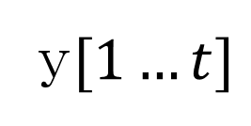

Proposed Approach
Lemma 2.
Assume $x[1…t]≈y[1…t]$, $t$<|$x$|,|$y$|, and $a$=$LMax_{x}[t+1]$, $b$=$LMin_{x}\left[t+1\right]$
Then, $x[1…t+1]≈y[1…t+1]$ ⇔ $y$[$a$]≤ $y$[$t$+1] ≤ $y$[$b$]
$$x[1…t]$$
y$[1…t]$
$$x[t+1]$$
$$y[t+1]$$
$$a=LMax_{x}[t+1]$$
$$a$$
$$b$$
$$b=LMin_{x}[t+1]$$

Slide 7
Proposed Approach
Lemma 2.
Assume $x[1…t]≈y[1…t]$, $t$<|$x$|,|$y$|, and $a$=$LMax_{x}[t+1]$, $b$=$LMin_{x}\left[t+1\right]$
Then, $x[1…t+1]≈y[1…t+1]$ ⇔ $y$[$a$]≤ $y$[$t$+1] ≤ $y$[$b$]
Lemma 3.
Let $x$ be a pattern of length $m$ whose symbols can be sorted in $O(m)$ time.
After $O(m)$ time preprocessing,
“Assuming that $x[1…t]≈y[1…t]$, check if $x[1…t+1]≈y[1…t+1]$”for any sequence $y$ in constant time

Slide 8
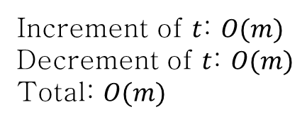
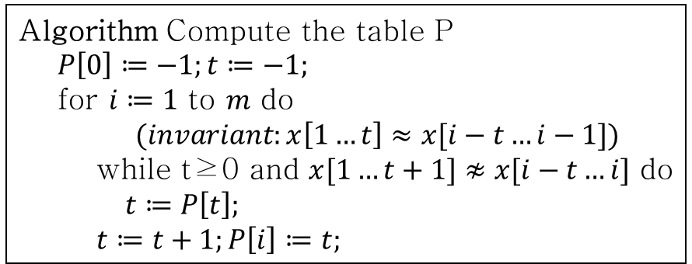
Proposed Approach
Lemma 4.
The order-borders table can be computed in linear time
Algorithm Compute the table P
$P\left[0\right]≔−1;t≔−1;$
for $i≔1$ to $m$ do
$(invariant:x\left[1…t\right]≈x[i−t…i−1])$
while t≥0 and $x[1…t+1]≉x[i−t…i]$ do
$t≔P\left[t\right];$
$t≔t+1;P\left[i\right]≔t;$
Increment of $t$: $O(m)$
Decrement of $t$: $O(m)$
Total: $O(m)$
i | 1 | 2 | 3 | 4 | 5 | 6 | 7 | 8 | 9
x[i] | 4 | 1 | 4 | 7 | 3 | 5 | 2 | 3 | 4
P[i] | 0 | 1 | 1 | 1 | 2 | 1 | 2 | 1 | 1
i | 1 | 2 | 3 | 4 | 5 | 6 | 7 | 8
x[i] | 2 | 5 | 1 | 4 | 7 | 3 | 6 | 8
P[i] | 0 | 1 | 1 | 2 | 2 | 3 | 4 | 5
Similar with sth in KMP algorithm

Slide 9

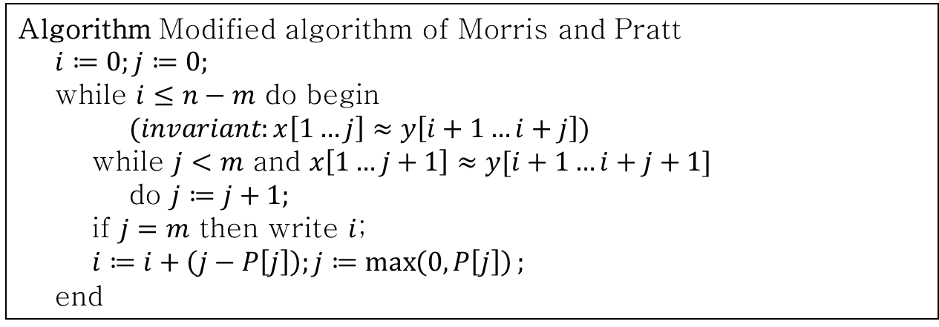
Proposed Approach
Theorem.
All order-occurrences of a pattern in a given that can be computed in linear time
Algorithm Modified algorithm of Morris and Pratt
$i≔0;j≔0;$
while $i≤n−m$ do begin
$(invariant:x\left[1…j\right]≈y\left[i+1…i+j\right])$
while $j<m$ and $x\left[1…j+1\right]≈y[i+1…i+j+1]$
do $j≔j+1;$
if $j=m$ then write $i$;
$i≔i+\left(j−P\left[j\right]\right);j≔\max\left(0,P\left[j\right]\right);$
end
Total: $O(n)$

Slide 10
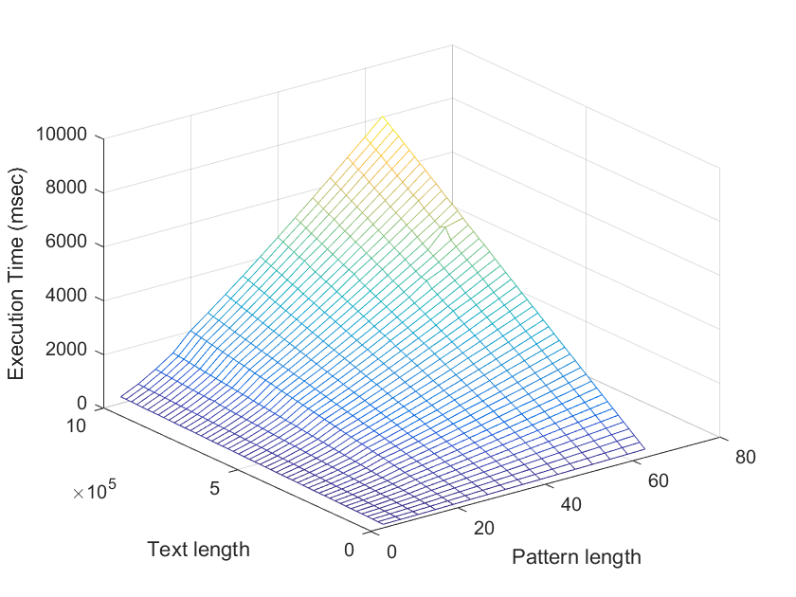
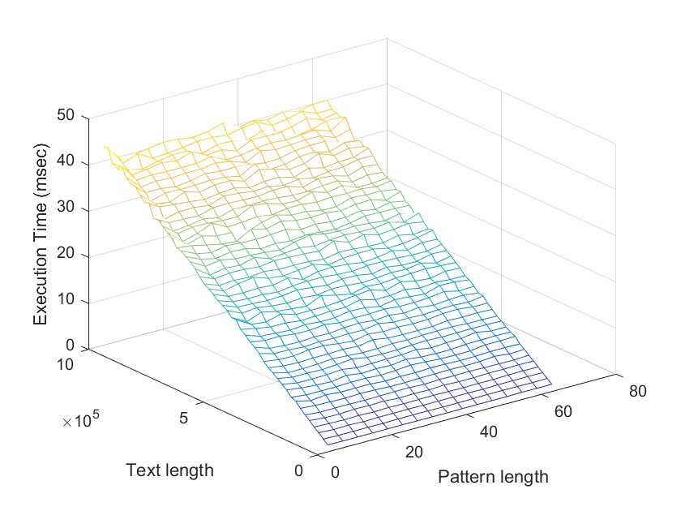
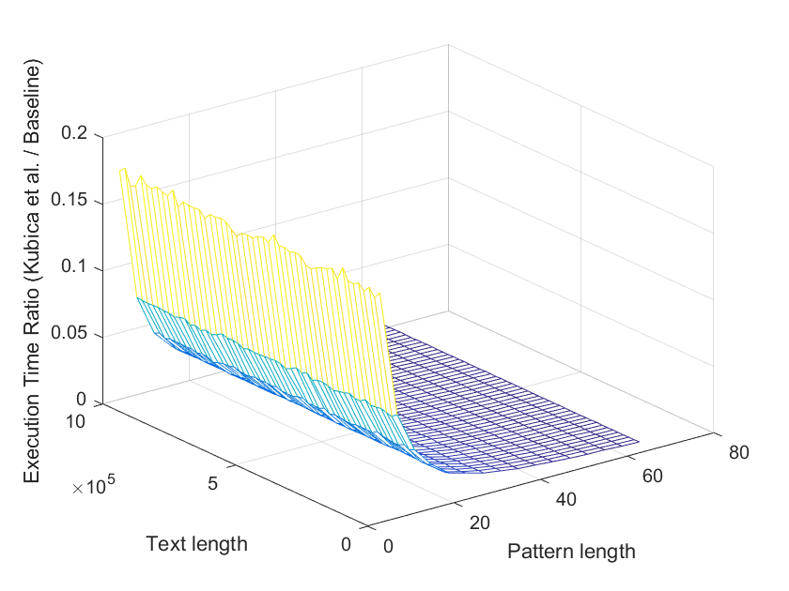
Evaluation
OS : Ubuntu 14.04.5 LTS
Language : C++11
Compiler : g++ 4.8.4
CPU : Intel Core™ i7-3770 @ 3.40GHz
RAM : 32 GB
(a) Baseline
(b) Kubica et al.
(c) Execution time ratio
Figure 3. Execution time of permutation pattern matching Kubica et al. vs. Baseline

