Slide 1
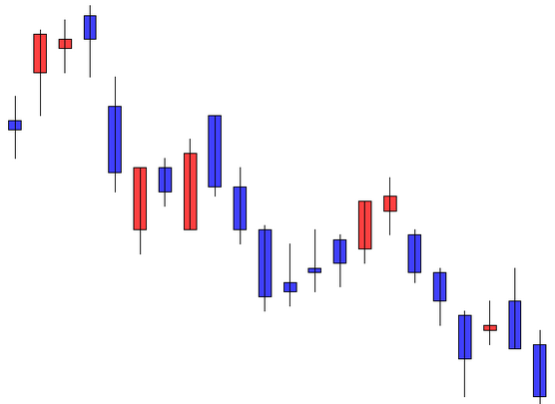
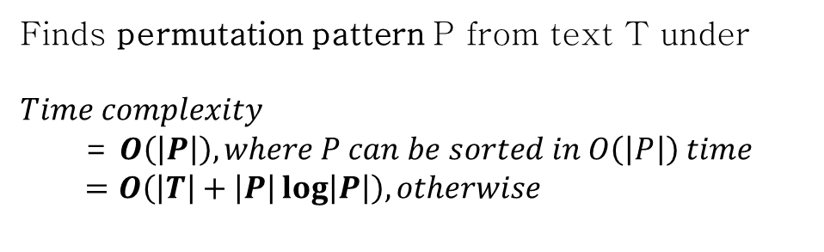
Problem Description
Kubica, Marcin, et al. "A linear time algorithm for consecutive permutation pattern matching." Information Processing Letters 113.12 (2013): 430-433.
Finds permutation pattern P from text T under
$$Time complexity$$
= $O\left(\left|P\right|\right), where P can be sorted in O\left(\left|P\right|\right) time$
$$=O\left(\left|T\right|+\left|P\right|\log\left|P\right|\right), otherwise$$
Figure 1. Candle chart you want to analyze
The same patterns...
5 → 3 → 4 → 1 → 2
99 → 33 → 82 → 17 → 20
1820 → 1720 → 1800 → 1700 → 1701
Figure 2. Pattern you want to find

Slide 2
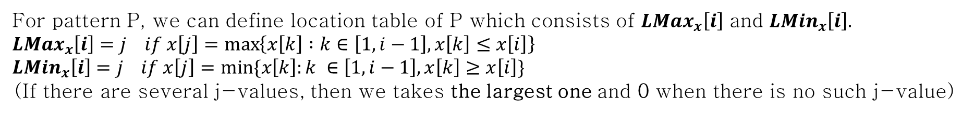
Formal Definitions
1. Order-isomorphic
Two sequences x, y of the same length are called order-isomorphic and written $x≈y.$
$$if \left(∀1≤i,j≤\left|x\right|=\left|y\right|\right) x\left[i\right]≤x\left[j\right]⇔y\left[i\right]≤y[j]$$
Ex> Order-isomorphic patterns...
5 → 3 → 4 → 1 → 2
99 → 33 → 82 → 17 → 20
1820 → 1720 → 1800 → 1700 → 1701
2. Location Table
For pattern P, we can define location table of P which consists of $LMax_{x}\left[i\right]$ and $LMin_{x}\left[i\right].$
$$LMax_{x}\left[i\right]=j if x\left[j\right]=\max\left\{x\left[k\right] :k∈\left[1, i−1\right], x\left[k\right]≤x\left[i\right]\right\} \\ LMin_{x}\left[i\right]=j if x\left[j\right]=min⁡\{x\left[k\right]:k ∈\left[1,i−1\right], x\left[k\right]≥x\left[i\right]\}$$
(If there are several j-values, then we takes the largest one and 0 when there is no such j-value)
Ex> Location table of pattern 414735234
Index | 1 | 2 | 3 | 4 | 5 | 6 | 7 | 8 | 9
Pattern | 4 | 1 | 4 | 7 | 3 | 5 | 2 | 3 | 4
LMax | 0 | 0 | 1 | 3 | 2 | 3 | 2 | 5 | 3
LMin | 0 | 1 | 1 | 0 | 3 | 4 | 5 | 5 | 3
← The largest index of the largest lower bound on the left
← The largest index of the smallest upper bound on the left

Slide 3
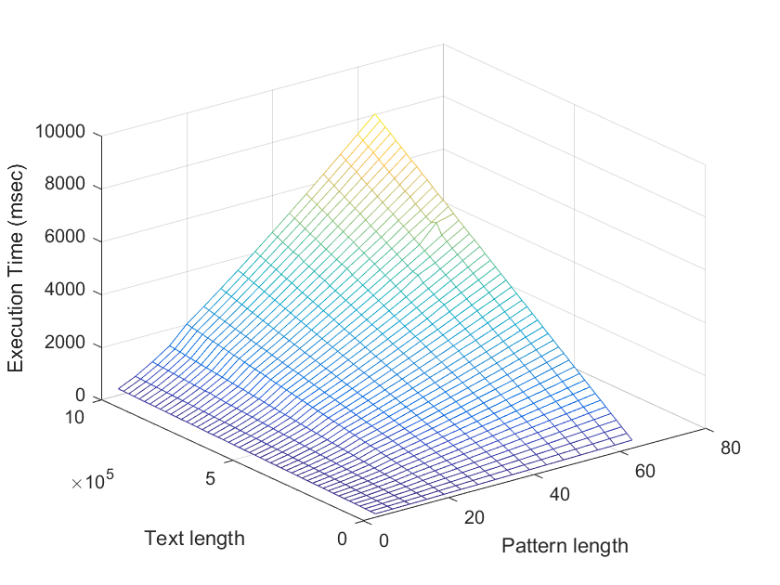
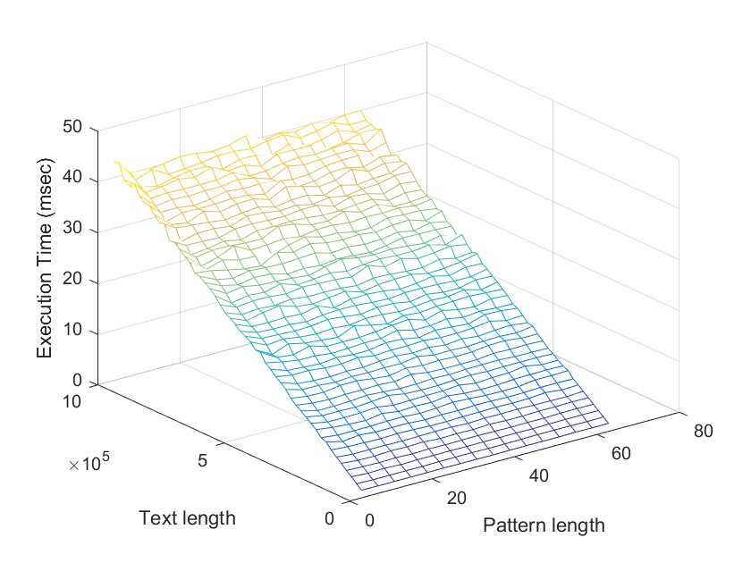
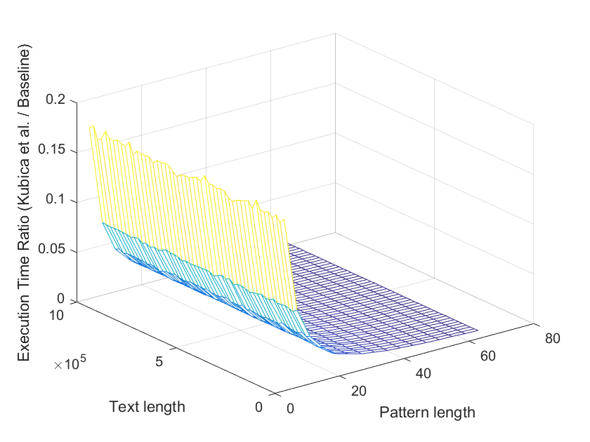
Evaluation
(a) Baseline
(b) Kubica et al.
(c) Execution time ratio
Figure 3. Execution time of permutation pattern matching Kubica et al. vs. Baseline

