Slide 1

CS 1900/1950 Introduction
Course Requirements and Logistics
School of Computing and Information
Department of Computer Science

Slide 2
About the Instructor
Wonsun Ahn
First name is pronounced one-sun
Or you can just call me Dr. Ahn (rhymes with naan)
Industry Experience
Software engineer, field engineer, technical lead, manager
Bluebird Corporation (70-person startup company)
Manufactures industrial hand-held devices from top to bottom
Me: Built software stack based on Windows Embedded
IBM Research (thousands of people)
Does next-gen stuff like carbon nanotubes, quantum computers
Me: Designed supercomputers for ease of parallel programming

Slide 3
Course Requirements
Attend each class (2 or less unexcused absences)
Give a presentation on your work to your peers
Do peer reviews of each other’s talks on TopHat
Write a final paper
(CS 1950 only) send regular progress reports

Slide 4
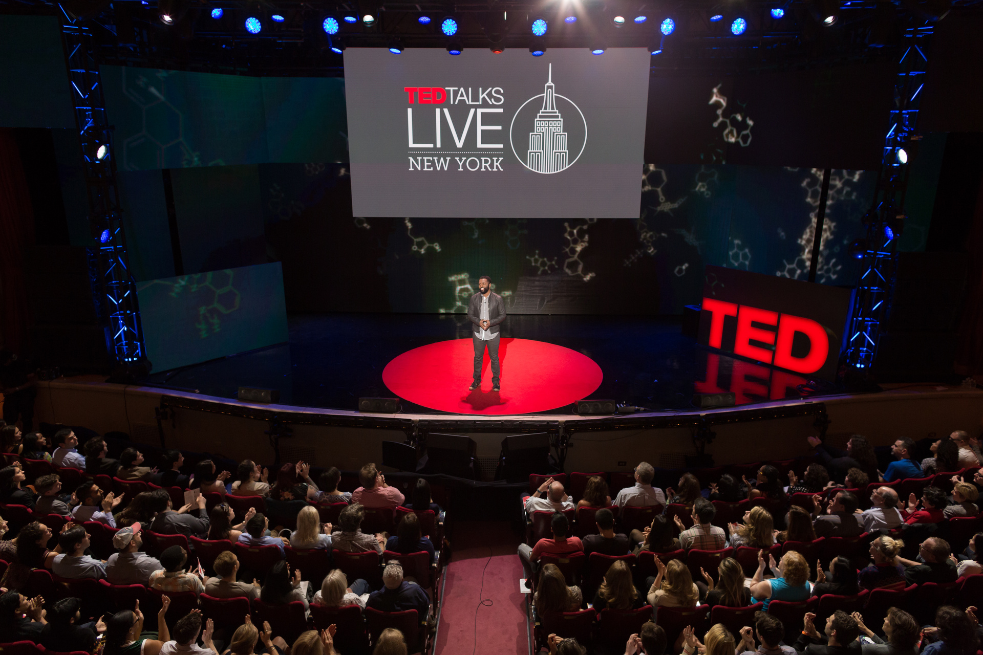
Your talk is consumed by your peers

Slide 5
Your talk is consumed by your peers
You have experience worth sharing with your peers
You worked on unique topics, ideas, products
You worked for a unique organization
Could be …
A small local company that is doing cool things: What is unique about working in that company?
A new interesting job category: How does it compare to SW developer? Did you like it?
Software development methodology: How did you feel about it? Did it increase productivity?
Challenges you faced (technical, interpersonal, organizational): How you did you resolved them? What did you learn?

Slide 6
Your talk is consumed by your peers
To gain practice in giving a technical talk
Learn how to structure your ideas
Learn how to design slides effectively
Learn how to deliver your ideas impactfully
NOT to report on your internship to your instructor
That purpose is already fulfilled by your final report

Slide 7
Before your presentation date
Submit all slides to Canvas by Thursday midnight
Preferred format: PDF (preferred), Powerpoint
Submit to the “Presentation Slides” link
Put title, name, and project on cover page (So your friends know who you are and where you worked)
Number your slides
Practice, practice, practice

Slide 8
On the day of your presentation
We’ll have 8~9 presentation sessions per day
5-minute talk
Q & A on TopHat Q & A section for each presenter
Please DO NOT be late to class!
Presenters, please come 10 minutes early to set up
Designated front row for presenters
Presenters will sit in the order of their presentations
Slides will be stored in order on in-class computer
At end of talk, please close your slides and open next slides

Slide 9
Peer Review Logistics
Submit TopHat answers by Sunday midnight
Give scores for Content, Organization, and Delivery
Freeform comments on the Feedback section

Slide 10
You can be honest with your review
Scores and feedback are anonymous
Only score averages will be posted to Canvas for presenter
Feedback is immediately visible, but names are hidden
Scores and feedback do not impact final grade
For top scorer, a prize is planned. Some ideas:
Certificate on Pitt letterhead congratulating achievement
Post recording to official Pitt CS YouTube channel
Get Panera or Starbucks to sponsor a gift card

Slide 11
But be constructive with your review
Don’t judge presenter on the work done
Judge presenter on how the work was presented
Positive comments are as valuable as “negative” ones
Important thing is to be specific with either
“I loved your talk” is not helpful beyond giving a warm feeling
A constructive comment does not:
Humiliate your peer
Complain about how much time was wasted listening
Use wording that triggers an emotional response

Slide 12
Final paper is consumed by instructor
What I will be looking for:
Technical work commensurate to a capstone was done
Well organized paper with sections and subsections
Goals, implementation, and outcomes are clearly stated
Each section, paragraph, and sentence has clear focus
Whether you had any insurmountable difficulties
Purpose is to compile a “blacklist” for advising future students
For details, refer to: https://wonsunahn.github.io/Capstone_Fall2021/final_paper

Slide 13
TODO Action Items
Please contact me if you are willing to consider postponing CS 1900 to Spring 2022
Please contact me by the end of the week
Talk to your supervisor about what you can publicize
Any intellectual property issues?
Any confidentiality issues?
Note: you are not expected to publicize code ☺
If your organization has red tape that you must go through, please start the process asap and let me know of the issue

