Slide 1

CS 1900/1950 Introduction
Course Requirements and Logistics
School of Computing and Information
Department of Computer Science

Slide 2
About the Instructor
Wonsun Ahn
First name is pronounced one-sun
Or you can just call me Dr. Ahn (rhymes with naan)
Research Interest
Computer architecture, Compilers, Quantum computing

Slide 3
Course Requirements
Attend each class (3 absences results in fail)
Write a final paper on your work to the instructor
Give a presentation on your work to your peers
Do peer reviews of each other’s talks on TopHat
(CS 1950) submit progress reports to Canvas Experiential Learning Hub
You need to fulfill all of the above to pass this class
Please refer to course webpage for details: https://wonsunahn.github.io/Capstone_Fall2025/CS1900_1950/

Slide 4
Your paper is consumed by instructor
What I will be looking for:
Technical work commensurate to a capstone was done
Whether you had any insurmountable difficulties
Purpose is to compile a “blacklist” for advising future students
Well organized paper with sections and subsections
Goals, implementation, and outcomes are clearly stated
Each section, paragraph, and sentence has clear focus
There is a link to a template (and more) on this URL: https://wonsunahn.github.io/Capstone_Fall2025/final_paper

Slide 5
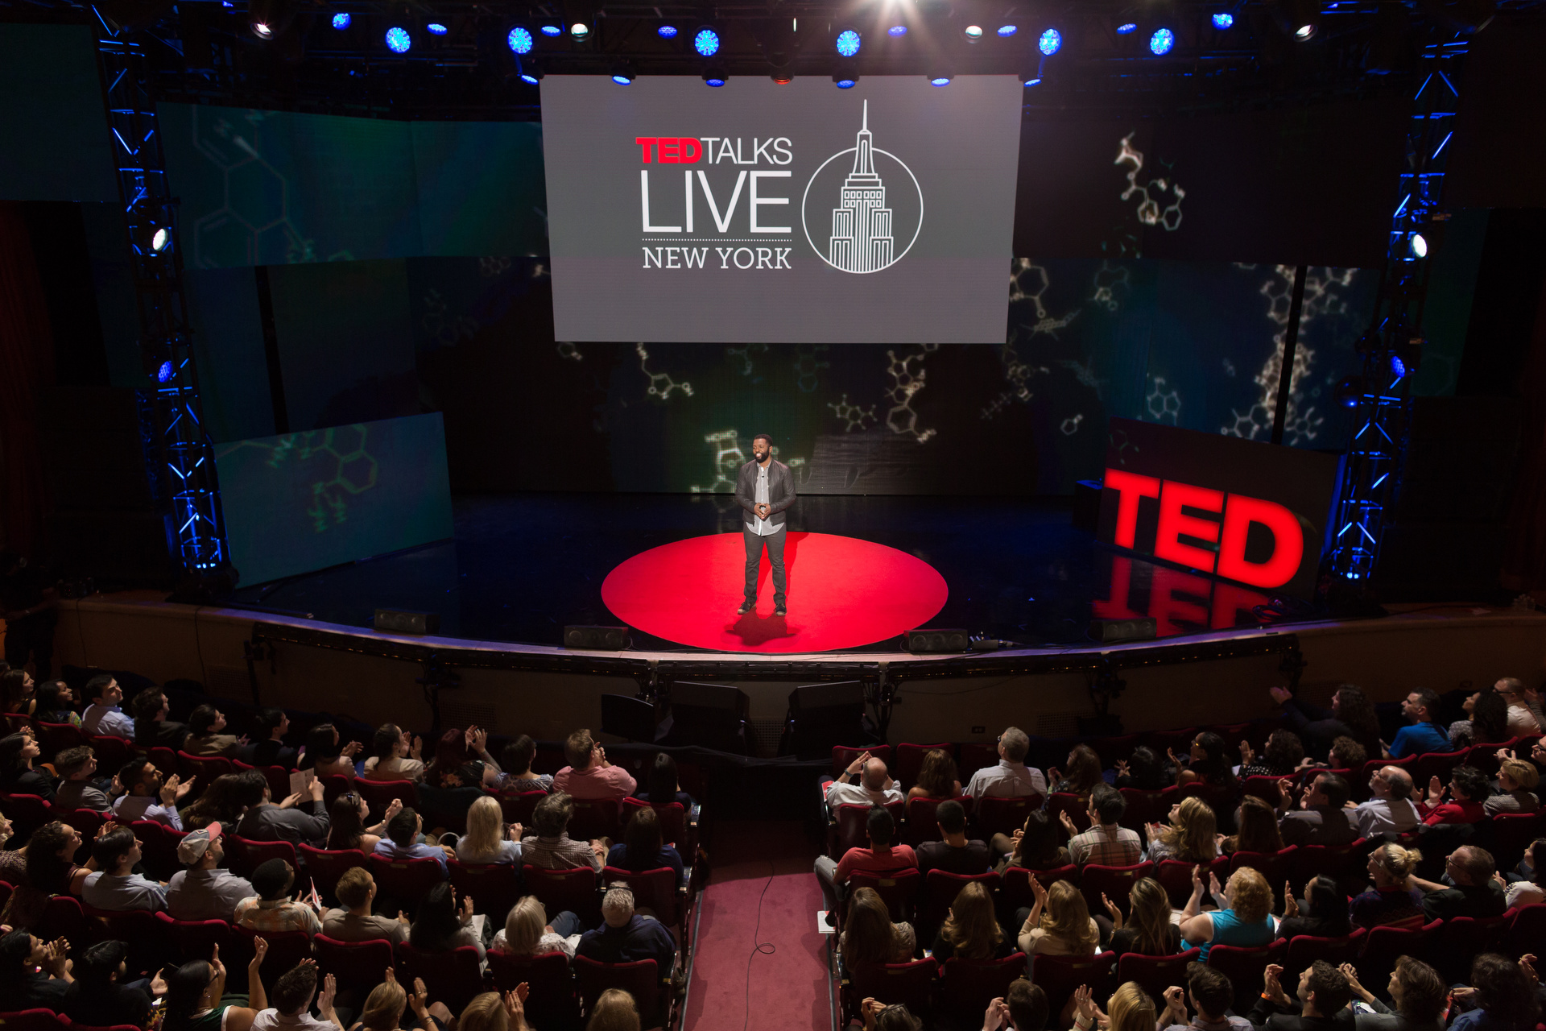
Your talk is consumed by your peers

Slide 6
Why give a talk in front of my peers?
To share experience with your peers
You worked on unique topics, ideas, products
You worked for a unique organization
To gain practice in giving a technical talk
Learn how to structure your ideas
Learn how to design slides effectively
Learn how to deliver your ideas impactfully
NOT to report on your internship to your instructor
That purpose is already fulfilled by your final report

Slide 7
Any experience is worth sharing
Your experiences may include…
A small local company that is doing cool things: What is unique about working in that company?
A new interesting job category: How does it compare to SW developer? Did you like it?
Software development methodology: How did you feel about it? Did it increase productivity?
Challenges you faced (technical, interpersonal, organizational): How you did you resolve them? What did you learn?
Bad experiences are also worth learning from: What would you do differently next time?

Slide 8
Before presentation date
Submit all slides to Canvas by Thursday 9 PM
Preferred format: Powerpoint, PDF
Submit to the “Presentation Slides” link
Put title, name, and project on cover page
So that your friends know who you are and where you worked
Put company or project logo/name in slide template
To remind the audience where you worked throughout the talk
Your slides will be ready for you next day on TopHat
Practice out loud and time yourself

Slide 9
During Presentation
~5 talks per day. 50 / 5 = 10 minutes per talk.
5 minutes: Presentation talk
Speaker: Present on TopHat using instructor’s laptop (If using your own laptop, let me know ahead of time)
3 minutes: Q & A
2 minutes: Intermission
Switch speakers, audience completes peer feedback
Keep your own time using your cell phone
I will cut you off if you go over 8 minutes with no warning

Slide 10
After Presentation
Audience:
Submit TopHat review by midnight, same day
Give scores for Content, Organization, and Delivery
Freeform comments on the Feedback section
Speaker:
Submit Final Paper by following Friday by midnight

Slide 11
You can be honest with your review
Scores and feedback are anonymous
Only score averages will be posted to TopHat for presenter
Feedback is immediately visible, but names are hidden
Scores and feedback do not impact final grade
For 3 top scorers, there will be cash prizes:
1st place - $100, 2nd place - $50, 3rd place - $25
Deposited into your PittFund$Me account

Slide 12
Peer Review Components
Content Score (1-5)
How much thought was put into providing content of value.
NOT a score of how productive or fun the internship was.
Organization Score (1-5)
How well organized the talk was.
Well-focused slides / well-visualized info / good flow
Delivery Score (1-5)
How good was the verbal delivery.
Pacing / articulation / engagement / demeanor
Feedback comment
Be specific, regardless of whether it is positive or constructive

Slide 13
TODO Action Item
Make sure you are enrolled in TopHat
Do the TopHat survey by this weekend
Talk to your supervisor about what you can publicize
Any intellectual property issues?
Any confidentiality issues?
Note: you are not expected to publicize code ☺
If your organization has any red tape, please start the process asap and let me know

