Slide 1
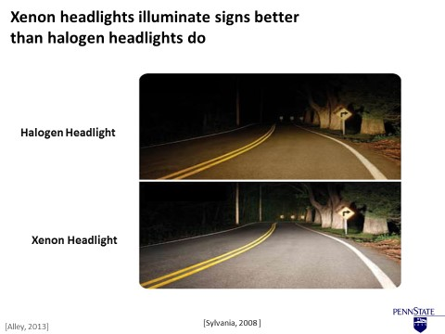
Rethinking Technical Presentations: The Assertion-Evidence Approach
Adapted from
Work of
Michael Alley
College of Engineering
Penn State
Notes:
Reference pages in The Craft of Scientific Presentations, 2nd ed.:
pp. 105-106, 132-135
Additional Notes: This presentation is designed to help instructors of university and high school students teach the assertion-evidence approach to presentations. These slides use the term “scientific presentations” to encompass the presentations done by engineers and scientists. If you prefer the more general term “technical,” you can use the Replace command to replace “scientific” with “technical” throughout. Likewise, if you desire a term more specific than “scientific,” you can use the same command to insert your preferred term (“engineering” or “biological” would be two examples).
References:
Michael Alley, The Craft of Scientific Presentations, 2nd ed. (New York: Springer-Verlag, 2013). Generally, the lowest price is on Amazon.com.
“Assertion-Evidence Approach,” http://www.assertion-evidence.com, ed. by Michael Alley (University Park: Penn State, 2016).

Slide 2
Build your talk on
messages
not on topics
Notes:
2
The first principle of the assertion-evidence approach is that you should build your talk on messages, not topics.
Reference pages in The Craft of Scientific Presentations, 2nd ed.: pages 130-139, 184.

Slide 3
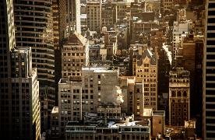
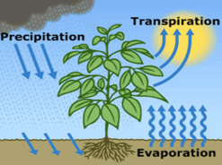
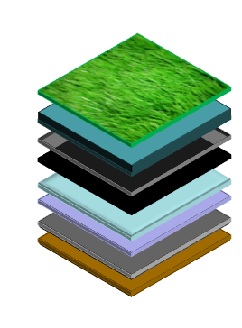
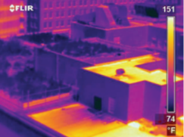
Support your messages
with visual evidence
not bullet points
Notes:
3
The second principle of the assertion-evidence approach is that you should support your messages with visual evidence, not bullet points.
Transition to next slide: So let’s start with the first principle: Build your talk on messages…
Reference pages in The Craft of Scientific Presentations, 2nd ed.: pages 140-143.

Slide 4
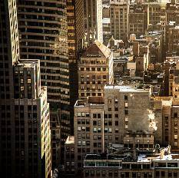
Build your talk on
messages
Urban Temperatures
Often warmer than surrounding areas
Caused by materials in roofs and roads
Also caused by lack of shade and vegetation
Lead to higher temper-atures in buildings
Require more energy for cooling
Notes:
4
Most engineers and scientists, unfortunately, follow PowerPoint defaults and build their talks on topic phrases. What occurs then is an unfocused talk with much noise.—”too many words.”
For instance, if most engineers and scientists wanted to discuss the problem of the increased temperatures in urban areas, they would waste the top 25% of the slide on a topic phrase such as Urban Temperatures. Then [animate] those engineers and scientists would create a bullet list of messages that they wanted to say about this topic. If room still existed on the slide [animate], those engineers and scientists would add visual evidence. The result is a cluttered slide with too many words.
Reference pages in The Craft of Scientific Presentations, 2nd ed.: pages 130-139, 184.
Reference: Jessica Smith, “Delivery,” http://vimeo.com/89648269 (4:44-6:05)

Slide 5
Build your talk on
messages
Urban Temperatures
Notes:
5
A better way would be to begin the slide not with a phrase [advance], but….
Reference pages in The Craft of Scientific Presentations, 2nd ed.: pages 130-139, 184.
Reference: Jessica Smith, “Delivery,” http://vimeo.com/89648269 (4:44-6:05)

Slide 6

Temperatures in urban centers are often much warmer than in surrounding rural areas
Notes:
…but with the most important message of the scene. In this case, that message is “Temperatures in urban centers are often much warmer than in surrounding rural areas.” Then the engineer or scientist should dedicate the rest of the canvas to visual evidence that supports the message. Moreover, the speaker should use that evidence to present the second messages for the scene.
For instance, in this scene, the speaker could first discuss the causes of the increased urban temperatures. One cause is the lack of shade trees. Another is the differences in the heat capacities of the surface materials. In other words, the rooftops in a city absorb more heat than the foliage in the countryside. That absorbed heat leads to higher temperatures in the surrounding air.
In addition, the speak could discuss the effects of the increased urban temperatures, the most important being the increased costs to cool the buildings in the summer. The increased energy needed to cool those buildings also results in increased air emissions.
After giving this scene, point out that although the sentence headline used more words than a phrase headline would have, the overall number of words on the scene was significantly less.
Reference pages in The Craft of Scientific Presentations, 2nd ed.: pages 130-139, 184.
Reference: Jessica Smith, “Delivery,” http://vimeo.com/89648269 (4:44-6:05)

Slide 7
The first step is to write a sentence headline that states the main message of the slide
sentence
headline
Notes:
7
Reference pages in The Craft of Scientific Presentations, 2nd ed.:
pp. 130-139
References:
Michael Alley, The Craft of Scientific Presentations, 2nd ed. (New York: Springer-Verlag, 2013), pp. 130-139.
Scott Fishbone, “Comparison of Xenon Headlights Versus Halogen Headlights,” presentation (University Park: College of Engineering, April 2008).

Slide 8
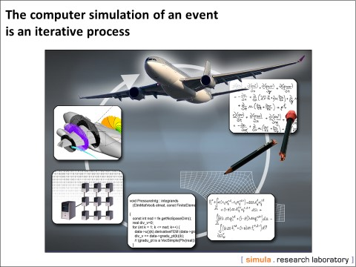
The second step is to find or create visual evidence that supports the sentence headline
visual evidence
[Alley, 2013]
Notes:
8
Reference pages in The Craft of Scientific Presentations, 2nd ed.:
pp. 140-143
References:
Michael Alley, The Craft of Scientific Presentations, 2nd ed. (New York: Springer-Verlag, 2013), pp. 140-143.
Are Magnus Bruaset and Jan Olav Langseth, “Computational Simulations at Simula,” presentation (Oslo: Simula Research Laboratory, 2005).

Slide 9
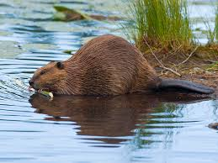
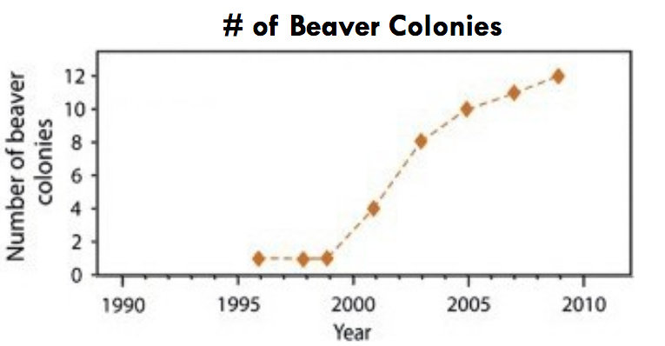
Increased willow tree ring area correlated with an increase in numbers of a nearly extinct beaver population.

Slide 10
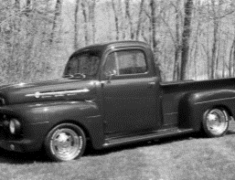
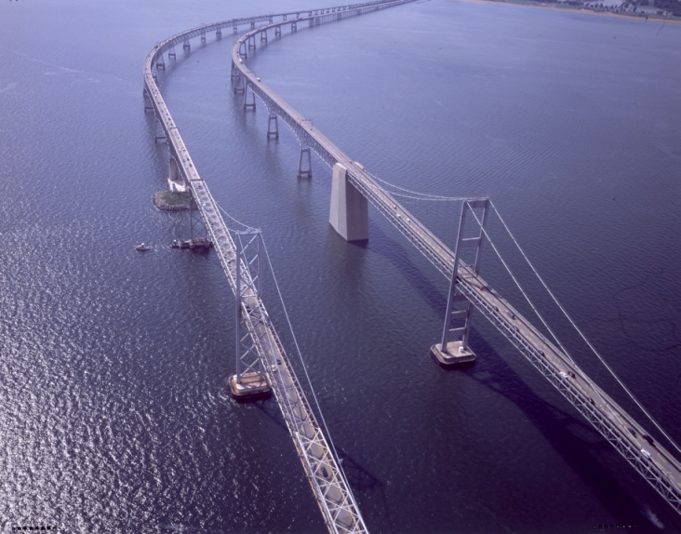
Since its construction in 1952, traffic across the bridge has grown exponentially
1952
1.1 million vehicles
[Maryland Transportation Authority, 2007]
Notes:
Reference pages in The Craft of Scientific Presentations, 2nd ed.:
pp. 140-142
References:
Michael Alley, The Craft of Scientific Presentations, 2nd ed. (New York: Springer-Verlag, 2013), pp. 140-142.
Adapted from Brittany Pavelko
10

Slide 11
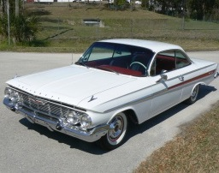
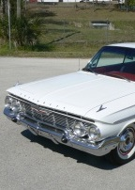
Since its construction in 1952, traffic across the bridge has grown exponentially
1952
1.1 million
1961
1.5 million
[Maryland Transportation Authority, 2007]
Notes:
Reference pages in The Craft of Scientific Presentations, 2nd ed.:
pp. 140-142
References:
Michael Alley, The Craft of Scientific Presentations, 2nd ed. (New York: Springer-Verlag, 2013), pp. 140-142.
Adapted from Brittany Pavelko
11

Slide 12
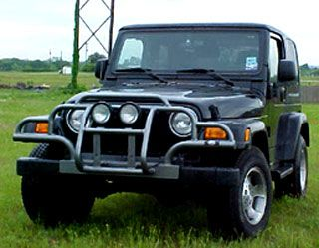

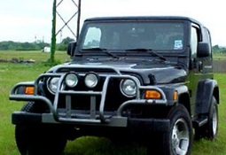
Since its construction in 1952, traffic across the bridge has grown exponentially
1952
1.1 million
1961
1.5 million
2007
27 Million
[Maryland Transportation Authority, 2007]
Notes:
Reference pages in The Craft of Scientific Presentations, 2nd ed.:
pp. 140-142
References:
Michael Alley, The Craft of Scientific Presentations, 2nd ed. (New York: Springer-Verlag, 2013), pp. 140-142.
Adapted from Brittany Pavelko
12

Slide 13
The third step in creating assertion-evidence slides is to breakout of the default PowerPoint layout
Encourages topics as titles
Encourages long text,
not visuals
Notes:
13
Reference pages in The Craft of Scientific Presentations, 2nd ed.:
pp. 154-159
References:
Michael Alley, The Craft of Scientific Presentations, 2nd ed. (New York: Springer-Verlag, 2013), pp. 154-159.

Slide 14
Title of Presentation in Initial Capitals:
36 Points, Calibri Bold
Replace this box with key image to introduce talk’s scope, importance, or background
Name
Name
Name
Department
Institution
Date
Replace with
your Logo
Notes:
This file presents an assertion-evidence template for making effective slides for scientific presentations. Although much about the layout and typography contrasts sharply with the defaults of PowerPoint, these changes are done so to make the slides more effective at communicating technical information. The design advocated by this template arises from Chapter 4 of The Craft of Scientific Presentations, 2nd edition (Springer, 2013). The homepage for this template exists at the following website:
http://writing.engr.psu.edu/assertion_evidence.html
Right now you are viewing the notes pages. To work on the slides, click on “Slide” under “View.” Tip: When creating a new presentation, save this file as the name of your presentation. Warning: You are more than welcome to use this template for your presentation slides. You may not, though, distribute this template for profit or distribute this template without giving credit to the source: http://writing.engr.psu.edu/
This slide is for the title slide of a presentation. Consider inserting an image that helps orient the audience to the title. You should not leave this slide until the audience feel comfortable with the title. Forcing yourself to spend more time with this slide is good because a common mistake in presentations is to leave the title slide too soon. Because of this mistake, many in the audience do not have the chance to comprehend the key details of the title. See pages 172-184 in The Craft of Scientific Presentations, 2nd ed. (CSP).
This template shows one layout for the slide. You might want to rearrange the placement of the body’s wording to accommodate a different sized image. On the next slide is a sample title slide. You should delete the examples after you create your own slides.

Slide 15
A common error in the beginning of scientific talks is to leave the audience behind
[Alley, 2013]
Notes:
15
Reference pages in The Craft of Scientific Presentations, 2nd ed.:
p. 72
References:
Michael Alley, The Craft of Scientific Presentations, 2nd ed. (New York: Springer-Verlag, 2013), p. 72.

Slide 16
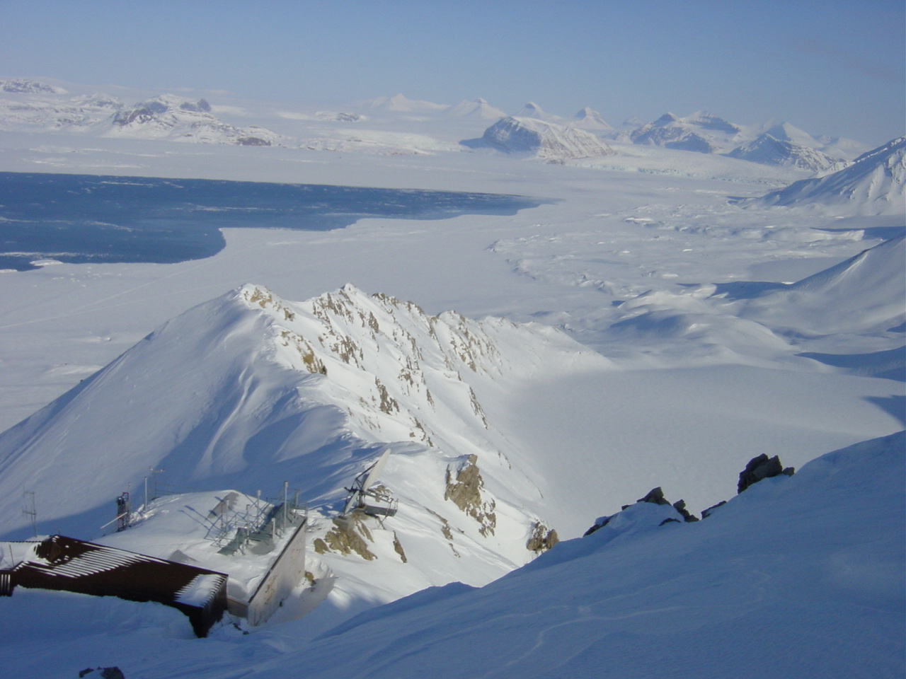


Determining Whether Atmospheric Mercury Goes into Surface Snow after a Depletion Event
Ny-Ålesund
Katrine Aspmo
Torunn Berg
Norwegian Institute for Air Research
Grethe Wibetoe
University of Oslo, Dept. of Chemistry
June 16, 2004
Event
[Alley, 2013]
Notes:
16
Reference pages in The Craft of Scientific Presentations, 2nd ed.:
pp. 72-73
References:
Michael Alley, The Craft of Scientific Presentations, 2nd ed. (New York: Springer-Verlag, 2013), pp. 72-73
Adapted from K. Aspmo, T. Berg, and G. Wibetow, “Atmospheric Mercury Depletion Events in Polar Regions during Arctic Spring, “ presentation (Oslo: University of Oslo, 16 June 2004).
2.

Slide 17
This presentation focuses on… (complete sentence, but go no more than two lines)
Image for
Topic 1
Topic 1
Image for
Topic 2
Topic 2
Image for
Topic 3
Topic 3
Notes:
Mapping slide for the presentation (note that a background slide or a slide justifying the importance might precede this slide). A common mistake with mapping slides is to give the audience simply an unmemorable bulleted list of topics (including the names “Introduction” and “Conclusion” and “Questions”). Such a list is quickly forgotten after the slide is removed.
On a mapping slide, take the opportunity to show a key image or perhaps a representative image for each major section of the presentation. In the second case, each image would be repeated on the first visual of the corresponding section and would remind the audience that they have arrived to a major section of the presentation’s middle.
In regards to the names “Introduction” and “Conclusion,” every talk has those sections, and the names are ignored by audiences. So why state them? Also, for the divisions that you do have, find a logical and parallel grouping. Note that groups of two’s, three’s, and four’s are much easier to remember and are not so nearly intimidating as groups of five’s, six’s, and seven’s. See the discussion of mapping slides in The Craft of Scientific Presentations, 2nd ed. (pages 177-181).

Slide 18
A common error in the mapping of scientific talks is to show a list that is not memorable
[Alley, 2013]
Notes:
18
Reference pages in The Craft of Scientific Presentations, 2nd ed.:
pp. 176-178
References:
Michael Alley, The Craft of Scientific Presentations, 2nd ed. (New York: Springer-Verlag, 2013), pp. 176-178.

Slide 19
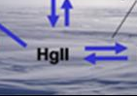
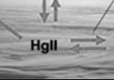
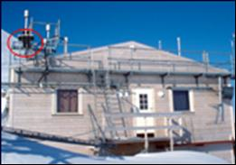
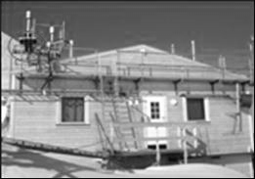
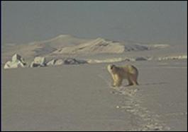
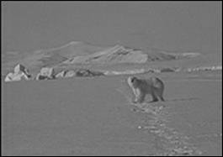
This talk traces what happens to mercury after it depletes from the atmosphere in arctic regions
Theory for mercury cycling
Measurements from Station
Environmental implications
Notes:
Reference pages in The Craft of Scientific Presentations, 2nd ed.:
pp. 178-180
Additional Notes: Be sure to view this slide in the slideshow mode to see how the presenter keeps the audience focused on the appropriate image. This technique of moving from black-and-white images to color to keep the audience on track originated with students at Penn State (see cheetah presentation).
References:
Michael Alley, The Craft of Scientific Presentations, 2nd ed. (New York: Springer-Verlag, 2013), pp. 178-180.
Adapted from K. Aspmo, T. Berg, and G. Wibetow, “Atmospheric Mercury Depletion Events in Polar Regions during Arctic Spring, “ presentation (Oslo: University of Oslo, 16 June 2004).

Slide 20
This sentence headline makes an assertion on the first topic in no more than two lines
Image(s)
supporting above assertion
If necessary, identify key assumption or background for audience—keep to two lines (18–24 point type)
Notes:
Body slide from the first section of the presentation’s middle. Consider having the first-topic image from the mapping slide repeated here. Use the headline (no more than two lines) to make an assertion about this topic. In the body of the slide, support that headline with images and with words, if necessary. See Chapter 4 of The Craft of Scientific Presentations, 2nd ed.
This slide shows one orientation for the image and text in the body of the slide. Other orientations appear in this template. Choose the one that best supports your headline assertion.
Some institutions will insist that you place an institutional logo on each slide. Other institutions recommend a logo on the first slide and the last. If you do place a logo on each slide, make sure that logo is at the bottom of the slide rather than the top. Placing the logo at the top (the place on a slide that receives the most emphasis) shifts the emphasis away from the work.

Slide 21


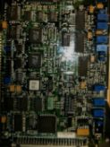

A data acquisition system changes the form of the data
A digital acquisition system has to sample at a rate fast enough to retain the shape of the analog signal
Measurement Device
Analog-to-Digital
Converter
[Alley, 2013]
Notes:
Reference pages in The Craft of Scientific Presentations, 2nd ed.:
pp. 110-111
References:
Michael Alley, The Craft of Scientific Presentations, 2nd ed. (New York: Springer-Verlag, 2013), pp. 110-111.

Slide 22
A digital acquisition system has to sample at a rate fast enough to retain the shape of the analog signal
Measurement Device
Analog-to-Digital
Converter
Notes:
Reference pages in The Craft of Scientific Presentations, 2nd ed.:
pp. 115-116
References:
Michael Alley, The Craft of Scientific Presentations, 2nd ed. (New York: Springer-Verlag, 2013), pp. 110-111.
H.H. Robertshaw, “Class Period 15: Signals and Systems,” class lecture in ME 4005 (Blacksburg, VA: Virginia Tech, 16 March 2004).

Slide 23
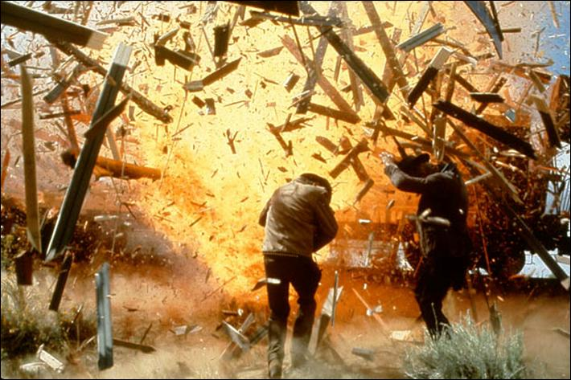

Fragments quickly outpace the blast wave and become the primary hazard to personnel
Notes:
Sample slide from second section of the presentation’s middle. The image was such that there was no need for subordinate descriptions.
Reference:
Jared Rochester, “Three Primary Products of an Explosive,” presentation (Aberdeen, MD: US Army Research Laboratory, 5 December 2005).

Slide 24
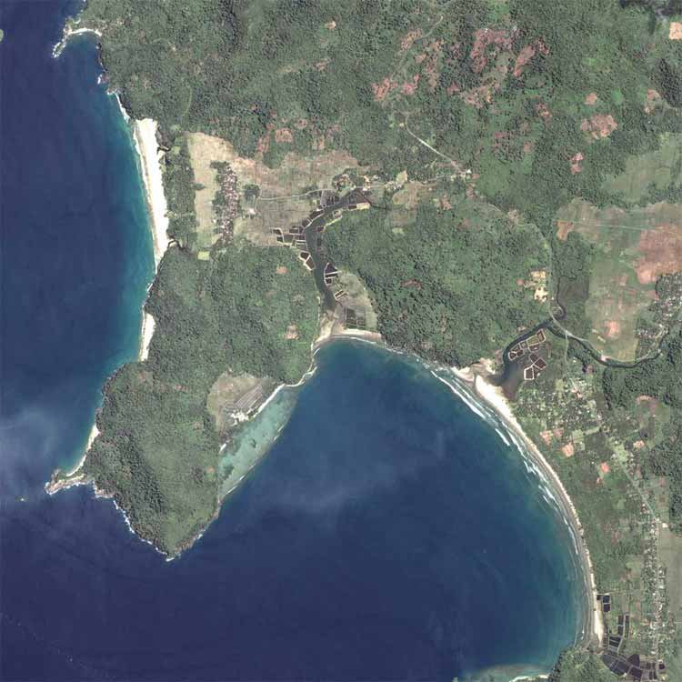
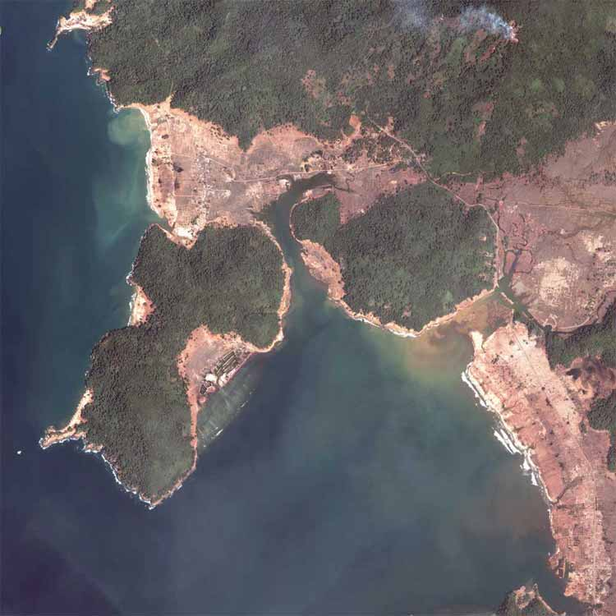
Tsunamis cause devastating destruction, especially to sparsely vegetated areas
Before
After
Sparse
Sparse
Sparse
2004 Indian Ocean Tsunami: Gleebruk Village, Sri Lanka
[homepage.mac.com/demark/]
Notes:
24
Reference pages in The Craft of Scientific Presentations, 2nd ed.:
pp. 166-168
References:
Michael Alley, The Craft of Scientific Presentations, 2nd ed. (New York: Springer-Verlag, 2013), pp. 166-168.

Slide 25
This sentence headline makes an assertion on the second topic in no more than two lines
Call-out, if necessary: keep to one or two lines
Call-out, if necessary: keep to one or two lines
Image or equations supporting the headline assertion
Call-out, if necessary: keep to one or two lines
Notes:
Body slide from the second section of the presentation’s middle. For the first body slide of this second section, consider repeating the corresponding image (or equation) from the mapping slide. Use the headline to make an assertion about this topic. In the body of the slide, support that headline assertion with images and needed callouts. See Chapter 4 of The Craft of Scientific Presentations, 2nd ed.
This slide shows one orientation for the image and text in the body of the slide. Other orientations appear in this template. Choose the orientation that best supports your headline assertion.

Slide 26
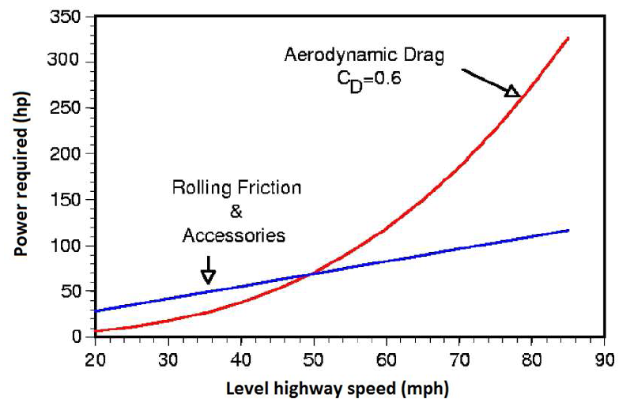

At typical highway speeds, overcoming drag requires about two-thirds of a truck engine’s output
Aerodynamic Drag
C_{D} = 0.6
Rolling Friction and Accessories
[McCallen, 2004]
Notes:
Reference pages in The Craft of Scientific Presentations, 2nd ed.:
pp. 143-144
References:
Michael Alley, The Craft of Scientific Presentations, 2nd ed. (New York: Springer-Verlag, 2013), pp. 140-142.
Cook, Jason, John Hurley, Ryan McNulty, Zack Reuter, and Charles Smith, “Recommendation of Rib Configuration for the Internal Cooling of Gas Turbine Blades” (Blacksburg, VA: Mechanical Engineering 4006, Fall 2004).
2010 by Casey Howsare, an engineering science student at Penn State. (CSP, 143-144)

Slide 27
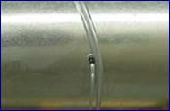
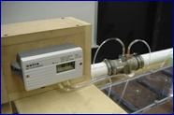
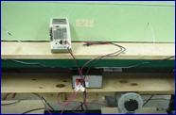
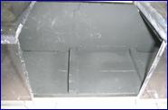
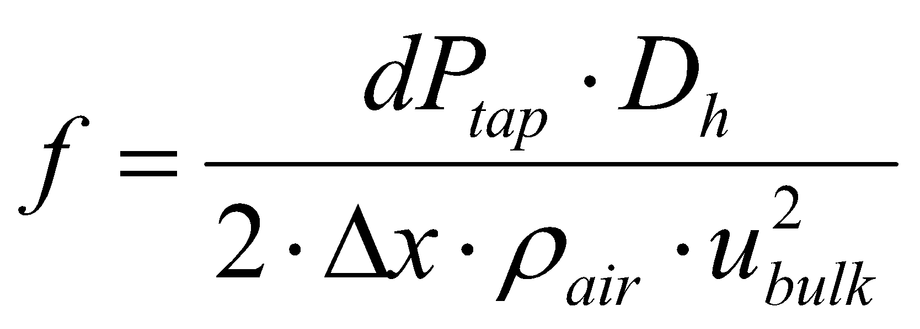
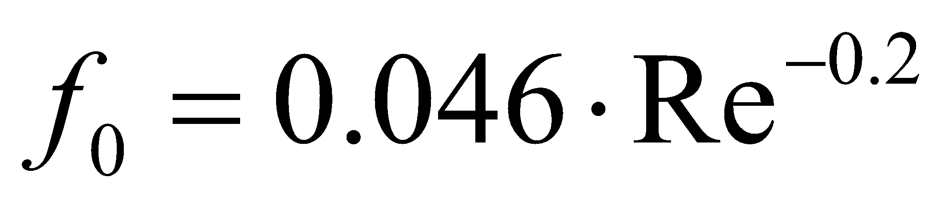
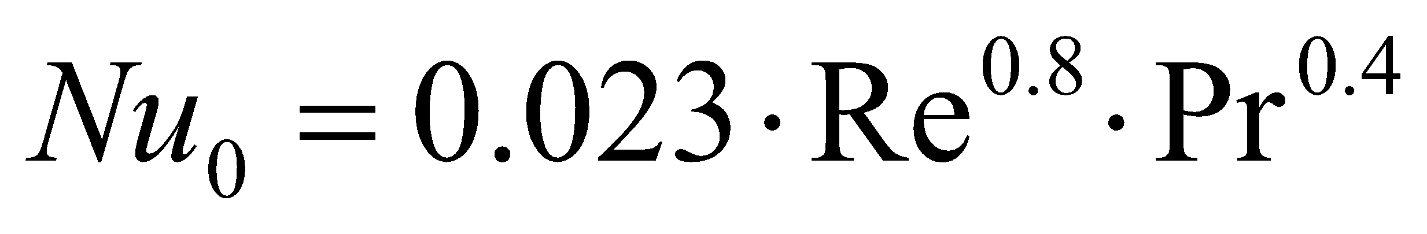
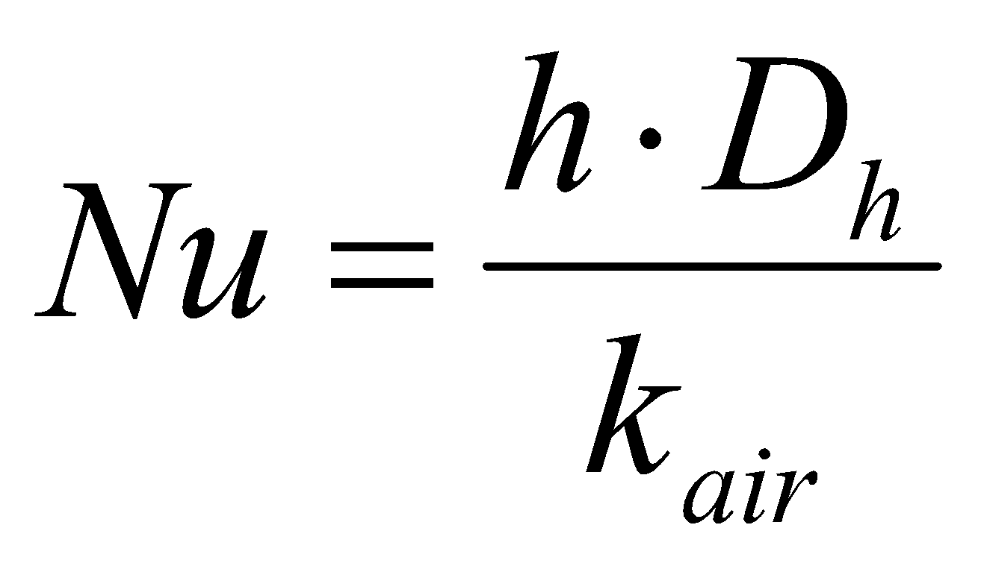

Normalized friction factors and Nusselt numbers correlated our data with the data of others
Pressure Taps
Venturi Meter
Voltmeter
Thermocouples
Pressure Drop
Reynolds Number
Heat Flux, q˝
T_{inlet}
T_{wall}
T_{bulk}
Friction Factor, f
h
Nu_{o}, f_{o}
Nu
Notes:
Sample slide from the middle of a presentation. Notice how animation works to allow the speaker to present fairly complex connections in a way that the audience can digest. Notice how the arrows show connections—something that bullets could not achieve.
Reference
This slide is a composite slide from a number of mechanical engineering seniors in ME 4006, a laboratory course at Virginia Tech. These presentations occurred during the Fall 2004 semester.

Slide 28
This sentence headline makes an assertion on the third topic in no more than two lines
Image supporting above assertion
Feature or call-out—no more than two lines
Feature or call-out—no more than two lines
Notes:
Body slide from the third section of the presentation’s middle. For the first body slide of this third section, consider repeating the corresponding image from the mapping slide. Use the headline to say state an assertion about this topic. In the body of the slide, support that headline with images and with needed callouts. See Chapter 4 of The Craft of Scientific Presentations, 2nd ed..
This slide shows one orientation for the image and text in the body of the slide. Other orientations appear in this template. Choose the orientation that best supports your headline assertion.

Slide 29

High concentrations of acetic acid help protect steel from corrosion
Adsorbed HOAc allows the growth of siderite
A thick siderite layer protects the steel from corrosion
FeCO₃
Steel
Fe_{3+x} O_{4-y}
Notes:
29
Reference pages in The Craft of Scientific Presentations, 2nd ed.:
pp. 181-184
References:
Michael Alley, The Craft of Scientific Presentations, 2nd ed. (New York: Springer-Verlag, 2013), pp. 181-184.
Omar Rosas Camacho, “High concentrations help protect steel from corrosion,” master’s defense presentation (University Park: Material Science and Engineering, Penn State, 2010).

Slide 30
In summary, this sentence headline states the most important assertion of the presentation
Image that supports conclusion
Supporting point (no more than two lines)
Another supporting point (parallel to the first)
Questions?
Logo
Notes:
Conclusion slide. Use the headline (no more than two lines) to state your most important conclusion. Begin the headline with In summary or In conclusion to ensure that the audience knows they have come to the presentation’s end. Support that headline with an image and parallel points.
This slide should be your last slide. Audiences lose patience when they believe that they have come to the end, but other slides follow.
Notice that the word Questions appears at the bottom of this slide. That strategy is much more effective than burning a slide with just the word Questions. This slide allows the audience to look at the most important slide of the presentation during the question period. See The Craft of Scientific Presentations, 2nd ed., pages 182-183.

Slide 31
A common error in the endings of scientific talks is to waste the last slide
[Alley, 2013]
Notes:
31
Reference pages in The Craft of Scientific Presentations, 2nd ed.:
pp. 181-184
References:
Michael Alley, The Craft of Scientific Presentations, 2nd ed. (New York: Springer-Verlag, 2013), pp. 181-184.

Slide 32
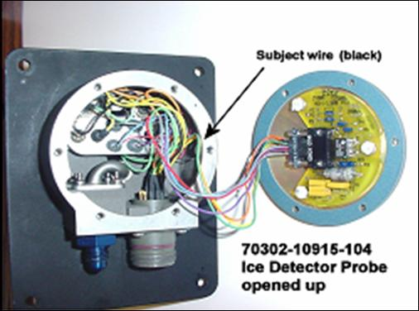

In summary, the detector failed because of a short-circuit created by the abrasion of wire insulation
Wires not harnessed to prevent contact with housing
Short circuit to ground created where wire contacted housing
Questions?
Notes:
Sample conclusion slide. Notice how the presenter showed the connection between words blocks on this slide—a strategy that is much more effective than a bullet list, which hides the connections between details.
Reference:
Manning Seltzer, “Failure Analysis of the Ice Detector in the Austria 13 Helicopter,” presentation (Hartford, CT: Sikorsky Helicopter, 30 April 2004).

Slide 33
No need to be religious in using assertion-evidence; Rather, I want to open up your minds to new possibilities
Look here, I’m using a bullet point. It’s not a sin. ☺
Regardless of which format you choose, there are takeaways
Takeaway 1: Organize around messages, not topics
Takeaway 2: Title should express message for whole slide

