Slide 1
Git & github 활용

Slide 2
What is Git? (1)
Git is a free and open source distributed version control system (VCS) designed to handle everything from small to very large projects with speed and efficiency.
A Source Code Management (SCM) tool

Slide 3
Version control system
a system that records changes to a file or set of files over time so that you can recall specific versions later.

Slide 4

Local version control system

Slide 5
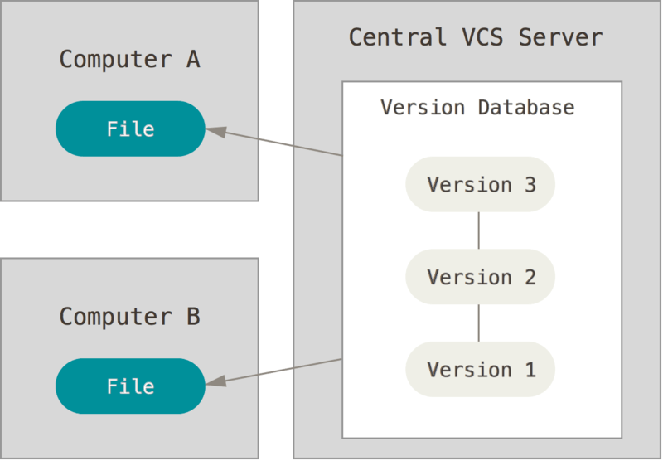
Centralized Version Control Systems

Slide 6
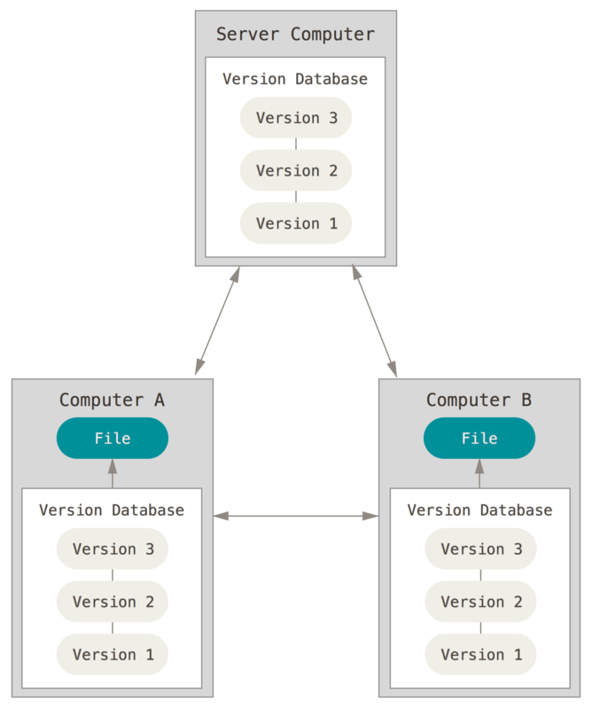
Distributed Version Control Systems

Slide 7
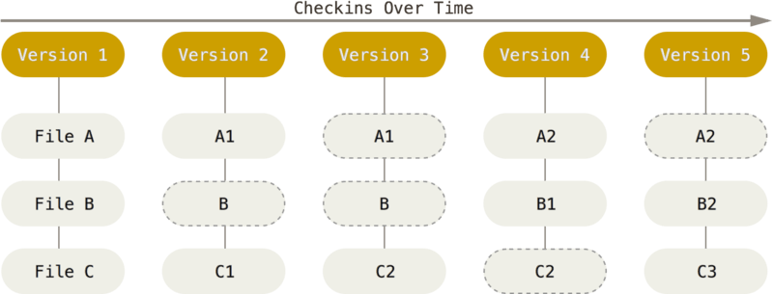
What is Git? (2)
Git thinks of its data more like a series of snapshots of a miniature filesystem. With Git, every time you commit, or save the state of your project, Git basically takes a picture of what all your files look like at that moment and stores a reference to that snapshot.

Slide 8
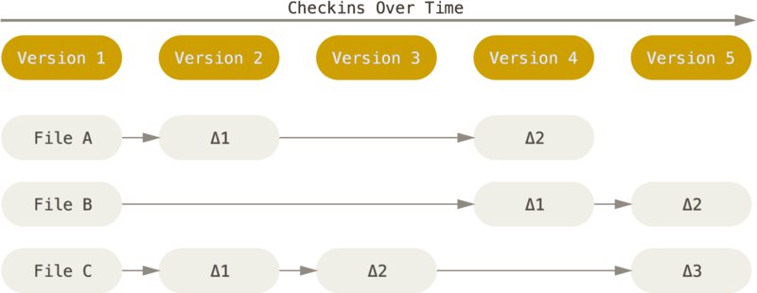
What is Git? (3)
The other systems (e.g. Subversion) think of the information they store as a set of files and the changes made to each file over time (delta-based version control).

Slide 9
What is Git? (4)
Nearly every operation is local
Git Has Integrity
Everything in Git is checksummed
This means it’s impossible to change the contents of any file or directory without Git knowing about it.
You can’t lose information in transit or get file corruption without Git being able to detect it.
Git Generally Only Adds Data
you can lose or mess up changes you haven’t committed yet, but after you commit a snapshot into Git, it is very difficult to lose, especially if you regularly push your database to another repository.
The Three States that your files can reside in
modified, staged, and committed:

Slide 10
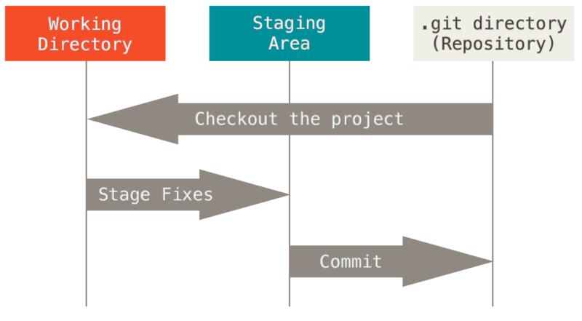

Slide 11
기본 용법들

Slide 12
이멜, 이름 세팅
$ git config --list --show-origin
$ git config --global user.name "John Doe"
$ git config --global user.email johndoe@example.com

Slide 13
What is a GIT Repository?
Repositories in GIT contain a collection of files of various different versions of a Project.
The process of copying the content from an existing Git Repository with the help of various Git Tools is termed as cloning.

Slide 14
What Is GitHub
GitHub is a for-profit company that offers a cloud-based Git repository hosting service.
GitHub is a website and cloud-based service that helps developers store and manage their code, as well as track and control changes to their code.

Slide 15
깃 리포 시작하기 (로컬에서)
$ git init
Initial commit
깃헙에서 리포 만들기
설명을 따라 리모트에 푸쉬하기

Slide 16
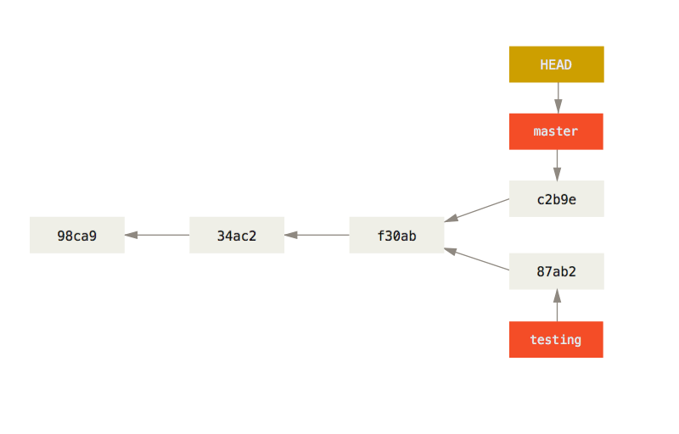
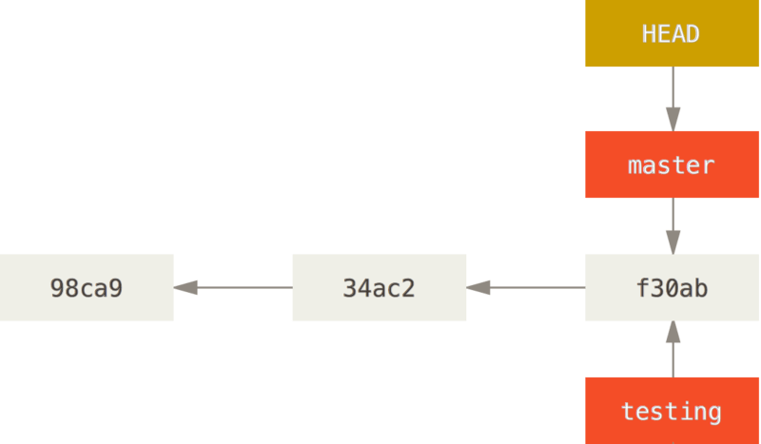
Branch
A branch in Git is simply a lightweight movable pointer to a commit.
Git keeps a special pointer called HEAD. This is a pointer to the local branch you’re currently on.

Slide 17
Branching
Branching means you diverge from the main line of development and continue to do work without messing with that main line.
Git encourages workflows that branch and merge often. (branching is super fast in git)

Slide 18
Branching
$ git branch <branch-name>
$ git checkout <branch-name> (or commit hash)
Better $ git checkout –b <branch-name>
Switching branches changes files in your working directory. If Git cannot do it cleanly, it will not let you switch at all.

Slide 19
Exercise
Do some work on a website.
Create a branch for a new user story you’re working on.
Do some work in that branch.
At this stage, you’ll receive a call that another issue is critical and you need a hotfix. You’ll do the following:
Switch to your production branch.
Create a branch to add the hotfix.
After it’s tested, merge the hotfix branch, and push to production.
Switch back to your original user story and continue working.

Slide 20
Basic merge conflicts (1/
If you changed the same part of the same file differently in the two branches you’re merging, Git won’t be able to merge them cleanly.
see which files are unmerged
$ git status

Slide 21
Basic merge conflicts (2/
Git adds standard conflict-resolution markers to the files that have conflicts
<<<<<<< HEAD:index.html
<div id="footer">contact : email.support@github.com</div>
=======
<div id="footer"> please contact us at support@github.com </div>
>>>>>>> iss53:index.html
In order to resolve the conflict, you have to either choose one side or the other or merge the contents yourself.

Slide 22
Basic merge conflicts (3/
run ”git add” on each file to mark it as resolved. Staging the file marks it as resolved in Git.
”git commit” to finalize the merge commit

Slide 23
Branch renaming
git branch --move bad-branch-name corrected-branch-name
git push --set-upstream origin corrected-branch-name
git branch –all
git push origin --delete bad-branch-name

Slide 24
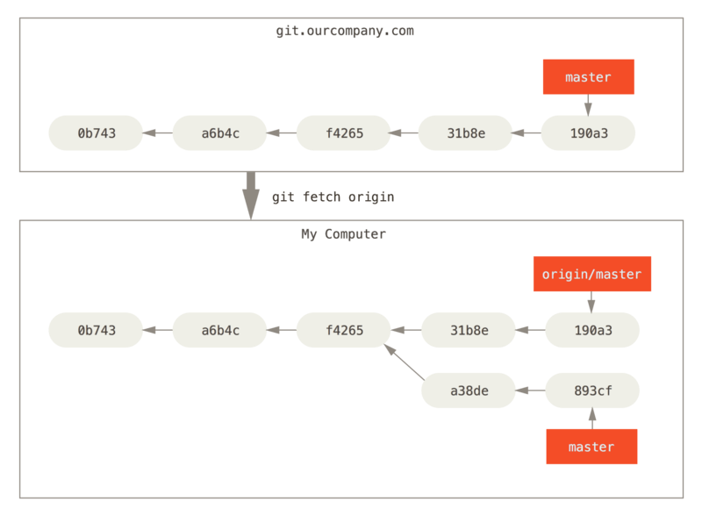
Remote branches
git fetch updates your remote-tracking branches

Slide 25
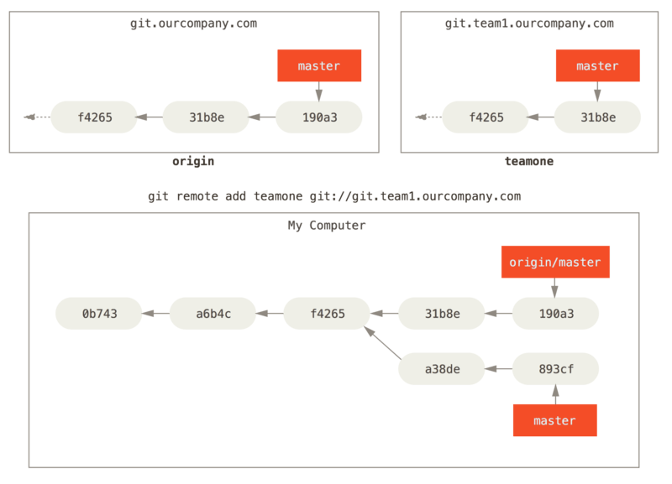
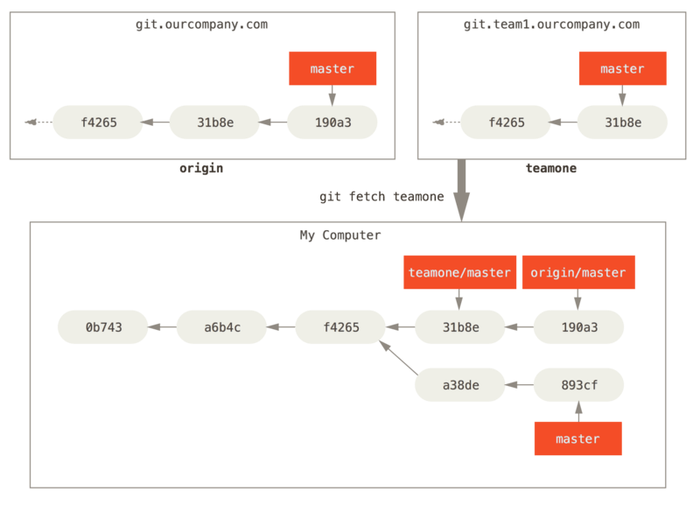
Adding another remote
git fetch updates your remote-tracking branches

Slide 26
Pushing
Your local branches aren’t automatically synchronized to the remotes you write to — you have to explicitly push the branches you want to share with others.
$ git push
$ git push <remote> <branch>
$ git push <remote> <local-branch>:<remote-branch>

Slide 27
Tracking Branches
Checking out a local branch from a remote-tracking branch automatically creates what is called a “tracking branch” (and the branch it tracks is called an “upstream branch”). Tracking branches are local branches that have a direct relationship to a remote branch. If you’re on a tracking branch and type git pull, Git automatically knows which server to fetch from and which branch to merge in.
$ git checkout -b <branch> <remote>/<branch>
If the branch name you’re trying to checkout (a) doesn’t exist and (b) exactly matches a name on only one remote, Git will create a tracking branch for you:
$ git checkout <branch>
you can use the -u or --set-upstream-to option to git branch to explicitly set upstream branch at any time.
$ git branch -u origin/serverfix

Slide 28
Pulling
essentially a `git fetch` immediately followed by a `git merge` in most cases.
`git pull` will look up what server and branch your current branch is tracking, fetch from that server and then try to merge in that remote branch.

Slide 29
Deleting Remote Branches
$ git push origin –delete <branch-name>

Slide 30
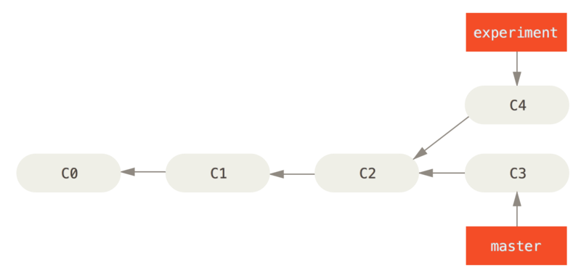
Rebasing
there are two main ways to integrate changes from one branch into another: the merge and the rebase.

Slide 31
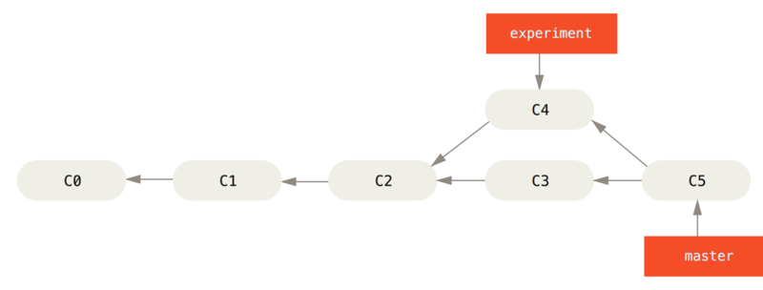
Merging to integrate diverged work history

Slide 32
Merging to integrate diverged work history

Slide 33
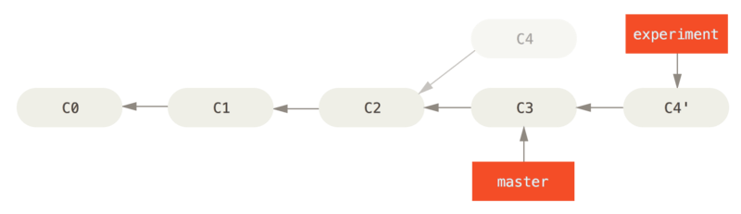
Rebasing the change introduced in C4 onto C3
With the rebase command, you can take all the changes that were committed on one branch and replay them on a different branch.

Slide 34
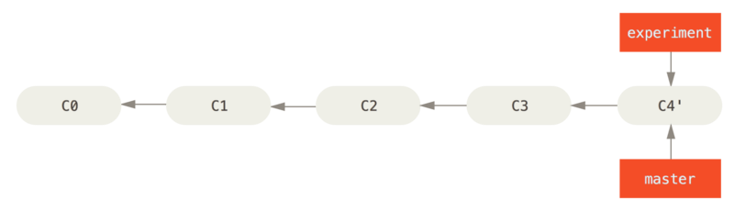
Fast-forwarding the master branch
$ git checkout master
$ git merge experiment

Slide 35
Merge & rebase, summary
Rebasing replays changes from one line of work onto another in the order they were introduced, whereas merging takes the endpoints and merges them together.
There is no difference in the end product of the integration, but rebasing makes for a cleaner history. That is, a linear history: it appears that all the work happened in series, even when it originally happened in parallel. (It’s only the history that is different.)

Slide 36
The Perils of Rebasing
Do not rebase commits that exist outside your repository and that people may have based work on.
When you rebase stuff, you’re abandoning existing commits and creating new ones that are similar but different. If you push commits somewhere and others pull them down and base work on them, and then you rewrite those commits with git rebase and push them up again, your collaborators will have to re-merge their work and things will get messy when you try to pull their work back into yours.

Slide 37
Rebase When You Rebase
Git also calculates a checksum that is based just on the patch introduced with the commit. This is called a “patch-id”.
If you pull down work that was rewritten and rebase it on top of the new commits from your partner, Git can often successfully figure out what is uniquely yours and apply them back on top of the new branch.
$ git pull –-rebase (fetch and rebase, instead of merge)
$ git config --global pull.rebase true

Slide 38
What commit history means
a record of what actually happened.
History should not be modified (tampered with)
the story of how your project was made.
Rewrite history with `rebase` and `filter-branch` to tell the story in the way that’s best for future readers.
Rebase vs. Merge
every team and every project is different.
It’s up to you to decide which one is best for your particular situation.

Slide 39
Revision selection (1)
Short SHA-1
A partial hash that is at least four characters long and unambiguous; that is, no other object in the object database can have a hash that begins with the same prefix.
Branch References
You can simply use the branch name in any Git command that expects a reference to a commit
RefLog Shortnames
“reflog” — a log of where your HEAD and branch references have been for the last few months.
$ git reflog

Slide 40
Revision selection (2)
Ancestry References
If you place a ^ (caret) at the end of a reference, Git resolves it to mean the parent of that commit.
~ (tilde). This also refers to the first parent, so HEAD~ and HEAD^ are equivalent. The difference becomes apparent when you specify a number. HEAD~2 means “the first parent of the first parent,” or “the grandparent” — it traverses the first parents the number of times you specify.

Slide 41
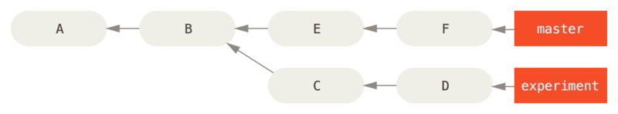
Revision selection (3)
Commit Ranges
Double Dot
a range of commits that are reachable from one commit but aren’t reachable from another.
$ git log master..experiment
D
C

Slide 42
Revision selection (4)
Commit Ranges
Triple Dot
specifies all the commits that are reachable by either of two references but not by both of them.
$ git log master…experiment
F
E
D
C

Slide 43
Stashing (1)
Stashing takes the dirty state of your working directory — that is, your modified tracked files and staged changes — and saves it on a stack of unfinished changes that you can reapply at any time (even on a different branch).
git stash or git stash push
$ git stash list
$ git stash apply
If you want to apply one of the older stashes, you can specify it by naming it
$ git stash apply stash@{2}

Slide 44
Stashing (2)
You can also have modified and uncommitted files in your working directory when you apply a stash — Git gives you merge conflicts if anything no longer applies cleanly.
to reapply the staged changes
$ git stash apply --index
The apply option only tries to apply the stashed work — you continue to have it on your stack. To remove it, you can run git stash drop with the name of the stash to remove:
$ git stash drop stash@{0}
You can also run git stash pop to apply the stash and then immediately drop it from your stack.

Slide 45
Stashing (3)
By default, git stash will stash only modified and staged tracked files. If you specify --include-untracked or -u, Git will include untracked files in the stash being created.
$ git stash -u

Slide 46
Stashing (4)
Creating a Branch from a Stash
$ git stash branch <new branchname>
This is a nice shortcut to recover stashed work easily and work on it in a new branch.

Slide 47
Cleaning
You’ll want to be pretty careful with this command, since it’s designed to remove files from your working directory that are not tracked. If you change your mind, there is often no retrieving the content of those files. A safer option is to run git stash --all to remove everything but save it in a stash.
$ git clean -f –d -x

Slide 48
Searching (1)
Git Grep
easily search through any committed tree, the working directory, or even the index for a string or regular expression.
-n or --line-number options to print out the line numbers where Git has found matches
$ git grep -n <search string>
complex combinations of strings with the --and flag, which ensures that multiple matches must occur in the same line of text.
you can search through any tree in Git, not just the working directory (e.g. an older version)

Slide 49
Searching (2)
Git Log Searching
git log command has a number of powerful tools for finding specific commits by the content of their messages or even the content of the diff they introduce.
We can use the -S option (colloquially referred to as the Git “pickaxe” option) to tell Git to show us only those commits that changed the number of occurrences of that string.
$ git log -S <search string> --oneline
If you need to be more specific, you can provide a regular expression to search for with the -G option.

Slide 50
Rewriting History (1) - Changing the Last Commit
Changing the Last Commit
If you simply want to modify your last commit message,
$ git commit --amend
If you want to change the actual content of your last commit,
first make the changes you think you forgot, stage those changes, and the subsequent git commit --amend replaces that last commit with your new, improved commit.
Amending changes the SHA-1 of the commit

Slide 51
Rewriting History (2) – Interactive rebase
Changing Multiple Commit Messages
With the interactive rebase tool, you can stop after each commit you want to modify and change the message, add files, or do whatever you wish. You must indicate how far back you want to rewrite commits.
E.g. if you want to change the last three commit messages, keep in mind that you’re designating four commits ago, the parent of the last commit you want to edit.
git rebase -i HEAD~3
Don’t include any commit you’ve already pushed to a central server — doing so will confuse other developers by providing an alternate version of the same change.

Slide 52
Rewriting History (3) – Interactive rebase
Reordering Commits
Squashing Commits
specify “squash” to apply both that change and the change directly before it and makes you merge the commit messages together.
Splitting a Commit
Change the instruction on the commit you want to split to “edit”.
Then, when the script drops you to the command line, you reset that commit (git reset HEAD^), take the changes that have been reset, and create multiple commits out of them.
and run ”git rebase –continue” when you’re done
Deleting a commit
put “drop” before the commit you want to delete (or just delete that line)

Slide 53
Rewriting History (4) – Interactive rebase
To stop rebase in the middle
git rebase --abort
a practical hands-on guide with exercises to learn how to use git rebase:
https://git-rebase.io/

Slide 54
Rewriting History (5) – filter-branch
to rewrite a larger number of commits in some scriptable way
Removing a File from Every Commit
git filter-branch --tree-filter 'rm -f <file name>' HEAD
Changing Email Addresses Globally
git filter-branch --commit-filter ' if [ "$GIT_AUTHOR_EMAIL" = "schacon@localhost" ];
then
GIT_AUTHOR_NAME="Scott Chacon";
GIT_AUTHOR_EMAIL="schacon@example.com";
git commit-tree "$@";
else
git commit-tree "$@";
fi' HEAD

Slide 55
Git Tools – Reset (1)
The HEAD
HEAD is the pointer to the current branch reference, which is in turn a pointer to the last commit made on that branch. That means HEAD will be the parent of the next commit that is created.
The Index
The index is your proposed next commit. We’ve also been referring to this concept as Git’s “Staging Area” as this is what Git looks at when you run git commit.
The Working Directory
Think of the working directory as a sandbox, where you can try changes out before committing them to your staging area (index) and then to history.

Slide 56
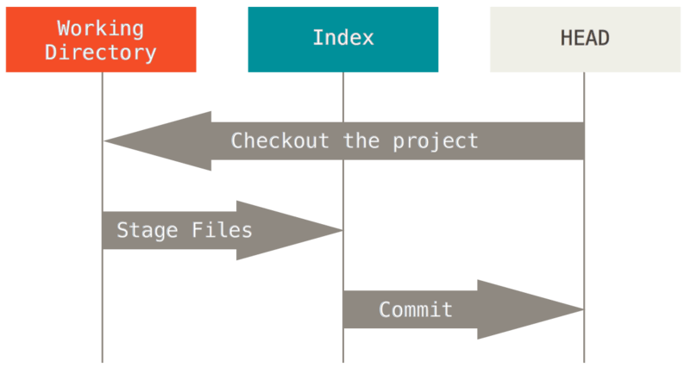

Slide 57
Git Tools – Reset (2)
The Role of Reset
Step 1: Move HEAD : git reset (--soft) HEAD~
This isn’t the same as changing HEAD itself (which is what checkout does); reset moves the branch that HEAD is pointing to
This does not changing the index or working directory (Only undoes commit)
Step 2: Updating the Index (default) : git reset (--mixed) HEAD~
update the index with the contents of whatever snapshot HEAD now points to.
Undoes commit and unstaged everything.
Step 3: Updating the Working Directory : git reset (--hard) HEAD~
Undoes your last commit, and all the work you did in your working directory.
if we had not committed it, Git still would have overwritten the file and it would be unrecoverable.

Slide 58
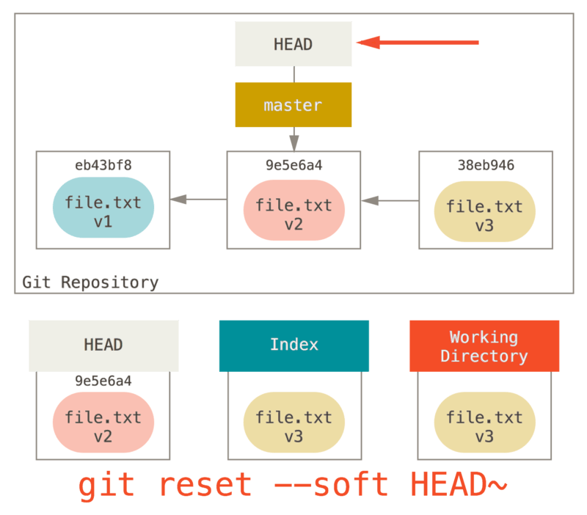

Slide 59
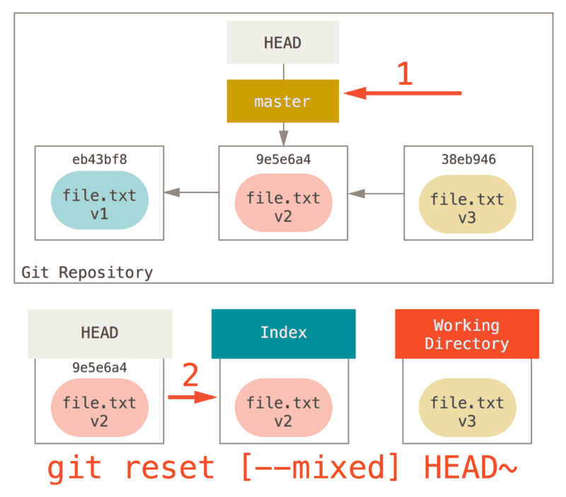

Slide 60
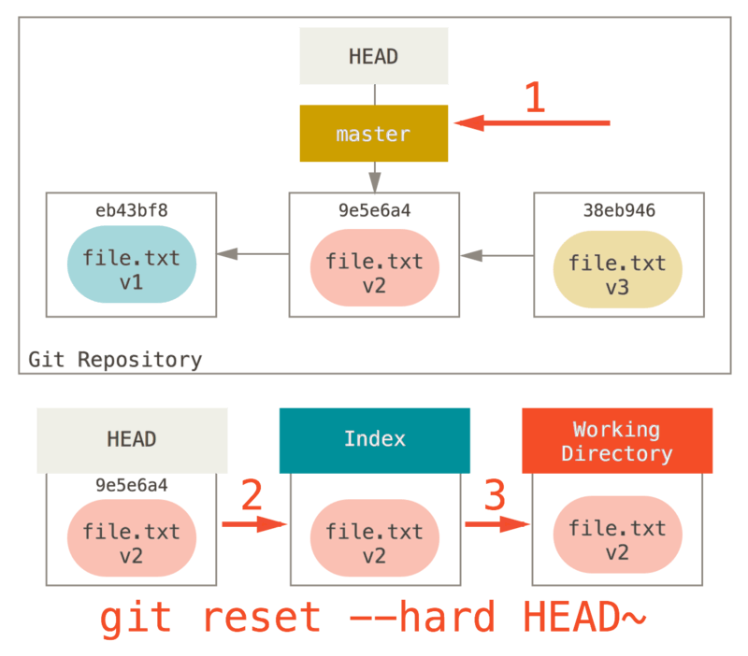

Slide 61
Git Tools – Reset (3)
Reset With a Path: git reset <path>
Shorthand for git reset --mixed HEAD <path>
Move the branch HEAD points to (skipped).
Make the index look like HEAD (stop here).
This has the practical effect of unstaging the file.

Slide 62
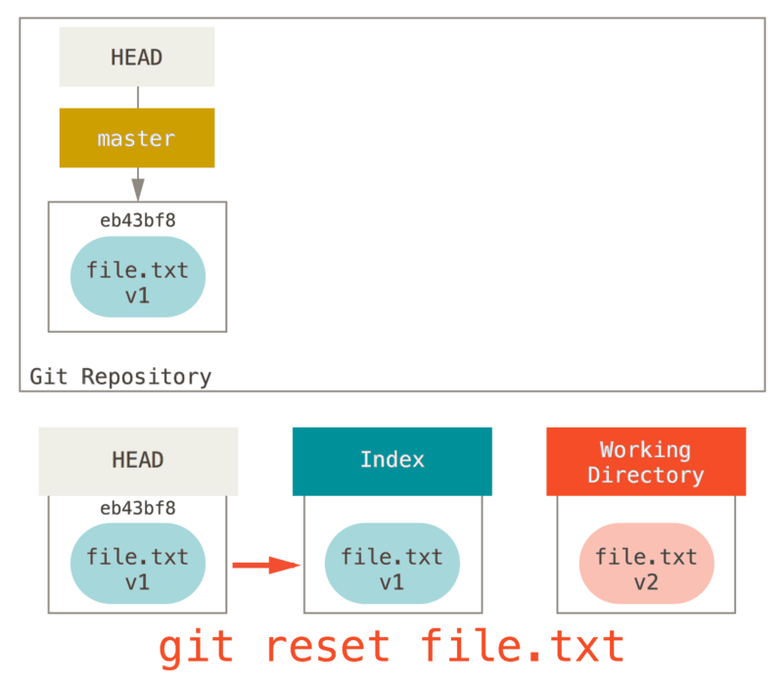

Slide 63
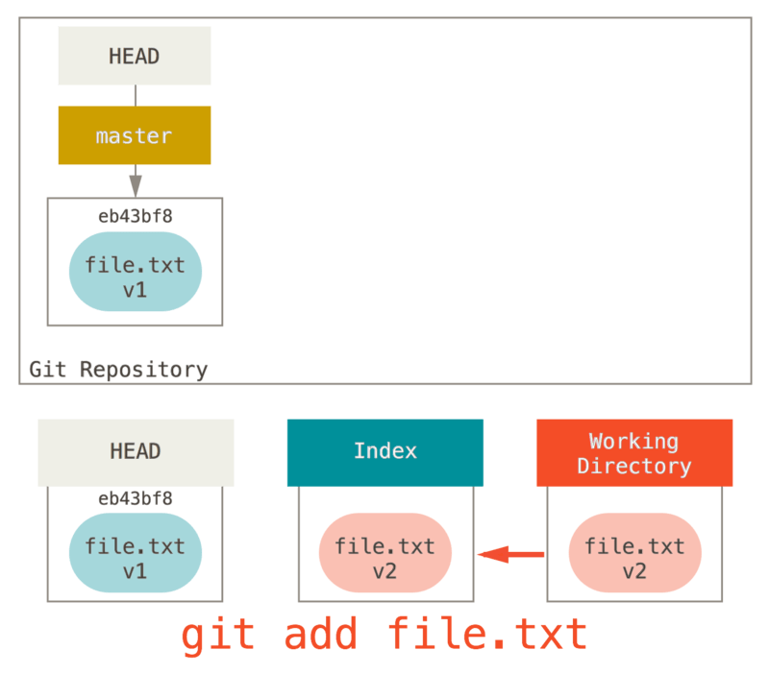

Slide 64
Git Tools – Reset (4)
Squashing
You can run ’git reset --soft <commit>’ to move the HEAD branch back to an older commit (the most recent commit you want to keep):
And then simply run ’git commit’ again:

Slide 65
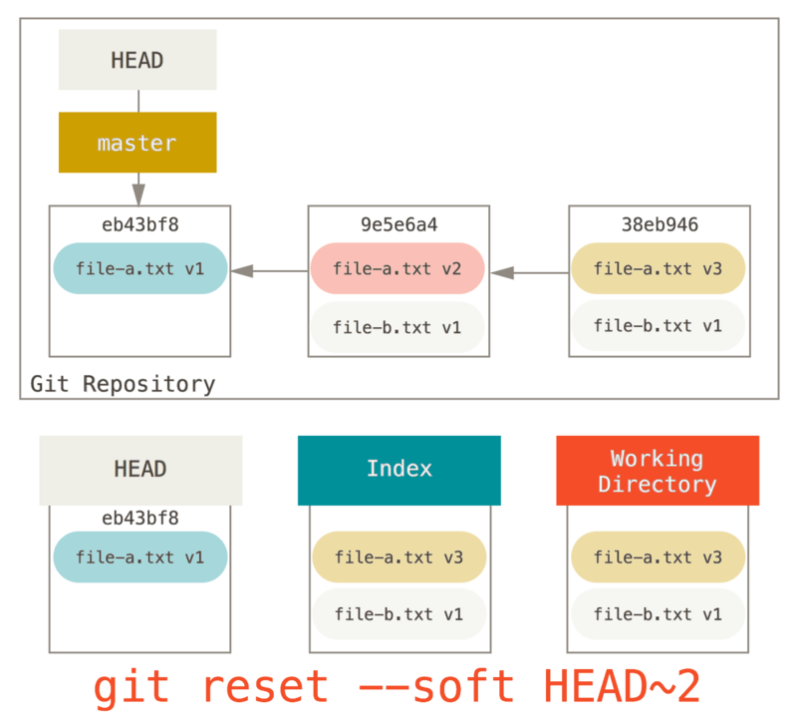

Slide 66
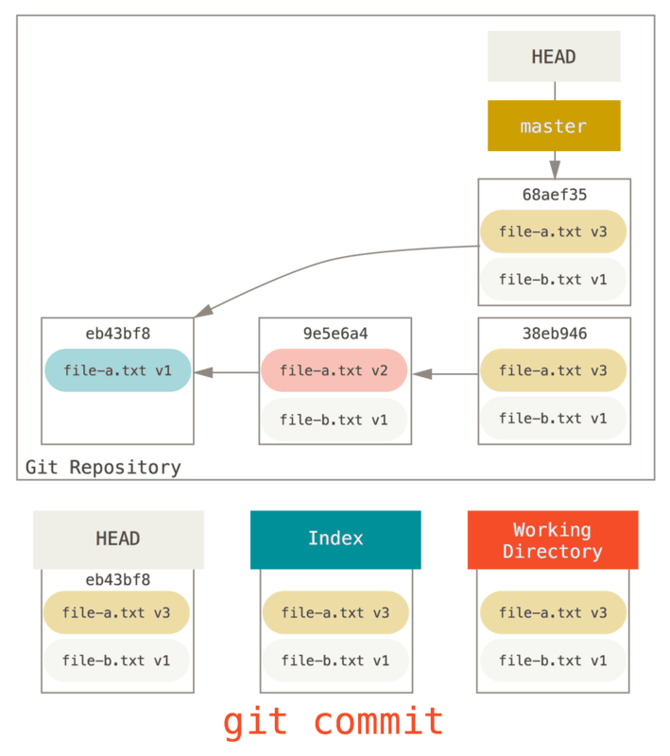

Slide 67
checkout (vs reset) (1)
Without Paths: git checkout [branch]
It updates all three trees for you to look like [branch]
First, unlike reset --hard, checkout is working-directory safe; it will check to make sure it’s not blowing away files that have changes to them.
reset will move the branch that HEAD points to, checkout will move HEAD itself to point to another branch.

Slide 68
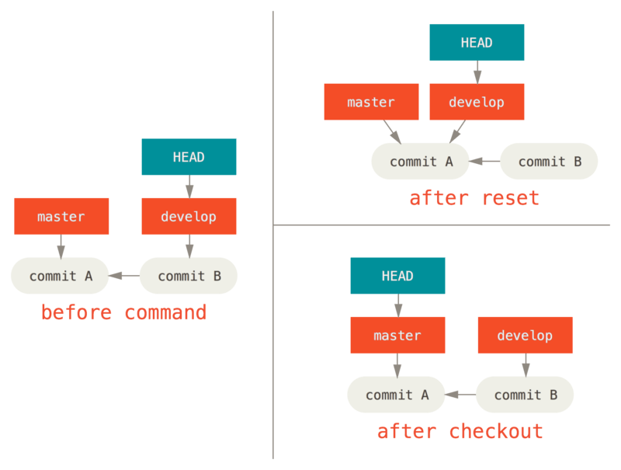

Slide 69
checkout (vs reset) (2)
With Paths: git checkout [branch] <path>
It’s like git reset --hard [branch] file (if reset would let you run that) — it’s not working-directory safe, and it does not move HEAD.

Slide 70
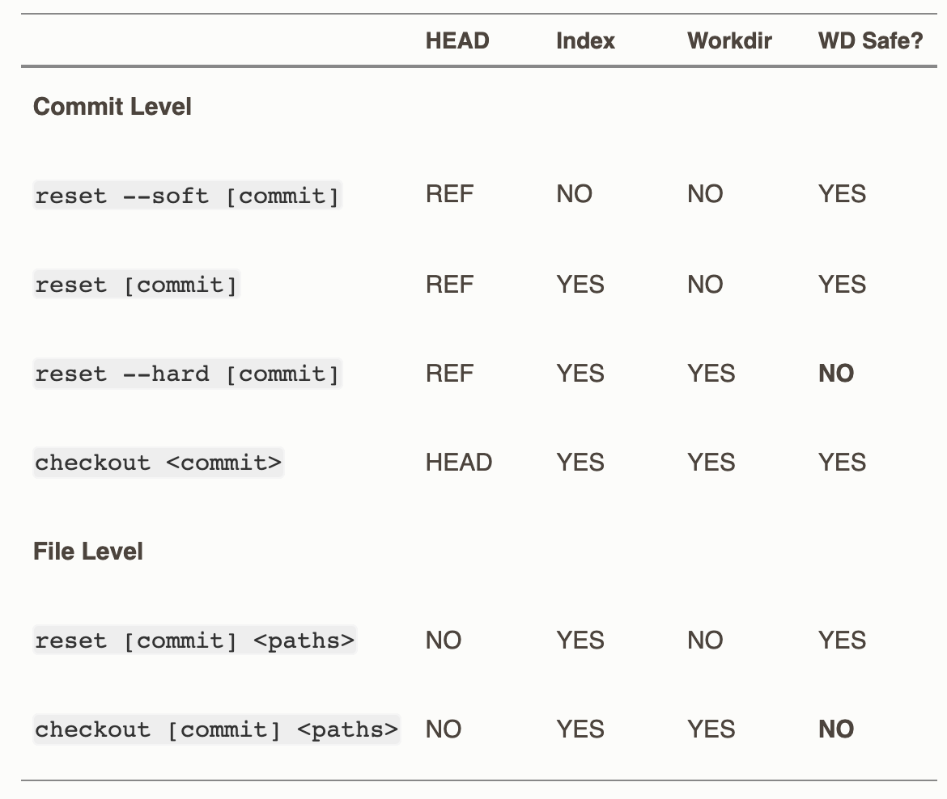
checkout (vs reset) (3)
Cheat-sheet
The “HEAD” column reads “REF” if that command moves the reference (branch) that HEAD points to, and “HEAD” if it moves HEAD itself.

Slide 71
Debugging with Git (1)
File Annotation
It shows you what commit was the last to modify each line of any file. (to know when a line was introduced and why)
git blame -L <line-number>, <line-number> <file>
You can use GUI tools (such as Github) too.

Slide 72
Debugging with Git (2)
Binary Search
The git bisect command does a binary search through your commit history to help you identify as quickly as possible which commit introduced an issue.
First you run git bisect start to get things going,
and then you use git bisect bad to tell the system that the current commit you’re on is broken.
Then, you must tell bisect when the last known good state was, using git bisect good <good_commit>:
Keep marking good commits with ’git bisect good’ and bad commits with ’git bisect bad’
Git tells you the SHA-1 of the first bad commit and show some of the commit information and which files were modified in that commit so you can figure out what happened that may have introduced this bug:
When you’re finished, you should run git bisect reset to reset your HEAD to where you were before you started, or you’ll end up in a weird state:

Slide 73
Debugging with Git (3)
Binary Search
if you have a script that will exit 0 if the project is good or non-0 if the project is bad, you can fully automate git bisect.
git bisect start <good commit> <bad commit>
git bisect run <test command>
Doing so automatically runs <test command> on each checked-out commit until Git finds the first broken commit.

Slide 74
Data Recovery (1)
Remember, anything that is committed in Git can almost always be recovered. Even commits that were on branches that were deleted or commits that were overwritten with an --amend commit can be recovered. However, anything you lose that was never committed is likely never to be seen again.

Slide 75
Data Recovery (2)
At some point in your Git journey, you may accidentally lose a commit (force-delete a branch, hard-reset a branch). Assuming this happens, how can you get your commits back?
As you’re working, Git silently records what your HEAD is every time you change it. Each time you commit or change branches, the reflog is updated. You can see where you’ve been at any time by running git reflog:
`git log –g` gives you a normal log output for your reflog.
git branch <branch name> <commit to recover>

Slide 76
Undoing things
Unstaging
git reset HEAD <file>
Unmodifying a Modified File (위험!)
git checkout -- <file>
With git restore (new)
Unstaging
git restore --staged <file>
Unmodifying a Modified File (위험!)
git restore <file>

Slide 77
Keep changes but undoing things (for now)
Branching
Stashing

Slide 78
Tagging (1)
Git has the ability to tag specific points in a repository’s history as being important. Typically, people use this functionality to mark release points (v1.0, v2.0 and so on).

Slide 79
Tagging (2)
Creating Tags
Git supports two types of tags: lightweight and annotated.
A lightweight tag is just a pointer to a specific commit.
Annotated tags, however, are stored as full objects in the Git database. They’re checksummed; contain the tagger name, email, and date; have a tagging message. It’s generally recommended that you create annotated tags so you can have all this information.

Slide 80
Tagging (3)
Annotated Tags
$ git tag -a <tag name> -m <tagging message>
You can see the tag data along with the commit that was tagged by using ’git show <tag name>`
Lightweight Tags
$ git tag <tag name>
Tagging Later
$ git tag -a v1.2 <commit>

Slide 81
Tagging (4)
Listing Your Tags (alphabetical order)
$ git tag
You can also search for tags that match a particular pattern.
$ git tag -l "v1.8.5*"

Slide 82
Tagging (5)
Sharing Tags
By default, the git push command doesn’t transfer tags to remote servers. You will have to explicitly push tags to a shared server after you have created them.
$ git push origin <tagname>
Transfer all of your tags to the remote server.
$ git push origin --tags

Slide 83
Tagging (6)
Deleting Tags
To delete a tag on your local repository, you can use
$ git tag -d <tagname>
To delete a remote tag,
$ git push origin --delete <tagname>

Slide 84
Tagging (7)
Checking out Tags
If you want to view the versions of files a tag is pointing to,
$ git checkout v2.0.0
if you need to make changes — say you’re fixing a bug on an older version, for instance — you will generally want to create a branch:
$ git checkout -b version2 v2.0.0

Slide 85
cherry-pick
Apply the changes introduced by some existing commits
$ git cherry-pick <commit>

Slide 86
깃 컨피그 (alias)

Slide 87
Git GUI (Sourcetree)

Slide 88
Demo
Add existing local repository
Staging / unstaging / discarding by files, hunks or lines

Slide 89
Git in Visual Studio Code

Slide 90
Github

Slide 91
Github
Repo 만들기
Readme.md 등 최초 커밋 푸쉬하기
파일을 깃헙에서 직접 변경해보기
Project 만들기
Board 에서 ticket (issue) 만들기
PR로 ticket (issue) 해결 하기
Comments, suggestions etc
https://lab.github.com/

Slide 92
깃 응용 용법들

Slide 93
깃헙 실습
Issue 만들기
Issue를 해결하는 PR 올리기
PR에 comments, suggestions 남기기
다른 사람 PR에 commit 올리기
Update된 main branch에 rebase 하기
Fork 하기
Upstream 리포에 피알 올리기
Upstream 따라 잡아 origin 업데이트하기

Slide 94
Rewriting history 실습
https://git-rebase.io/
Dropping, squashing, reordering, editing, rewording commits

Slide 95
끝~

