Slide 1
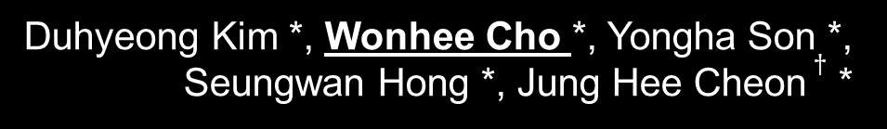
Secure Genotype Imputation using HEAAN
Duhyeong Kim *, Wonhee Cho *, Yongha Son *, Seungwan Hong *, Jung Hee Cheon $†$ *
* Seoul National University, South Korea
$†$ Cryptolab
October 26, 2019
iDASH Privacy & Security Workshop 2019
http://www.free-powerpoint-templates-design.com
Notes:
Thank you for introduction.
My name is wonhee Cho from Seoul National University.
I will talk about secure genotype imputation using HEAAN which is task 2 of idash competition.
This work is a joint work with Duhyeong Kim, Yongha Son, Seungwan Hong and Jung Hee Cheon.

Slide 2
CONTENTS
01
Overview of Genotype Imputation
02
DNN Configuration
03
Data Encoding
04
Data Windowing Technique
05
Experimental Results
Notes:
The contents consist of overview of genotype imputation, DNN configuration, Data encoding, data windowing technique and experimental results.

Slide 3
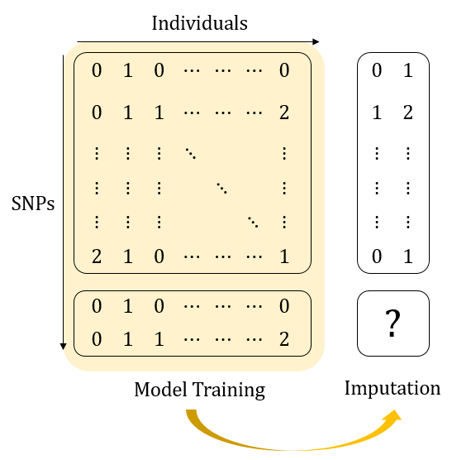
Track 2: Genotype Imputation
Goal
To predict missing genotypes.
Usually performed on single nucleotide polymorphisms(SNPs)
It can be thought of as filling in the missing parts of the matrix
Notes:
At first, I will talk about what is Genotype imputation.
Genotype imputation is to predict missing genotypes and usually performed on single nucleotide polymorphisms(SNPs).
According to this picture, data in upper box means the tag data, and below box is the target data.
Our imputation consists of two steps.
***First, model training, second, prediction.
we do model training with given data and predict missing part.
This work can be thought of as filling in the missing parts of the matrix.

Slide 4
Genotype Imputation Models
We considered…
Hidden Markov Models (HMM)
K-Nearest Neighborhood (KNN)
.. and also checked open libraries ..
IMPUTE2
Beggle
Notes:
HMM 알고리즘 – recursive 계산 -> depth 높음
KNN – 안어울렸음 (불확실 ㅠㅠ)
Open libraries : 주어진 정보 말고 추가로 다른 것들을 사용해야 했음
We considered many genotype imputation models.
Typically, there is Hidden Markov Models but HMM needs recursive computations.
Therefore, it needs high depths.
Also, we tested K-nearest neighborhood method. But it also does not fit well since it needs min/max algorithm, which costs a lot.
And open libraries such as impute2 and beggle need reference haplotyes and comparison which uses lots of depths.
Plain 상태에서 해봤을 때 별로 좋지 않았다.
Min/max 함수를 사용해야하여 뎁스가 너무 높았다.
Traning을 통해 모델을 만들기보단 reference로 지속적으로 참고해야하여 효율이 떨어짐.

Slide 5
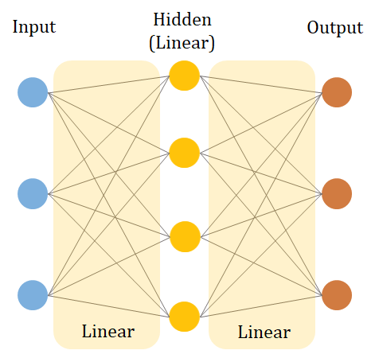
DNN Configuration
DNN configuration
Set one hidden layer with a linear activation function
Even better than ReLU
Omit the last sigmoid evaluation
Sufficient for our purpose
Our HE solution only performs one matrix multiplication!
Notes:
ReLU
Consequently, our team uses DNN algorithms for genotype imputation.
We found that DNN algorithm has many advantage for HE implementation.
First, we can test various activation functions, and we checked that linear activation function in hidden layer outputs enough accuracy.
Linear function is not only simple to calculate but also more accurate than ReLU function at the plain.
We think the characteristic of SNP data cause this situation.
Thus we Set one hidden layer with a linear activation function.
And we omit the last sigmoid evaluation because it is sufficient for our purpose.
Through the above reasons, our HE solution only performs one matrix multiplication!
실험적으로 히든레이어 하나있는게 잘됨.

Slide 6
DNN Configuration
Data Encoding
Given SNP data
Convert SNP data
Convert both target-SNPs and tag-SNPs
Greatly improves 1’s accuracy
micro-AUC: 0.8 → 0.94
Empty data in tag-SNPs?
Encoded into 000.
0
001
1
010
2
100
Notes:
** 왜 이랬냐, 그냥 돌려보니까 1의 정확도가 좀 별로다. 그 이유가 0,1,2라서 숫자의 relation이 생긴거같음.
Now, I will explain how we encoded our data.
When we apply DNN algorithm to given SNP data, the accuracy of 1 is much less than others.
We guess that the reason is when we run DNN algorithm, the numbers, 0, 1, 2 not only distinguish the SNPs but also give some orders.
In this reasons, we convert SNPs data.
Given SNP data consists of 0, 1, 2, we change them 001, 010, 100, respectively to erases their orders.
This conversion makes the size of SNP data triple but it greatly improves 1’s accuracy.
Specifically, micro-AUC of 1 increases from 0.8 to 0.94(zero point nine four).
Additionally, we fill 000 into empty data in tag-SNPs.

Slide 7
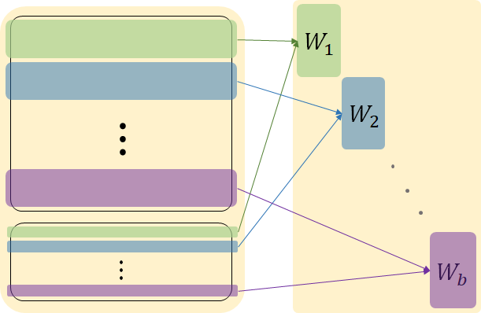
Data Windowing Technique
Data Windowing Technique
Intuition: A SNP is strongly related to close SNPs
Intuition: A SNP is strongly related to close SNPs
Tag-SNPs
Divide tag-SNPs and target-SNPs
Train models on each divided blocks
Micro-AUC: 0.757 → 0.977
Target-SNPs
Notes:
I would like to introduce data windowing technique.
Intuition is that a SNP is strongly related to close SNPs.
As many of you have already experienced, if one directly apply the DNN algorithm to tag-SNPs and target-SNPs, the accuracy is low.
Through this intuition, we divide tag-SNPs and target-SNPs and train models on each divided blocks.
.
According to this picture, we divide SNPs by color, and train models on same color blocks
Due to the above action, micro-AUC increases from 0.757(this) to 0.977(this).

Slide 8

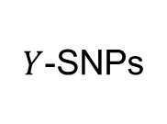
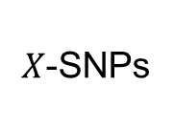

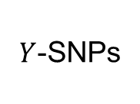
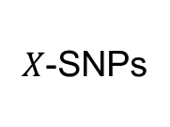
Data Windowing Technique
$Y$-SNPs
Before Windowing
Whole
Model
$X$-SNPs
$X$-SNPs
$Y$-SNPs
ind.
$$×$$
$$=$$
ind.
One large matrix multiplication
Notes:
This slide will help you understand.
Before windowing, we do one large matrix multiplication between this one and this one for prediction.

Slide 9
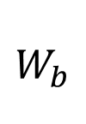


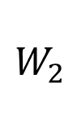



Data Windowing Technique
$Y$-SNPs
After Windowing
$$W_{1}$$
$X$-SNPs
$X$-SNPs
$$W_{2}$$
$Y$-SNPs
ind.
$$X_{1}$$
$$X_{b}$$
$$×$$
$$=$$
$$\hat{Y_{1}}$$
$$\hat{Y_{b}}$$
ind.
$$W_{b}$$
Several small matrix multiplications
Much Faster!
Notes:
After windowing, we divide tag-SNPs and target-SNPs.
This means that we do several small matrix multiplications between matrices with same color for prediction.
This technique decreases the computation cost incredibly and increases the accuracy.

Slide 10
How to divide the SNP data?
Notes:
Then how to divide the SNP data?
It can be divided into equal intervals with naïve thoughts.

Slide 11
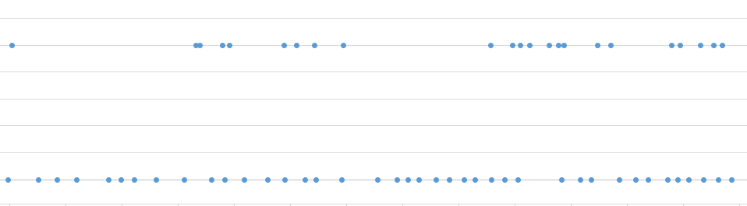
Analysis of Location of SNPs
Target-SNPs
Tag-SNPs
Divide SNPs according to their locations
Improve accuracy in 10k data : micro-AUC: 0.937 → 0.977
Notes:
But it is not the best solutions.
We analyze the location of SNPs and divide SNPs according to their locations.
Look at this picture.
In the picture, each points presents the locations of given SNPs data.
Upper part is target-SNPs and lower part is tag-SNPs.
First, we focus on location of target-SNPs and divide adjacent target-SNPs together.
And then, we divide the tag-SNPs so that it belongs to a location near the target-SNPs.
This work improves micro-AUC compared to dividing into equal intervals.

Slide 12
Analysis of Location of SNPs
num_list_x_start_10k = [0,57,83,147,153,211,265,305,312,335,364,381,397,412,423,457,467,489,498,514,530,541,558,591,598,641,651,694,725,763,786,807,878,890,921,928,966,999]
num_list_x_end_10k = [55,82,146,152,210,264,304,311,334,363,380,396,411,422,456,466,488,497,513,529,540,557,590,597,640,650,693,724,762,785,806,877,889,920,927,965,998,1044]
Notes:
These are intervals we really divided in 10k data.
We actually divided it finer, but the accuracy did not improve.
Also, cutting too finely increases the impact of empty data.

Slide 13
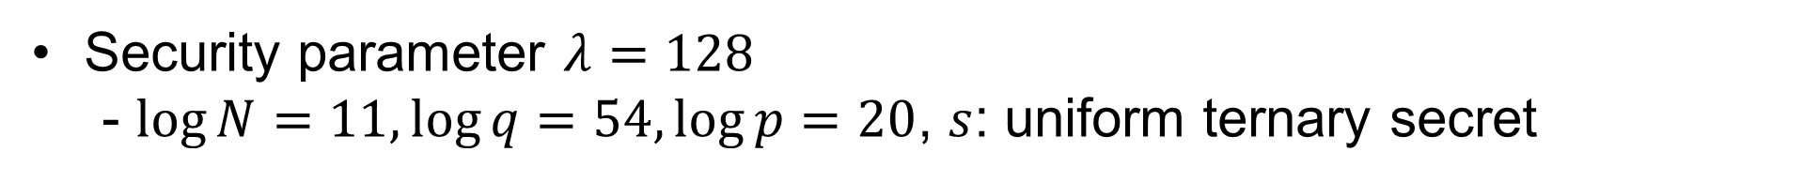
Experimental Results
Exp | Enc (sec) | Comp (sec) | Dec (sec) | Correctness via micro-AUC
 |  |  |  | 0 | 1 | 2 | total
1k SNPs | 29.4 | 47.6 | 2.5 | 0.999 | 0.996 | 0.999 | 0.998
10k SNPs | 3.8 | 22.7 | 2.2 | 0.946 | 0.946 | 0.989 | 0.977
Intel® Xeon CPU E5-2620 v4 @ 2.10GHz processor with 8 threads
Security parameter $λ=128$
- $\log{N}=11,\log{q=54, \log{p=20}}$, $s$: uniform ternary secret
Notes:
These are our experimental results.
We cut 1k SNPs to 100 intervals and 10k SNPs to 38 intervals.
Therefore, although 1k SNPs has 10 times more data, it takes twice as long.
Also, we do only one multiplication so that we could choose small the HEAAN parameters .
These values were used as HEAAN parameters and these satisfy 128 security.

Slide 14
Thank You
Notes:
Thank you for listening my presentation.

