Slide 1
META-BTS: Bootstrapping Precision Beyond the Limit
Wonhee cho¹
Joint work with Jung Hee Cheon^{1,2}, Youngjin Bae², Jaehyung Kim² and Taekyung Kim²
¹Seoul National University and ²CryptoLab. Inc.
2022. 10. 19

Slide 2
Outline
Homomorphic Encryption
CKKS scheme
Bootstrapping for CKKS
META-BTS

Slide 3







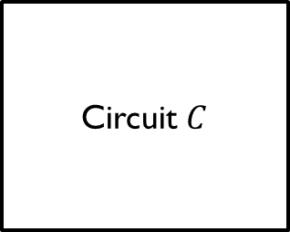
Homomorphic Encryption
Circuit $C$
$$m$$
$C(m$)
$$ct(m)$$
$$ct(C(m))$$
?
Encryption scheme which allows computing over encrypted data without decryption
Provides efficient privacy preserving computation
Notes:
They use 5 to 6 pages for only scheme description

Slide 4
CKKS scheme
3
.2
+
5
.3
=
8
.3
Encrypt
Encrypt
Decrypt
3
.3
5
.2
=
8
.1
+
Provides approximate computation
Supports SIMD addition and multiplication on complex numbers
[CKKS17] Jung Hee Cheon et.al. Homomorphic Encryption for Arithmetic of Approximate Numbers. Asiacrypt 2017
Notes:
iDash contest (2014 ~ )
Machine Learning such as logistic regression, DNN, CNN

Slide 5






Homomorphic Encryption
$$L\text{−}Level$$
Capacity of ciphertext
$$\left(L−1\right)\text{−}Level$$
Bootstrapping (BTS)
Message
$$⋮$$
$$⋮$$
Error
$$0\text{−}Level$$
Multiplication of ciphertexts consumes level(modulus)
To continue homomorphic computations, need to refresh
Notes:
They use 5 to 6 pages for only scheme description

Slide 6




Bootstrapping (BTS)
ModRaise
EvalMod
$$(mod q)$$
$$(mod \tilde{Q})$$
$$(mod Q)$$
Capacity of ciphertext
Homomorphic re-encryption of a ciphertext
Requiring a complicated combination of homomorphic operations
Bottleneck of HE application
Needs a lot of time
Hard to obtain high precision
Message
Error
$$qI$$
Error(BTS)
Notes:
Depth가 낮을수록 parallel computing에서 유리

Slide 7
Bootstrapping (BTS)
Measures of BTS efficiency
More mult. Level after BTS
Less time consuming
(level)/(BTS time) can be a rough efficiency of BTS with fixed precision
Hard to achieve high precision after BTS
Notes:
Depth가 낮을수록 parallel computing에서 유리

Slide 8
The Limit - BTS precision
Bootstrapping itself consumes modulus (level)
Limitation of ciphertext modulus with fixed ciphertext polynomial dimension N
To achieve high precision, uses more levels during BTS
Higher degree polynomial approximation
BTS (low prec.)
BTS (high prec.)
Notes:
Depth가 낮을수록 parallel computing에서 유리

Slide 9

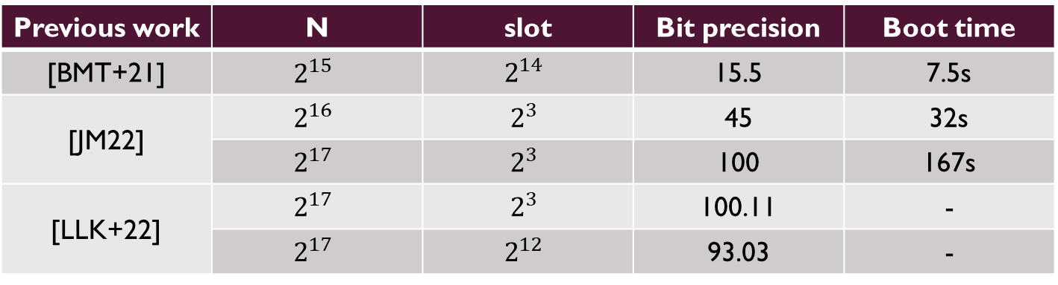
Previous work
Previous work | N | slot | Bit precision | Boot time
[BMT+21] | $$2^{15}$$ | $$2^{14}$$ | 15.5 | 7.5s
[JM22] | $$2^{16}$$ | $$2^{3}$$ | 45 | 32s
 | $$2^{17}$$ | $$2^{3}$$ | 100 | 167s
[LLK+22] | $$2^{17}$$ | $$2^{3}$$ | 100.11 | -
 | $$2^{17}$$ | $$2^{12}$$ | 93.03 | -
There are various studies to obtain high precision
Need large parameters such as $N=2^{17}$
Limit of maximum precision
[BMT+21] Jean-Philippe Bossuat et.al. Efficient Bootstrapping for Approximate Homomorphic Encryption with Non-sparse Keys. Eurocrypt 2021
[JM22] Nathan Manohar Charanjit S. Jutla. Sine Series Approximation of the Mod Function for Bootstrapping of Approximate HE. Eurocrypt 2022
[LLK+22] Joon-Woo Lee et.al. High-Precision Bootstrapping for Approximate Homomorphic Encryption by Error Variance Minimization. Eurocrypt 2022
Notes:
Depth가 낮을수록 parallel computing에서 유리

Slide 10
META-BTS
BTS (low prec.)
BTS (high prec.)
Use a low-precision BTS as a building block for a high precision BTS
Since we repeat low-precision BTS, modulus consumption of BTS is still low and we have more levels than just raising precision for each components of BTS

Slide 11

















META-BTS - case k=2
$$×\frac{1}{2^{n}}$$
1.
 | $$m_{1}$$ | $$m_{0}$$ | $$e$$
 |  | $$m_{1}$$ | $$m_{0}$$
BTS input range limit
BTS
 |  | $$m_{1}$$ | $$e_{1}$$
2.
 |  | $$m_{1}$$ | $$m_{0}$$
 |  | $$m_{1}$$ | $$m_{0}$$
 |  | $$m_{1}$$ | $$e_{1}$$
$$×2^{n}$$
 | $$m_{1}$$ | $$e_{1}$$ | $$\tilde{e}$$
3.
$$−input_{1}$$
4.
 | $$m_{1}$$ | $$e_{1}$$ | $$\tilde{e}$$
 |  | $$e_{1}$$ | $$\tilde{e}$$
BTS
5.
 |  | $$e_{1}$$ | $$\tilde{e}$$
 |  | $$e_{1}$$ | $$e_{2}$$
6.
 | $$m_{1}$$ | $$e_{1}$$ | $$\tilde{e}$$
$$−Output_{5}$$
 | $$m_{1}$$ | $$m_{0}$$ | $$\tilde{{ e}_{2}}$$

Slide 12


META-BTS
n-bit
BTS
k-times
 | $$m_{k}$$ | $$⋯$$ | $$m_{1}$$ | $$m_{0}$$ | $$e$$
 | $$m_{k}$$ | $$⋯$$ | $$m_{1}$$ | $$m_{0}$$ | $$\tilde{{ e}_{k}}$$
Given n-bit precision BTS, one can obtain a kn-bit BTS by repeating the bootstrapping algorithm k-times

Slide 13
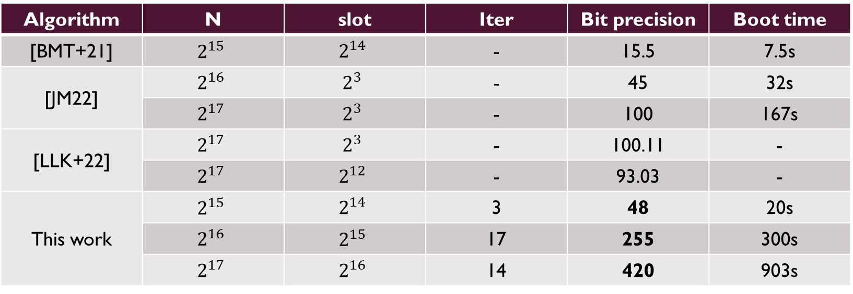
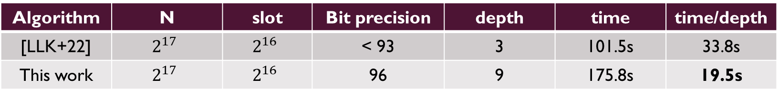
Comparison
Algorithm | N | slot | Iter | Bit precision | Boot time
[BMT+21] | $$2^{15}$$ | $$2^{14}$$ | - | 15.5 | 7.5s
[JM22] | $$2^{16}$$ | $$2^{3}$$ | - | 45 | 32s
 | $$2^{17}$$ | $$2^{3}$$ | - | 100 | 167s
[LLK+22] | $$2^{17}$$ | $$2^{3}$$ | - | 100.11 | -
 | $$2^{17}$$ | $$2^{12}$$ | - | 93.03 | -
This work | $$2^{15}$$ | $$2^{14}$$ | 3 | 48 | 20s
 | $$2^{16}$$ | $$2^{15}$$ | 17 | 255 | 300s
 | $$2^{17}$$ | $$2^{16}$$ | 14 | 420 | 903s
Algorithm | N | slot | Bit precision | depth | time | time/depth
[LLK+22] | $$2^{17}$$ | $$2^{16}$$ | < 93 | 3 | 101.5s | 33.8s
This work | $$2^{17}$$ | $$2^{16}$$ | 96 | 9 | 175.8s | 19.5s

Slide 14
META-BTS
Provides higher precision BTS under the same parameters
Improves asymptotic time complexity in BTS
More levels for multiplication left after BTS
Can use any BTS algorithm

Slide 15
The end

