Slide 1
The Grenfell Curriculum
Remembering Grenfell
Lesson 3
Notes:
Teachers may wish to hide this slide, as it will prejudice how students approach the ‘do now activity’ on the next slide.

Slide 2
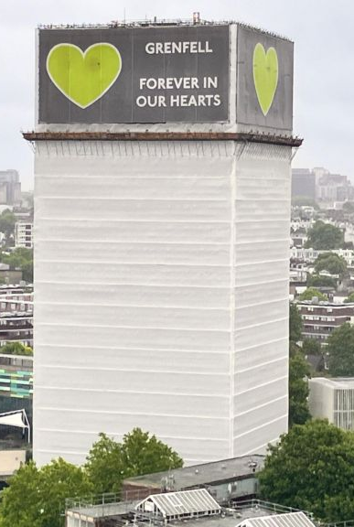
The Grenfell Curriculum
How can we challenge injustice after a national disaster?
Imagine that there had been a disaster that claimed the lives of many people and forever changed the lives of many more. This disaster was avoidable and came about through the negligence and greed of some powerful people at the expense of others.
What should happen next? Think about this on your own, before discussing it with the person next to you. Get ready to share ideas with the class!
Notes:
TIME: 10 minutes, including settling in time.
Students should write down today’s title. Students should then do a think/pair/share for the activity in the white box. They may link this explicitly to Grenfell but also to other real disasters or keep it hypothetical.

Slide 3
Learning objectives
01
KNOW
who was found responsible for the disaster at Grenfell
02
COMPARE
the Hillsborough Disaster with the Grenfell fire
03
IDENTIFY
ways to challenge injustice after a disaster like Grenfell
Notes:
TIME: 2 minutes.
Students should hear the objectives. This is also a good time to remind students of how to ask for support if this is stressful.

Slide 4
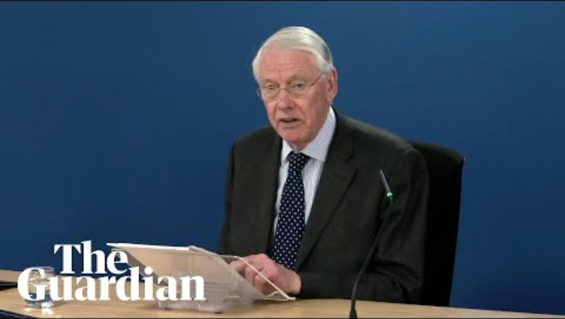
In this clip, the Chair of the Grenfell Inquiry sums up who bears responsibility for the fire and explains that all the deaths were avoidable.
“Not all of them bear the same degree of responsibility for the eventual disaster but… all contributed to in one way or another, in most cases through incompetence, but in some cases through dishonesty and greed.”
Notes:
TIME: 10 minutes.
Watch the clip with the students (Source: Grenfell deaths were avoidable, says inquiry chair). Also found here: All Grenfell deaths were avoidable - inquiry chair - BBC News.
KEY QUESTION: How do you think it might have felt to be a member of the Grenfell Community and hear about this?

Slide 5
What failures led to the disaster at Grenfell?
Warnings from residents were ignored
Fires and deaths at other high-rise buildings were not learned from
The companies who made the cladding and the insulation deliberately hid dangers and made false claims
The companies involved in the refurbishments failed to identify and act on their fire safety responsibilities
Governments cut ‘red tape’ and squandered chances to do something about dangerous cladding
The local council, The Royal Borough of Kensington and Chelsea, showed a “persistent indifference to fire safety.”
The London Fire Brigade had not properly trained firefighters and did not have a strategy to evacuate the tower when the fire was out of control.
Notes:
TIME: 5 minutes
Source: https://www.bbc.co.uk/news/articles/c049yvrd5qxo
The slide includes the different groups held responsible by the Inquiry. It is important to note that the Inquiry was not the end of the process, and neither was the Testimony Week. The community is still pursuing justice in the form of consequences for those who failed them and brought about the deaths of so many.

Slide 6
In P6, Hanan says that she does not remember being given any information on fire safety when she moved in.
In P15, 16, 20 & 22, she describes problems with the doors and windows after the refurbishment that were never dealt with.
Hanan’s Testimony
Hanan Wahabi, who was involved in the Grenfell Curriculum Project, gave testimony in the Inquiry.
Her witness statement can also is 23 pages long and made up of 74 paragraphs.
How does this link to what we have been looking at this lesson?
In P25, she explains how she and others founded the Grenfell Action Group.
Paragraphs 70-74 explain the impact of the disaster.
“You always hear that there is a difference in terms of the way people are treated depending on their social class, and their ethnicity. I never really used to believe that. I was born and raised in London; I'm a Londoner. Since the fire though, I have come to feel that people are treated differently, treated as less important, depending on their social class and ethnicity. We brought our children up to believe everyone is equal, but maybe a fire like this wouldn't have been allowed to happen if a different type of person had been living in the building.”
Notes:
TIME: 10 minutes
Source: https://webarchive.nationalarchives.gov.uk/ukgwa/20250320062715/https://www.grenfelltowerinquiry.org.uk/evidence/witness-statements-hanan-wahabi (open the IWS of Hanan Wahabi, Flat 66, Floor 9).

Slide 7
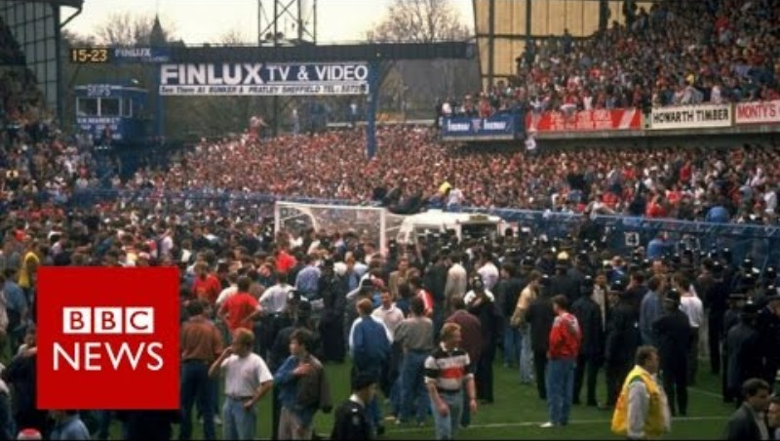
What lessons can we learn from the Hillsborough Disaster?
In many ways, the Hillsborough Disaster was different to what happened at Grenfell.
However, like Grenfell it had a huge impact on the survivors, the bereaved, and the community.
They faced lies and cover-ups, including from the police and the government, and discovered that the disaster was completely avoidable.
Overcrowding and inadequate safety measures At a football match at Hillsborough in 1989 led to a catastrophic crush. 97 people died. There was a huge cover-up and Liverpool fans were initially wrongfully blamed and accused of terrible behaviour.
Notes:
TIME: 7 minutes.
The video clip in 2 minutes long. Students may have already heard about Hillsborough. What parallels can they draw between this and what happened at Grenfell? A key link can be made to classism and the way that Liverpool fans were spoken about.

Slide 8
How have communities responded to disasters?
It took decades for the truth behind the Hillsborough Disaster to come to light and one of the great achievements of the community is the Hillsborough Law, which aims to prevent future cover-ups.
At Grenfell, the community have stayed strong in their pursuit for justice, as well as remembering the victims, the survivors and the bereaved.
This has included community projects, like the Grenfell Curriculum Project, as well as raising money and pursuing justice in the courts.
This has taken a huge toll on the community, as it did on the survivors and bereaved families of Hillsborough.
Both Disasters were more than tragedies; they were the result of negligence and dishonesty. What advice might we give anyone who finds themselves in a similar position?
Notes:
TIME: 3 minutes.
Talk through this. The next slide has a discussion and feedback activity.

Slide 9
What advice might you give anyone who finds themselves affected by a disaster like Grenfell or Hillsborough?
Notes:
TIME: 10 minutes.
Elicit ideas from the students through hands up or cold-calling (you may wish to do think/pair/share if there is time). This should focus on:
The importance of self-care throughout this process.
The need to be practical. For example, keeping hold of all paperwork that you are given.
Engage with people and groups that can help, for example your local MP or community groups.

Slide 10
Learning objectives
01
KNOW
different ways of challenging injustice
02
COMPARE
the Hillsborough Disaster with the Grenfell fire
03
CREATE
a practical guide for those affected by national disasters
Have we met these objectives today?
How have you found learning about Grenfell?
How are you feeling?
Notes:
TIME: 3 minutes.
Students should hear the objectives. This is also a good time to remind students of how to ask for support if this is stressful.

