Slide 1
The Grenfell Curriculum
Remembering Grenfell
Lesson 1
Notes:
Teachers may wish to hide this slide, as it will prejudice how students approach the ‘do now activity’ on the next slide.

Slide 2
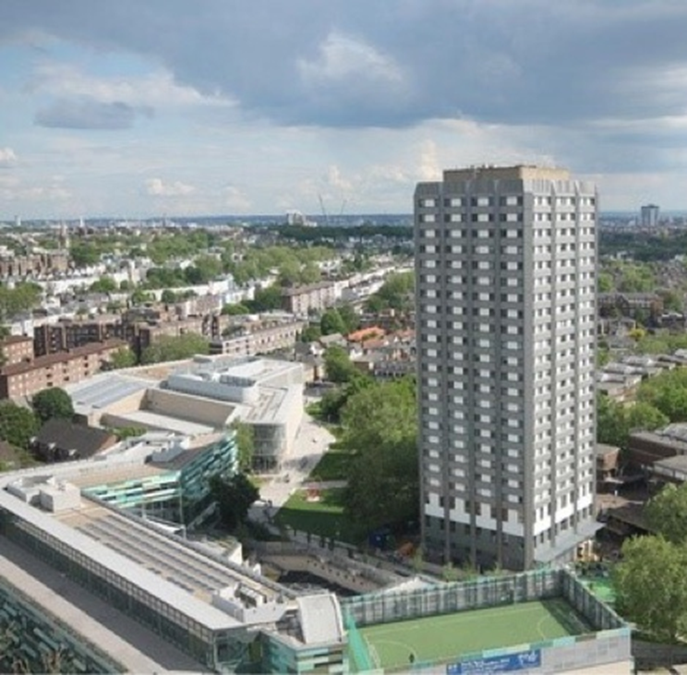
What can you see?
The Grenfell Curriculum
Spend two minutes describing what you can see in this picture.
Now, spend another two minutes discussing what you can see and any guesses you might make about what this picture shows.
This might include where it is, who lives there, and why we might be looking at it.
Does anyone recognise the Tower?
Notes:
TIME:13 minutes, including settling time.
This image is taken from Grenfell Tower, London, W11 1TQ – Regeneration Project – WITT UK Group, which describes the regeneration project in 2016. WITT were involved in the refurbishment of Grenfell.

Slide 3
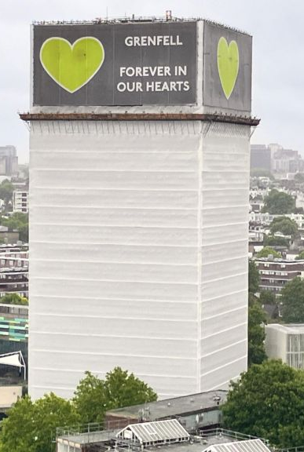
The Grenfell Curriculum
Who are the Grenfell community?
Notes:
TIME: 2 minutes.
Students should write down today’s title. We will discuss the image on the left on Slide 5

Slide 4
Learning objectives
01
KNOW
about the Grenfell community
02
UNDERSTAND
who was harmed by the fire at Grenfell
03
REFLECT
On the best way to represent and talk about Grenfell
Key Question: Talking about disasters like Grenfell can be distressing. How can we take care of ourselves during and after this lesson? Discuss this in your pairs.
Notes:
TIME: 7 minutes.
Students should hear the objectives then discuss the key question in pairs, before feeding back. PSHE/Citizenship lessons may already have class rules in place for how to manage discussions that can be distressing, so teachers may wish to refer to these. However, if there are not set classroom rules, teachers should take time now to discuss why this might be distressing for some students and what support there is place to help manage this. This should also include references to wider support networks in the school and future check-ins.

Slide 5

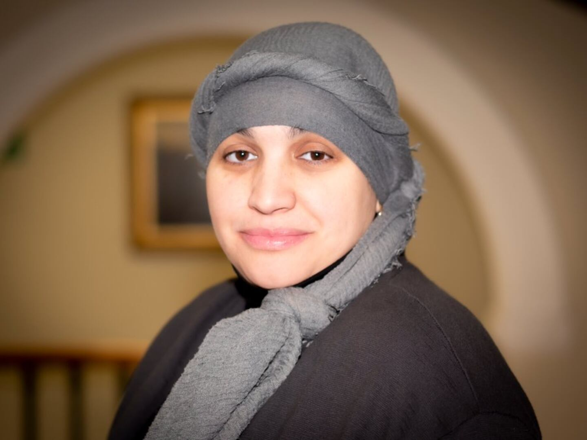
What are we learning about?
This topic will take three lessons which focus on what happened at Grenfell, what remembering Grenfell means, and how to challenge the injustice that can go with national tragedies.
These lessons are part of the project “Teaching about Grenfell: recommendations from the community.”
This project was conducted with members of the Grenfell community and researchers from Southampton and Oxford Universities.
Hanan Wahabi, a teacher who was bereaved by the disaster, represented her community on the project
Notes:
TIME: 2 minutes
Teacher talk through this slide. This sets up for a discussion in Slide 5 / the next slide.
Source: https://grenfell.soton.ac.uk/

Slide 6
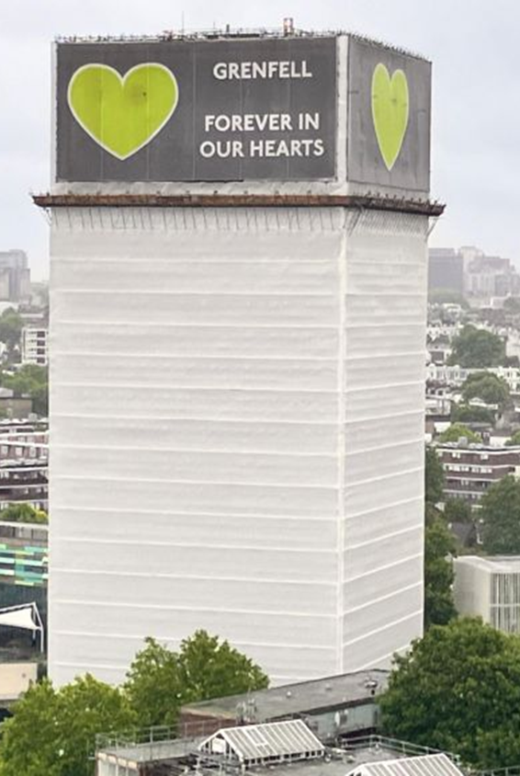
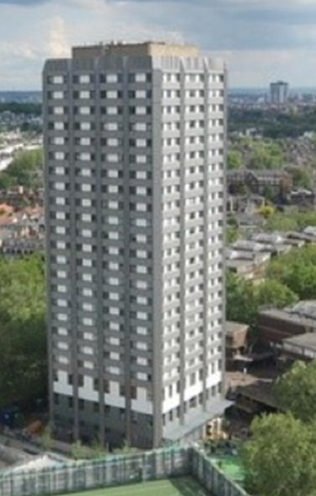
How should we show Grenfell Tower?
During these lessons you will see pictures of Grenfell.
However, we will not be looking at any pictures of Grenfell on fire or of the Tower without its protective covering.
Why do you think this is?
The Teaching about Grenfell project states:
At the time of the disaster, the news showed many photographs and videos of the fire as it was happening and afterwards.
What do you think about this?
“As a recent and ongoing national disaster, Grenfell should be taught with sensitivity and respect for those who were affected.”
Notes:
TIME: 5 minutes.
Teacher-led slide, with a focus on representation. Brief discussion with class. Note that there are no wrong answers here.
Teachers are encouraged to warn students about looking up images or footage of the fire at home, as this will likely be distressing.
Source: https://grenfell.soton.ac.uk/

Slide 7
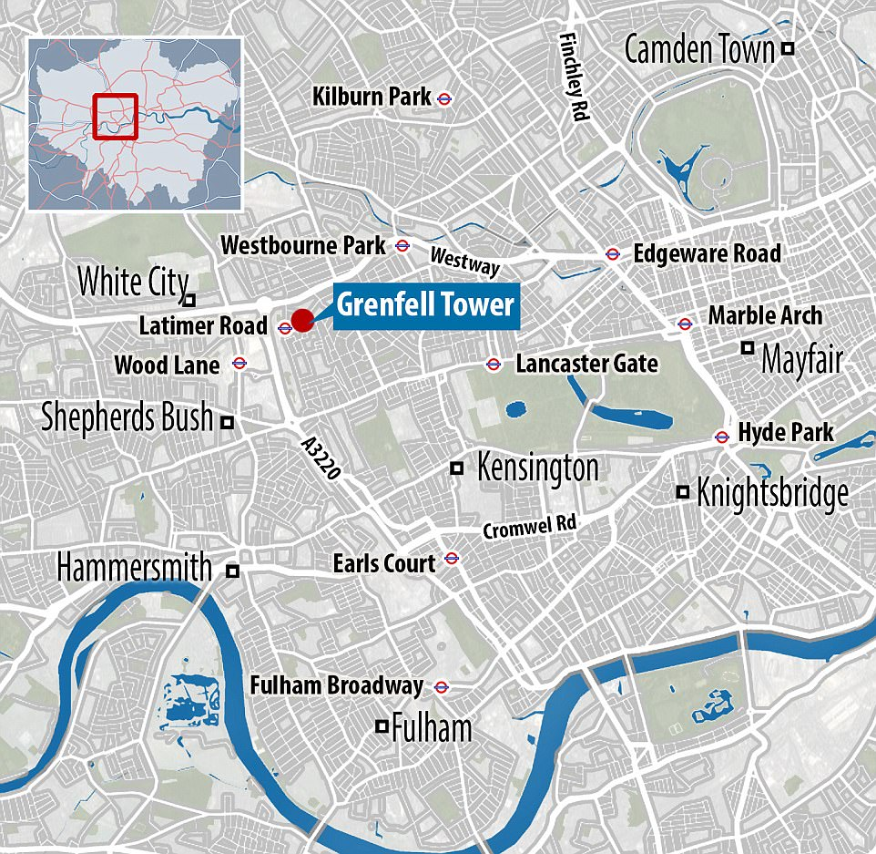
Grenfell Tower stands in North Kensington, London.
The community that lived in Grenfell Tower and who continue to live around the Tower is ‘tight-knit’; this means that people are close with their neighbours, know each other well, and look out for one another.
Importantly, the Grenfell community existed before the disaster and continues to exist after the fire.
The Grenfell Community
Notes:
TIME: 3 minutes.
Teacher-led slide. You may wish to show the map first and ask students if they recognise it as a map of London.

Slide 8
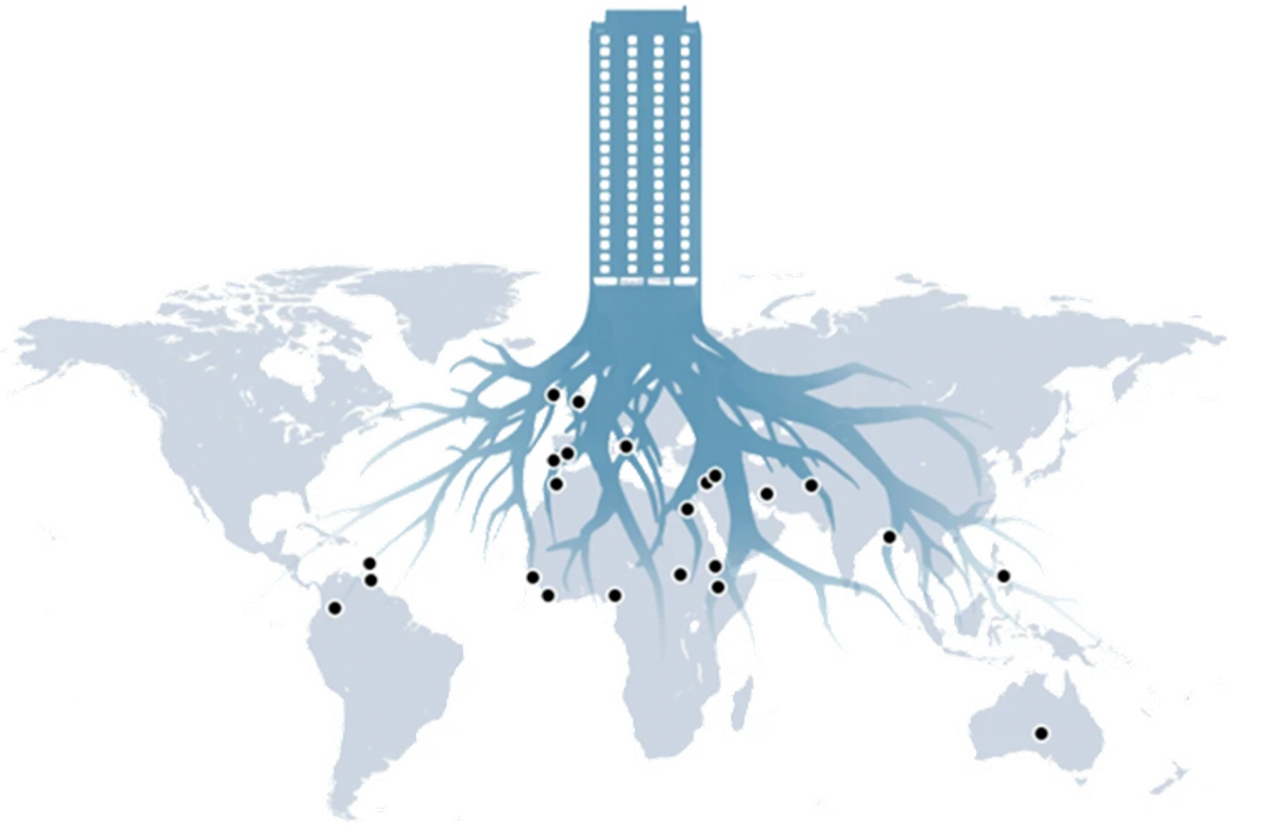
The Grenfell community is multicultural, with people of different ethnicities, nationalities, and religions all living close to one another. Some of its members are immigrants coming to the UK in search of safety or new opportunities.
Most of the people who lived in Grenfell were working class and most of the residents were from African, Middle Eastern or Asian backgrounds. Many of the flats were social housing, which means they were provided as places to live by the local council.
The Grenfell Community
Notes:
TIME: 5 minutes.
Teacher-led slide, setting up for next slide (Slide 8). This slide may need to be handled sensitively if students makes comments that are xenophobic or racist about the residents or the community. The teacher may wish to spend more time on this if needed.
Image source: https://www.bbc.co.uk/news/world-44395591

Slide 9
What led to the Grenfell disaster?
There were serious issues with the building’s safety, including the cladding. This meant that when a fire began, it swiftly covered the whole Tower.
Government, regulators, manufacturers, contractors, the building’s managers and the fire service all contributed to the conditions that made the disaster possible.
The Inquiry also found systematic dishonesty by companies that made and sold some of the products used. Residents had repeatedly raised safety concerns but were not listened to.
Crucially, residents had been raising concerns about safety – there were over 40 flagged safety concerns.
They were ignored. Why might this have happened?
Notes:
TIME: 5 minutes.
There are many reasons that may come up in this discussion but do bear in mind that we will return to this in the next two lessons. Core concerns in this are the impact of racism, xenophobia, and classism, as well as a lack of regulatory oversight for landlords, drives to lower costs for councils etc through austerity measures (using this cladding saved the council around £300,000, for example, though it should be noted that this was done with malicious intent). We will also consider the impact of state cover-up in later lessons, linking this to other disasters like Hillsborough.
This should primarily be led by the teacher.

Slide 10
Who were the victims of the Grenfell disaster?
72 people were killed in the disaster.
This article from The Guardian newspaper seeks to try and tell their story: Grenfell: the 72 victims, their lives, loves and losses | Grenfell Tower fire | The Guardian.
We are going to read this article together as a class.
As we go through, think about:
Why the writer focuses on individual stories
What this tells us about the people who died in Grenfell Tower
What it might be like to read an article like this as a survivor
Whether you think this is a useful source
What do you think about the article overall?
Notes:
TIME: 15 minutes, including reading time.
Teachers may choose to read this as a class (this may be useful in order to define some difficult words or concepts) or to allow students to read silently or in pairs. This will depend on the reading ability of the class. Similarly, while these questions are posed for reflection, teachers may choose to have students answer all or some of them in writing.

Slide 11
Learning objectives
01
KNOW
about the Grenfell community
02
UNDERSTAND
who was harmed by the fire at Grenfell
03
REFLECT
On the best way to represent and talk about Grenfell
Have we met these objectives today?
What would you like to know more about?
How is everyone feeling?
Notes:
TIME: 3 minutes to check in
Use thumb-o-meter with the whole class. If needed, remind students of additional support available to them if they need it.

