Slide 1
The Grenfell Curriculum
Remembering Grenfell
Lesson 2
Notes:
Teachers may wish to hide this slide, as it will prejudice how students approach the ‘do now activity’ on the next slide.

Slide 2
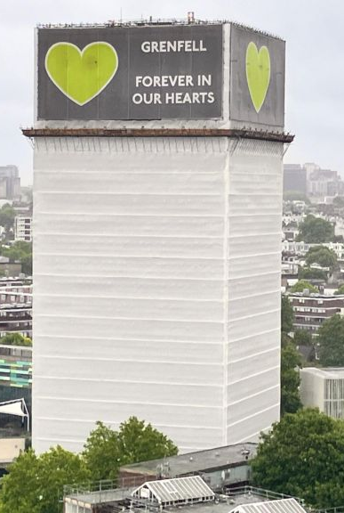
The Grenfell Curriculum
What does it mean to ‘remember’ a disaster like Grenfell?
Think back to last lesson. What can you remember about…
The Grenfell community?
What happened at the Grenfell Tower in 2017?
The victims of the disaster?
Notes:
TIME: 8 minutes
Students should write down today’s title. Students should then do a think/pair/share for the activity in the white box to recap the previous lesson. 10 minutes.
The Grenfell community are diverse/multicultural. Many of the members of the community are working class, immigrants or people of colour (or all the above). They represent a wide range of religions and ages. Crucially, the community existed before the fire and continues to exist after it.
The fire broke out in June 2017 and swiftly consumed the Tower, due to the negligent design of refurbishments, which included flammable materials and a structure that acted like a chimney.
There were 72 victims of the fire; 71 died in the Tower, one in hospital. 18 of the victims were children.

Slide 3
Learning objectives
01
KNOW
how the Grenfell disaster has been memorialised
02
CONSIDER
the phrases ‘never forget’ and ‘never again’
03
DESIGN
our own memorial to Grenfell
Notes:
TIME: 2 minutes.
Students should hear the objectives. This is also a good time to remind students of how to ask for support if this is stressful.

Slide 4
Who else was affected by the disaster?
There were around 450 survivors of the Grenfell fire (121 were children and young people).
There were around 318 people bereaved family members (100 were children or young people).
Many other people experienced grief and bereavement.
What does this quote tell us about bereavement?
“The reason that we lived separately is because we’re both Muslims, so religiously we can’t live together unless we’re married.”
“I would have thought the English law would take me into consideration and I feel like it didn’t.”
“It’s fundamental to be recognised as someone who has lost someone. Because you fall through the cracks and you don’t get the help that you need. I don’t know if I was seen as maybe less, but it’s not less than anybody else’s. You know, I lost the most special person in my life. So, I just felt like it was undermined and they didn’t understand the depth of my loss and the depth of my mental health and how much help I needed.” Anonymous Testimony, Grenfell Testimony Week.
Notes:
TIME: 5 minutes
Source for data: Source: NHS (CNWL NHS Trust) Dedicated Service (2023). Should be noted that there is not complete agreement about the numbers given by this report, due to disagreements about terminology (e.g. who ‘counts’ as bereaved).
Source for quote: Grenfell Testimony Week - Grenfell Testimony Week
Survivors refers to people who had lved in Grenfell Tower.
“Bereaved” here is the term used by the council and refers to immediate family members (siblings, parents, children, spouses); this is a limited term as there are many others who are bereaved or whose relationship as a bereaved person may not be included here. This quote invites students to think about may be affected by bereavement and sets up for the following slide.

Slide 5
What is this diagram trying to demonstrate? What do you think about it?
National community
Wider local community
Bereaved and survivors
The 72 people who died
Notes:
TIME: 10 minutes
The circles diagram was designed by the lesson-writer.
It is worth noting that there will be increasing circles of impact from this disaster and that the ripples will be felt for some time.
ACTIVITY: have students label this diagram it with who might appear in the outer circles – 3 minutes of paired work, 5 minutes class discussion.
For national community:
People who are saddened/felt grief for those who were lost, as well as those retraumatized by seeing this as they had their own terrible experiences of similar disasters whether those be disasters with high death tolls (e.g. the Hillsborough Disaster) or personal experience of fire.
Note that there was a national outpouring of grief. The Prime Minister Theresa May visited Grenfell (though there was controversy about how long it took her to visit), as did the Queen.
There were also repercussions in terms of public trust, as it became clear that the residents had been ignored, the developers had taken short-cuts and the council (the landlord) had not taken due to care that could have prevented the disaster.
May also be useful to discuss impact on people who live in buildings with similar cladding who have been unable to sell their homes or get insurance: https://www.independent.co.uk/news/uk/home-news/cladding-grenfell-insurance-bills-government-b2512005.html

Slide 6
What does it mean to ‘remember’ a disaster?
“A whole family has gone. It still feels surreal. I look up at the Tower and think about how the last time I saw them they were in their kitchen window during the fire. I was outside looking up at them. I will never forget that night. The waiting, watching the fire, the desperate calls and then running around trying to find some information about our five beloved relatives, trying to find out how they had survived.” Testimony from Yousra Chaer-Yemlahi, Grenfell Testimony Week.
Grenfell Testimony Week was a platform for those affected by the Grenfell Tower Fire in 2017 who wished to speak about the impact it has had on them and those they care about.
Representatives of defendant organisation, who many of the community hold responsible for the fire, attended but were only there to listen to testimony.
This included government bodies like the local council, the London Fire Brigade and private companies involved in the refurbishment.
Notes:
TIME: 5 minutes.
Source: Grenfell Testimony Week
Discuss the importance of Testimony Week and the sharing of testimony as part of remembrance. What do students get from Yousra’s testimony? What makes this so powerful?

Slide 7
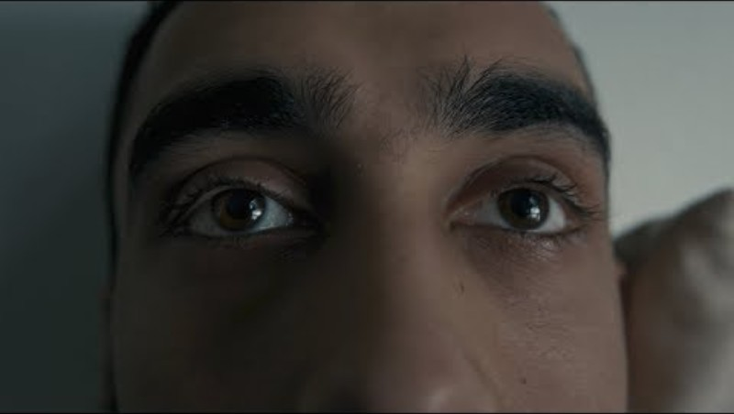
How else are the victims of Grenfell remembered?
Grenfell is remembered in many ways, including through formal events like Testimony Week.
The tragedy has also been remembered with through art, like this song by Lowkey.
There are also plans to build a Grenfell Memorial on the site of the Tower and annual silent walks are held.
Notes:
TIME: 10 minutes (this includes playing the song, which is 6 minutes long)
Source: Ghosts of Grenfell – Justice4Grenfell
“Lowkey, a North Kensington resident affected by the Grenfell disaster, brings the community together to call for justice with his latest release, Ghosts of Grenfell. Many of the local residents, key players in the community generated relief and support efforts, are featured in the accompanying video, demanding to know where are all those friends and neighbours who are still “missing”. Powerful, emotive, apposite.” quote from site above.
The Memorial and some of the challenges residents have faced with being heard by the government about the Grenfell site will be discussed in Lesson 3.

Slide 8
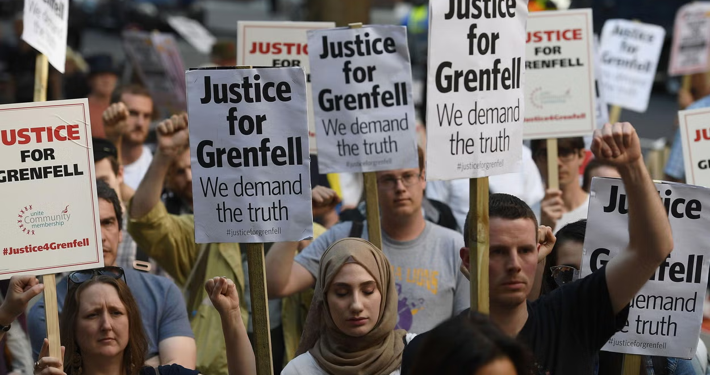
What is the purpose of remembering?
There are many reasons why we might remember a disaster like Grenfell.
What can you think of?
What is the purpose of a memorial for a disaster like Grenfell?
Never forget
This focuses on never forgetting the people who were harmed or what led to their suffering.
This focuses on never allowing a tragedy like this to happen again to anyone else.
Never again
Notes:
10 minutes
Source: Grenfell victims 'evicted from temporary housing' in move described as barbaric by activist groups | The Independent | The Independent
“Never again” will be the focus of Lesson 3.

Slide 9
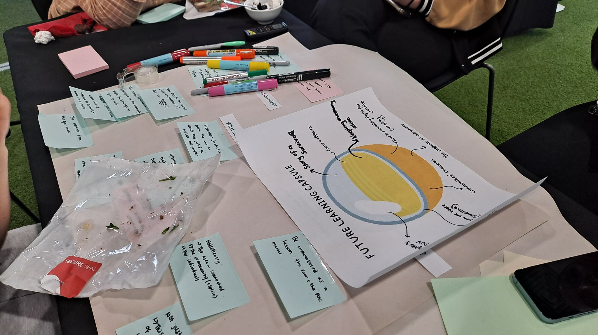
How else might we remember Grenfell?
What do you think would be a good way to remember Grenfell?
Working in pairs or small groups, discuss how you might memorialise Grenfell.
You might link this to never forget or never again or both.
As you do this, think about why this would be a good way to remember or memorialise the fire.
This picture comes from the Grenfell Education Meeting with community members, which was part of the Grenfell Curriculum Project
Notes:
TIME: 10 minutes.
This may also suit as a homework activity if there is not enough time in the lesson, or may function well as a single standalone lesson with time for students to full design their memorial and share this.

Slide 10
Learning objectives
01
KNOW
how the Grenfell disaster has been memorialised
02
CONSIDER
the phrases ‘never forget’ and ‘never again’
03
DESIGN
our own memorial to Grenfell
Have we met these objectives today?
What would you like to know more about?
How is everyone feeling?
Notes:
TIME: 2 minutes.
Check in, using thumb-o-meter with the whole class. If needed, remind students of additional support available to them if they need it.

