Slide 1
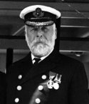
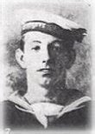
Captain Edward
Smith
Smith was a respected captain and lived in Southampton. He probably had a comfortable home being a respected and experienced captain. Smith was in charge of the Titanic and had many years of experience at sea. Being captain of Titanic was a big opportunity for Smith, he had never captained such a big and famous ship before. Smith lost his life when the ship sank.
Alfred Frank Evans
Evans lived in Southampton in a part of the city with other maritime workers, he probably lived in a small house or apartment. Evans worked as an able seaman on the Titanic, he had skills handling ropes and assisting with maintenance. The Titanic gave Evans the chance to work on a large and famous ship. He did not survive the sinking.

Slide 2
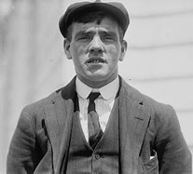
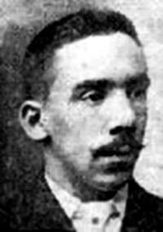
Frederick Fleet
Fleet lived in Southampton, probably in a shared boarding house. Fleet worked a lookout on Titanic, he was responsible for watching out for icebergs and other obstacles. The Titanic was a big job for Fleet. He spotted the iceberg the Titanic hit and played an important role in understanding what happened on the night it sank.
Charles Joughin
Joughin lived in Southampton with his family. He was the chief baker on Titanic. He had first gone to sea at the age of 11. He was off duty when the Titanic hit the iceberg and provided provisions for the lifeboats. He did not get onto a lifeboat but survived the sinking.

Slide 3
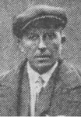
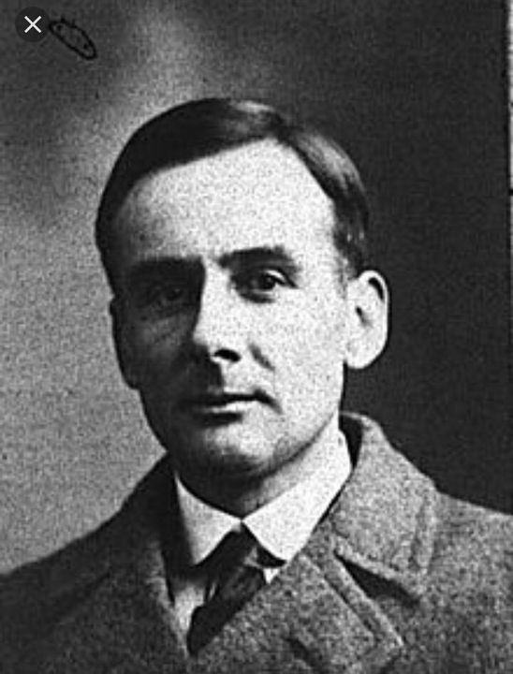
Joseph Scarrott
Joseph Boxhall
Boxhall lived in Southampton and was part of the maritime community. He was not from a wealthy background and probably lived in a boarding house near the port. Boxhall worked as a Fourth Officer. His job involved helping with navigation and looking out for dangers. The job was an exciting career opportunity, giving him a chance to gain experience on such a grand ship. He survived the sinking and later shared his knowledge of what happened.
Scarrott lived in Southampton and was from a working-class background. Scarrott worked as a fireman on the Titanic, he was responsible for looking after the boilers and engines. The Titanic provided work for Scarrott . He survived the sinking and provided testimony at the British Inquiry after his rescue.

Slide 4


Remembering Titanic Lessons © 2023 by Wonyong Park, Neta Shaby, Rachele Newman, Megan Barton, Christopher Dale, Ashleigh Fair, Natalie Harrison, Mary Shepherd and Christopher Zieba is licensed under CC BY-NC-SA 4.0. You can share and adapt the materials, as long as you give appropriate credit and do not use them for commercial purposes.

