Slide 1
Lesson title: Why was the Titanic significant to Southampton?
Objectives:
To make inferences from individual experiences about why the Titanic was significant to Southampton.
To reach a well explained judgement on why the Titanic was significant to Southampton.

Slide 2

Brain dump
What do you already know about Titanic?
Add to your notes using the video
Titanic
Notes:
The Titanic | 3 Minute History Cartoon - YouTube

Slide 3
Similarity spotters!
When we last saw
‘Significant’
what did it mean?
what was the context?
Notes:
Only use this for abstract concepts. For example: monarchy, institution, parliament, injustice, peasant, nobility, gentry, revolution, kingship, take-over, seizing power,

Slide 4
What makes something significant in History?
Remarkable | The person was talked about at the time.
Resulted in change | Something changed following their actions. This could be positive or negative.
Remembered | We know about this person today.
Revealing | We can learn about the past from them and they tell us things we otherwise might not have known.
Resonant | Links can me made between the person and life today. Their actions continue to affect/shape our lives.
Notes:
Teacher freedom to create own criteria/allow student to create their own criteria

Slide 5
What makes something significant in History?
Remarkable | The person was talked about at the time.
Resulted in change | Something changed following their actions. This could be positive or negative.
Remembered | We know about this person today.
Revealing | We can learn about the past from them and they tell us things we otherwise might not have known.
Resonant | Links can me made between the person and life today. Their actions continue to affect/shape our lives.
Notes:
Teacher freedom to create own criteria/allow student to create their own criteria

Slide 6
The launch
Southampton was a major port city and hub of the maritime industry in the early 20th Century.
The Titanic was built in the Harland and Wolff shipyard in Belfast, but Southampton was its home port.
Southampton’s port facilities were well-developed and could accommodate large ocean liners like Southampton.
On Wednesday 10th April 1912 shortly after 12noon, RMS Titanic set sail from Southampton's White Star Dock on her maiden voyage to New York.

Slide 7

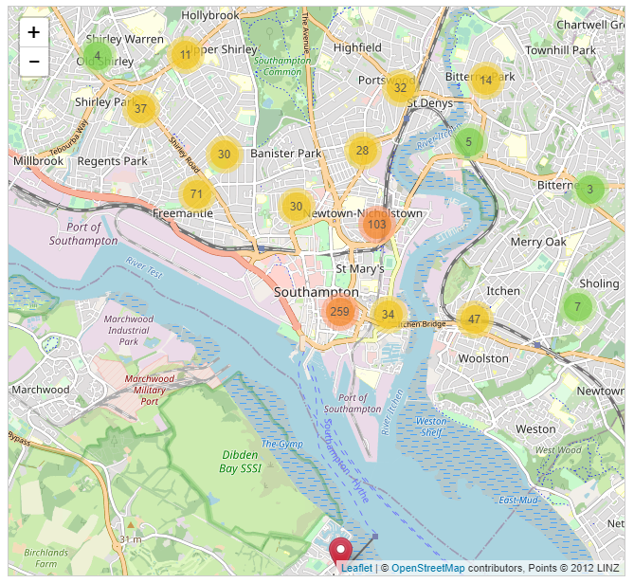
Source inference
1. What can we learn from this source about why Titanic was significant to Southampton?
2. Which details from the source are the most useful for telling us that?
3. If we use this source for a different enquiry, which other details could be more relevant?
Notes:
Interactive Map: Titanic Crew – Historic Southampton
Students can play around and explore the area.

Slide 8



Initial thoughts
Why was the Titanic significant to Southampton?
Example:
I didn’t realise…

Slide 9
Individual focus task
Read about each individual from Southampton and their experience of Titanic.
What do they reveal about Southampton at the time Titanic set sail?
What can you infer about how Titanic changed the lives of people in Southampton?
What can you infer about why Titanic would have been remarkable in Southampton?
Notes:
Questions can be tweaked if different criteria is being used
Task could be delivered in a number of ways: Individual, group work, pupils take on an individual

Slide 10
Individual | What do they reveal about Southampton at the time Titanic set sail? | What can you infer about how Titanic changed the lives of people in Southampton? | What can you infer about why Titanic would have been remarkable in Southampton?
Edward Smith
Joseph Boxhall
Frederick Fleet
Alfred Frank Evans
Joseph Scarrott
Charles Joughin

Slide 11
Which statement matches your understanding the most?
Titanic was significant to Southampton because it created new jobs for the people who lived there.
Titanic was significant because it united the city in grief
Titanic was significant because it brought in more money to the city of Southampton
Titanic was significant to Southampton as a lot of people would have been talking about the city following the ship’s launch and sinking
I have a different idea and I can explain it…

Slide 12
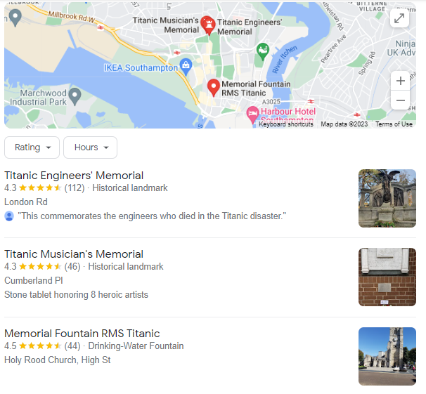
Why is the Titanic significant to Southampton today?

Slide 13


Remembering Titanic Lessons © 2023 by Wonyong Park, Neta Shaby, Rachele Newman, Megan Barton, Christopher Dale, Ashleigh Fair, Natalie Harrison, Mary Shepherd and Christopher Zieba is licensed under CC BY-NC-SA 4.0. You can share and adapt the materials, as long as you give appropriate credit and do not use them for commercial purposes.

