Slide 1
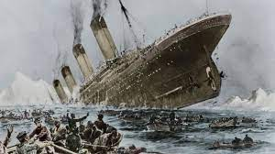
Title – Why was the sinking of the Titanic a disaster?
Do now
Bullet point x3 ways in which the Titanic made an impact to Southampton
Notes:
This lesson is in 2 parts:
1’st part – how It sank
2ns part – why it became such a disaster

Slide 2
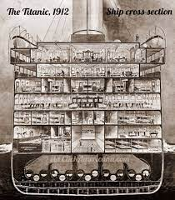
At the time of her construction, the Titanic was the largest ship ever built. It was 230m long, 25 stories high, and weighed 46,000,000 kg.
The ship’s modern design and technology included sixteen watertight compartments in her lower section that could easily be sealed off in the event of a punctured hull and deemed her unsinkable.

Slide 3
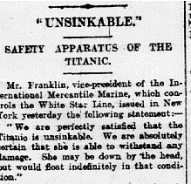
Why did they think she was unsinkable?

Slide 4
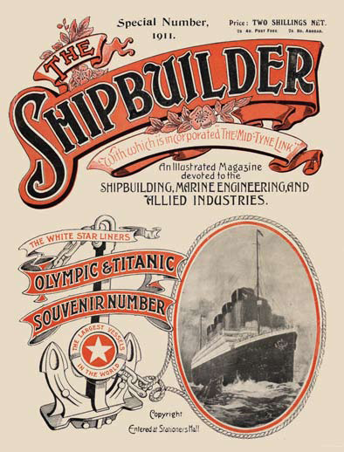
Why did they think she was unsinkable?
The shipbuilders Harland and Wolff insist that the Titanic was never advertised as an unsinkable ship.
They claim that the 'unsinkable' myth was the result of people's interpretations of articles in the Irish News and the Shipbuilder magazine. They also claim that the myth grew after the disaster.

Slide 5
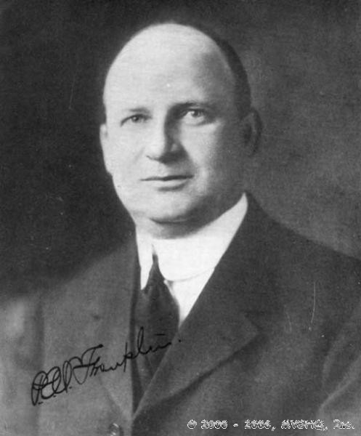
Yet, when the New York office of the White Star Line (the company that owned the ship) was informed that Titanic was in trouble, White Star Line Vice President Franklin announced:
"We place absolute confidence in the Titanic. We believe the boat is unsinkable."

Slide 6
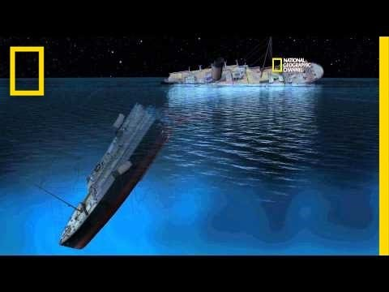
So, how did the unsinkable sink?
Notes:
https://www.youtube.com/watch?v=FSGeskFzE0s – how did it sink? Simple explanation of how it san before the second part of the lesson looking at why it was a disaster
Students could use this to write out what happened as th ship went down.

Slide 7
Why did it become such a disaster?
The definition of a disaster is –
a sudden accident or a natural catastrophe that causes great damage or loss of life.
Can you think of another example?
What is a disaster?

Slide 8
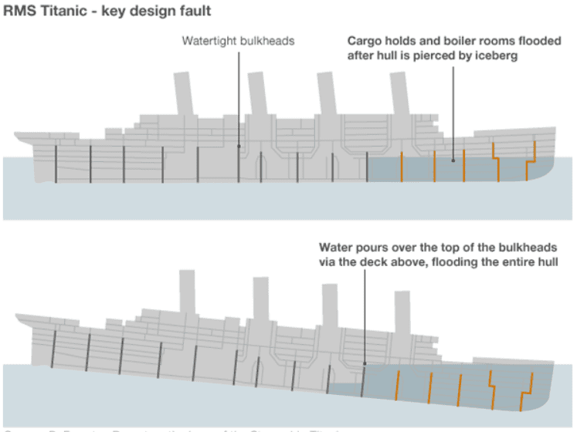
Notes:
Extra support for video if needed/recap. Simple explanation of how it san before the second part of the lesson looking at why it was a disaster

Slide 9
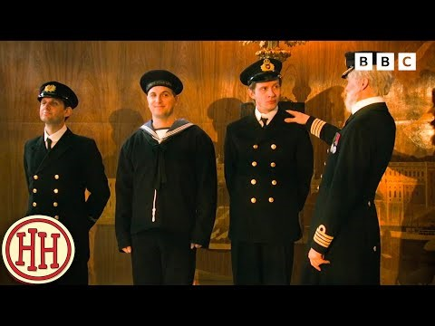
Task
From this video, mind map as many ways as you her about how unprepared the ship was
Why did it sink?
Why was it such a disaster?
Notes:
Then, mind map on the board their findings

Slide 10
Why was it such a disaster?
How could it be argued that this becoming a disaster could have been avoided?
Notes:
Looking for the answer - preparation

Slide 11
Why was it such a disaster?
Using the reasons you have come up with, along with mine below, you need to do the following:
Categories your points into:
Before departure
During the collision
After the collision
Answer in your books giving multiple reasons as your evidence – Why did the sinking of the Titanic become such a disaster?
Iceberg
Steel Rivets
Warnings ignored from other ships nearby
Not enough lifeboats
Weren’t filling up the lifeboats
Not enough searchlights
Going too fast
Other ships had radios turned off so could not hear Titanic distress call
Temperature of the sea (-2)
No second skin
Lookout did not have binoculars

Slide 12
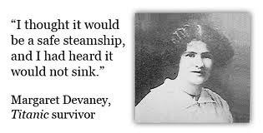
Whatever the origin of the belief, there is no doubt that people did believe Titanic to be unsinkable.
Passenger Margaret Devaney said "I took passage on the Titanic for I thought it would be a safe steamship and I had heard it could not sink."

Slide 13
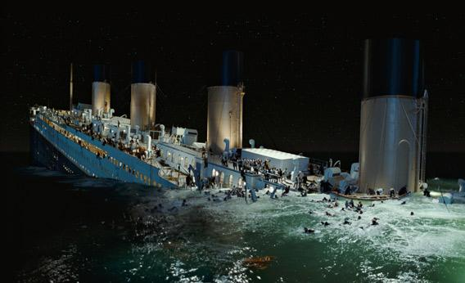
Reflection…
What was the main 3 reason that this became such a disaster?
Support your choices with evidence

Slide 14


Remembering Titanic Lessons © 2023 by Wonyong Park, Neta Shaby, Rachele Newman, Megan Barton, Christopher Dale, Ashleigh Fair, Natalie Harrison, Mary Shepherd and Christopher Zieba is licensed under CC BY-NC-SA 4.0. You can share and adapt the materials, as long as you give appropriate credit and do not use them for commercial purposes.

