Slide 1
Lesson 3:Who was most to blame for the sinking of the Titanic?
Recall Quiz
What was one design flaw for the Titanic that contributed to it being such a tragedy?
Which company owned the Titanic?
What was J Bruce Ismay alleged to have ordered the captain to do?
Why didn’t the California (a nearby ship) help?
How much would a first class ticket have been in modern money?

Slide 2
Lesson 3:Who was most to blame for the sinking of the Titanic?
Recall Quiz
What was one design flaw for the Titanic that contributed to it being such a tragedy? Watertight Bulkheads
Which company owned the Titanic? White Star Line
What was J Bruce Ismay alleged to have ordered the captain to do? Increase ship's speed
Why didn’t the Californian (a nearby ship) help? The distress signal was never received as Californian turned their radio off
How much would a first class ticket have been in modern money? £850 in 1912 equating to £105,000 in today's money

Slide 3
Lesson 3:Who was most to blame for the disaster of the Titanic?
Objectives:
To construct an interpretation as to who was most to blame for the Titanic disaster
To compare and critically analyse British and American enquiries
Notes:
Rationale: Throughout this lesson, students will build on their prior learning from the previous lessons looking at why the Titanic disaster happened and why it was significant. Using the different cause factors identified in lesson 2, students will now apportion blame for these errors, building to them creating their own interpretation of “Who was to blame”. Students will then have the chance to compare their interpretation to two real life views, that of the US and British enquiries into the disaster.

Slide 4




CORE VOCAB
Culpable | When someone is to blame for something
Interpretation | The different viewpoints people have of an event

Slide 5
Who was to blame for it being such a major disaster?

Slide 6
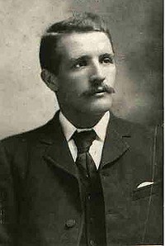
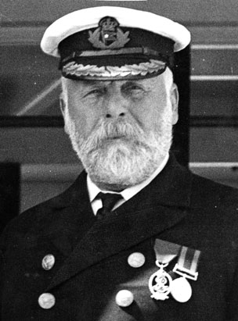
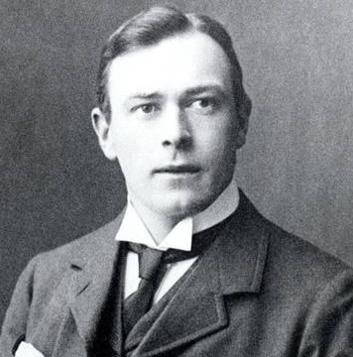
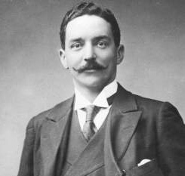
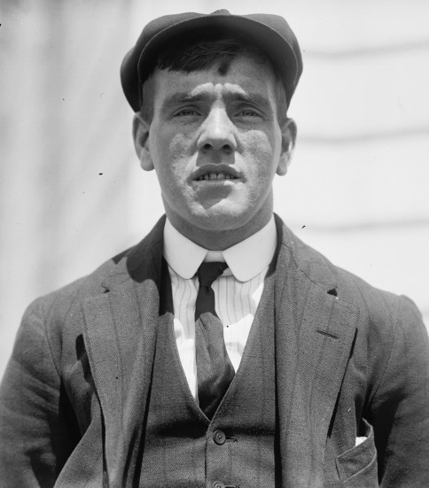
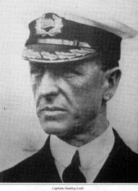
Captain Smith
The Ship's Captain
Thomas Andrews
The Ship's designer
William Murdoch
First Officer
J Bruce Ismay
Chairman of White Star Line
Frederick Fleet
The Lookout
Stanley Lord
Captain of the Californian

Slide 7
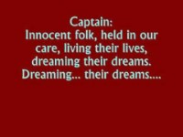
Notes:
Listen to the song and read through the lyrics
Who does it suggest could be to blame for the Titanic disaster?
What reasons does it give for blaming these people?

Slide 8
Problem | Who was to blame? Why? | What could have been done differently?
Many lifeboats were being launched with very small numbers of people being on them. If they had been filled up, many more lives could have been saved. Only 50 members of the crew had been trained to man the lifeboats and there had been no drill
The ship only had 20 lifeboats, which was only enough for about half of the passengers. There should have been more, but they were removed to make more space for first class passengers
Bruce Ismay was overheard suggesting to Captain Smith that he should sail the ship at full speed so as they could reach New York sooner than expected. This meant that the ship did not have enough time to steer clear of the iceberg.
The lookouts were not provided with binoculars as these had been locked away. The ship was also not fitted with a search light, making it impossible to see the iceberg.
The nearest ship, the California, sent out an ice berg warning. However, they then turned their radios off, meaning the Titanic could not contact them. When they saw the flares, they assumed they were fireworks and ignored them. If they had noticed the distress signals, there would have been enough time to save everyone on board
First Officer William Murdock had been left in charge of the ship. When he was notified of the ice berg straight ahead, he steered to try and avoid it, meaning the ice berg hit the side of the ship, smashing it open. Some experts believe if they had hit it head on, they would have broken through it and caused no damage to the ship.
There were some major errors with the design and build of the ship. One of these is that poor quality rivets were used to connect the panels, which broke easily. Secondly, the water tight compartments were smaller than they should have been to make more room for first class passengers.
Although Smith was an experienced Captain, he had never sailed a ship as large as the Titanic. He nearly collided with another ship in the first few days, and had previously had this same problem when captaining the Olympic. He also ignored 7 iceberg warnings and was actually asleep when it hit the iceberg.

Slide 9
Who do you think was to blame?
Why?

Slide 10
American Inquiry
The report's key findings were:
A lack of emergency preparations had left Titanic's passengers and crew in "a state of absolute unpreparedness", and the evacuation had been chaotic: "No general alarm was given, no ship's officers formally assembled, no orderly routine was attempted or organized system of safety begun."
The ship's safety and life-saving equipment had not been properly tested.
Titanic's Captain Edward Smith had shown an "indifference to danger [that] was one of the direct and contributing causes of this unnecessary tragedy."
The lack of lifeboats was the fault of the British Board of Trade, "to whose laxity of regulation and hasty inspection the world is largely indebted for this awful tragedy."
The SS Californian had been "much nearer [to Titanic] than the captain is willing to admit" and the British Government should take "drastic action" against him for his actions.
J. Bruce Ismay had not ordered Captain Smith to put on extra speed, but Ismay's presence on board may have contributed to the captain's decision to do so.
The report was strongly critical of established seafaring practices and the roles that Titanic's builders, owners, officers and crew had played in contributing to the disaster. It highlighted the arrogance and complacency that had been prevalent aboard the ship and more generally in the shipping industry and the British Board of Trade. However, it did not find White Star Line negligent under existing maritime laws, as they had merely followed standard practice, and the disaster could thus only be categorised as an "act of God"

Slide 11
British Inquiry
The report found that Titanic's sinking was solely the result of colliding with the iceberg, not due to any inherent flaws with the ship, and that the collision had been brought about by a dangerously fast speed in icy waters:
The Court, having carefully inquired into the circumstances of the above mentioned shipping casualty, finds, for the reasons appearing in the annex hereto, that the loss of the said ship was due to collision with an iceberg, brought about by the excessive speed at which the ship was being navigated.”
It also found that the lookout being kept was inadequate given the navigational hazards Titanic faced, and that the ship's officers had been complacent. There were too few lifeboats available and they had not been properly filled or manned with trained seamen, though they had been lowered correctly. The inquiry concluded that Californian "could have pushed through the ice to the open water without any serious risk and so have come to the assistance of the Titanic. Had she done so she might have saved many if not all of the lives that were lost
The Mersey report did not condemn the failures of the Board of Trade, the White Star Line or Titanic's captain, Edward Smith. The report found that although Smith was at fault for not changing course or slowing down, he had not been negligent because he had followed long-standing practice which had not previously been shown to be unsafe. It concluded that Smith had merely done "only that which other skilled men would have done in the same position”.

Slide 12
Who does the American Inquiry blame for the Titanic disaster? Why?
Who does the British Inquiry blame for the Titanic disaster? Why?
Why do you think these might have different interpretations about who was to blame?

Slide 13
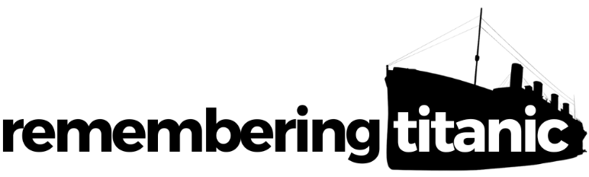

Remembering Titanic Lessons © 2023 by Wonyong Park, Neta Shaby, Rachele Newman, Megan Barton, Christopher Dale, Ashleigh Fair, Natalie Harrison, Mary Shepherd and Christopher Zieba is licensed under CC BY-NC-SA 4.0. You can share and adapt the materials, as long as you give appropriate credit and do not use them for commercial purposes.

