Slide 1
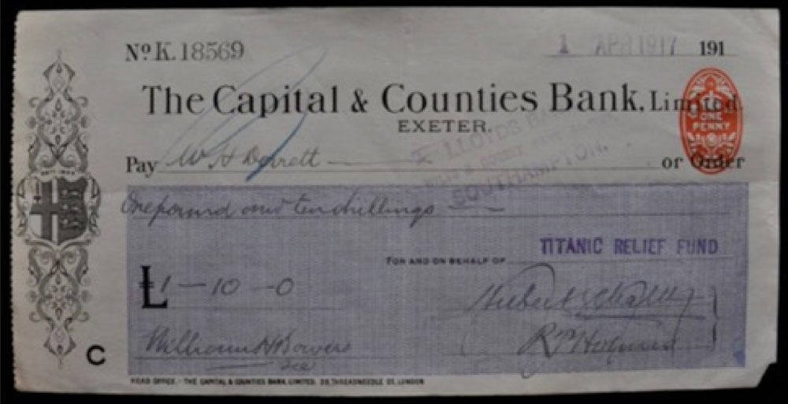
Source 1
Notes:
Source 1 is discussed in the starter task and could be used to model the task. Information about the sources are available in the lesson plan.

Slide 2
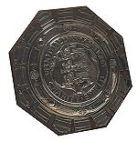
Source 2
1911/12 F.A. Charity Shield was played on Saturday 4th May 1912 at White Hart Lane, Tottenham Hotspur FC with an attendance of 7,100. The final score was:
Blackburn Rovers 2 Queens Park Rangers 1
The Charity Shield match was between the 1911/12 Football League champions, Blackburn Rovers, and 1911/12 Southern League champions Queens Park Rangers. The match was played at the end of the season in which they won their titles although it was originally scheduled for the start of the 1912/13 season. The match was then brought forward following the sinking of the Titanic.

Slide 3
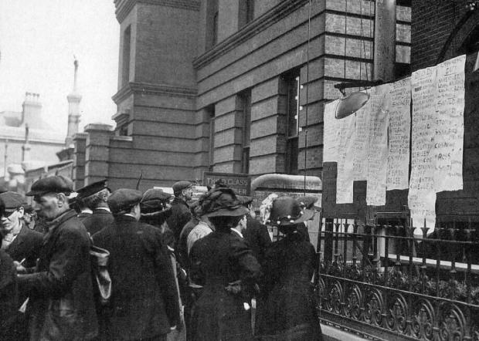
Source 3
A scene from Southampton shortly after the disaster in 1912

Slide 4
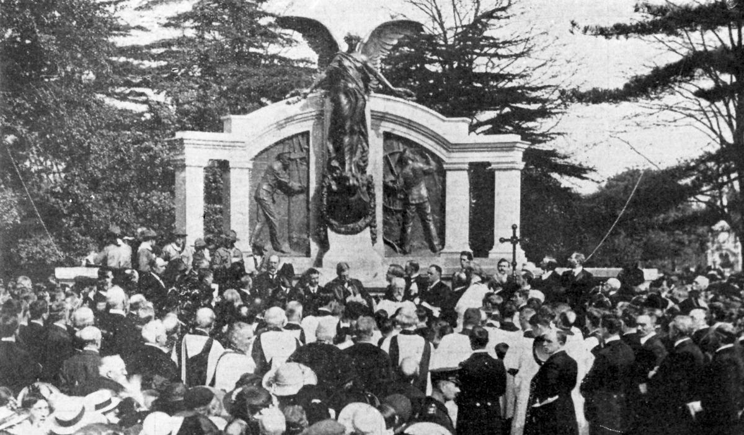
Source 4
Ceremony to reveal the memorial to the Titanic Engineers, 1914

Slide 5
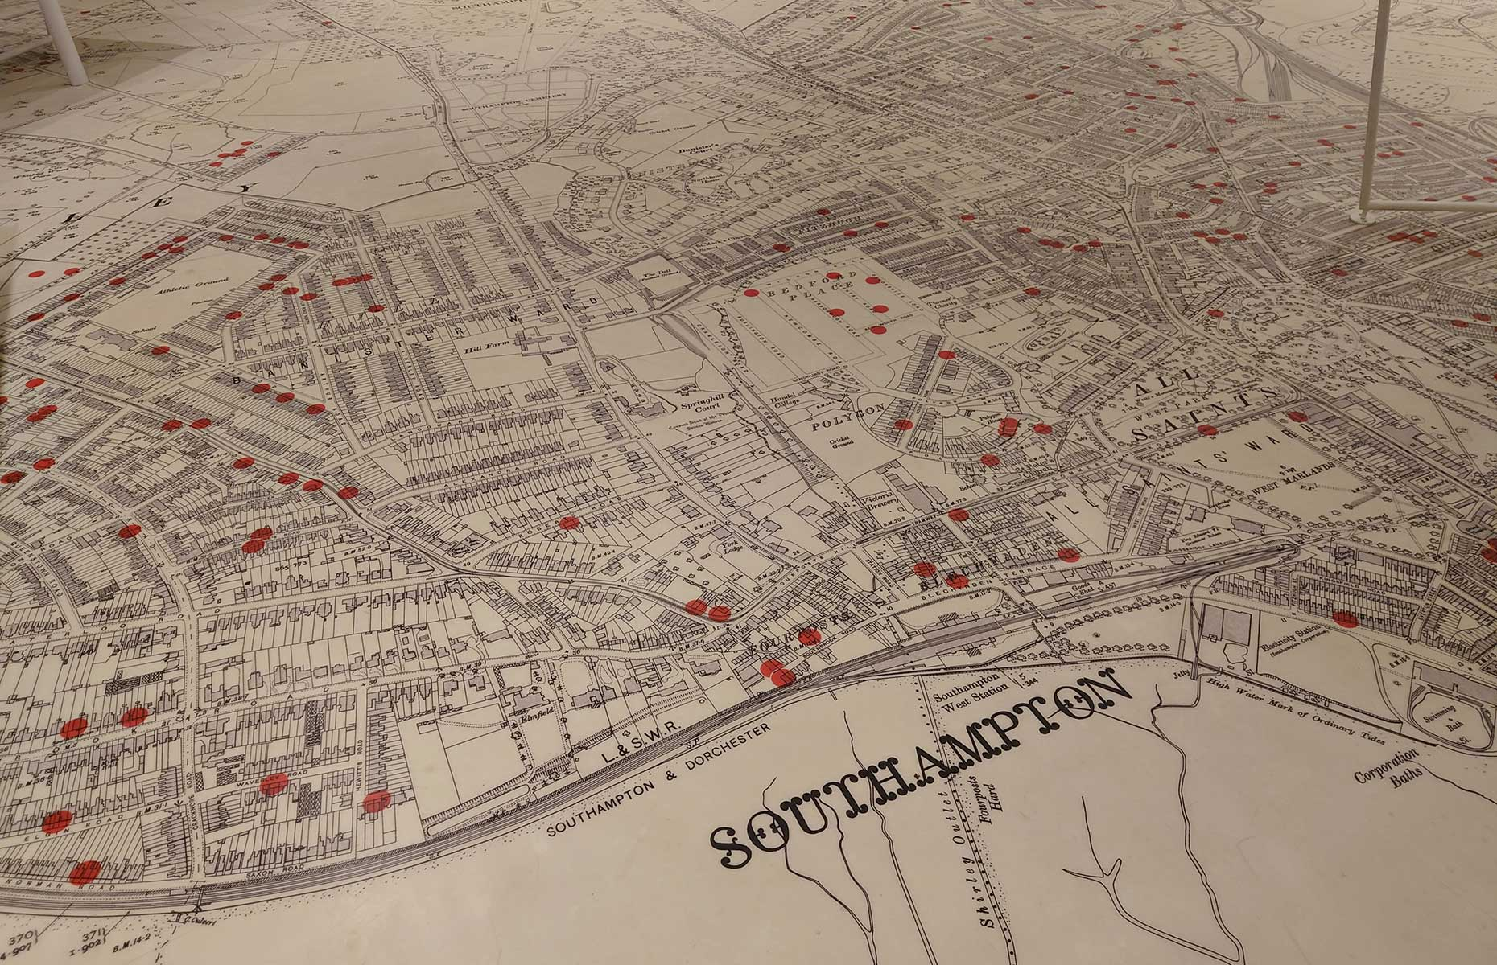
Source 5
Map of Southampton displayed at the SeaCity Museum

Slide 6
Source 6
Entries in the Southampton Titanic Committee Minutes book
“To Miss Penrose. Cost a pair of eyeglasses.
“That all the Saints Parish relief committee be asked to contribute half the cost of Mrs Fielder's artificial teeth.
“One Quart of milk per day, six eggs to the value of one halfpenny a week to be continued to Mrs Johnson (widow) for a further three months.’’
“The boy aged nine was placed under the charge of the matron of Shirley Warren workhouse, and the two little girls are at present being looked after by the Society of Musicians and the Charity Organisation Society and other friends.’’

Slide 7


Remembering Titanic Lessons © 2023 by Wonyong Park, Neta Shaby, Rachele Newman, Megan Barton, Christopher Dale, Ashleigh Fair, Natalie Harrison, Mary Shepherd and Christopher Zieba is licensed under CC BY-NC-SA 4.0. You can share and adapt the materials, as long as you give appropriate credit and do not use them for commercial purposes.

