Slide 1
Lifeboats British and American Boards of Inquiry decided that ships should carry enough lifeboats for everyone on the ship. There would also be required lifeboat drills and inspections to divert another mass boat-sinking accident. In 1983, amendments were made by SOLASrequired all lifeboats on passenger ships to be totally or partially enclosed equipped with an engine rather than the traditional open lifeboats manual propelled by oars. | Radio The Radio Act of 1912 was passed and it required that all sea vessels have a 24-hour radio system in place to stay in contact with other ships on the water and coastal radio stations. In addition, after the passage of this act, all radio operators were required to obtain a license to promote the credibility and responsibility of operators.
Working at sea The Jones Act or the Merchant Marine Act was passed in 1920. This federal law has many components, but also allows a ship employee or “seaman” injured at sea to file a lawsuit against their employer. This act calls for rightful compensation and recovery for the injured party. | Checking for ice First developed in 1914, the International Ice Patrol was founded to alert any sea vessels traveling in the shipping routes of Europe, Canada, and the United States of any icebergs. Today, the U.S. Coast Guard runs the International Ice Patrol.

Slide 2
Weather The RMS Empress of Ireland sank in the Saint Lawrence Rive in Canada following a collision in thick fog on 29 May 1914. The ship was equipped with watertight compartments, and had enough lifeboats for all passengers but she sank in 14 minutes, with 1012 fatalities and only 465 survivors. | Human Error The Herald of Free Enterprise capsized and sank on 6 March when the doors to the car deck were left open and the boat took on water. Of the 539 people on board, 193 died.
Technical Failures 8 miles off the coast of New Jersey the Mohawk, a passenger liner suffered failures of the automatic steering gear leading to a collision. She sank with an our hour, 16 of the 53 passengers were killed, and 31 of the 110 crew were killed. | Pushing limits On 18th June 2023, a deep sea submersible “Titan” imploded on a voyage to visit the wreck of the Titanic. It is estimated it took one millisecond to implode. 5 lives were lost.

Slide 3
Ship Design The White Star Line, which owned and operated the Titanic, modified the designs of sister ships the RMS Olympic and RMS Britannic so that the double bottoms were extended above the waterline, resulting in double hulls. This meant that if the hulls were punctured—be it by an iceberg or a collision of some other kind—water would be less likely to pour into the watertight compartments. Another significant change to ship design after the sinking of the Titanic was bringing the bulkheads higher above the waterline, so that each compartment would truly be watertight.
Co-operation Convention for the Safety of Life at Sea (SOLAS) was set up following the disaster. The main objective of the SOLAS Convention is to specify minimum standards for the construction, equipment and operation of ships, compatible with their safety. The SOLAS Convention in its successive forms is generally regarded as the most important of all international treaties concerning the safety of merchant ships. The first version was adopted in 1914, in response to the Titanic disaster, and there have been updates since.

Slide 4
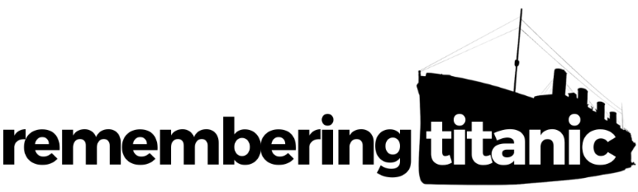

Remembering Titanic Lessons © 2023 by Wonyong Park, Neta Shaby, Rachele Newman, Megan Barton, Christopher Dale, Ashleigh Fair, Natalie Harrison, Mary Shepherd and Christopher Zieba is licensed under CC BY-NC-SA 4.0. You can share and adapt the materials, as long as you give appropriate credit and do not use them for commercial purposes.

