Slide 1
Lesson: How far did the Titanic disaster have an impact on the world?
Objectives:
To make inferences from historical sources about the local and national impact of the Titanic disaster.
To analyse the impact on sailing and shipping by identifying change and continuity following the Titanic disaster.

Slide 2
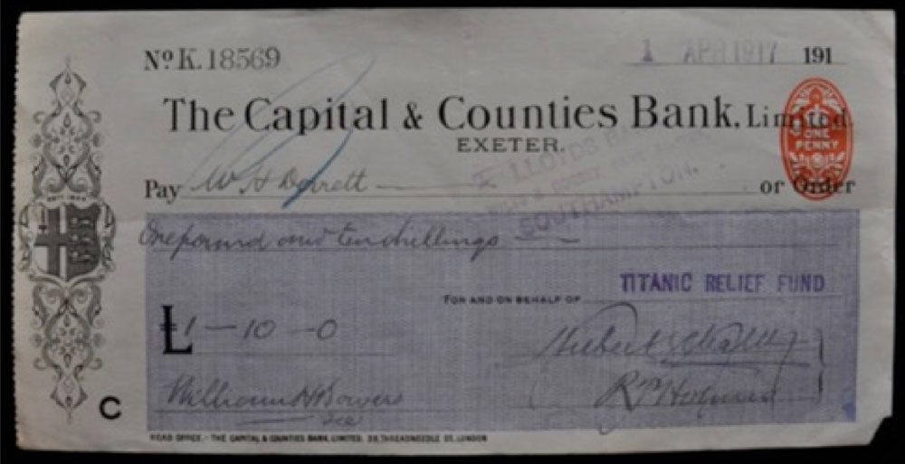
Task: Look at Source A; what can you infer from the source about the local impact of the sinking of the Titanic?

Slide 3
This is a cheque for one pound and ten shillings made out to the “Titanic Relief Fund”. In 2023, this would be the equivalent of around £120.
What does this reveal about the impact of the Titanic?

Slide 4
The Titanic Relief Fund
This was a charity set up the Mayors of Southampton and London, the Daily Telegraph along with support from some American companies, and it provided support for those that had suffered after the disaster.
Many families lost their main source of income due to the death of the male in the household.
It was in business until 1958.

Slide 5
Task focus: To make inferences from historical sources about the local and national impact of the Titanic disaster.
Using the sources, students are going to explore how Southampton and the UK reacted to the disaster to identify the impact it had at the time. Questions to use are below or on the worksheet. Use slide 1 to model the first example - the cheque from the starter task.bDoes the source show:
1) Immediate/short term/long term impact?
2) Local or national
3) What can we learn about the impact it had on Southampton and the UK?

Slide 6
 | Does the source show Immediate/short term/long term impact? | Does it demonstrate a local or national impact? | What can we learn about the impact it had on Southampton and the UK?
1
2
3
4
5
6
Notes:
Worksheet to use for the source analysis

Slide 7
 | Does the source show Immediate/short term/long term impact? | Does it demonstrate a local or national impact? | What can we learn about the impact it had on Southampton and the UK?
1 | Short term | National | People were still donating money to the charity in 1917, 5 years after the disaster showing there was still a need from the families affected.
2
3
4
5
6
Notes:
Worksheet to use for the source analysis

Slide 8
Source 1
Notes:
Source 1 is discussed in the starter task and could be used to model the task. Information about the sources are available in the lesson plan.

Slide 9
With the impact of the Titanic stretching across the UK, what changes do you think there would be after the disaster?

Slide 10
Recommendations from the British and American Inquiries
To provide sufficient lifeboats for all passengers
For radios to be manned 24 hours a day
For regular drills to be completed on board
To reduce speed in bad weather.
Notes:
Further information and extracts of both inquiries can be found here: https://www.titanicinquiry.org/

Slide 11
Task focus: To analyse the impact on sailing and shipping by identifying changes over time.
Place the information cards along the line, what has changed over time?
Continuity
Change

Slide 12
Task focus: To analyse the impact on sailing and shipping by identifying changes over time.
What does this new information tell us about the impact of the Titanic?
Continuity
Change

Slide 13
Plenary: What lessons have been learned from the Titanic disaster?
Students can do this in a number of ways.
Complete a formal piece of writing detailing your findings about the impact (locally, nationally or internationally) or your views on change and continuity.
Explain your position with regards to how far you agree there was change. This could be done verbally, physically or written.
Write your response to the following question: “Why could the lessons learnt from the Titanic not prevent further disasters?”.

Slide 14


Remembering Titanic Lessons © 2023 by Wonyong Park, Neta Shaby, Rachele Newman, Megan Barton, Christopher Dale, Ashleigh Fair, Natalie Harrison, Mary Shepherd and Christopher Zieba is licensed under CC BY-NC-SA 4.0. You can share and adapt the materials, as long as you give appropriate credit and do not use them for commercial purposes.

