Slide 1
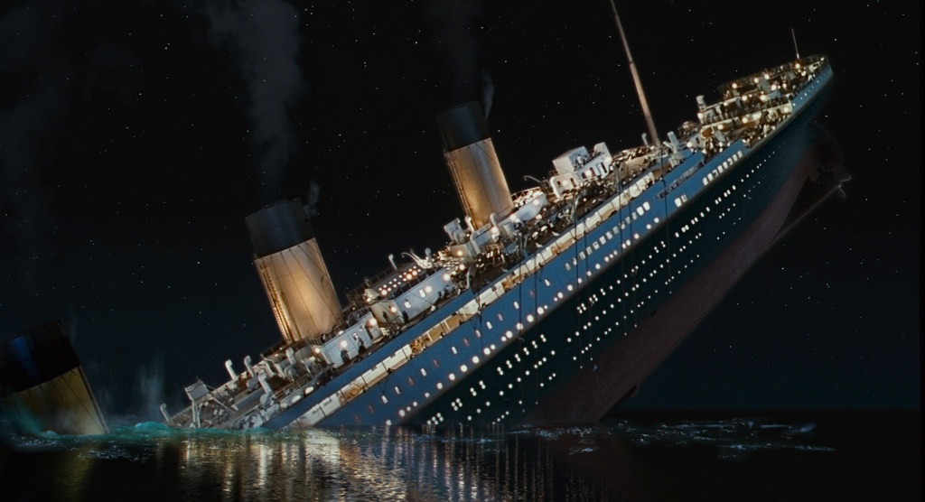
Watertight Bulkheads

Slide 2
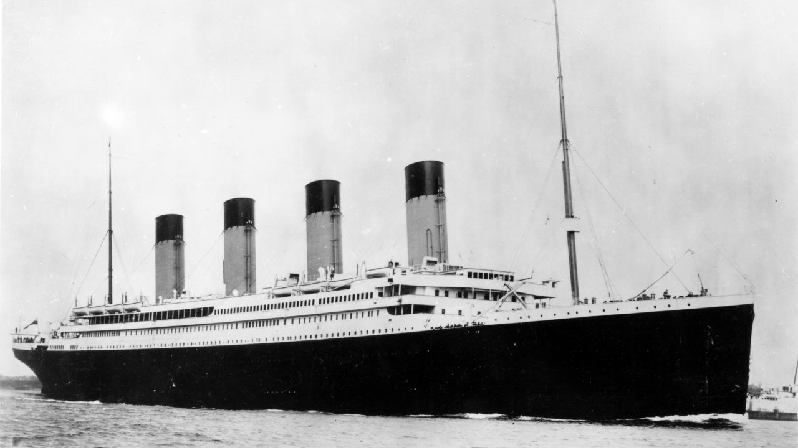
What do you know about the Titanic?

Slide 3
Titanic weighed 46, 000 tonnes
A ship will float providing it is able to displace a larger weight of water that its own weight
When the Titanic struck the iceberg, a series of holes punctured the first five compartments, and as these filled up with water the bow of the ship tilted forward
Once this was below the waterline there was nothing to stop the water replacing the air in other compartments, and since water is heavier than air, gravity became bigger than upthrust and the Titanic sank.

Slide 4
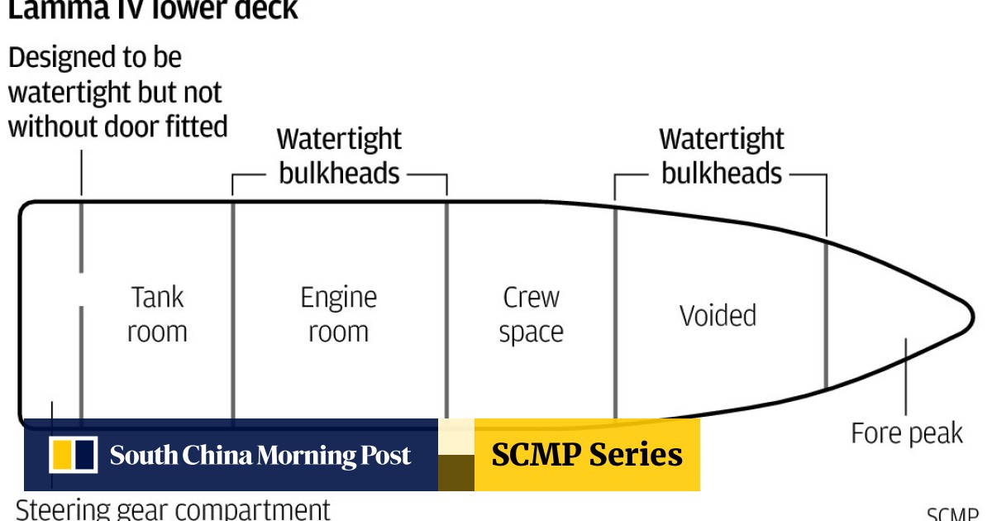
Watertight Bulkheads
Watertight bulkheads are vertically designed watertight divisions/walls within the ship's structure to avoid intake of water in the compartment if the adjacent compartment is flooded due to damage in ship's hull

Slide 5
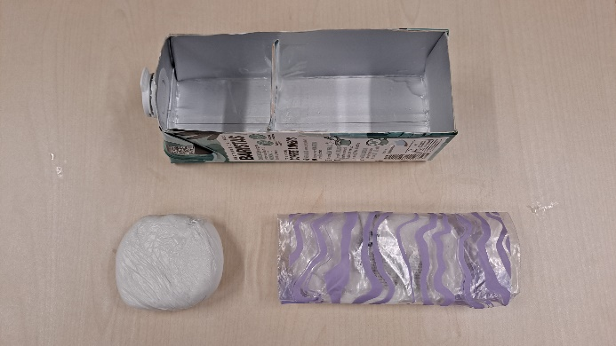

Juice carton (waterproof)
Remove one side
Clay, wrapped in waterproof bags
Clay, wrapped in waterproof bags

Slide 6
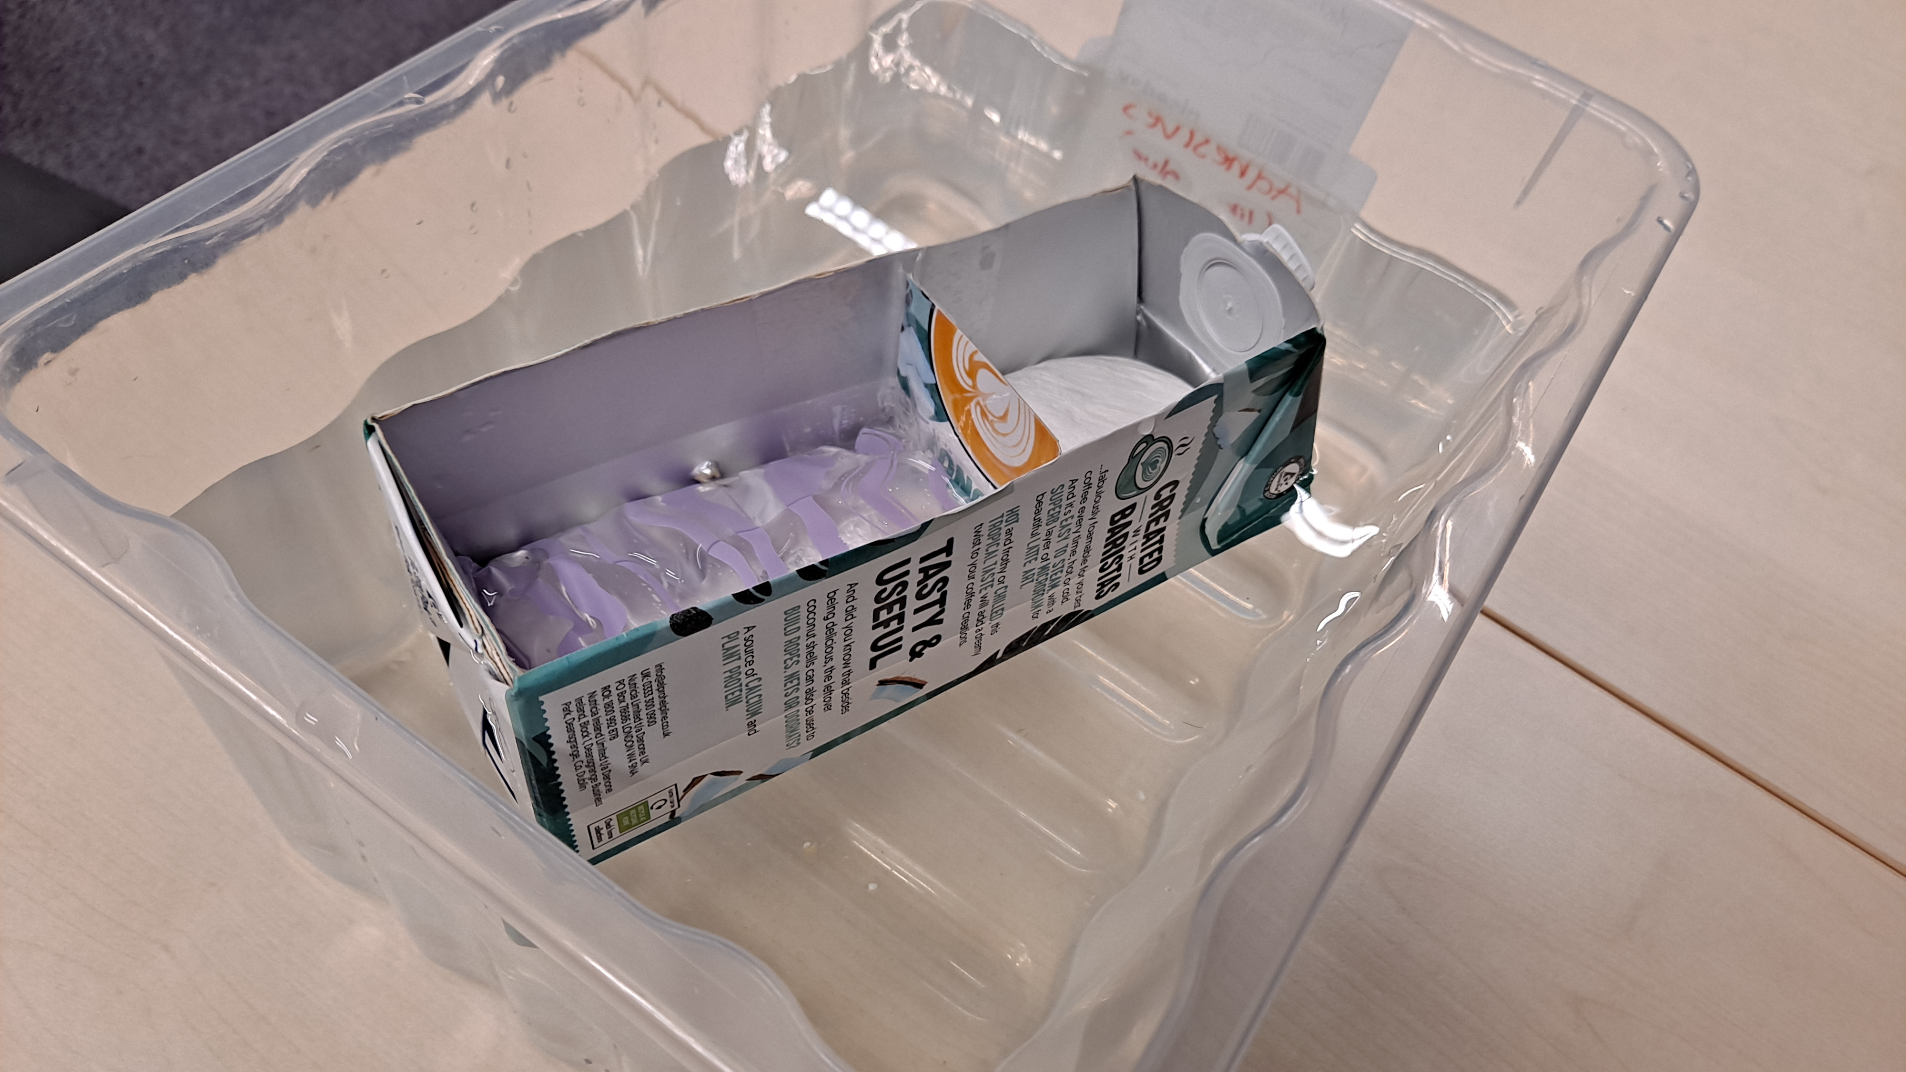
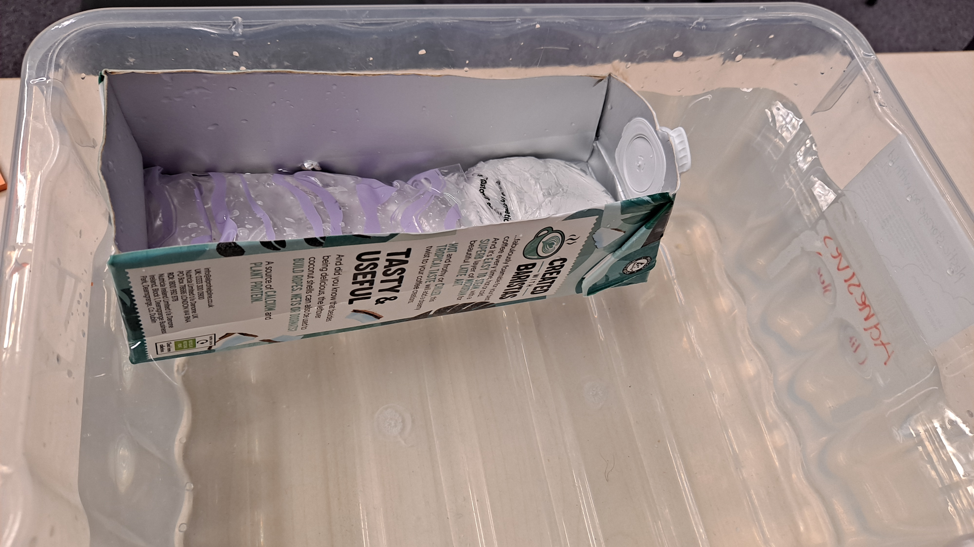
Carton ship layout
Build two identical model ships: one without a bulkhead, and one with a bulkhead.
Place equal weights (clay in resealable bag) inside both ships to simulate the cargo and passengers. Ensure the weight is evenly distributed.
Float the ships in their respective water tanks and observe if they remain stable and at the same water level.
With bulkhead
Without bulkhead

Slide 7
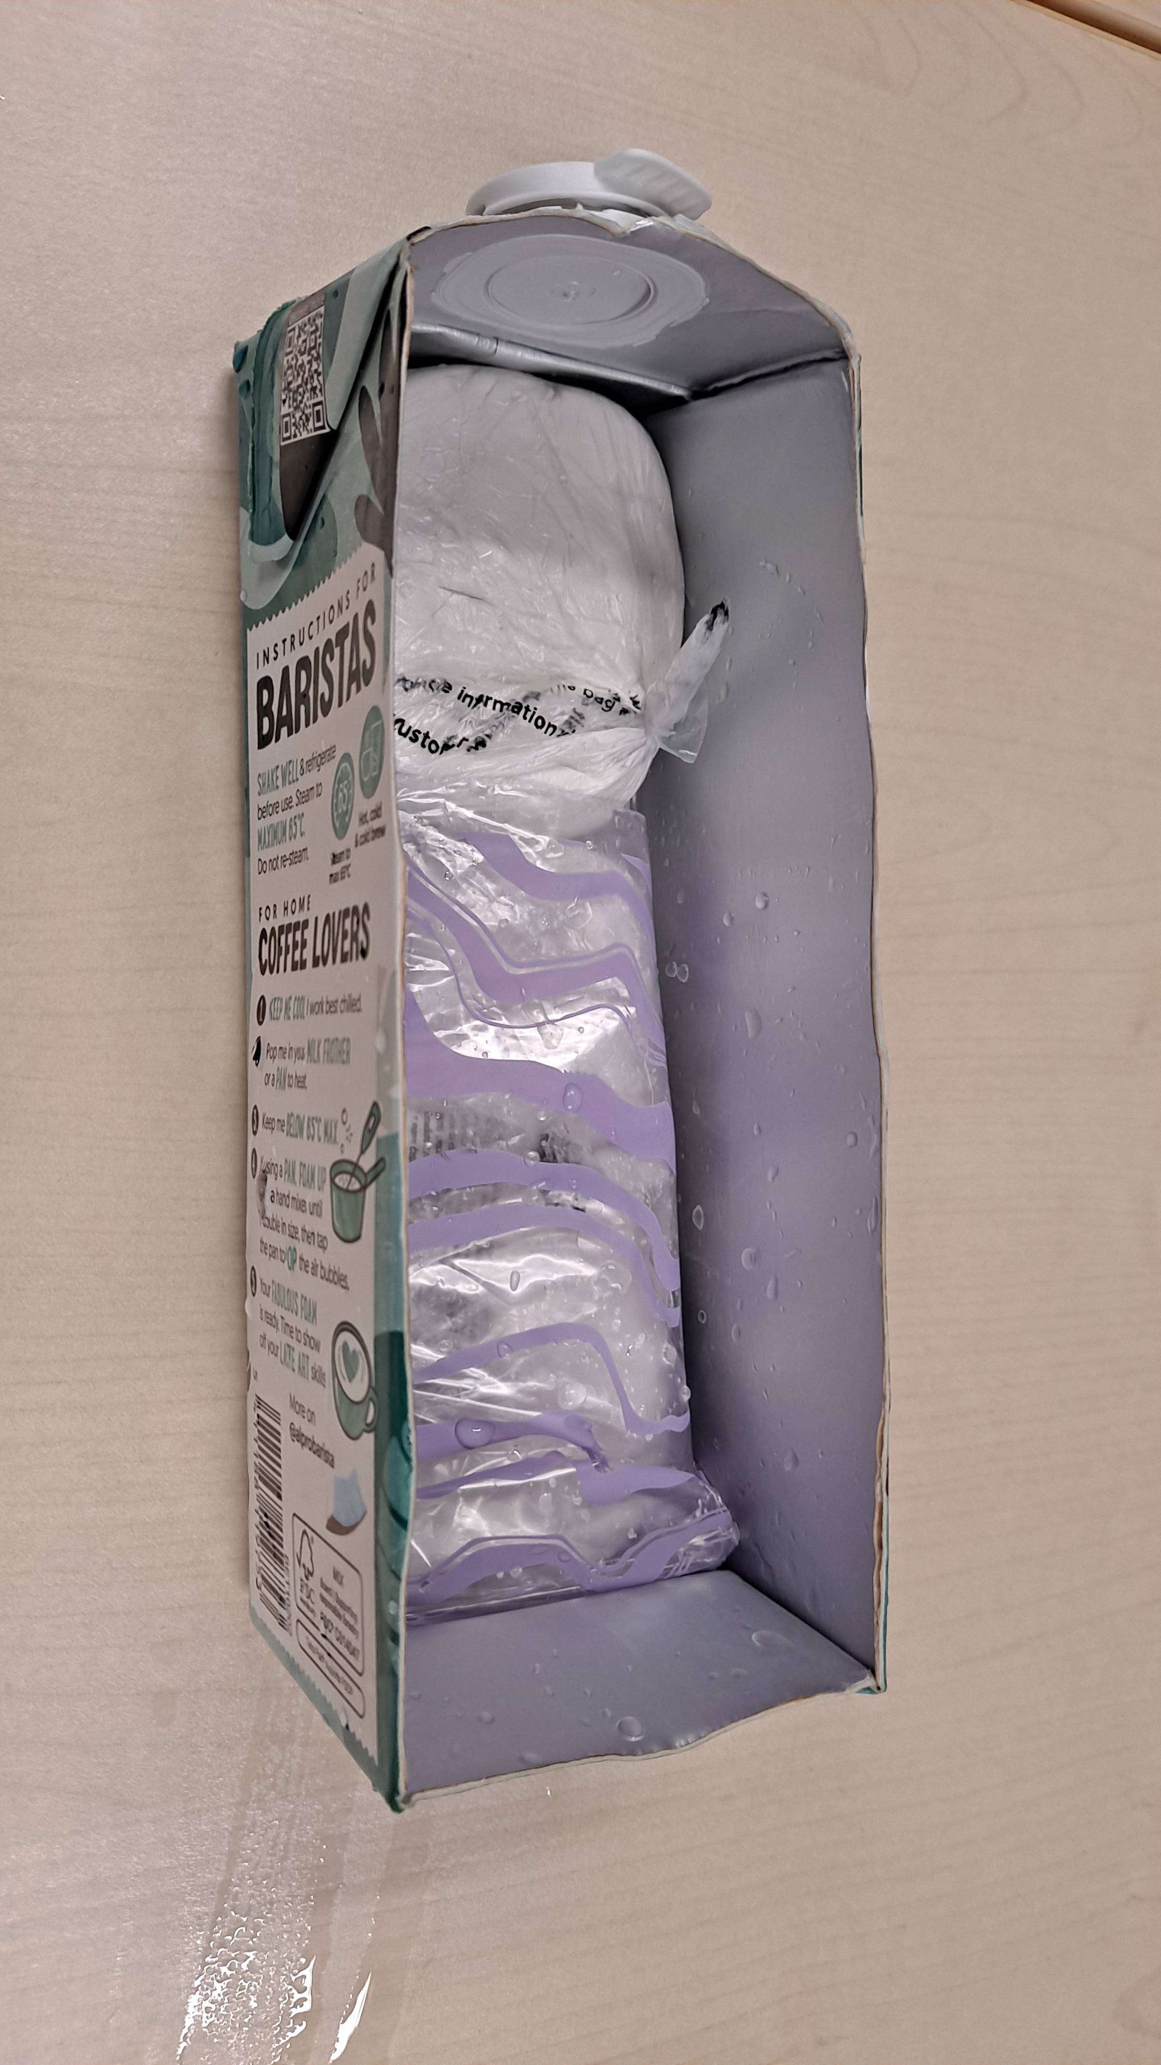
Method
Using a pencil, poke a small hole at the same height (about 1.5 cm from the bottom) on both ships to simulate a breach in the hull.
Observe and time how long it takes for each ship to begin to sink. Observe and record what happens in each ship. Repeat this process three times.
Hole (= breach in Titanic’s hull)

Slide 8
Variables
Independent variable - bulkhead
Dependent variable - time it takes to sink
Control variable – mass and distribution of clay, size of the hole, boat size …

Slide 9
Conclusion
What difference does the bulkhead make to the ship when there is damage?

Slide 10
The watertight bulkheads on the Titanic
Fifteen transverse bulkheads created sixteen compartments or cells, each of which could be isolated from the adjoining compartment using special doors which could be closed in the event of an emergency.
The lower section of the Titanic was divided into sixteen major watertight compartments that could easily be sealed off if part of the hull was punctured and leaking water.
When the hull of the Titanic was torn open in the collision with the iceberg, water began to flood the damaged compartments in the bow. As the ship pitched forward under the weight of the water in the bow compartments, water began to spill over the tops of the bulkheads into adjacent, undamaged compartments.
The iceberg breached 6 compartments. However, the damage to the 6th was fairly minor, so the crew were able to shore up. Unfortunately, 5 compartments flooding was enough to pull the tops of the bulkheads below the waterline, meaning they all eventually flooded.

Slide 11


Remembering Titanic Lessons © 2023 by Wonyong Park, Neta Shaby, Rachele Newman, Megan Barton, Christopher Dale, Ashleigh Fair, Natalie Harrison, Mary Shepherd and Christopher Zieba is licensed under CC BY-NC-SA 4.0. You can share and adapt the materials, as long as you give appropriate credit and do not use them for commercial purposes.

