Slide 1
Lesson B
Keeping Afloat

Slide 2
Learning Objectives
To investigate different ‘anti-sinking’ ideas
To evaluate the effectiveness of different ‘anti-sinking’ ideas

Slide 3
Recall
What is the purpose of a watertight bulkhead?
What was the independent variable?
What was the dependent variable?
What were the control variables?

Slide 4
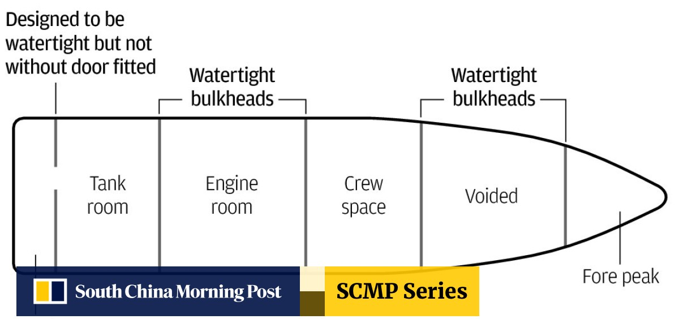
Watertight Bulkheads
Watertight bulkheads are vertically designed watertight divisions/walls within the ship's structure to avoid intake of water in the compartment if the adjacent compartment is flooded due to damage in ship's hull

Slide 5
Aim
Can you find a way to keep the ship afloat when the hull is damaged?

Slide 6
Method
Remake your Carton ship
Poke a hole in the hull
Can you find a way to keep the SHIP floating?

Slide 7
Results table
Idea to prevent sinking | Time to sink (s)

Slide 8

Conclusion
Did any of your ideas work?
Can you link your ideas to the Titanic. Could they have done something similar?

Slide 9
Did Titanic need to sink?
https://www.youtube.com/watch?v=NEkBSpmXxmg

Slide 10


Remembering Titanic Lessons © 2023 by Wonyong Park, Neta Shaby, Rachele Newman, Megan Barton, Christopher Dale, Ashleigh Fair, Natalie Harrison, Mary Shepherd and Christopher Zieba is licensed under CC BY-NC-SA 4.0. You can share and adapt the materials, as long as you give appropriate credit and do not use them for commercial purposes.

