Slide 1
How to get a good grade in Professor Moody’s class?
Jason Woo

Slide 2
Introduction
How to get a good grade in Professor Moody’s class?
We will look at the data and find which factors influence the grade besides the scores
We can look at a few attributes that can contribute to getting a better grade
Some attributes include texting, asking questions, and dozing off in class
The following slides include analysis on subsets of particular attributes within the dataset

Slide 3
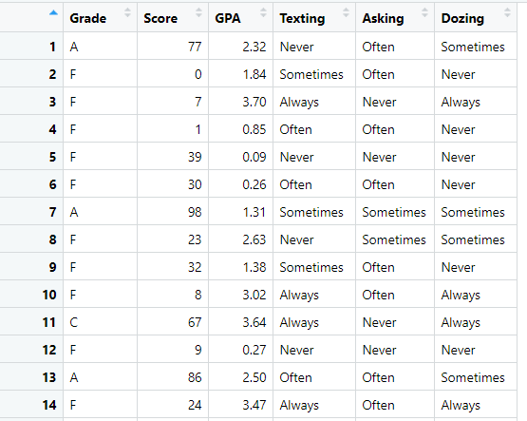
Overview of the Data
Number of Students: 2000
Number of attributes: 5 (2 numerical, 3 categorical)
Number of values per categorical attribute
Grade: 4
Texting: 4
Asking: 3
Dozing: 3

Slide 4
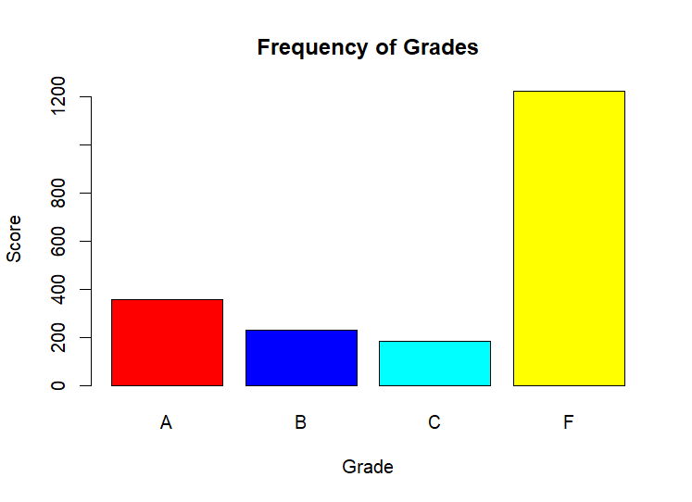
Distribution of Grades
Bar plot graph of the 2000 students and the frequency of letter grades
There is a high distribution of F letter grades, while the others are uniform
Let’s see if we can look further to see why this is the case through attributes
This really does not tell us much other than that Professor Moody is assigning a large amount of F letter grades
barplot(table(moody$Grade), main = 'Frequency of Grades', xlab='Grade', ylab='Score', col=colors)

Slide 5
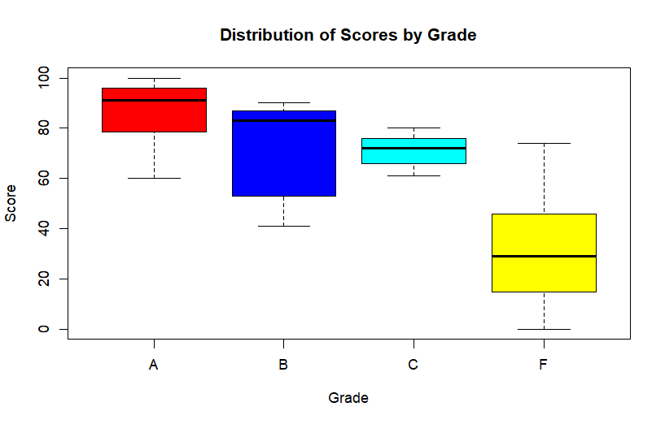
Distribution of Scores by Grade
These are the scores distributed by each letter grade
There’s a fair amount of overlap where we see scores of around a 60 getting an A, while scores reaching to a high at about 75 receiving an F letter grade
This could be one sign of Professor Moody no assigning fair letter grades based on number scores
boxplot(moody$Score~moody$Grade, main = 'Distribution of Scores by Grade', xlab = 'Grade', ylab = 'Score', col=colors)

Slide 6
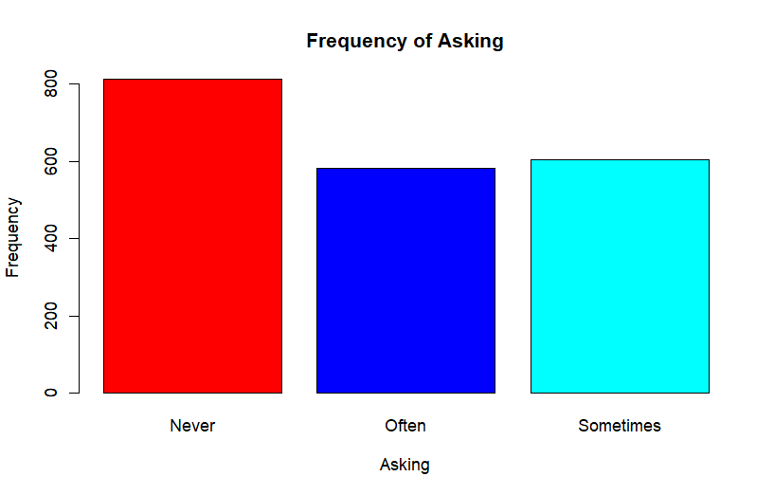
Frequency of Asking Attribute
We can try to find patterns by splitting the data up around the attribute of asking questions

Slide 7
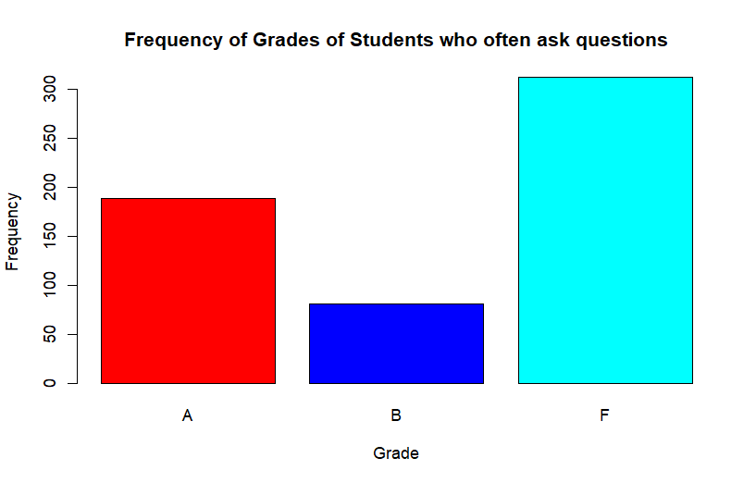
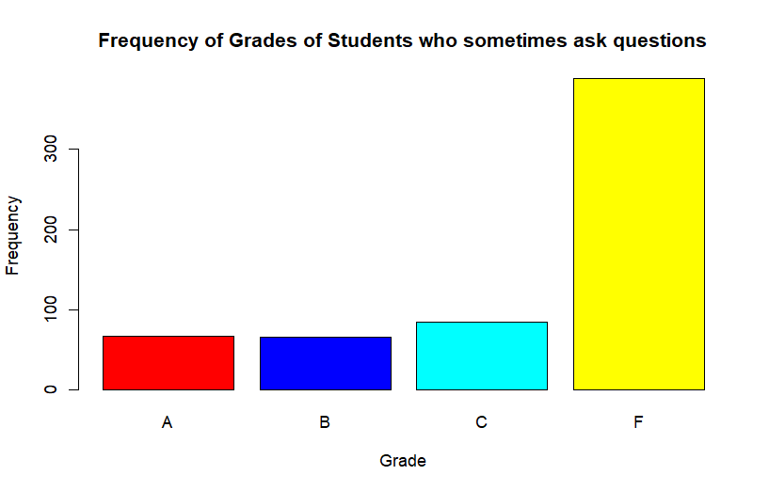
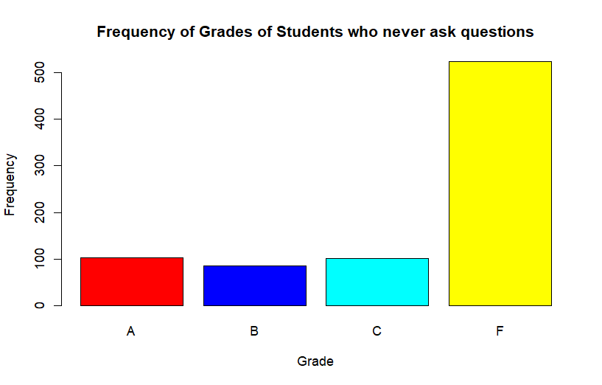
Splitting Up by Asking Attribute
We split up the asking attribute by the 3 values within the variable (often, sometimes, never) ask questions
Students who often ask questions have more F’s
Students who sometimes ask questions have more F’s
Students who never ask questions have more F’s
Considering there is more F’s in the overall dataset, this is to be expected and must look into it further

Slide 8
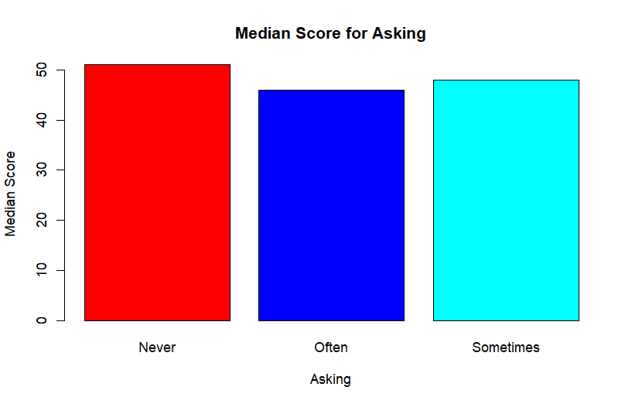
Splitting Up by Asking Attribute
This bar plot shows the median score for asking questions
Students who never ask questions have a higher median score

Slide 9
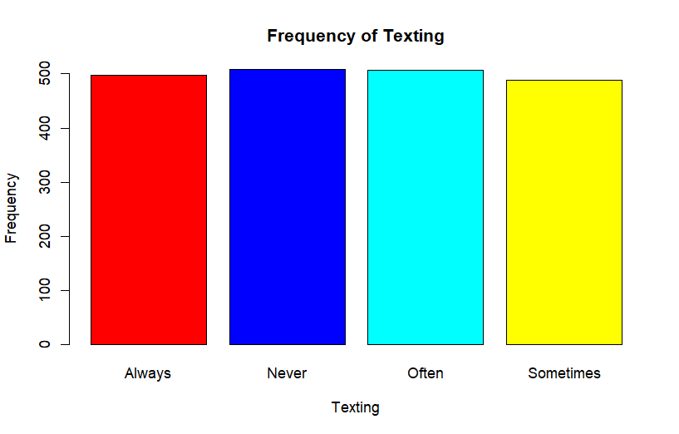
Splitting up by Texting Attribute
This is the frequency of texting levels
Through all 4 values, it is approximately all equal at around 500 students

Slide 10
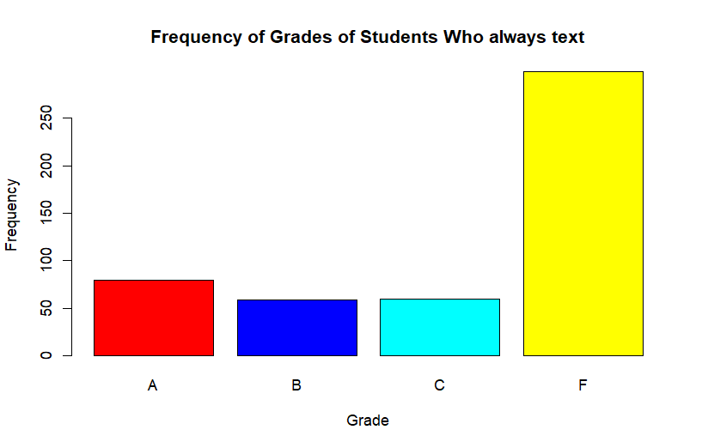
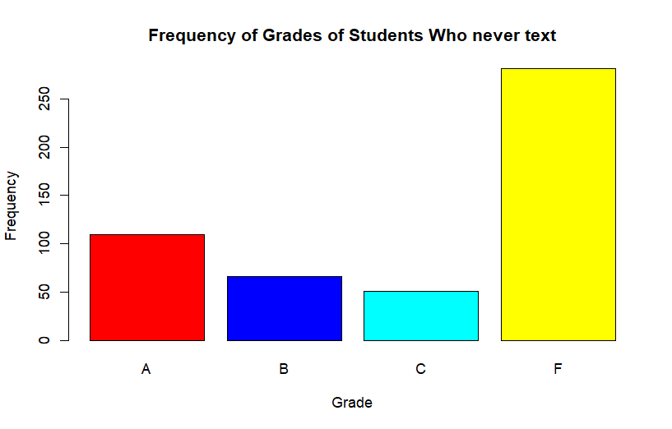
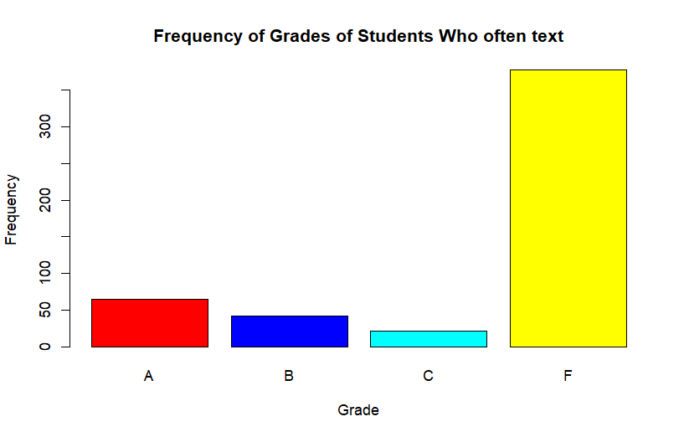

Splitting Up by Texting Attribute
Students who always text have more F’s
Students who never text have more F’s
Students who often text have more F’s
Students who sometimes text have more F’s
Yet again, it is hard to evaluate the data since are frequency is high in F’s

Slide 11
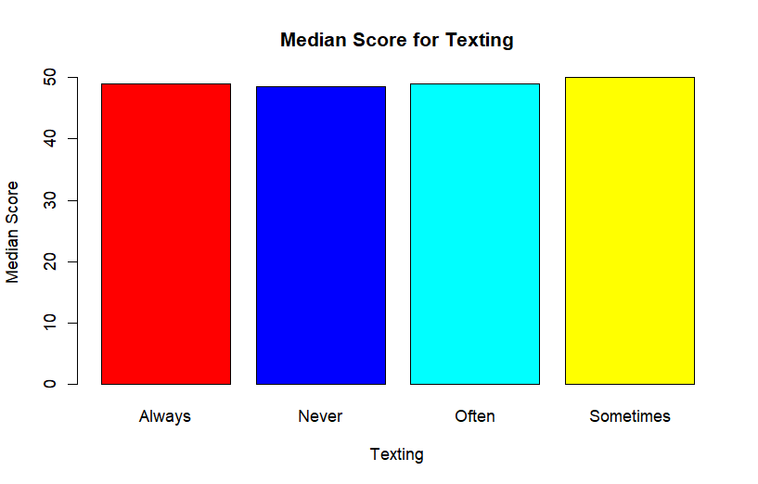
Splitting up by Texting Attribute
The scores are equivalent for those students who always text and those who often text
Students who sometimes text have a higher median score

Slide 12
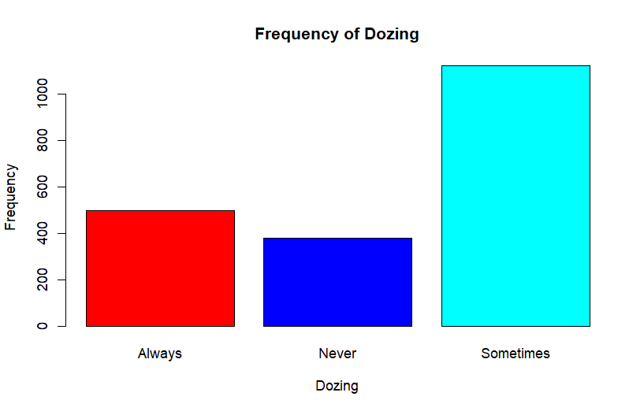
Splitting Up by Dozing Attribute
Lets examine the frequency of dozing levels
There is a high frequency of students who sometimes doze

Slide 13

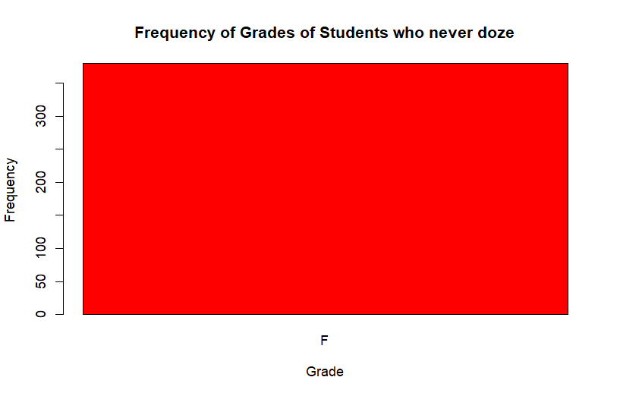
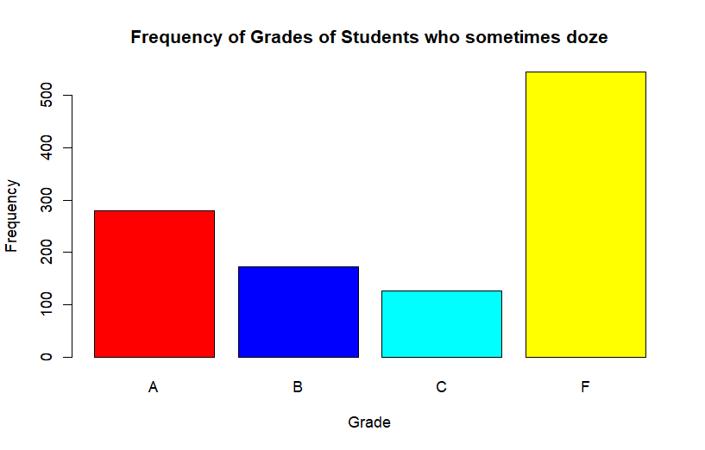
Splitting Up by Dozing Attribute
Students who always doze have more F’s
Students who never doze have only F’s
Students who sometimes doze have more F’s
We can see that students who never doze only received F’s

Slide 14
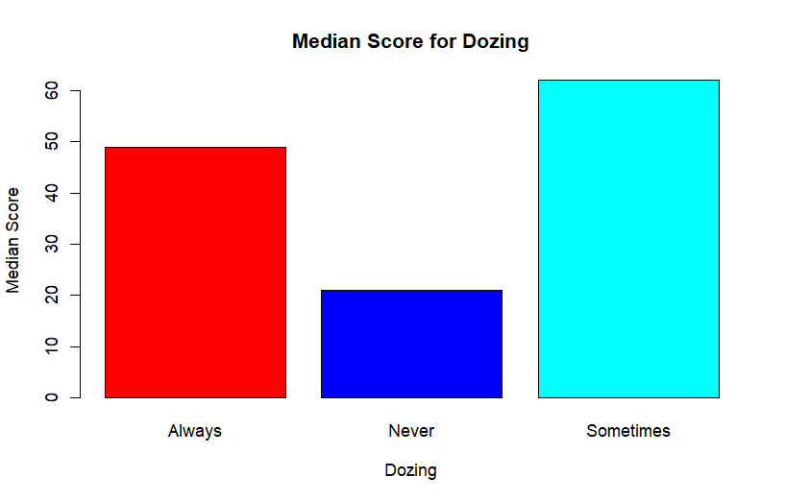
Splitting up by Dozing Attribute
Students who sometimes doze have a higher median score while those who never doze have the lowest median score

Slide 15
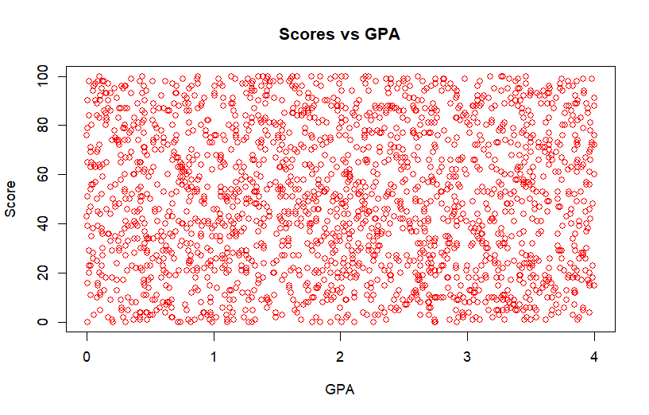
Scores vs GPA
This scatter plot shows the distribution of scores based on the students GPA
We can see that there is no correlation within what scores the students received to their GPA

Slide 16
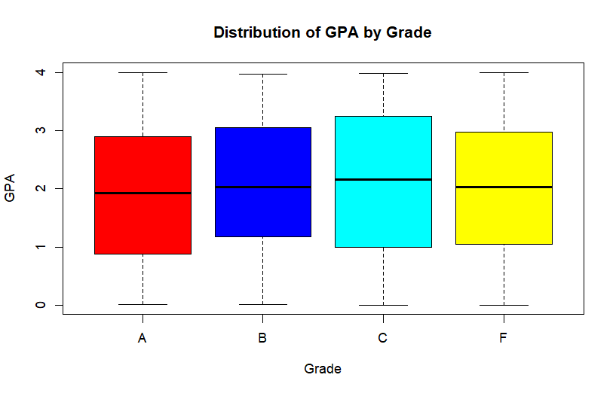
Distribution of GPA by Grade
Students with lower GPA either receive more A’s or F’s
Students with a higher GPA have more B’s and C’s

Slide 17
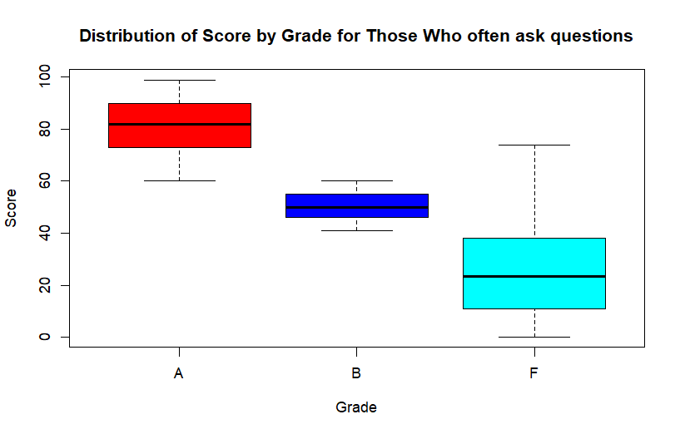
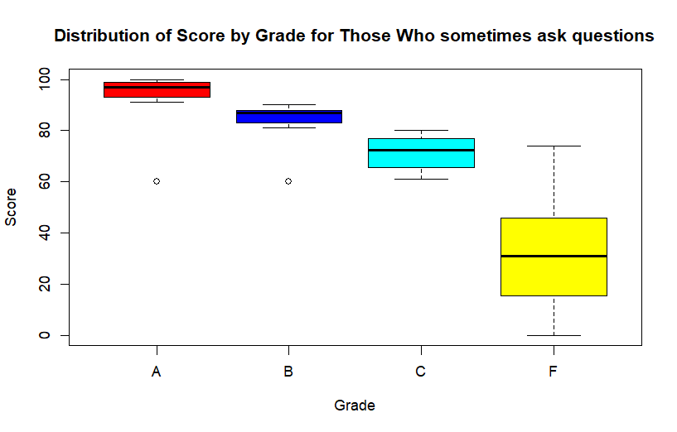
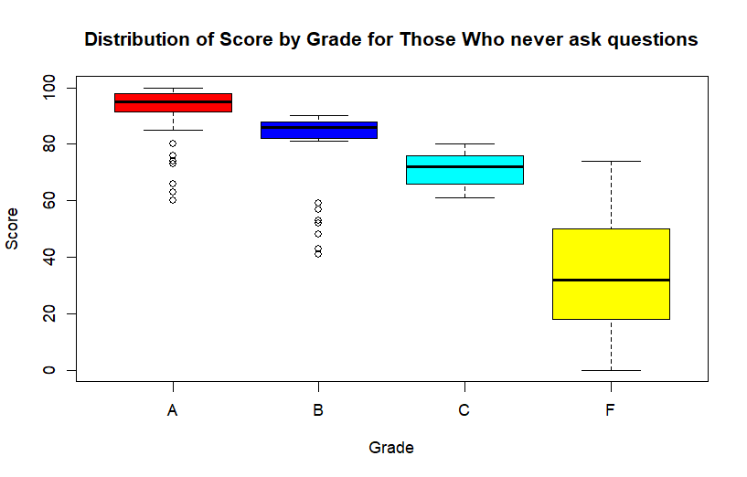
Distribution of Scores by Grade with Asking

Slide 18
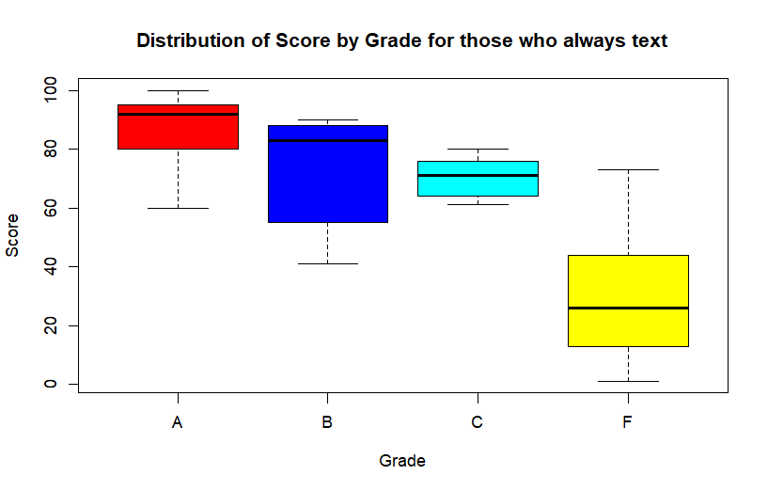
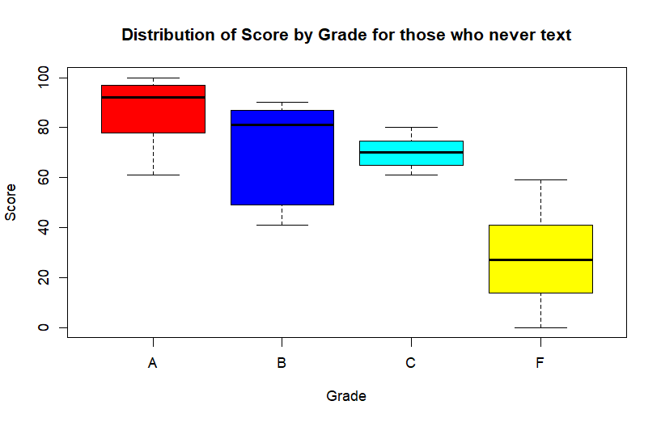
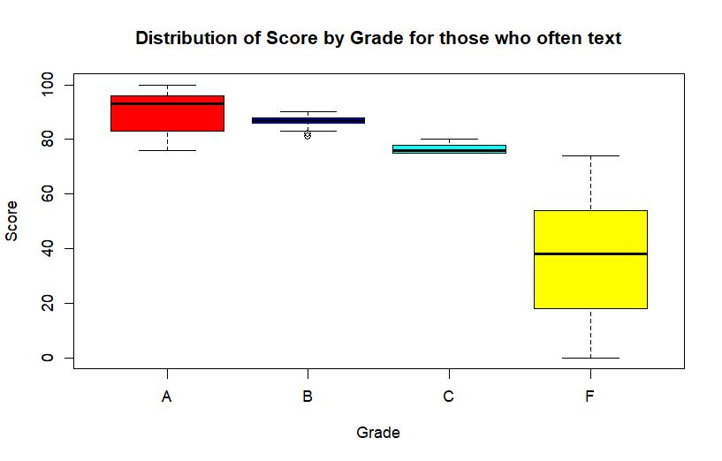
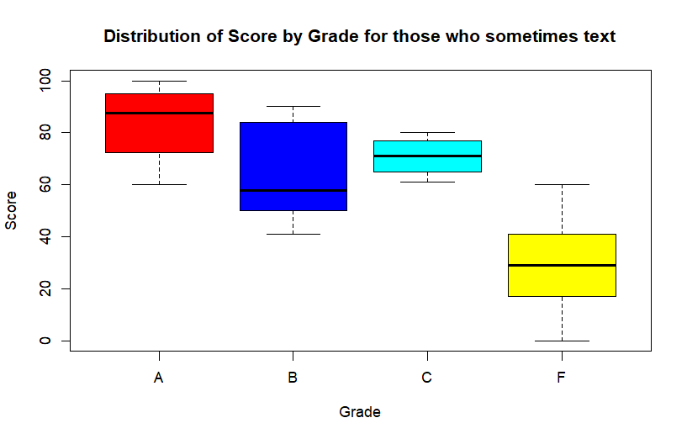
Distribution of Score by Grade with Texting

Slide 19

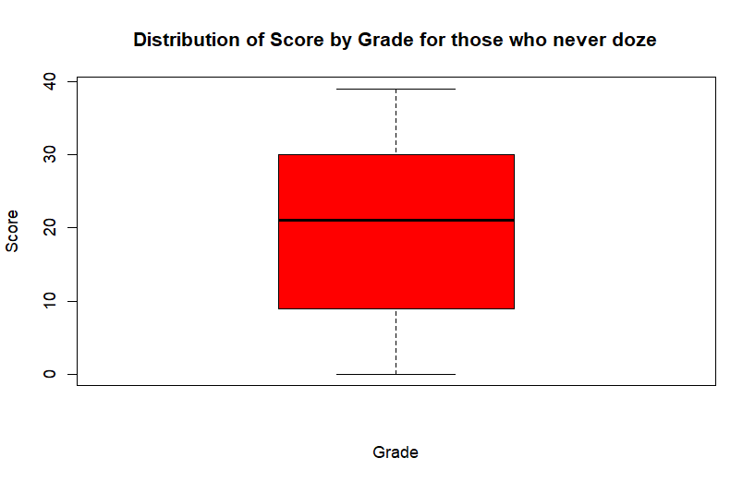
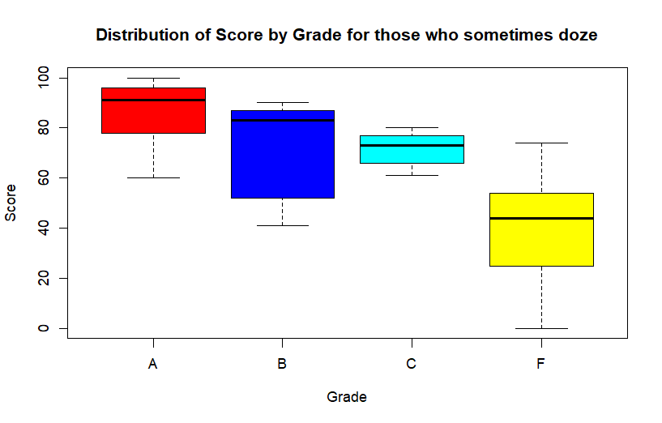
Distribution of Scores by Grade with Dozing

Slide 20
Conclusion
There are certain patterns within the data
It can be observed that students who never doze receive only F’s compared to those who always or sometimes doze
Students who never ask questions have a higher median score compared to those who sometimes or often ask questions
Overall various patterns can be observed by creating subset and plotting those to establish relationships

