Slide 1
Weekly Meeting: Sleep-EDF
Wooyoung Kim
Media Communication Lab
Notes:
LaBraM (Jiang, Zhao & Lu, ICLR 2024): validation of the released code and LaBraM-Base weights, plus a survey of how EEG review papers report existing methods' results (reproduction vs. citation).

Slide 2
Sleep Staging on Sleep-EDF: Seven Models, One Split
Sleep-EDF Expanded, Sleep Cassette: 153 nights of 78 healthy subjects (25–101 years), 5 stages; Fpz-Cz + Pz-Oz, sleep period ± 30 min
What I ran
What I found
Model | Implementation | Training | Runs
CBraMod (pre-trained / no pre-training) | released code and weights | CBraMod pipeline | 5 + 5
LaBraM-Base | released code and weights | CBraMod pipeline | 5
EEG Conformer | released model | CBraMod pipeline | 5
EEGNet | our PyTorch EEGNet-8,2 | CBraMod pipeline | 5
ATCNet | braindecode (code is TF) | CBraMod pipeline | 5
DeepSleepNet | braindecode (single-epoch) | CBraMod pipeline | 5
DeepSleepNet | released code (TF 1.15) | its own | 3
L-SeqSleepNet | released code (TF 1.15) | its own | 3
CBraMod, LaBraM, Conformer, EEGNet | braindecode 1.8.1 | CBraMod pipeline | 5 each
One pipeline. Five models as the epoch encoder of CBraMod's released sleep-staging code (ISRUC path): same head (Transformer over 20 epochs), trainer, checkpoint (best validation κ), seeds 0–4.
One split. Subjects split by age, 62 / 8 / 8: Sleep-EDF subject numbers follow age.
Two sleep models with their own released code: their papers' Sleep-EDF-20 protocols, and the shared Sleep-EDF-78 split.
One test set. Every model scored on the same 20,976 test epochs.
Takeaway: No paper in the repository reports Sleep-EDF except the two sleep models, so this is a comparison under identical conditions, plus two reproductions.

Slide 3
DeepSleepNet and L-SeqSleepNet: Paper vs. on My End (Sleep-EDF-20)
Released code, the papers' own protocols: 20 subjects, 39 nights, Fpz-Cz; all folds pooled
Result
What I found
Model, protocol | Accuracy | Macro-F1 | κ
DeepSleepNet, 20-fold CV | 81.8 (82.0) | 76.7 (76.9) | 0.754 (0.76)
L-SeqSleepNet, LOSO (1 of 5 repetitions) | 86.1 (86.3 ± 0.2) | 79.4 (79.3 ± 0.4) | 0.811 (0.813)
Both reproduce: all overall metrics within 0.6 points; per-stage F1 within 1.4 (DeepSleepNet) and 0.6 (L-SeqSleepNet).
L-SeqSleepNet needed one fix: its run scripts test every fold on subject 0's list (in folds 2–20 that subject is training data); evaluate.py scores fold n against its own subject.
Scripts ≠ paper: 20 × 10 folding and a fixed 11,000 steps vs. 10 × 20 with early stopping; the evaluation batch needs > 12 GB (reduced, prediction-neutral).
DeepSleepNet's epoch count matches because predict.py drops each night's last n mod 25 epochs.
ours (paper). DeepSleepNet: 41,950 test epochs, the paper's count. L-SeqSleepNet: 1 of the paper's 5 repetitions.
Takeaway: Both sleep models' released code reproduces its paper on Sleep-EDF-20; subject 11 is the hardest subject for both.

Slide 4
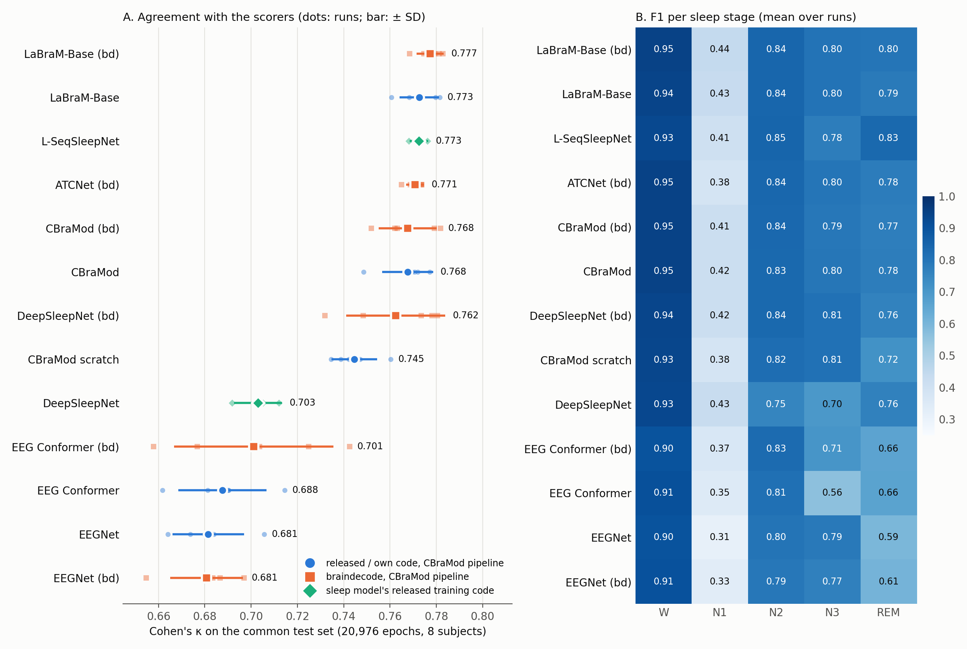
Sleep-EDF-78: Every Model on the Same Split and Test Epochs
Common test set: 20,976 epochs of 8 held-out subjects; pipeline models: seeds 0–4; sleep models with their own released code: 3 runs
What I found
Four tie at the top: LaBraM-Base, L-SeqSleepNet (own released code), ATCNet (bd), CBraMod (κ 0.768–0.773; all p ≥ 0.40); braindecode's LaBraM re-run 0.777, also a tie.
Pre-training helps here: CBraMod +0.023 κ over scratch (p = 0.009).
Small supervised models trail: EEG Conformer 0.688, EEGNet 0.681 (CBraMod +0.08 / +0.09, p < 0.001). ATCNet's 112k-parameter encoder ties CBraMod.
N1 is hard for all (F1 0.31–0.44); L-SeqSleepNet has the best REM (0.83).
Takeaway: Under identical conditions, the foundation models, L-SeqSleepNet and ATCNet are indistinguishable on Sleep-EDF-78.

Slide 5
Pairwise Tests on the Common Test Set
A − B, mean over runs; Welch p over runs (5 seeds vs. 5, or vs. 3 runs)
Differences
What I found
A − B | κ | Balanced acc. | Macro-F1
LaBraM-Base − CBraMod | +0.005 (p = 0.43) | +0.008 (p = 0.44) | +0.008 (p = 0.34)
L-SeqSleepNet (own released code) − CBraMod | +0.005 (p = 0.40) | +0.002 (p = 0.86) | +0.005 (p = 0.53)
L-SeqSleepNet (own released code) − LaBraM-Base | 0.000 (p = 0.96) | -0.005 (p = 0.70) | -0.004 (p = 0.70)
CBraMod − ATCNet (bd) | -0.003 (p = 0.56) | +0.011 (p = 0.076) | +0.004 (p = 0.45)
CBraMod − CBraMod, no pre-training | +0.023 (p = 0.009) | +0.022 (p = 0.030) | +0.019 (p = 0.050)
LaBraM-Base − CBraMod, no pre-training | +0.028 (p = 0.001) | +0.030 (p = 0.026) | +0.027 (p = 0.021)
CBraMod − EEG Conformer | +0.080 (p < 0.001) | +0.109 (p < 0.001) | +0.095 (p < 0.001)
CBraMod − EEGNet | +0.086 (p < 0.001) | +0.068 (p < 0.001) | +0.075 (p < 0.001)
L-SeqSleepNet (own released code) − DeepSleepNet (own released code) | +0.070 (p = 0.003) | +0.031 (p = 0.078) | +0.044 (p = 0.009)
DeepSleepNet (bd) − DeepSleepNet (own released code) | +0.059 (p = 0.002) | +0.042 (p = 0.011) | +0.038 (p = 0.010)
DeepSleepNet (bd) − CBraMod | -0.005 (p = 0.65) | +0.013 (p = 0.027) | -0.001 (p = 0.87)
No winner at the top: LaBraM-Base, L-SeqSleepNet and CBraMod differ by ≤ 0.005 κ.
Pre-training: +0.02 to +0.03 κ, significant.
The released DeepSleepNet is 0.07 κ below L-SeqSleepNet (p = 0.003) and 0.06 below braindecode's DeepSleepNet in the pipeline (p = 0.002).
Takeaway: Balanced accuracy puts braindecode's DeepSleepNet above CBraMod; κ puts it level: the top is a tie.

Slide 6
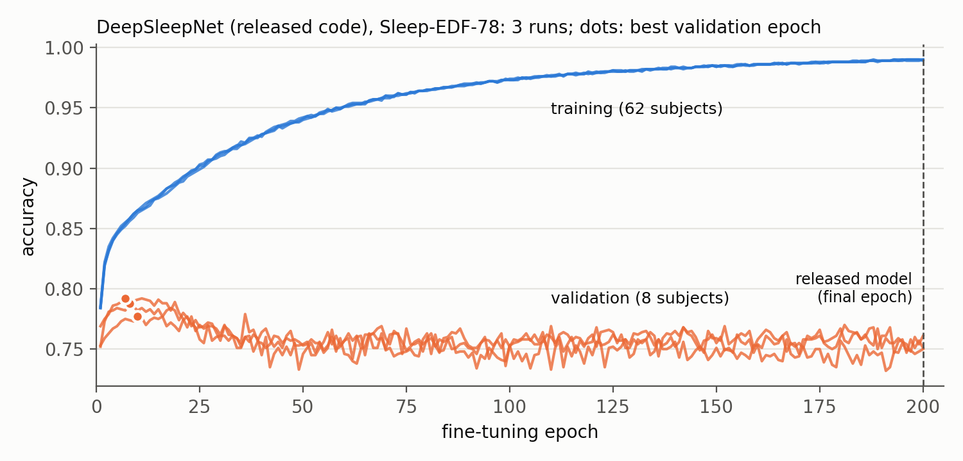
DeepSleepNet: Its Released Training Rule Falls Short, Not the Model
Released code keeps the final model of 200 fine-tuning epochs; the validation set is printed, never used
What I found
Validation peaks early: fine-tuning epoch 7–10 (accuracy 0.78–0.79), then falls to 0.75–0.76 while training accuracy reaches 0.99.
Larger data, same schedule: the 200 epochs were set for Sleep-EDF-20; this training set is 3.5× larger.
Effect: +0.059 κ for the pipeline version (p = 0.002); N2 / N3 F1 of the released model 0.75 / 0.70 vs. 0.85 / 0.84 on Sleep-EDF-20.
Next: the released trainer with validation-based selection.
κ on the common test set: released code 0.703 (3 runs); braindecode's DeepSleepNet in CBraMod's pipeline 0.762 (5 seeds, best-validation epoch).
Takeaway: On Sleep-EDF-78 the released DeepSleepNet is the weakest sequence model because it keeps an overfitted final model.

Slide 7
braindecode vs. the Original Implementations on Sleep-EDF
Same pipeline, split, seeds 0–4 and common test set; EEGNet compared with our PyTorch EEGNet
κ and balanced accuracy
What I found
Model | κ, released / ours | κ, braindecode | braindecode − original, κ | Balanced acc.
CBraMod | 0.768 | 0.768 | 0.000 (p = 0.99) | -0.014 (p = 0.17)
LaBraM-Base | 0.773 | 0.777 | +0.005 (p = 0.36) | +0.006 (p = 0.56)
EEG Conformer | 0.688 | 0.701 | +0.014 (p = 0.47) | +0.035 (p = 0.089)
EEGNet | 0.681 | 0.681 | -0.001 (p = 0.95) | +0.001 (p = 0.89)
All four within noise: κ all p ≥ 0.36, balanced accuracy all p ≥ 0.089.
LaBraM-Base: identical encoder features; the re-run has the highest κ of all runs (0.777).
CBraMod: κ +0.0001 with the same sequence head; the PhysioNet-MI gap fits braindecode's task head.
EEG Conformer: N3 F1 0.71 vs. 0.56 (p = 0.047), the one stage of 20 that differs; attention scaling and micro-batch both differ.
EEGNet: level with our PyTorch EEGNet despite max-norm, batch-norm and initialisation differences.
Takeaway: With the same sequence head, braindecode's models give the original implementations' Sleep-EDF results.

Slide 8
Issues Found and Next Steps
Released code of the two sleep models, and braindecode
Issues found
Next
L-SeqSleepNet: run scripts test every fold on subject 0; scripts ≠ paper (folding, stopping); evaluation batch > 12 GB; released data unfiltered although the prep script filters; Table III cites DeepSleepNet's per-stage F1 differently from DeepSleepNet's own Table IV.
DeepSleepNet: prepare_physionet.py stops at SC4362F0 on Sleep-EDF-78 (82 of 153 nights unwritten); no model selection, and 200 fine-tuning epochs overfit on the larger set.
braindecode: DeepSleepNet is single-epoch (no cross-epoch BiLSTM) with standard LSTM gates; L-SeqSleepNet is not in braindecode.
DeepSleepNet on Sleep-EDF-78 with validation-based checkpoint selection (its released trainer prints the validation accuracy already), to confirm that the final-model rule causes the gap.
L-SeqSleepNet: repetitions 2–5 on Sleep-EDF-20, to compare with the paper's SD.
ISRUC, CBraMod's own sleep benchmark, through the same pipeline: a published number to check the pipeline against.
SEED for all models once the license is approved. Carry-over: braindecode issues upstream; TUH access.
Takeaway: The sleep models reproduce; on a larger dataset, training rules matter as much as architectures.

Slide 9
Thank you

