Slide 1
Weekly Meeting: LaBraM Validation
Wooyoung Kim
Media Communication Lab
Notes:
LaBraM (Jiang, Zhao & Lu, ICLR 2024): validation of the released code and LaBraM-Base weights, plus a survey of how EEG review papers report existing methods' results (reproduction vs. citation).

Slide 2
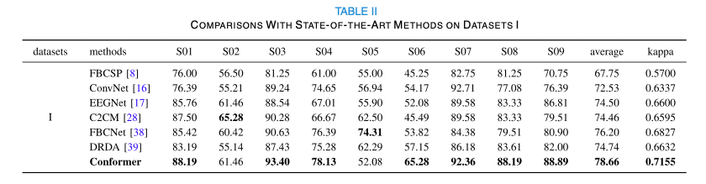
Experiment Result in the Paper vs. on my end (LaBraM, ICLR 2024)
Released run_class_finetuning.py (unmodified) + released LaBraM-Base weights · README recipe · CBraMod’s data and subject splits · 5 seeds (0–4) · Δ = mine − paper
Test metrics: published LaBraM-Base vs. my reproduction
Balanced accuracy (mean ± std, 5 seeds)
Dataset | Metric | Paper | Mine (5 seeds) | Δ
PhysioNet-MI CBraMod T3 | Balanced Acc. | 0.6173 ± 0.0122 | 0.6098 ± 0.0098 | −0.0075
 | Cohen's Kappa | 0.4912 ± 0.0192 | 0.4797 ± 0.0131 | −0.0115
 | Weighted F1 | 0.6177 ± 0.0141 | 0.6129 ± 0.0095 | −0.0048
BCIC-IV-2a CBraMod T15 | Balanced Acc. | 0.4869 ± 0.0085 | 0.4477 ± 0.0421 | −0.0392
 | Cohen's Kappa | 0.3159 ± 0.0154 | 0.2637 ± 0.0562 | −0.0522
 | Weighted F1 | 0.4758 ± 0.0103 | 0.3911 ± 0.0534 | −0.0847*
Mumtaz2016 CBraMod T10 | Balanced Acc. | 0.9409 ± 0.0079 | 0.8905 ± 0.0041 | −0.0504*
 | AUC-PR | 0.9798 ± 0.0093 | 0.9711 ± 0.0089 | −0.0087
 | AUROC | 0.9782 ± 0.0057 | 0.9664 ± 0.0166 | −0.0118
MentalArithmetic CBraMod T12 | Balanced Acc. | 0.6909 ± 0.0125 | 0.6562 ± 0.0397 | −0.0346
 | AUC-PR | 0.5999 ± 0.0155 | 0.6146 ± 0.0793 | +0.0147
 | AUROC | 0.7721 ± 0.0093 | 0.7791 ± 0.0608 | +0.0070
Takeaway: LaBraM-Base reproduces its published numbers on 10 of 12 metrics (2 significant*); last week CBraMod missed its own paper on 9 of 12 in the same pipeline. The Mumtaz2016 BA gap is shared by all three models I ran through this pipeline.
* Welch t-test against the published mean ± std (n = 5 vs. 5), p < 0.05. “Paper” = LaBraM-Base as reported in the CBraMod paper; LaBraM’s own paper evaluates only TUAB/TUEV/SEED-V/MoBI (access-gated).
Notes:
Setup: LaBraM-Base fine-tuned with its released run_class_finetuning.py (unmodified; only get_dataset() swapped for CBraMod's LMDB files) and released checkpoints/labram-base.pth. README recipe: lr 5e-4, layer decay 0.65, 5 warm-up epochs, 50 epochs, batch 64, drop path 0.1. Seeds 0-4, CBraMod's subject-independent splits, epoch chosen by validation kappa (4-class) / AUROC (binary) as LaBraM's paper states, test scored once. 20 runs on 8x Quadro M6000.
Within noise on 10 of 12 metrics; exceptions BCIC-IV-2a weighted F1 (-0.085) and Mumtaz2016 BA (-0.050). Mumtaz2016 gap shared by CBraMod (-0.063) and EEGNet (-0.040) in the same pipeline.

Slide 3
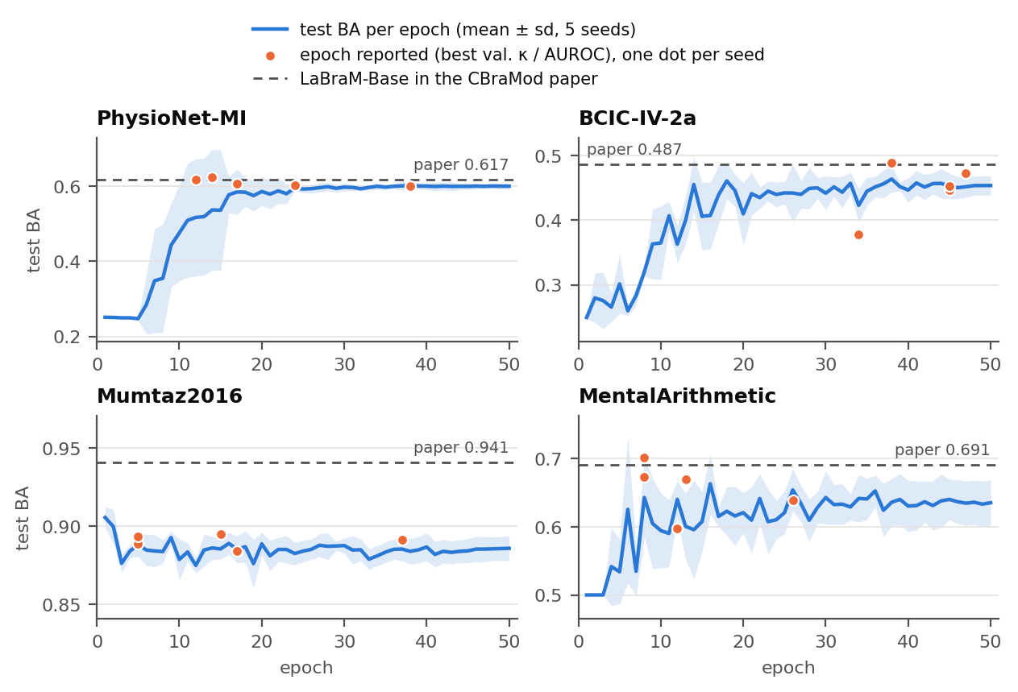
How Robust Is the Number? Epoch Selection, Threshold and Seeds
Same 20 runs · validation and test predictions saved for all 50 epochs, so every rule is recomputed without a GPU (code/selection_analysis.py) · test balanced accuracy
Test BA under four epoch-selection rules
What I found
Dataset | Reported (best val. κ / AUROC) | Best val. acc. (LaBraM code) | Last epoch | Best test epoch† | Paper
PhysioNet-MI | 0.6098 ± 0.0098 | 0.6098 ± 0.0098 | 0.5995 ± 0.0078 | 0.6161 ± 0.0082 | 0.6173
BCIC-IV-2a | 0.4477 ± 0.0421 | 0.4477 ± 0.0421 | 0.4536 ± 0.0147 | 0.4847 ± 0.0202 | 0.4869
Mumtaz2016 | 0.8905 ± 0.0041 | 0.8919 ± 0.0030 | 0.8858 ± 0.0079 | 0.9078 ± 0.0052 | 0.9409
MentalArithmetic | 0.6562 ± 0.0397 | 0.6632 ± 0.0988 | 0.6354 ± 0.0334 | 0.7215 ± 0.0421 | 0.6909
Clean protocol, robust rule: validation-only selection; κ and accuracy pick the same epoch in all 10 four-class runs.
Test-set selection would add +0.006 to +0.065 BA, an EEG-Conformer-style inflation.
Published ≥ my test-selected bound on 3 of 4 sets: the gap is the recipe or the pipeline, not the epoch.
† Picks the epoch with the test labels: not a valid protocol, shown only as an upper bound (it is EEG Conformer’s rule). Mean ± std over 5 seeds.
Seed spread: my runs vs. the published std (BA)
Dataset | Std (mine) | Std (published) | My 5 seeds, min – max
PhysioNet-MI | 0.0098 | 0.0122 | 0.601 – 0.623
BCIC-IV-2a | 0.0421 | 0.0085 | 0.379 – 0.489
Mumtaz2016 | 0.0041 | 0.0079 | 0.884 – 0.895
MentalArithmetic | 0.0397 | 0.0125 | 0.597 – 0.701
Conclusion: the reported LaBraM-Base number is robust to the reporting rule. What does not reproduce is the published seed spread: mine is 3–5× larger on BCIC-IV-2a and MentalArithmetic.
Notes:
Rules: (1) reported = first epoch with best validation kappa (4-class) / AUROC (binary); (2) LaBraM code = best validation accuracy (run_class_finetuning.py lines 499-505); (3) last epoch; (4) best test epoch (oracle, uses test labels).
Mumtaz2016: test BA highest after epoch 1 (0.906), then declines; threshold chosen on validation (Youden J) gives 0.8959 +- 0.0048. MentalArithmetic: validation-optimal thresholds 0.003-0.096, outputs badly calibrated; re-thresholding 0.6611 +- 0.0545.
Numbers: results/selection_analysis.txt; figure: results/fig_epoch_selection.png.

Slide 4
LaBraM’s Own Claims (TUAB, TUEV): What Can and Cannot Be Checked
TUAB/TUEV need TUH registration (not run on my end yet) · evidence: the paper, the released code, its GitHub issues and two independent benchmarks
LaBraM-Base on its own benchmarks: paper vs. re-runs (BA)
Issues found in the paper and the code
Source | TUAB | TUEV | Setting
LaBraM paper, Tables 1–2 | 0.8140 ± 0.0019 | 0.6409 ± 0.0065 | own pipeline, 5 seeds
EEG-FM-Bench 2025, T2 | 0.7950 ± 0.0081 | 0.5958 ± 0.0431 | released ckpt, matched protocol
AdaBrain-Bench 2025, T2 | 0.8150 | 0.5905 | released ckpt, cross-subject
Checkpoint rule ≠ paper: the paper monitors AUROC / κ (Sec. 3.2); the code keeps the best validation accuracy (lines 499–505).
Single-GPU runs never reshuffle: DistributedSampler is always on, but set_epoch() runs only for a distributed launch (lines 258, 476).
50 Hz notch on US (60 Hz) TUH data in make_TUAB.py / make_TUEV.py (issue #67, closed, no reply).
TUEV windows likely duplicated: one sample per annotation row, and rows are per channel (issue #46, open; not verifiable without TUH).
Seeds not reported; the README command runs --seed 0 only.
The benchmarks use their own preprocessing and splits: supporting evidence, not a controlled reproduction.
Where the rows of LaBraM’s Tables 1–2 come from
Row | Source
SPaRCNet … ST-Transformer | Copied from BIOT App. Tables 4–5 (BIOT’s re-implementations, 16-ch bipolar)
BIOT | Best of BIOT’s 4 TUAB / 13 TUEV variants (“we choose the best results”)
LaBraM-Base | LaBraM’s runs on 23 monopolar channels, 50 Hz notch
LaBraM-Large / -Huge | Weights not released (“commercial reasons”, issue #3)
LaBraM-Base, TUEV balanced accuracy
0.641 → 0.59–0.60
Paper (Table 2) vs. both independent re-runs from the released checkpoint. TUAB holds up better: 0.814 vs. 0.795 / 0.815.
Conclusion: LaBraM-Base is a sound baseline, but its headline comparison uses copied BIOT numbers from a different montage, Large/Huge cannot be checked, and both independent re-runs put its TUEV score about 0.05 BA lower.
Notes:
LaBraM Sec. 3.2 (p. 7): "The baselines are from Yang et al. (2023a), where we choose the best results to compare with." Every baseline cell in LaBraM Tables 1-2 equals BIOT Appendix Tables 4-5. make_TUEV.py line 157: the bipolar conversion inherited from BIOT is commented out, so LaBraM TUEV inputs are 23 monopolar channels. EEG-FM-Bench: arXiv 2508.17742 Table 2 (full-parameter single-task fine-tuning). AdaBrain-Bench: arXiv 2507.09882 Table 2 (cross-subject, full fine-tuning).

Slide 5
Review Papers: Do They Re-run Methods or Cite Their Numbers?
21 papers read in full · every verdict backed by a quote with page / table · details and links: docs/literature/review-papers-reproduction-vs-citation.md
Reviews & surveys: all cite, none re-runs
Benchmarks: all re-run, none checks claims
Paper | Where its numbers come from | Proof
Roy et al. 2019, JNE | Meta-analysis of 156 papers’ self-reported gains | Fig. 14; p. 28 “might be biased positively”
Zhang et al. 2021, JNE | Accuracies quoted from each paper | p. 7 “achieved an accuracy of 86%”
Gu et al. 2021, TCBB | Accuracies quoted from each paper | p. 11 “accuracy rate of 97.37%”
Kuruppu et al. 2025 | Reported scores, some read off plots | Fig. 3; Suppl. T2 “estimated based on the graphics”
Zhou et al. 2025 | LaBraM / NeuroLM rows copied; BA shown as “ACC” | Table III (p. 19)
Lai et al. 2025 | No numbers: results “incomparable” | p. 10
Benchmark | What was re-run
MOABB 2018 / 2024 | 30 pipelines re-implemented, 36 datasets
Gemein 2020 | Own runs + cited literature, labelled
Rommel 2022 | 13 augmentations, one protocol
Lee 2025 | LaBraM 0.742 vs. EEGNet 0.731 acc.
AdaBrain-Bench 2025 | LaBraM 64.61 > CBraMod 62.66 (avg.)
EEG-FM-Bench 2025 | 7 FMs, released checkpoints
EEG-Bench, Brain4FMs, OmniEEG-Bench | Released weights, one pipeline
Paywalled, not classified: Craik 2019, Lotte 2018, Yao 2025 (JNE), Altaheri 2023 (NCA). Method papers: BIOT re-implements its baselines; LaBraM and NeuroLM copy; CBraMod mixes both in one table, unmarked.
0 of 10 benchmarks put a method’s re-run number next to the number its own paper reports; they rank models instead.
Takeaway: reviews cite and benchmarks re-run, but nobody sets the re-run number against the paper’s own claim. That paper-vs-re-run column is what our review adds.
Notes:
Reviews/surveys without own experiments (6/6 cite): Roy 2019 (arXiv 1901.05498), Zhang 2021 (1905.04149), Gu 2021 (2001.11337), Kuruppu 2025 (2507.11783), Zhou 2025 (2503.00580), Lai 2025 (2504.20069). Hybrid: EEG-FM-Compass 2026 (2601.17883), whose Suppl. Table 59 also marks Lai, Zhou and Kuruppu as having no benchmark. Benchmarks (10/10 re-run): MOABB 2018 (1805.06427), MOABB 2024 (2404.15319), Gemein 2020 (2002.05115), Rommel 2022 (2206.14483), Lee 2025 (2507.01196), AdaBrain-Bench (2507.09882), EEG-FM-Bench (2508.17742), EEG-Bench (2512.08959), Brain4FMs (2602.11558), OmniEEG-Bench (2606.00815).

Slide 6
Citation Chain: One Set of TUAB/TUEV Numbers Through Five Papers
Same digits downstream: SPaRCNet TUEV 0.4161 ± 0.0262 (BIOT → CBraMod), LaBraM-Base TUEV 0.6409 ± 0.0065 (LaBraM → Zhou et al.)
BIOT
NeurIPS 2023
LaBraM
ICLR 2024
NeuroLM
ICLR 2025
CBraMod
ICLR 2025
Zhou et al.
survey, 2025
RE-RUN
COPIED
COPIED
COPIED
COPIED
Re-implements 5 baselines on TUAB / TUEV (16-ch bipolar), 5 seeds.
Copies every baseline row; BIOT row = best of 4 / 13 variants; adds Base, Large, Huge.
Reprints LaBraM’s rows; says its results use three seeds (LaBraM’s are five).
Reprints 9 rows incl. Large/Huge next to its own TUEV runs on 16 bipolar ch, 60 Hz (LaBraM: 23 monopolar, 50 Hz).
Reprints LaBraM’s and NeuroLM’s values; balanced accuracy printed as “ACC”.
Proof: App. A.2; Tables 4–5
Proof: Sec. 3.2 “we choose the best results”; T1–2
Proof: p. 7; Table 2
Proof: Tables 13–14
Proof: Table III
Meanwhile, re-run from the released checkpoint: LaBraM-Base TUEV BA 0.596 (EEG-FM-Bench) and 0.591 (AdaBrain-Bench), against the 0.641 copied along this chain. LaBraM-Large / -Huge rows (0.658 / 0.662) cannot be re-run by anyone.
Takeaway: copied numbers travel without a label. Our tables will mark every number as either re-run by us or cited, with the source paper and table.
Notes:
BIOT arXiv 2305.10351 App. A.2 p.15, Tables 4-5 p.16. LaBraM arXiv 2405.18765 Sec. 3.2 p.7, Tables 1-2 p.8. NeuroLM arXiv 2409.00101 p.7 ("reported using three random seeds"), Table 2 p.8. CBraMod arXiv 2412.07236 Sec. 3.2 p.7, Tables 13-14 p.26 (TUEV: "16 bipolar montage", notch 60 Hz). LaBraM make_TUEV.py: 23 monopolar channels, notch 50 Hz. Zhou et al. arXiv 2503.00580 Table III p.19.

Slide 7
Thank you

