Slide 1
Weekly Meeting: ATCNet & braindecode
Wooyoung Kim
Media Communication Lab
Notes:
LaBraM (Jiang, Zhao & Lu, ICLR 2024): validation of the released code and LaBraM-Base weights, plus a survey of how EEG review papers report existing methods' results (reproduction vs. citation).

Slide 2
braindecode Re-implementations of the Four Reviewed Methods
braindecode 1.8.1 swapped into each released pipeline (data, splits, seeds, checkpoint rule unchanged) · same weights compared first · 149 runs
braindecode vs. the released implementation
Model | Same weights → same output? | braindecode − released, same pipeline | Verdict
EEG Conformer | No: attention ÷ √(head dim) = 2, not √40; identical once patched | released rule 78.56 vs. 78.72% (p = 0.57) validation-selected 69.32 vs. 70.01% (p = 0.57) | reproduces
CBraMod | Encoder + weights identical; head differs (proj_out kept + 1 linear layer) | 3 of 4 datasets within noise; PhysioNet-MI BA −0.020 (p = 0.02), −0.072 scratch, −0.092 frozen | except PhysioNet-MI
LaBraM-Base | Identical (weights and logits) | all 12 metrics within noise (p ≥ 0.12) | reproduces
EEGNet | vs. our PyTorch EEGNet (same size) | all 12 metrics within noise (closest p = 0.053) | reproduces
CBraMod’s gap is the head: the released model with its own 1-layer head scores like braindecode’s when fine-tuned (0.604 vs. 0.607); frozen, probing proj_out’s output costs 0.10.
No braindecode version comes closer to its paper; one ranking changes: CBraMod no longer beats LaBraM-Base on PhysioNet-MI when both come from braindecode (−0.011, p = 0.13).
Pitfalls: needs torch ≥ 2.1 (declares 2.0); Labram.from_pretrained() fails for windows ≠ 15 s; Labram lacks no_weight_decay(); CBraMod.from_pretrained() loads with strict=False.
Takeaway: braindecode’s versions of the four models reproduce the released code’s numbers, except CBraMod on PhysioNet-MI, where braindecode ships a different task head.

Slide 3
ATCNet (IEEE TII 2023): Experiment Result in the Paper vs. on My End
Authors’ TensorFlow code: the 2022 version behind the paper (repo history) and today’s two scripts · BCI IV 2a, session T → E · 297 runs
Accuracy (%), mean over 9 subjects
What I found
Code | Validation data | Reported | Acc. (κ)
Paper (Tables IV–V) | – | – | 85.38 (0.805)
Authors’ 2022 runs (log) | test set | best of 10 | 85.38 (0.805)
Authors’ 2022 runs (log) | test set | mean | 81.98 (0.760)
2022 code, mine | test set | best of 10 | 84.18 (0.789)
2022 code, mine | test set | mean | 81.47 (0.753)
main_TrainTest.py (today) | test set | mean | 86.89 (0.825)
main_TrainValTest.py (today) | 20% of session T | mean | 79.52 (0.727)
Paper, LOSO (Table VI) | – | – | 70.97 (0.613)
LOSO, main_TrainTest.py | held-out subject | best of 3 | 70.16 (0.602)
LOSO, main_TrainTest.py | held-out subject | mean | 69.06 (0.587)
Data check: the paper’s saved best-of-10 models give exactly 85.38% / κ 0.805 on my copy of the data.
85.38% = best of 10 runs per subject, chosen by test accuracy, each run checkpointed on the test set (authors’ 2022 log: best 85.38, mean of all runs 81.98).
The 2022 code reproduces the authors’ runs: mean 81.47% vs. 81.98% (Mann-Whitney p = 0.77).
With a validation split (the authors’ current recommendation): 79.52%, −5.86 pp. Seed 1 matches the README (81.10%) on 8 of 9 subjects to the trial.
Today’s main_TrainTest.py is a rewritten model: 86.89% per run under the old protocol (+5.42 pp vs. the 2022 code).
LOSO reproduces within 1–2 pp (70.16% best of 3 vs. 70.97%).
Takeaway: the code behind the paper reproduces; the 85.38% is a best-of-10, test-selected statistic. A single run with a validation split gives ≈ 79.5%.

Slide 4
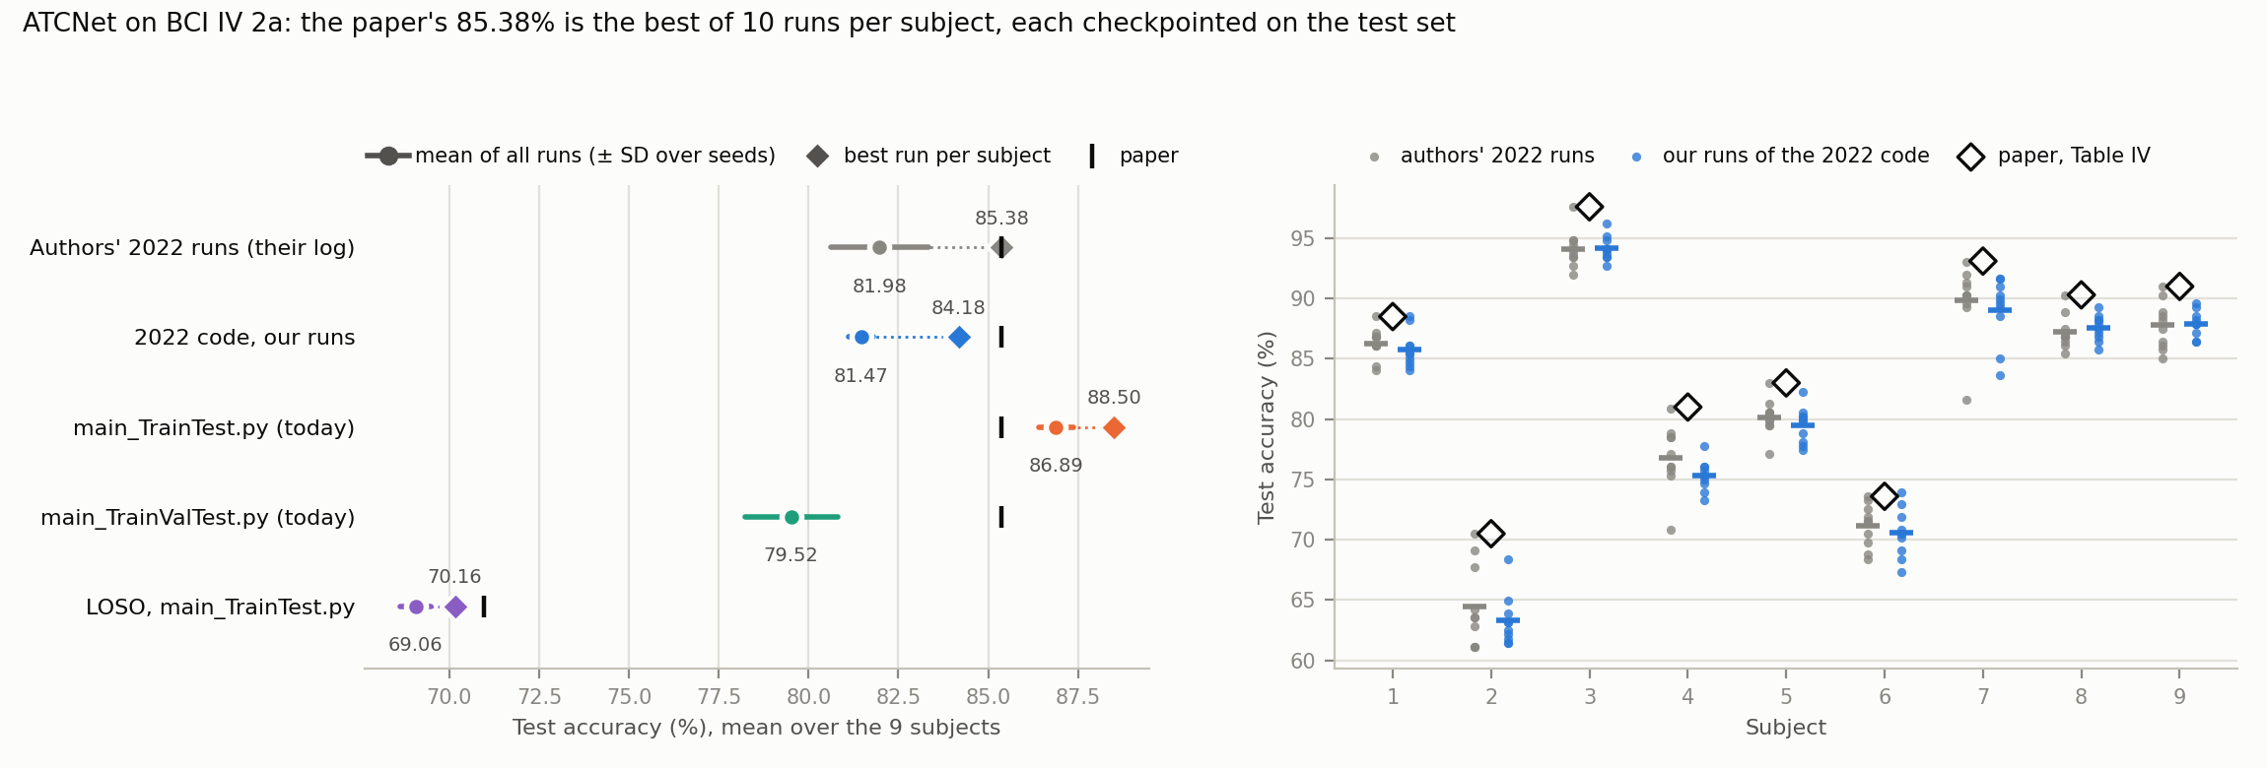
What the 85.38% Is Made Of: Two Selections on the Test Set
2022 main.py: session E is Keras’ validation data → checkpoint = best test epoch, early stopping on test accuracy; test() reports each subject’s best of 10 runs
2022 code, one run: 77.9% over its last 50 epochs → saved best test epoch 81.47% (+3.6 pp) → best of 10 runs 84.18% (+2.7 pp); the authors’ own runs: 81.98 → 85.38% (+3.4 pp).
Takeaway: ≈ 6–7 pp of the 85.38% come from choosing epochs and runs on the test set; with a validation split ATCNet scores 79.52%.

Slide 5
braindecode’s ATCNet vs. the Released Code
Released training loops ported to PyTorch (released data loader, Keras fit semantics, callbacks, seeds) · controls = braindecode + Keras training behaviour
Accuracy (%), braindecode − Keras on the same seeds
What I found
Protocol | Keras | bd default | Δ default | Δ “faithful” | Δ control
2022 loop (paper) | 81.47 | 76.26 | −5.20* | – | +0.72
main_TrainTest.py | 86.76 | 76.41 | −10.35* | −3.29* | +0.58
main_TrainValTest.py | 80.29 | 67.57 | −12.72* | −4.63* | −1.12
LOSO | 69.12 | 67.36 | −1.76 | – | –
Same network: authors’ weights load 1:1; identical predictions with Keras’ BatchNorm eps (with braindecode’s eps the paper’s models score 84.53%, not 85.38%).
Paper’s protocol: −5.20 pp (76.26 vs. 81.47%, 0 of 9 subjects higher); the control with the Keras training behaviour is level.
Cause: the final max-norm axis. MaxNormLinear limits the norm per input feature; per output unit (Keras) recovers +3.68 to +4.57 pp. Other differences ≤ 1.5 pp.
Today’s loops: −10 to −13 pp; “faithful” options close two thirds (wrong axis kept; their L2 is half strength).
LOSO: −1.76 pp (1 seed, n.s.).
* Wilcoxon p < 0.05 over the 9 subjects. Mean of runs; 2022 loop 10 seeds, others 1–5 (README).
Ablation (2022 loop): defaults + one Keras behaviour
Switched on | Δ vs. defaults | Δ vs. Keras
element-wise dropout | +1.50 | −2.35
attention-weight dropout | −0.58 | −4.44*
Keras BatchNorm | +0.46 | −3.40
Keras init | −0.69 | −4.55*
depthwise max-norm | +0.73 | −3.13*
final max-norm per output unit | +3.68* | −0.89
Takeaway: braindecode’s ATCNet is the released network with a one-argument difference (MaxNormLinear’s dim) that costs 5 pp; with the Keras axis it matches the Keras code within noise.

Slide 6
Issues Found and Conclusion
ATCNet paper and code; braindecode’s ATCNet
Issues found
Conclusion
Test set used twice: checkpoint/early stopping on session E, then best of 10 runs by test accuracy; neither in the paper.
Released code ≠ paper code: the 2022 code, log and weights were removed in Dec. 2023 after a rewrite (+5.4 pp per run under the same protocol).
Table VI: the uploaded 2022 LOSO loader cannot run (arguments in the wrong order).
Paper vs. code: windows averaged, not concatenated; extra dropout; 115.2K params incl. BatchNorm statistics.
Baselines (Table IV) were re-run with the same test-set selection.
braindecode: MaxNormLinear axis (also EEGTCNet); BatchNorm eps; L2 helper at half strength.
Reproduces under its own rule: 85.38% exact from the paper’s models; 2022 code ≈ authors’ runs.
Honest number: 79.52% (validation split, 10 seeds); LOSO 69.06%.
Still strong: above EEG Conformer’s 70.01% with a validation split (different pipelines).
braindecode: four earlier models reproduce (CBraMod except PhysioNet-MI); ATCNet needs a one-line fix.
Next: report the braindecode issues upstream; re-run ATCNet’s baselines with a validation split; one shared protocol for ATCNet, EEG Conformer and EEGNet.

Slide 7
Thank you

