Slide 1
Weekly Meeting: SEED, SEED-V, STEW and DGCNN
Wooyoung Kim
Media Communication Lab
Notes:
SEED, SEED-V and STEW: every method in one pipeline per dataset; DGCNN (Song et al., IEEE TAC 2020) added, validated on SEED and run on every dataset in the repository.

Slide 2
SEED, SEED-V, STEW and DGCNN: What I Ran
Three new datasets with every model in one pipeline per dataset; DGCNN (Song et al., IEEE TAC 2020) added and run on every dataset
What I ran
What I found
Dataset | Protocol | Models | Runs
SEED, SEED-V | CBraMod's released SEED-V pipeline: trial split and subject split, seeds 0–4 | all models; 5 braindecode twins | 210 + 12
SEED | DGCNN's protocols: within subject (9 → 6 clips), leave one subject out | DGCNN, linear SVM | 87 jobs
SEED | EEG Conformer's released 5-fold code; the same with whole clips held out | EEG Conformer | 120
STEW | 7-fold GroupKFold across subjects, rest vs. task and 3 rating levels, seeds 0–4 | all models; 5 braindecode twins | 980 + 42
BCI-IV-2a, PhysioNet-MI, Mumtaz2016, MentalArithmetic, Sleep-EDF | the existing pipelines of each dataset | DGCNN (ours, braindecode) | 124
SEED, SEED-V. CBraMod's released SEED-V code (1-s samples, 62 channels, 200 Hz) with only the model swapped. Trial split = the CBraMod paper's protocol; subject split 9 / 3 / 3 (SEED-V 10 / 3 / 3).
STEW. 48 subjects, Emotiv (14 channels, 128 Hz), rest vs. the SIMKAP multitasking test; 4-s windows, 25% overlap, GroupKFold(7) by subject.
DGCNN. Ported line by line from the authors' archived TensorFlow code; with the same weights it equals braindecode's DGCNN (to 1e-7).
Paper protocols. The two papers that report SEED, DGCNN and EEG Conformer, re-run under their own rules.
Takeaway: Every model in the repository now has SEED, SEED-V and STEW results under identical conditions, and DGCNN has results on every dataset.

Slide 3
STEW: Does GroupKFold Need a Random Seed?
As specified: sample_rate 128 Hz, window_sec 4.0, overlap_ratio 0.25, GroupKFold(n_splits=7) across subjects
Protocol
What I found
Setting | Value
Recordings | 48 subjects × (150 s rest + 150 s SIMKAP), 14 channels at 128 Hz; 0.3 Hz high-pass
Windows | 512 samples, stride 384: 49 per recording, 4,704 in all (98 per subject)
Folds | GroupKFold(n_splits=7) by subject; test = fold k, validation = fold k + 1
Tasks | rest vs. task (48 subjects); 3 rating levels 1–3 / 4–6 / 7–9 (45 subjects)
Foundation models | the same windows resampled to 200 Hz, as their weights require
Seeds | 0–4 for each fold; each seed scored on its 7 pooled test folds
No seed to set. GroupKFold does not shuffle, and random_state without shuffle=True raises an error.
Deterministic, but not portable. Every subject has 98 windows; with tied group sizes the assignment depends on the numpy / scikit-learn version.
Pinned. The folds are saved in folds.json, and every model reads them.
Training seeds are still needed: 5 per fold. On rest vs. task the SD across folds (0.05–0.06) is four to eight times the SD across seeds.
Fold 0 from the same call, two environments
scikit-learn / numpy | Subjects in fold 0
1.6.1 / 2.0.2 | 3, 10, 17, 31, 38, 45, 48
1.9.1 / 1.26.4 (pinned) | 6, 13, 20, 27, 34, 41, 48
Takeaway: GroupKFold needs no random seed, but its folds must be saved: the same call gives different folds with different library versions.

Slide 4
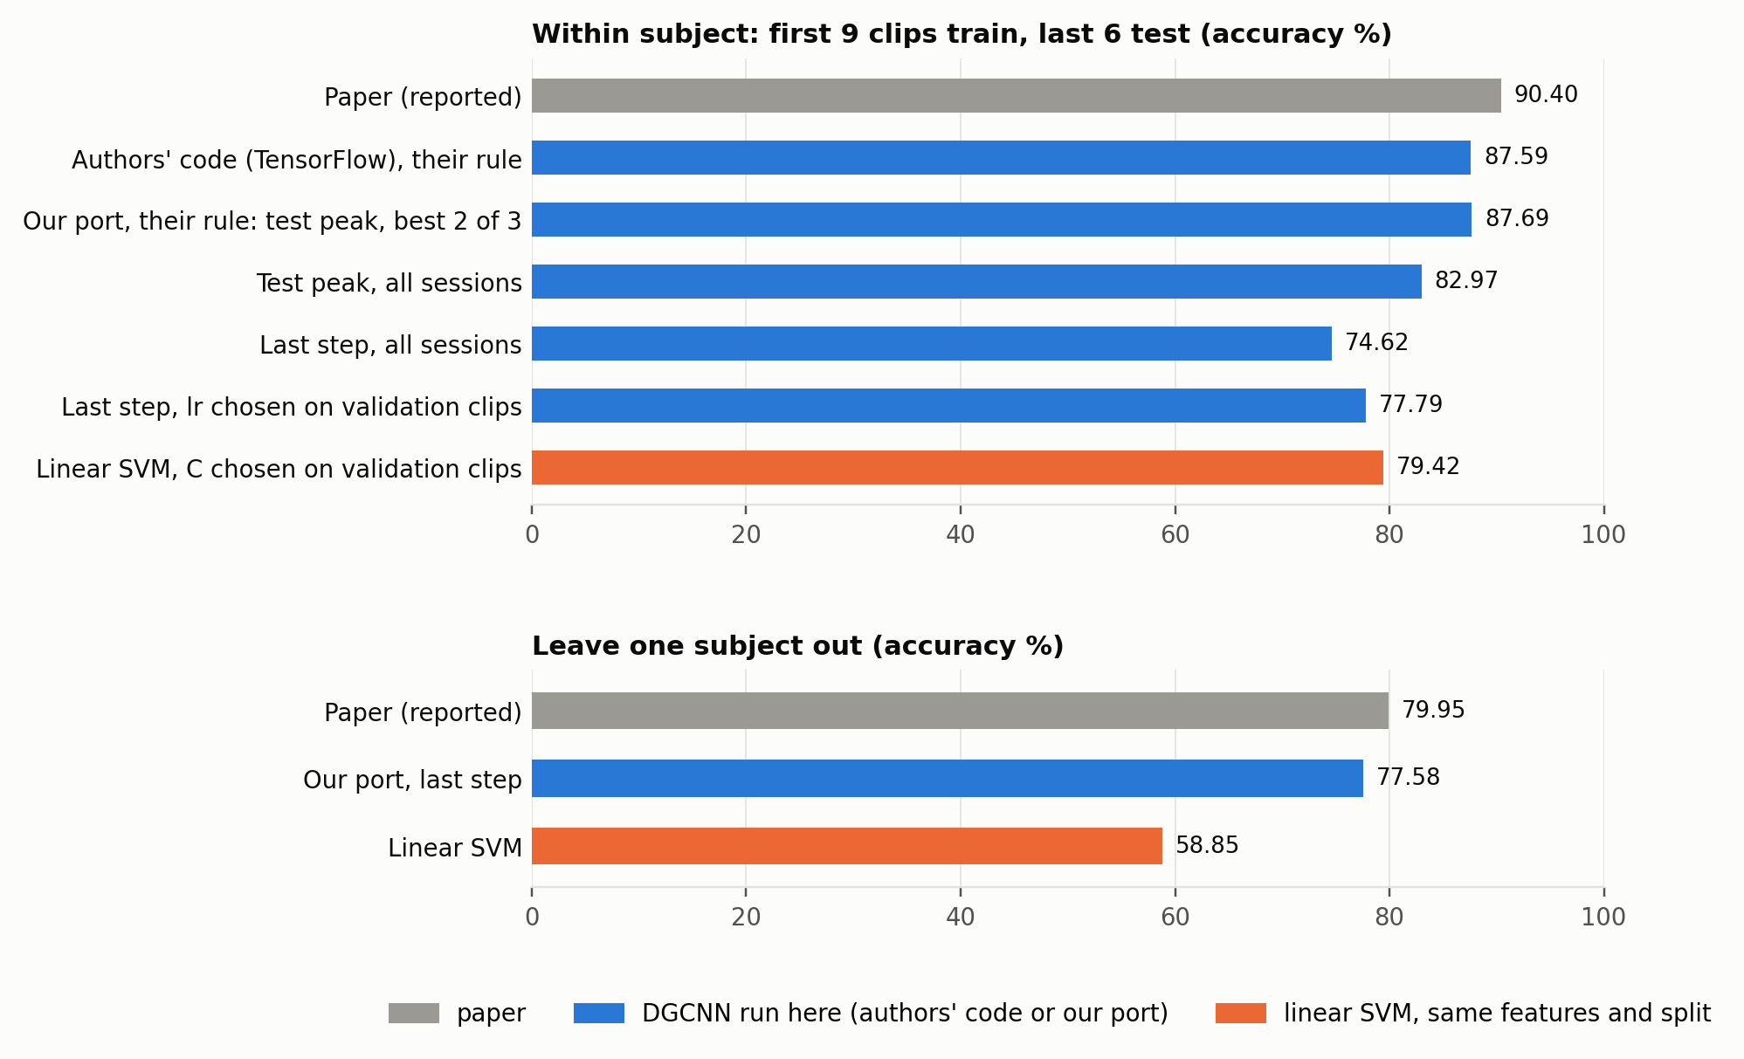
DGCNN's 90.40% on SEED Is Mostly Test-Set Selection
SEED de_LDS features, 45 sessions, first 9 clips train, last 6 test; 5 runs each of the authors' unmodified TensorFlow code and our PyTorch port
What I found
The authors' rule: eeg_DE.py validates on the test set; the reported number is the peak of ~80 test evaluations, averaged over each subject's best 2 of 3 sessions.
Their own code, run unmodified: 87.59 under that rule; our port 87.69 (p = 0.75). Both 2.7 points below the paper: the gap is not in the port (most likely the input files).
Without test selection: 74.62 at the last step, 77.79 with the learning rate chosen on validation clips.
A linear SVM ties: 79.42 on the same features and split (Wilcoxon p = 0.33).
Across subjects the paper holds: 77.58 vs. 79.95; SVM 58.85 (p = 0.0001).
Takeaway: DGCNN's within-subject 90.40% is mostly test-set selection; its real advantage over a linear SVM is across subjects.

Slide 5
EEG Conformer's 95.30% on SEED: Folds Cut Inside Clips
Released conformer_seed_1s_5fold.py, session 1 of 15 subjects, 1-s windows; the second split changes only which windows are tested
Which windows are tested (one session: 15 clips of about 4 min)
What I found
Released: 5 folds inside every clip (fold 1 shown)
Reproduces: 98.24 at the best test epoch, 96.82 at the final epoch (README: 95.30).
Folds inside clips: each clip is cut into fifths and fold k tests the k-th fifth of every clip, so a test window's neighbours one second away are in training.
Whole clips held out: 79.12 / 71.59 with the same model, session and training.
Gap: 25 points at the final epoch (p = 0.0001, 15 subjects).
Second split: whole clips held out (first 9 train, last 6 test)
1
2
3
4
5
6
7
8
9
10
11
12
13
14
15
training windows
test windows
Accuracy %, mean ± SD over 15 subjects
Epoch rule | Folds inside clips | Whole clips held out | Difference (Wilcoxon)
best epoch on test, released | 98.24 ± 1.06 | 79.12 ± 11.91 | +19.12 (p = 0.0001)
final epoch | 96.82 ± 1.71 | 71.59 ± 12.54 | +25.23 (p = 0.0001)
Takeaway: EEG Conformer's SEED number mostly measures recognising clips it trained on; on unseen clips it reaches 71.6%.

Slide 6
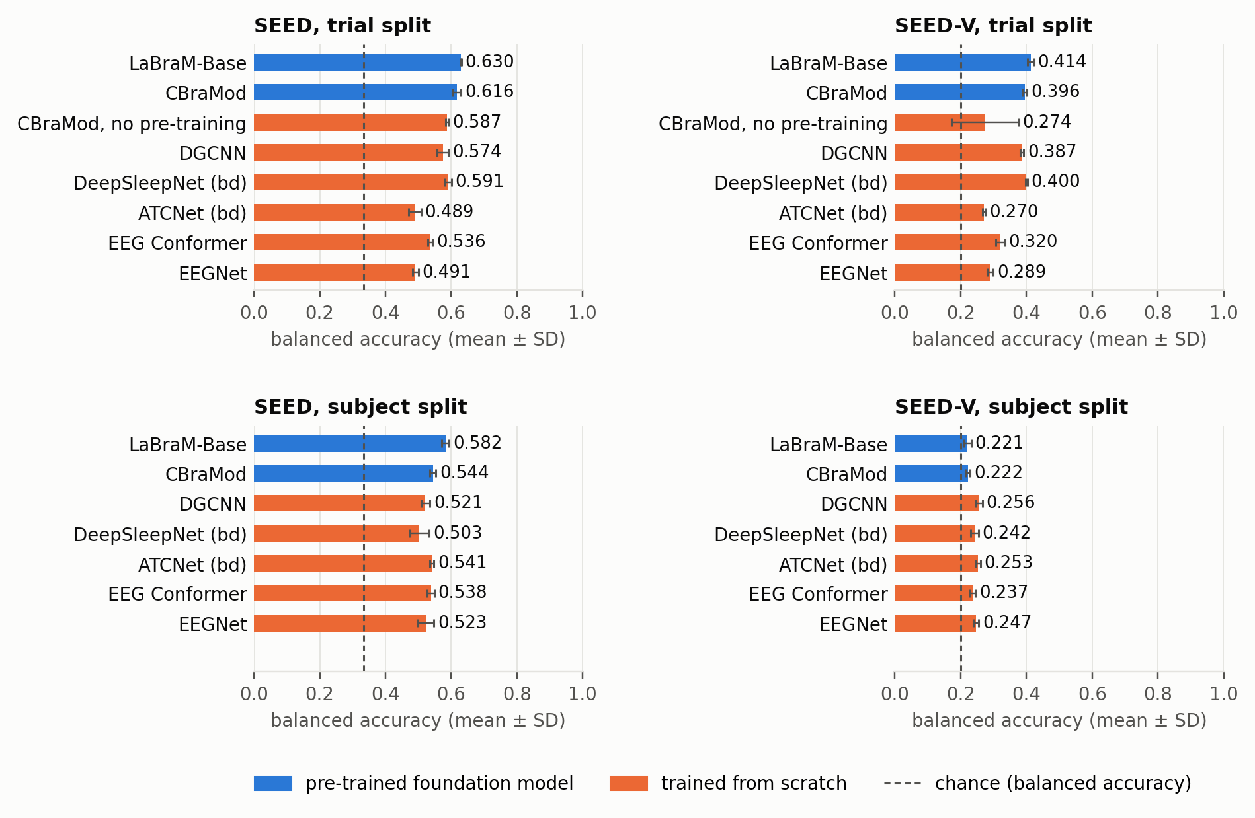
SEED and SEED-V: Every Model in CBraMod's Pipeline
Balanced accuracy, seeds 0–4. Trial split: clips 1–5 / 6–10 / 11–15 of every subject (the CBraMod paper's SEED-V protocol); subject split: unseen subjects
What I found
LaBraM-Base leads: 0.630 on SEED's trial split, 0.582 across subjects, 0.414 on SEED-V (CBraMod 0.396, p = 0.011).
SEED-V across subjects is near chance: 0.22–0.26 for 5 classes (κ 0.02–0.07); the foundation models lowest.
Pre-training: +0.029 on SEED (p = 0.007); on SEED-V 3 of 5 seeds without it never leave chance.
Small supervised models: DGCNN beats EEG Conformer and EEGNet on both trial splits; braindecode's DeepSleepNet is level with CBraMod on SEED-V; ATCNet (bd) underfits 1-s samples (SEED-V 0.270, SEED 0.489), yet matches CBraMod across subjects on SEED (0.541).
L-SeqSleepNet (off-label, 30-s windows): clip vote 0.51 on SEED's trial split; its 0.79 across subjects is not valid (it reads the fixed clip order).
Takeaway: Published SEED-V numbers need the test subjects in training; across subjects every model is near chance.

Slide 7
SEED-V Against the CBraMod Paper (Table 2)
Trial split, seeds 0–4, CBraMod's released code; ours − paper, Welch p from the paper's means and SDs (n = 5)
Paper / ours (Δ, p)
What I found
Model | Balanced accuracy | Cohen's κ | Weighted F1
CBraMod | 0.409 / 0.396 −0.013 (p = 0.041) | 0.257 / 0.250 −0.007 (p = 0.38) | 0.410 / 0.402 −0.008 (p = 0.21)
LaBraM-Base | 0.398 / 0.414 +0.016 (p = 0.069) | 0.239 / 0.266 +0.028 (p = 0.041) | 0.397 / 0.416 +0.019 (p = 0.020)
EEG Conformer | 0.354 / 0.320 −0.033 (p = 0.003) | 0.177 / 0.146 −0.031 (p = 0.031) | 0.349 / 0.314 −0.035 (p = 0.023)
EEGNet | 0.296 / 0.289 −0.007 (p = 0.31) | 0.101 / 0.113 +0.013 (p = 0.15) | 0.275 / 0.274 −0.001 (p = 0.87)
CBraMod reproduces in κ and weighted F1 (within noise); its balanced accuracy is 0.013 lower (p = 0.041).
Its closest match to its paper here: on its four other datasets 9 of 12 metrics were significantly lower.
LaBraM-Base exceeds the paper's κ and weighted F1 for it and beats CBraMod (p = 0.011): the paper's ranking reverses.
EEG Conformer is about 0.03 below the paper on all three metrics; EEGNet is within noise.
Bold: ours differs from the paper (p < 0.05). Paper: CBraMod's Table 2 for all four models.
Takeaway: CBraMod's SEED-V result reproduces; its lead over LaBraM-Base does not.

Slide 8
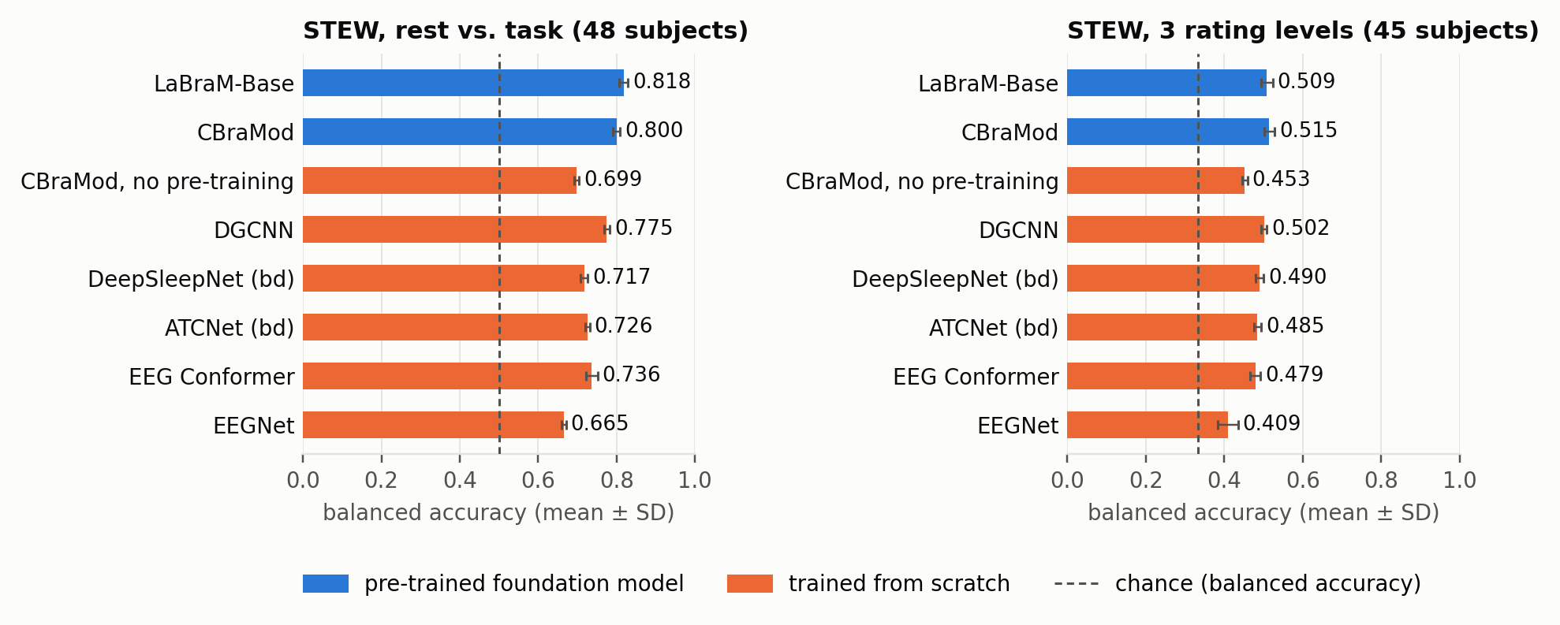
STEW: Foundation Models Lead; Three Workload Levels Barely Decodable
7-fold GroupKFold across subjects, seeds 0–4; each seed scored on its 7 pooled test folds; balanced accuracy
What I found
Rest vs. task: LaBraM-Base 0.818, CBraMod 0.800 (p = 0.022); DGCNN 0.775 is the best model without pre-training.
Pre-training: +0.10 (p < 0.001), CBraMod's largest significant gain in the repository.
Folds dominate: on rest vs. task the SD across folds (0.05–0.06) is four to eight times the SD across seeds.
3 rating levels: at most 0.574 accuracy (braindecode's LaBraM-Base) against 0.467 for the majority class; κ ≤ 0.33.
L-SeqSleepNet (off-label, 30-s windows, 3 channels): 0.767 on rest vs. task, 0.541 on 3 levels; longer windows, so not a ranking.
3 rating levels, Cohen's κ: LaBraM-Base (braindecode) 0.33, CBraMod 0.31, LaBraM-Base 0.31, DGCNN 0.30, DeepSleepNet (bd) 0.27, ATCNet (bd) 0.26, EEG Conformer 0.25, CBraMod, no pre-training 0.20, EEGNet 0.14.
Dataset paper (Lim et al., 2018): 69% / κ 0.46 on 3 levels with a feature-selection pipeline; its abstract does not state how it cross-validated.
Takeaway: Rest vs. task is decodable across subjects; three self-rated workload levels barely are.

Slide 9
DGCNN on the Other Datasets: The Input Decides
CBraMod's cross-subject splits, seeds 0–4, balanced accuracy. DGCNN: differential entropy (DE) of 5 bands per channel; braindecode's DGCNN as shipped: raw samples
CBraMod's splits
What I found
Dataset | DGCNN (DE) | DGCNN (bd, raw) | CBraMod | LaBraM-Base | EEGNet
PhysioNet-MI | 0.482 | 0.578 | 0.626 | 0.610 | 0.595
BCI-IV-2a | 0.346 | 0.452 | 0.457 | 0.448 | 0.529
Mumtaz2016 | 0.962 | 0.871 | 0.893 | 0.890 | 0.883
MentalArithmetic | 0.624 | 0.559 | 0.589 | 0.656 | 0.557
Band power suits it: best model on Mumtaz2016 (0.962) and second to LaBraM-Base on MentalArithmetic (0.624 vs. 0.656).
Motor imagery does not: raw samples beat DE by 0.09–0.11, and DGCNN is last on PhysioNet-MI and BCI-IV-2a, within subject too (44.4% vs. 70.0% for EEG Conformer).
Sleep-EDF-78: κ 0.694, level with EEG Conformer and EEGNet.
braindecode's DGCNN ships with raw samples as node features: 0.05–0.11 lower on every dataset except motor imagery.
Bold: best in the row.
Other protocols
Protocol | DGCNN | EEG Conformer | EEGNet
BCI-IV-2a, within subject, validation-selected epoch (accuracy %) | 44.4 | 70.0 | 67.4
Sleep-EDF-78, CBraMod's sleep pipeline (κ) | 0.694 | 0.688 | 0.681
Takeaway: DGCNN is a band-power model: strong where spectral power carries the label, weak on motor imagery.

Slide 10
braindecode vs. the Original Implementations
Same pipeline, splits and seeds 0–4; braindecode − original, balanced accuracy, Welch p over seeds; EEGNet against our PyTorch EEGNet
braindecode − original (p)
What I found
Model | SEED trial | SEED-V trial | STEW rest vs. task | STEW 3 levels
CBraMod | +0.004 (p = 0.59) | −0.018 (p = 0.011) | −0.002 (p = 0.71) | −0.021 (p = 0.021)
LaBraM-Base | −0.014 (p = 0.061) | −0.003 (p = 0.56) | −0.003 (p = 0.74) | +0.018 (p = 0.077)
EEG Conformer | −0.010 (p = 0.099) | −0.024 (p = 0.019) | −0.004 (p = 0.65) | −0.022 (p = 0.018)
EEGNet | −0.016 (p = 0.093) | −0.009 (p = 0.26) | −0.013 (p = 0.31) | −0.009 (p = 0.56)
DGCNN, our DE input | +0.001 (p = 0.94) | −0.011 (p = 0.005) | +0.009 (p = 0.14) | +0.002 (p = 0.76)
DGCNN as shipped (raw) | −0.055 (p = 0.001) | −0.102 (p < 0.001) | −0.106 (p < 0.001) | −0.066 (p < 0.001)
Within noise on the easier tasks: every model on SEED's trial split and STEW's rest vs. task (all p ≥ 0.06).
About 0.02 lower on the harder ones: CBraMod (braindecode's one-layer head instead of the released three-layer head) and EEG Conformer, on SEED-V and on STEW's 3 levels.
DGCNN: on our DE input level with ours except on SEED-V (−0.011); as shipped, raw input costs 0.05–0.11.
LaBraM-Base and EEGNet: within noise everywhere.
Bold: p < 0.05.
Takeaway: braindecode reproduces the original models on the easier tasks; its CBraMod and EEG Conformer lose about 0.02 on the harder ones.

Slide 11
Issues Found and Next Steps
Released code, datasets and braindecode
Issues found
Next
DGCNN: the reported 90.40% validates on the test set, keeps the peak of ~80 test evaluations and averages each subject's best 2 of 3 sessions; its own code reaches 87.6% on SEED's DE features; no subject-independent script; the DE smoothing is not stated. torcheeg's DGCNN uses powers of the adjacency matrix, not Chebyshev polynomials.
EEG Conformer: conformer_seed_1s_5fold.py makes its folds inside clips (96.8% vs. 71.6% with clips held out).
CBraMod: model_for_seedv.py crashes with its default head; the released Trainer crashes when validation κ never exceeds 0 (both worked around outside upstream/).
Datasets: SEED-V ships subject 7's first session twice; LaBraM's SEED-V result uses a 20-subject version that is not public; GroupKFold folds on STEW depend on library versions.
DGCNN: its authors' own code reaches 87.6%, not 90.40%; read the paper for how its DE features were made, and ask the authors for the input files.
L-SeqSleepNet on SEED with sequences confined to one clip, to confirm that its subject-split score reads the clip order.
Carry-over: DREAMER for DGCNN (access by request); ISRUC; TUH access; braindecode issues upstream (including DGCNN's raw-input default).
Takeaway: Both SEED papers reproduce under their own rules, and both rules inflate the number; in one pipeline per dataset LaBraM-Base is first or level with the first wherever a model learns.

Slide 12
Thank you

