Slide 1
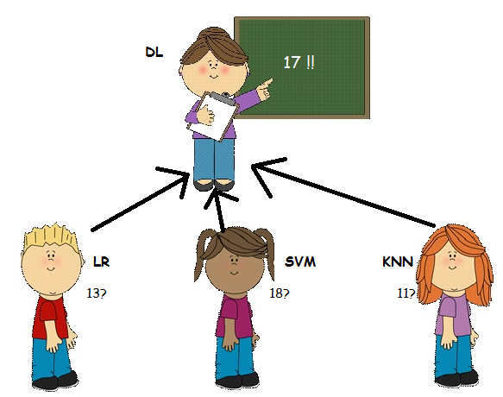
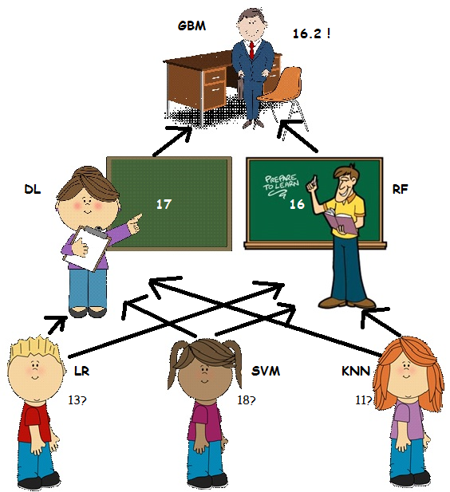
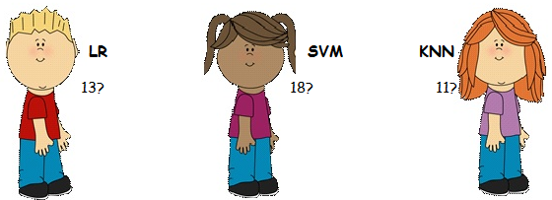
Why meta modelling?

Slide 2
Inspiration - Stacking
Wolpert in 1992 introduced stacking – a Meta-modelling technique.
Split the training set into two disjoint sets.
Train several base learners on the first part.
Make predictions with the base learners on the second part.
Using the predictions from (3) as the inputs, and the correct responses as the outputs, train a higher level learner.

Slide 3

Still confused about Stacking?
Train algorithm 0 on A and make predictions for B and C and save to B1, C1
Train algorithm 1 on A and make predictions for B and C and save to B1, C1
Train algorithm 2 on A and make predictions for B and C and save to B1, C1
Consider datasets A,B,C. Target variable (y) is known for A,B
Train algorithm 3 on B1 and make predictions for C1

