Slide 1

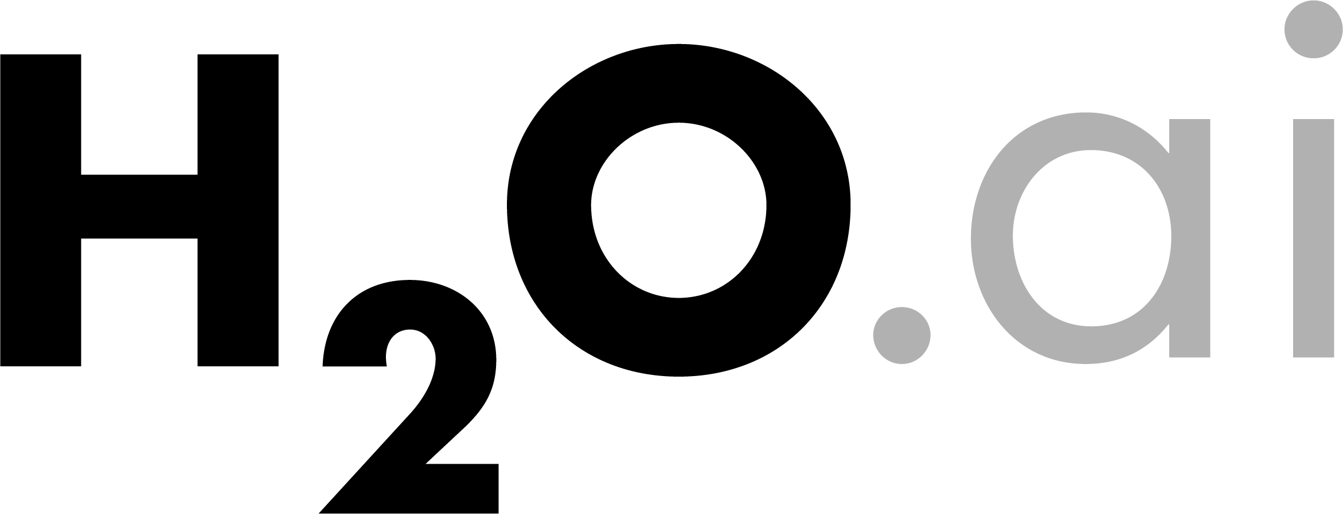
Productionizing H₂O

Slide 2
Productionizing H₂O
Scenario One
Test Environment:
Train different models
Identify the best model(s)
Export the best model(s)
Production Environment:
Use the best model(s) in production for scoring
Scenario Two
Test Environment:
Trying out different algorithms and settings
Determine a set of best algorithms and settings
Production Environment:
Re-train model(s) using the best algorithms and settings

Slide 3
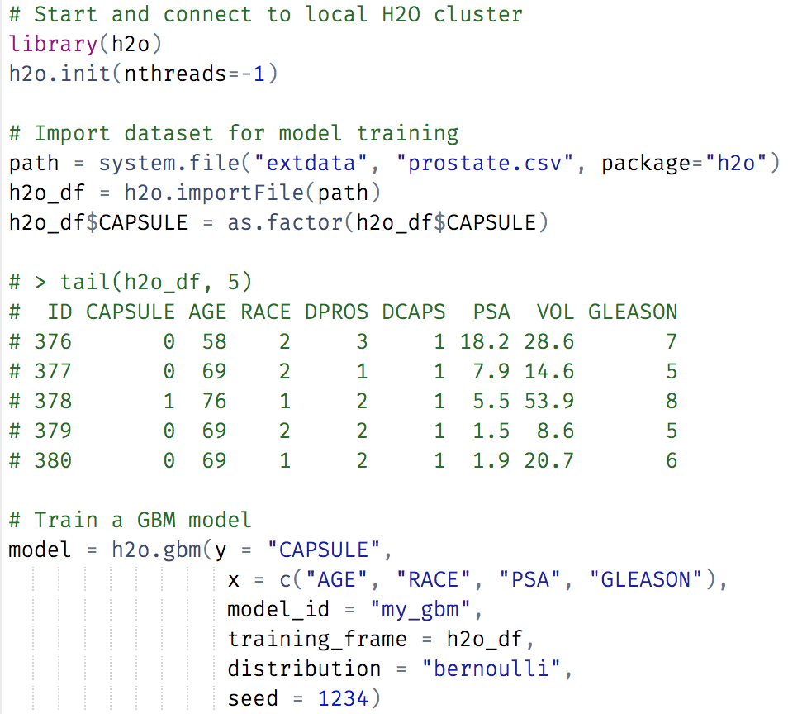
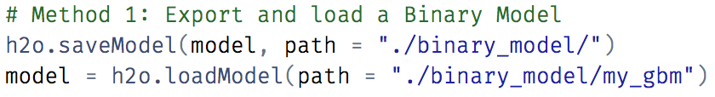
Scenario One (Export Binary Model)

Slide 4
MOJOs Enable Machine Learning Model Predictions in Most Languages
Java
R
Py
.NET
...
Model Repository
...
H₂O Flow
Load
Model
...
Java
MOJO Library
Save
Model
H2O Cluster
MOJO
(zip file)
C++
MOJO Library
Load
Model
APPS
LANGUAGE BINDINGS
(H2O can run anywhere: desktop, cloud, on-prem;
Hadoop and Spark environments also supported)
(Store models in H2O Steam, git, HDFS, S3, etc.)
(Add any language with C/C++ binding support)
Model Training
Model Management
Model Deployment

Slide 5
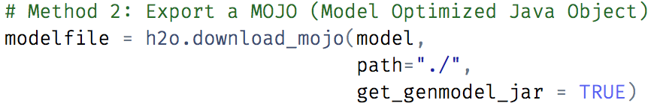

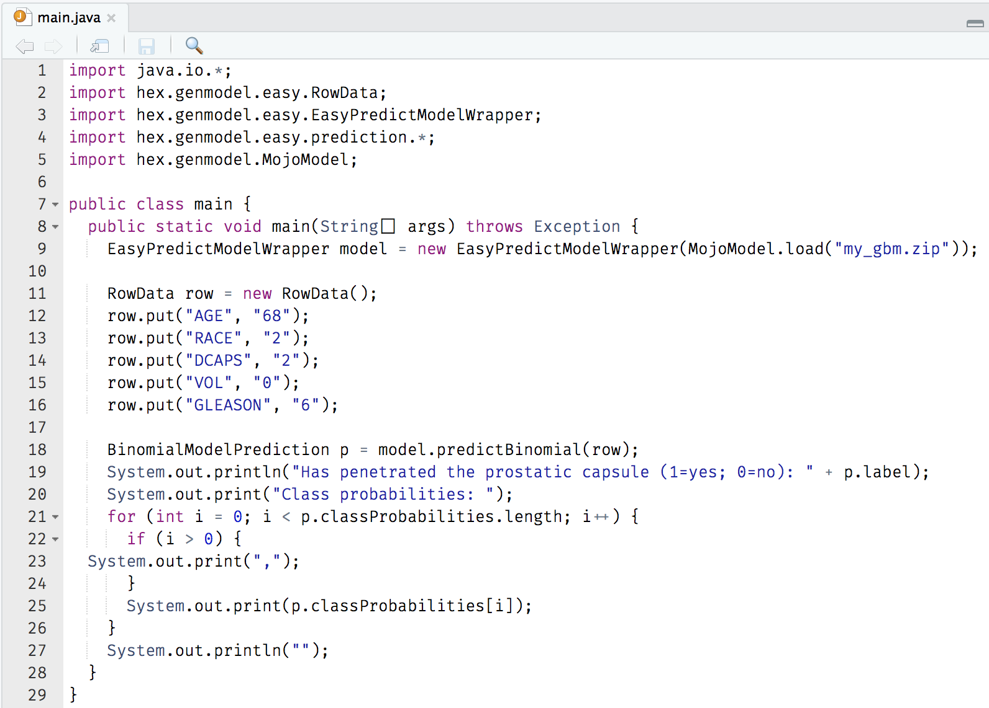
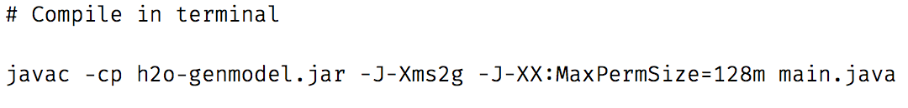

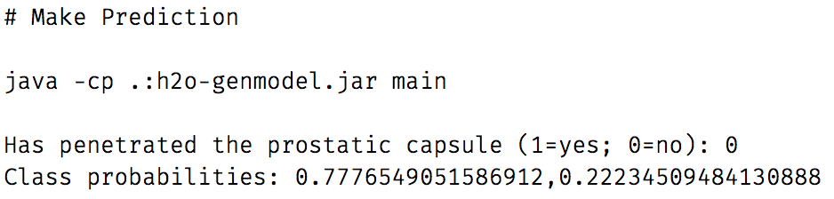
MOJO
New Inputs
Output
Format

Slide 6
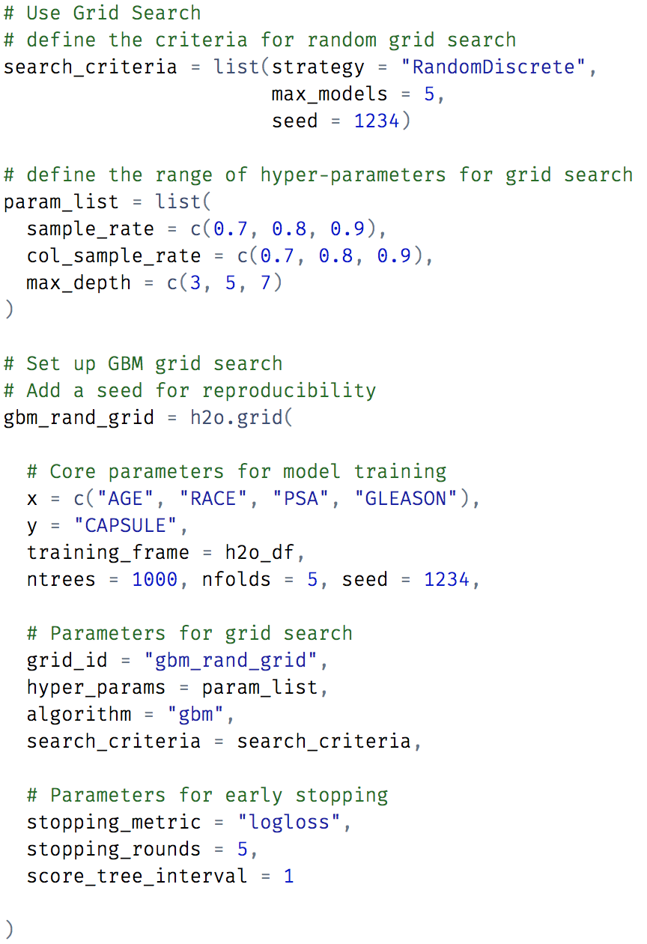
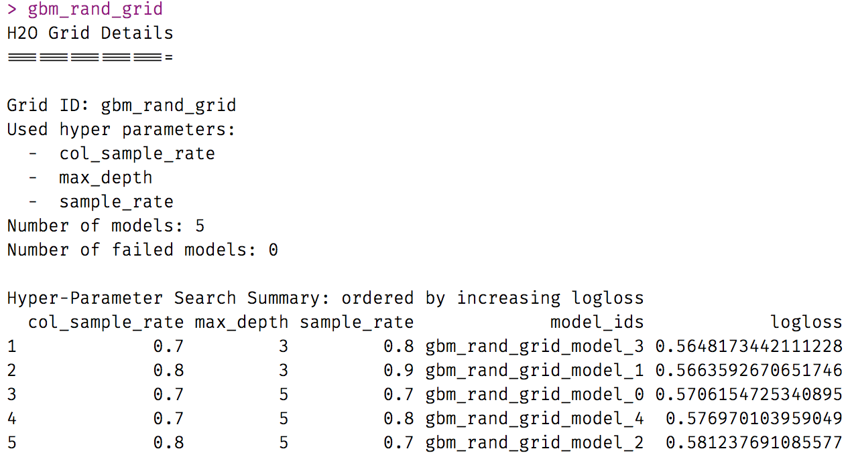
Scenario Two (Export Best Settings)
Use “Grid Search” to find best settings
based on a specific metric

Slide 7
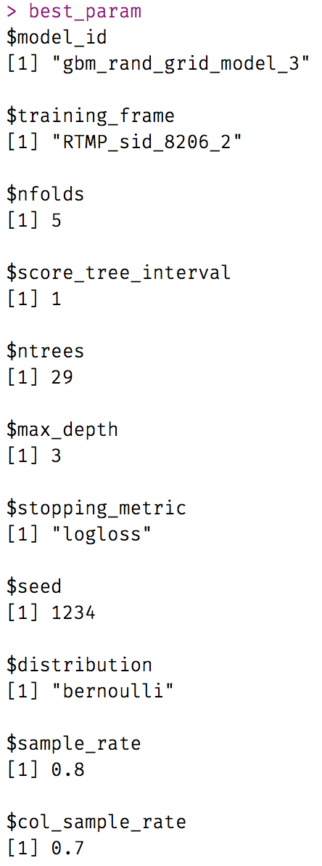
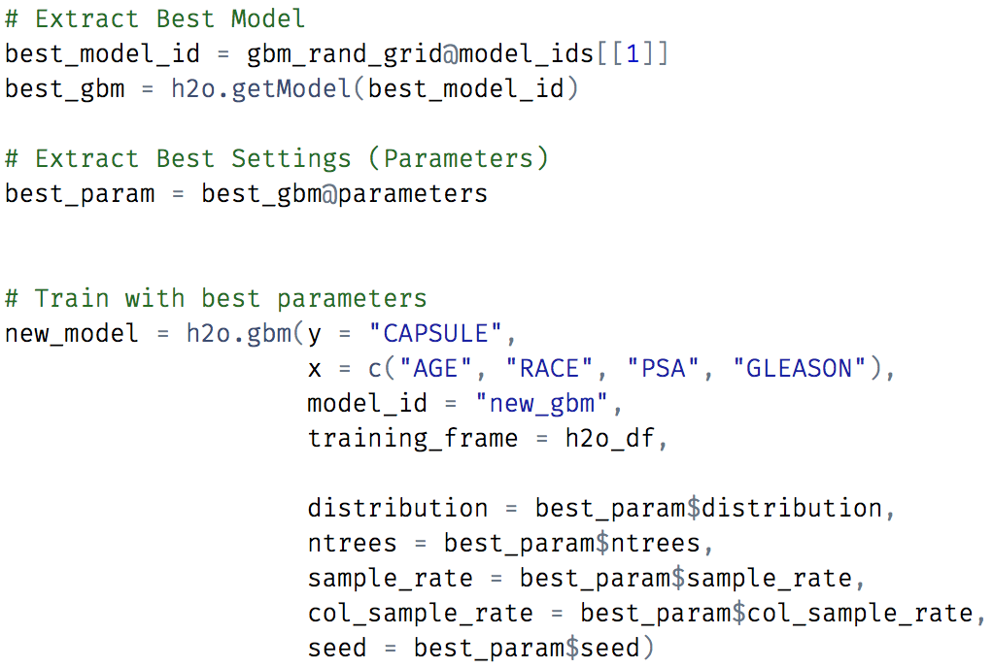
Scenario Two (Export Best Settings)

