Slide 1
H2O Algorithms: Tree Models Deep Dives

Slide 2
Tree Algorithms

Slide 3
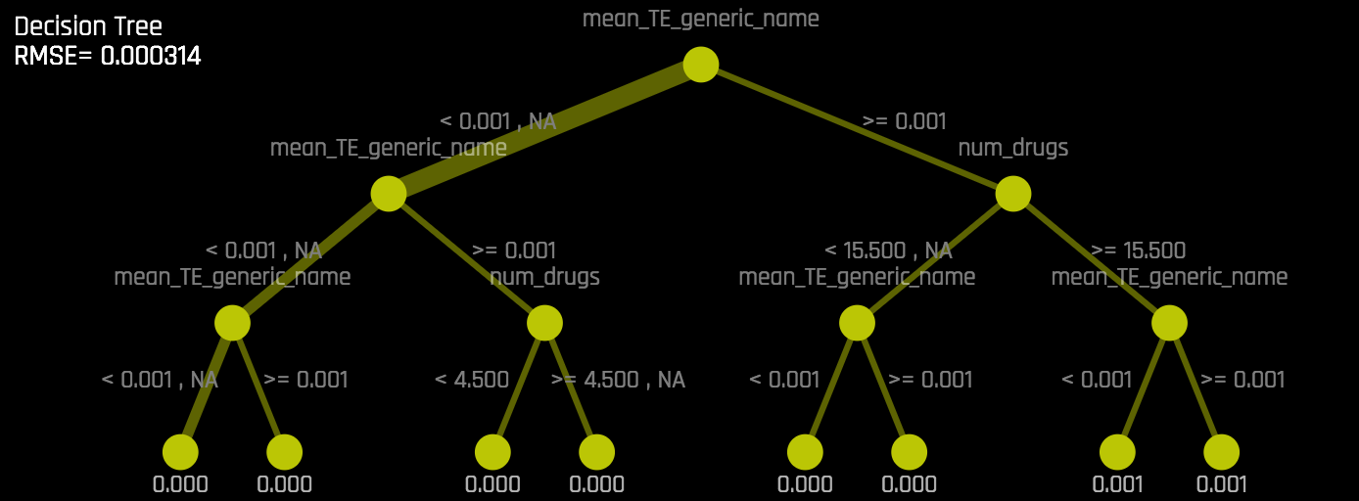
What is a Decision Tree?
Separate data into left and right buckets by splitting on a feature
Goal is to separate the data so that we have all fraud cases in some child nodes and all non-fraud cases in others

Slide 4
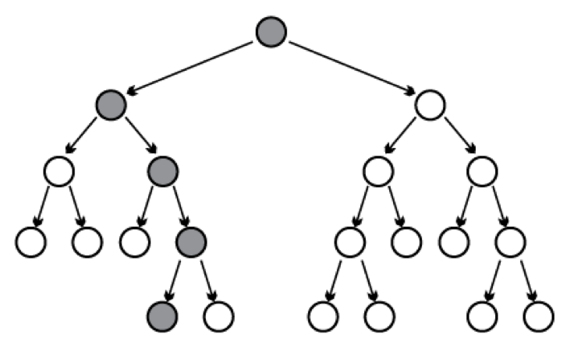
What is Random Forest?
Ensemble of decision trees
Each tree built on a random sample of data and using a random sample of columns
Data
Random Sample
Random Sample
Random Sample
…...
Tree 1
Tree 2
Tree 50
Average Predictions Together

Slide 5
What is a Gradient Boosting Machine?
Sequential ensemble of decision trees
Each tree attempts to correct the mistakes of the previous tree
Tree 1
Tree 2
…..
Tree 50

Slide 6
What is GBM?
1
Make Initial Prediction
f₀ = 0
2
Calculate Residuals
r = y – f₀
3
Build Regression Tree on Residuals
h =
Fits consecutive trees where each solves for the net loss of the prior trees.
f₁ = f₀ + learn_rate * h
Results of new tree are partially applied to the entire solution.
4
Update

Slide 7
When to use GBM?
Advantages
Disadvantages
Often the best model
Nonlinear models
Robust to correlated features
Robust to feature distribution
Robust to missing values
Tends to overfit on the training set
Sensitive to noise and outliers
Several hyper-parameters

Slide 8
H2O Implementation of GBM

Slide 9
Scalable Implementation in H2O
1
Parallel Data Ingest
2
Distributed Tree Building via Fine-Grain Map/Reduce to find optimal split points of data layer by layer
Start with root node and build layers of tree nodes [ILLUSTRATION BELOW]
For each layer, repeat the following:
For a set of features, split the data at every possible split point
Find the split that leads to best model improvement
Use discretization to limit the number of potential splits
To find the split, local histograms are calculated on each node and then aggregated into a global histogram
From the global histogram, the best split column is chosen
Data is stored in-memory on all cluster compute nodes
Rows are evenly distributed across the cluster
Columns are stored separately and compressed
Basis for fine-grain Map/Reduce for histogram calculation
For each layer, iterate

Slide 10
Scalable Distributed Histogram Calculation
Parallel Parse into Distributed Rows
Fine Grain Map Reduce Illustration: Scalable Distributed Histogram Calculation for GBM

Slide 11
GBM Functionalities in H2O
Automatic Handling of:
Categorical Features
Missing Values
Prevent Over Fitting
Early Stopping
Stochastic
Parameter Tuning
Grid Search
Model Output
Export model as Java Code
Parallelized Implementation

Slide 12
GBM: Best Practices

Slide 13
Establish a Validation Schema
Training Data | Model Tuning
Validation Data | Parameter Tuning
Testing Data | Final estimate of generalization error

Slide 14
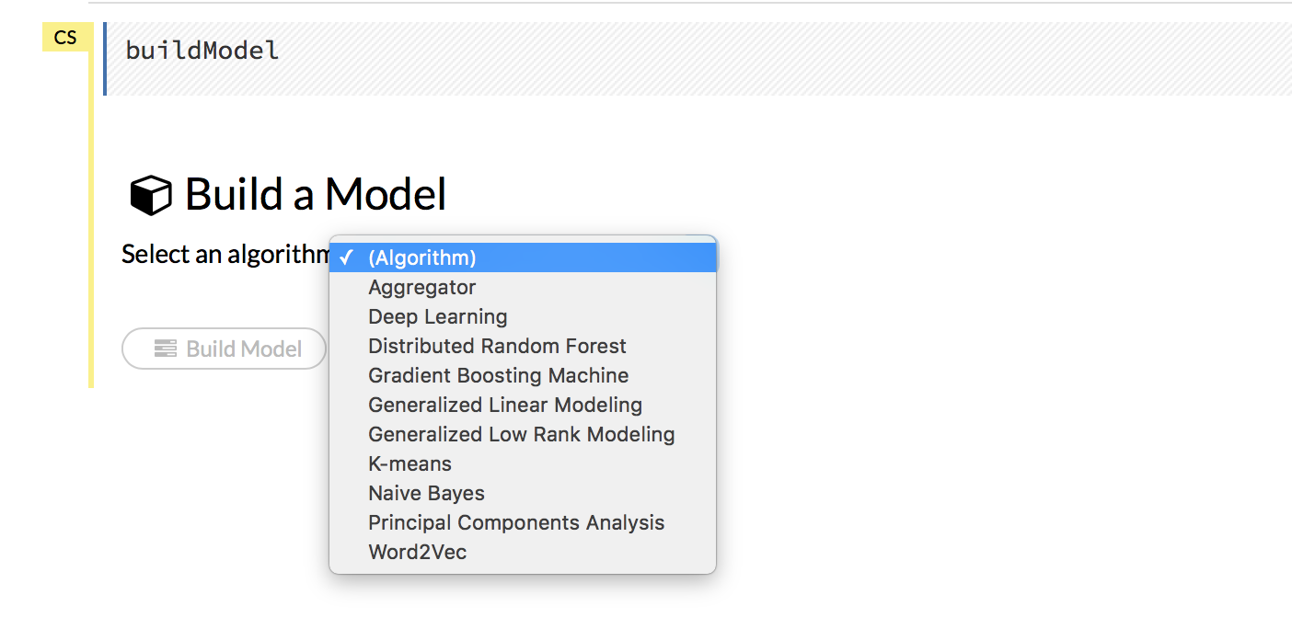
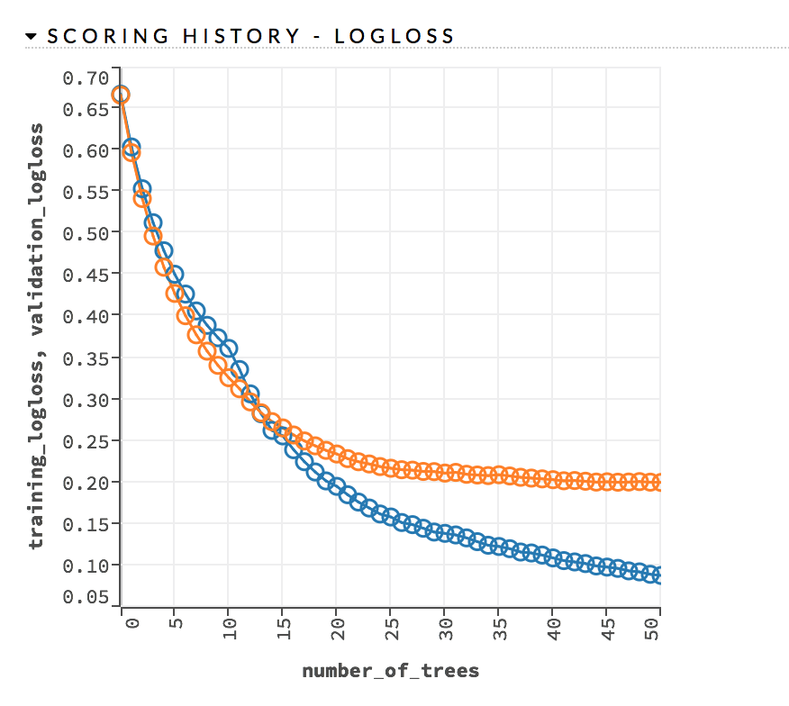
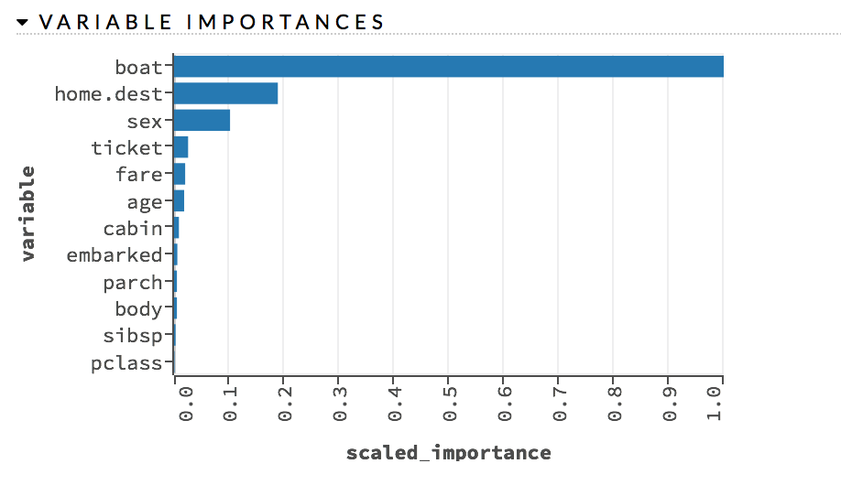
Establish a Baseline
Train multiple models using different supervised learning algorithms with the default parameters.
Inspect models in Flow

Slide 15
Use Early Stopping
Training Data
Validation Data
The Sweet Spot

Slide 16
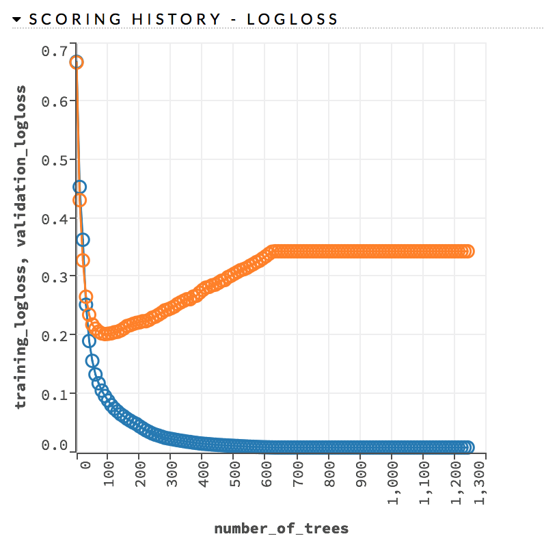
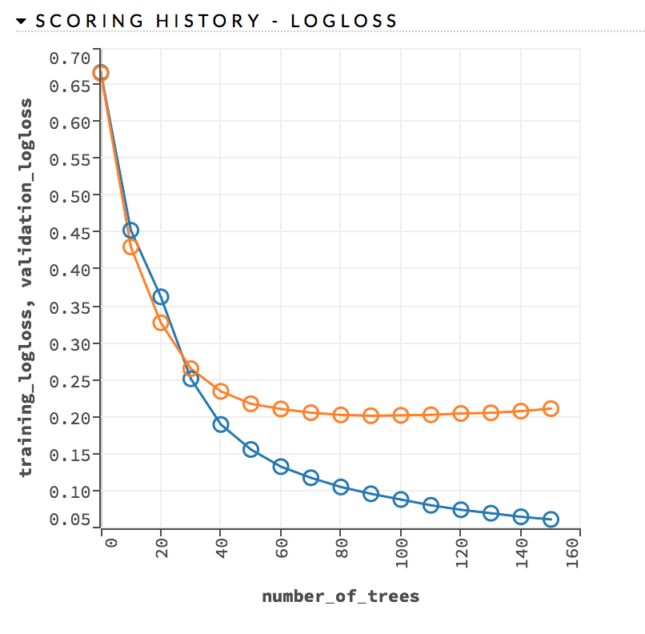
Use Early Stopping
Early stopping once the moving average (window length = 5) of the validation AUC doesn’t improve by at least 0.1% for 5 consecutive scoring events
stopping_rounds = 5
stopping_tolerance = 0.001
stopping_metric = “AUC”
Overfitting
Early Stopping

Slide 17
Choose the Correct Distribution Function
Distribution | Loss | Details
Gaussian | Squared Error Loss | Sensitive to outliers
Laplace | Absolute Error Loss | Very robust to outliers
Huber | Hybrid of Squared and Absolute Error Loss | Robust to outliers
Poisson | Poisson Loss (Deviance) | Used for estimating counts
Gamma | Gamma Loss | Used for estimating total values
Tweedie | Tweedie Loss | Used for estimating densities
Quantile | Quantile Regression Loss | Used for estimating a specified percentile

Slide 18
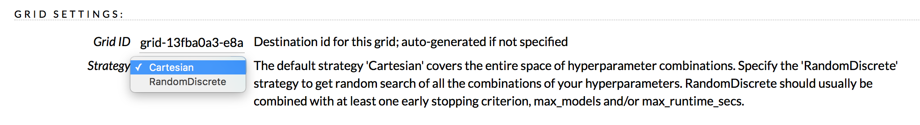
Perform Hyperparameter Search
In R:
grid <- h2o.grid(hyper_params = list(max_depth = c(1:20)),
search_criteria = list(strategy = "RandomDiscrete", max_runtime_secs = 3600),
algorithm = "gbm“, ..)
In Flow:

Slide 19
Perform Hyperparameter Search
Parameter | Definition | Typical Values
max_depth | Maximum tree depth | 1 to 25
learn_rate | The rate at which the GBM learns while building the model Typically lower levels are better but require more trees | 0.01 to 0.1
sample_rate | Row sampling rate per tree | 0.2 to 1
col_sample_rate | Column sampling rate per split | 0.2 to 1
min_rows | The minimum number of observations for a leaf in order to split | 1 to 20
nbin_cats | Number of bins to be included in the histogram Ex: {A, B, C, D, E, F, G} splits to {A, B}, {C, D}, {E, F}, {G} when nbin_cats = 4 | 10, 100, 1000, 10000
histogram_type | What type of histogram to use for finding the optimal split point. | “UniformAdaptive”, “QuantilesGlobal”

Slide 20
Questions?

