Slide 1
Feature Engineering with H2O

Slide 2

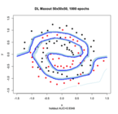
Typical Enterprise Machine Learning Workflow
Feature Engineering
Features
Target
+
Data Quality
& Transformation
Modeling
Table
Model
Building
Model
Data
Integration

Slide 3
Feature Engineering
you have to turn your inputs into things the algorithm can understand — Shayne Miel, answer to “What is the intuitive explanation of feature engineering in machine learning?”
…some machine learning projects succeed and some fail. What makes the difference? Easily the most important factor is the features used. — Pedro Domingos, in “A Few Useful Things to Know about Machine Learning”

Slide 4
What is Feature Engineering?
Sales Forecasting
Store | Date | Sales
1 | 2015-07-31 | $5,263
1 | 2015-08-01 | $6,064
2 | 2015-07-29 | $15,344
Mean Absolute Percent Error = 37%

Slide 5
What is Feature Engineering?
Sales Forecasting
Store | Month | Day Of Week | Sales Previous Day | Sales
1 | July | Friday | $5,431 | $5,263
1 | August | Saturday | $5,102 | $6,064
2 | July | Wednesday | $14,958 | $15,344
Mean Absolute Percent Error = 16%

Slide 6
Feature Engineering Cycle
Dataset
Apply
Hypothesis
Hypothesis
Set
Validate
Hypothesis

Slide 7
Feature Engineering Cycle
Dataset
How?
Domain Knowledge
EDA
ML Model Feedback
Apply
Hypothesis
Hypothesis
Set
Validate
Hypothesis

Slide 8
Feature Engineering Cycle
Dataset
How?
Cross Validation
Measurement of Desired Metric
Avoiding Data Leakage
Apply
Hypothesis
Hypothesis
Set
Validate
Hypothesis

Slide 9
H2O Feature Engineering Demo

Slide 10
The Data
Type | Features
Physician Identifier | NPI,
Demographic Information | City, State, Specialty
Drug Information | Drug Name, Generic Name
Drug Statistics | Number of Beneficiaries, Total Cost of Claims
Response Column | Physician Lost License (our proxy for fraud)

Slide 11
Target Encoding

Slide 12
Target Mean Encoding
Replace categorical variables with the mean of the response
Categorical variables increase the number of features (dummy encoding) and can cause us to overfit
What?
Why?

Slide 13
Target Mean Encoding
CITY | FRAUD
LAKE TAHOE | 0
LAKE TAHOE | 0
LAKE TAHOE | 0
NEW YORK | 1
NEW YORK | 0
NEW YORK | 0
TILTONSVILLE | 1
Physicians based in Lake Tahoe
No occurrence of Fraud
Physicians based in New York
Some occurrence of Fraud
Physicians based in Tiltonsville
Always occurrence of Fraud

Slide 14
Target Mean Encoding
CITY | FRAUD | Mean Target Encoding
LAKE TAHOE | 0 | 0
LAKE TAHOE | 0 | 0
LAKE TAHOE | 0 | 0
NEW YORK | 1 | 0.33
NEW YORK | 0 | 0.33
NEW YORK | 0 | 0.33
TILTONSVILLE | 1 | 1

Slide 15
Data Leakage
Mean Target Encoding is based on the response column of the rows
The lower the number of rows in the group, the more it reveals the response column value
CITY | FRAUD | Mean Target Encoding
TILTONSVILLE | 1 | 1
Worst Case Scenario: Response Column = Mean Target Encoding

Slide 16
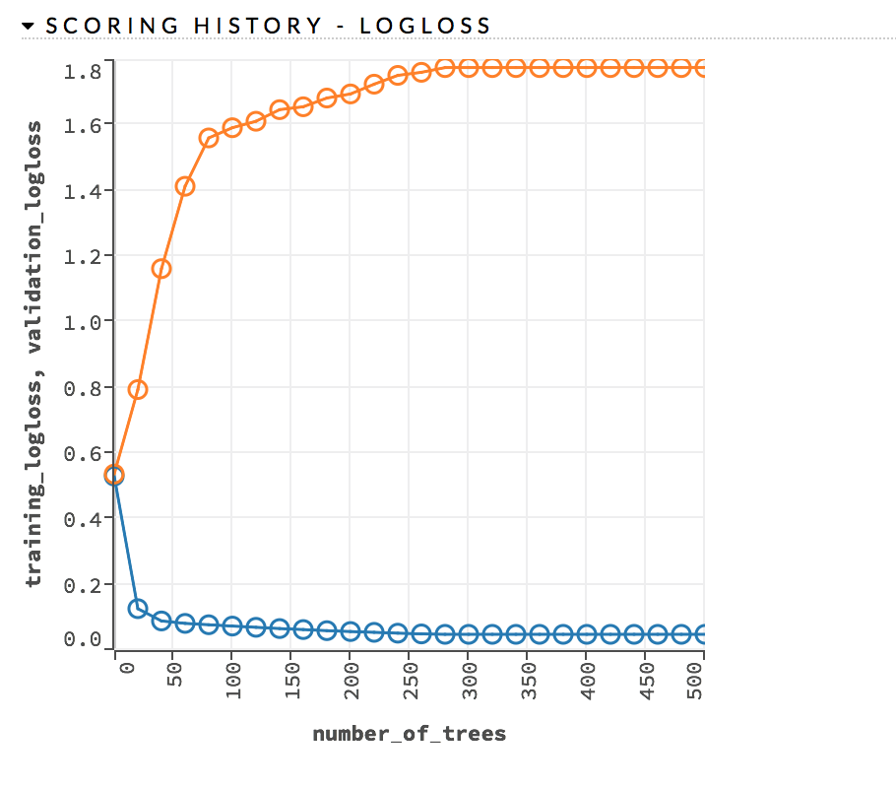
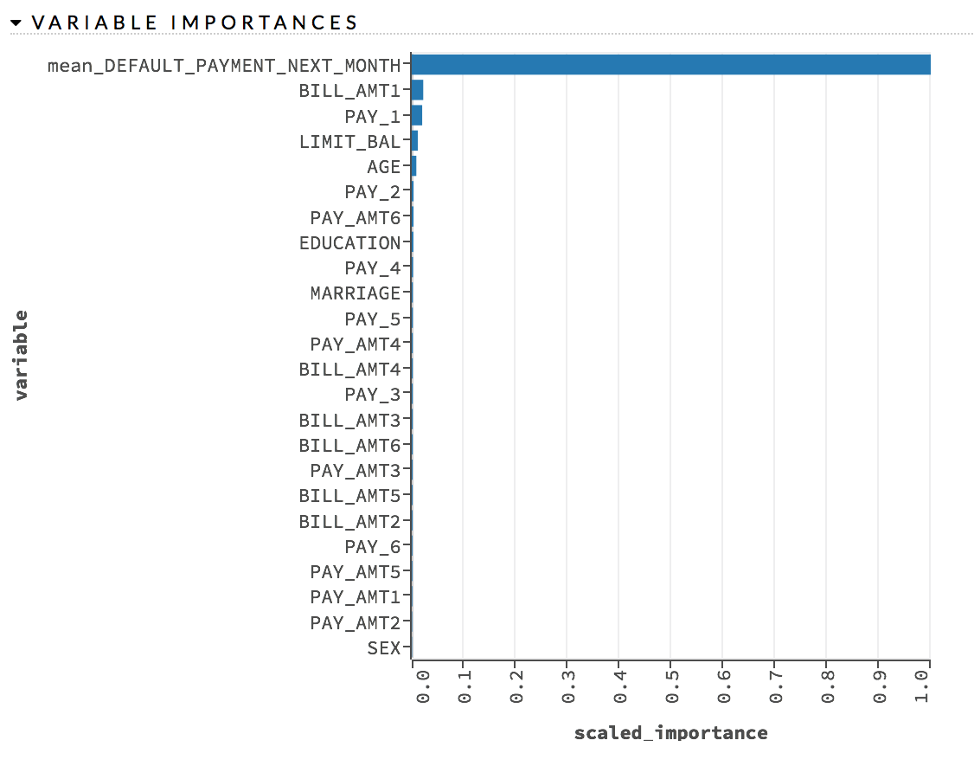
Overfitting
Data Leakage causes overfitting
Great results on the training, bad results on hold out data
Scoring History: Training vs Testing
Data Leakage Feature is the only important feature

Slide 17
Known Issues
Anything we don’t know when scoring, shouldn’t be used as training features
Mean Target Encoding incorporates the response value
We would not know the response value when scoring
The less frequent the categorical value is, the more the mean target encoding is overfitting
CITY | FRAUD | Mean Target Encoding
TILTONSVILLE | 1 | 1
Worst Case Scenario: Response Column = Mean Target Encoding

Slide 18
Weighted Target Encoding
Calculate Weighted Mean instead of Mean:
weight₁ * mean(level) + weight₂*mean(dataset)
The less frequent the level is, the greater the weight of the overall mean is
CITY | Count | Weight of Overall Mean | Mean Target Encoding | Weighted Mean Target Encoding
LAKE TAHOE | 3 | 0.5 | 0 | 0.0002
NEW YORK | 3 | 0.5 | 0.33 | 0.165
TILTONSVILLE | 1 | 0.9 | 1 | 0.10

Slide 19
Questions?

