Slide 1


Credit Card Fraud Detection Example

Slide 2
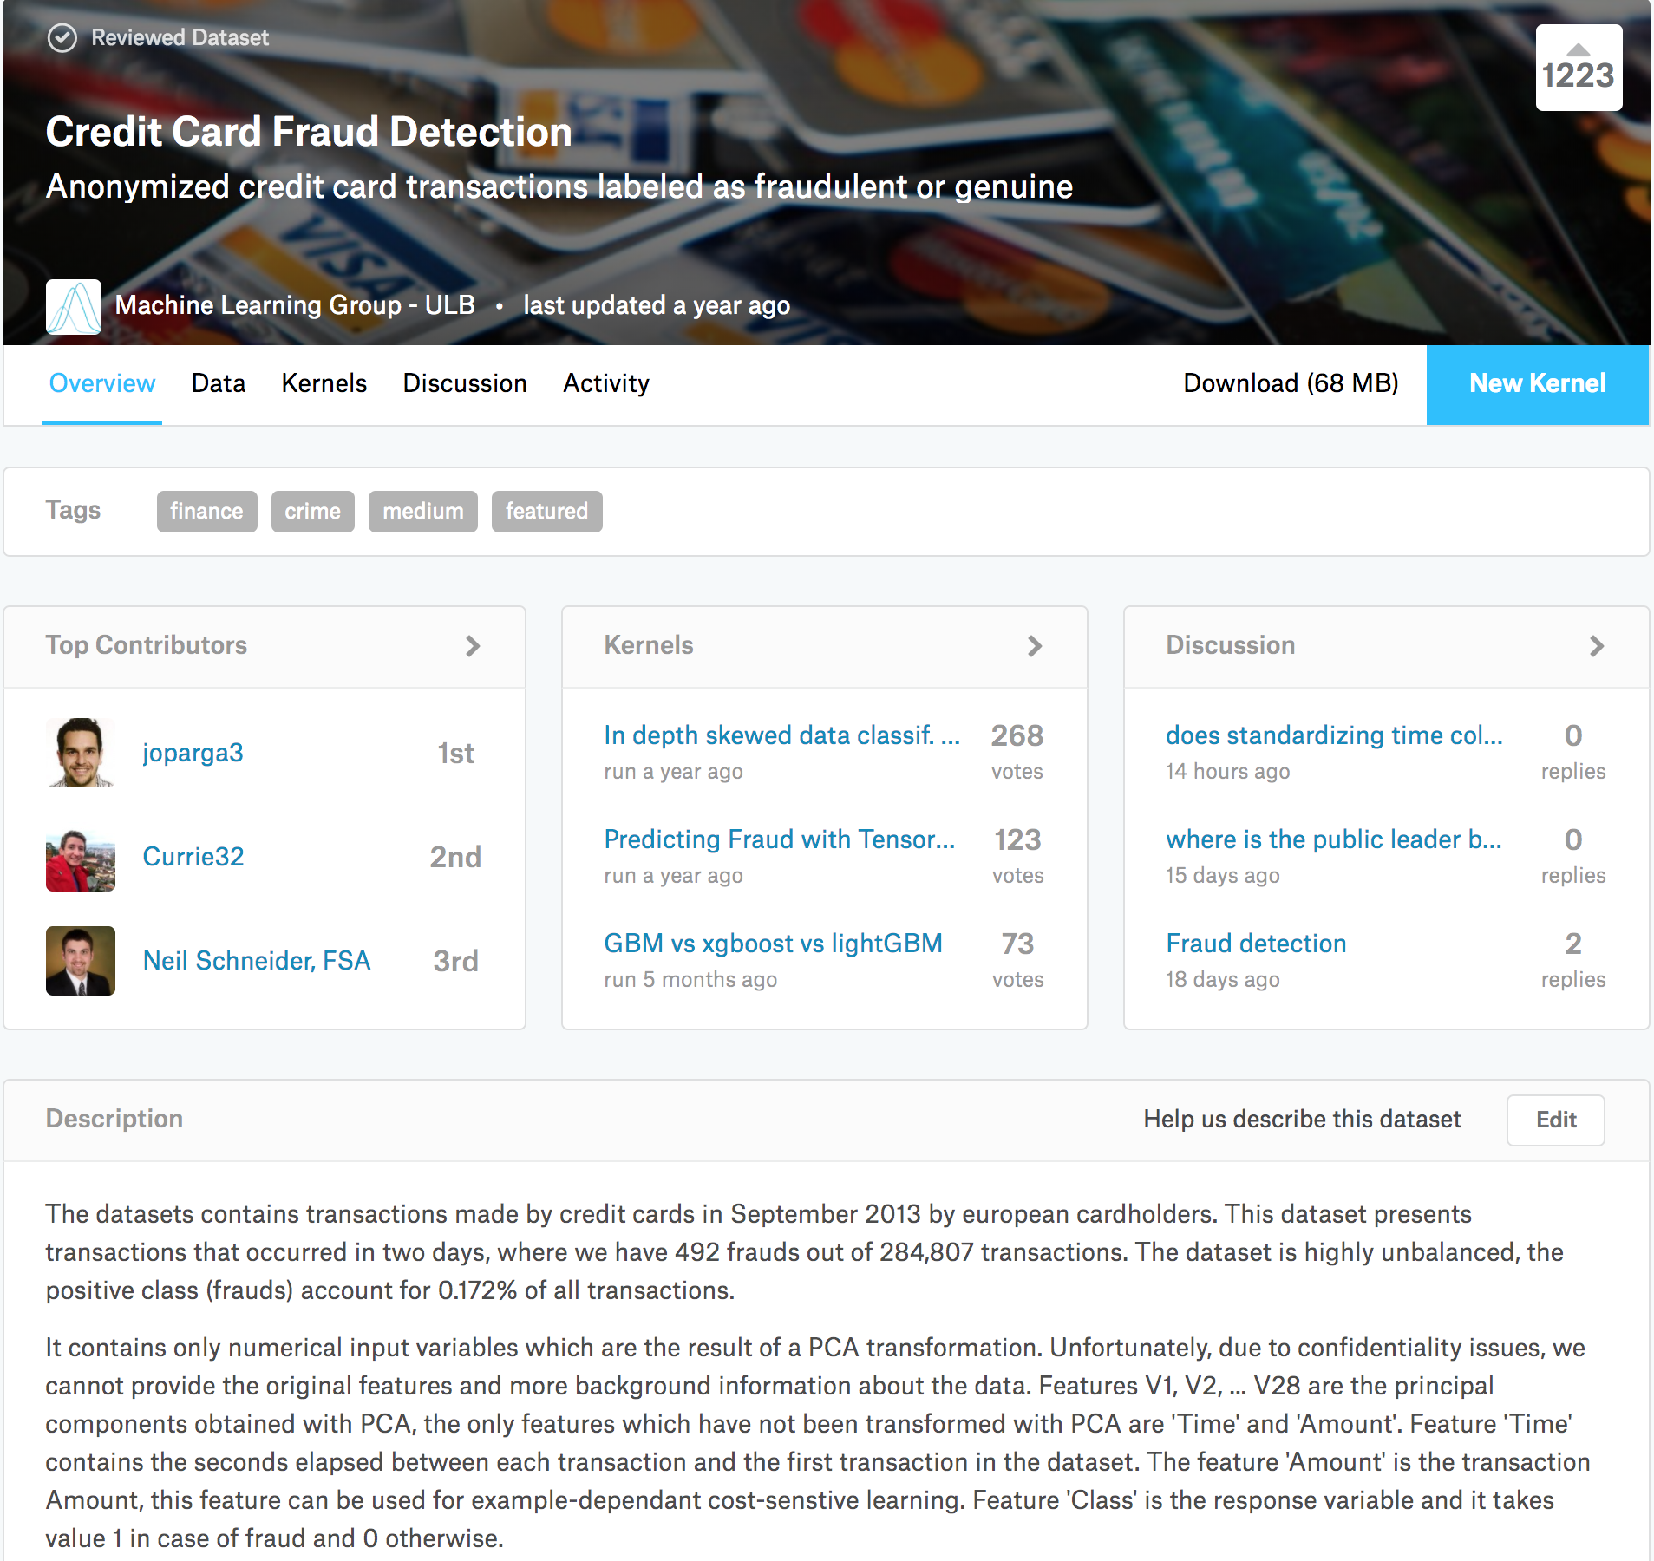
Background Information
Source
A recent project with one of our customers
This Demo
Public Kaggle Dataset
Credit Card Fraud Detection
https://www.kaggle.com/mlg-ulb/creditcardfraud

Slide 3
Procedures
Train a baseline (Random Forest, no tuning) model.
Evaluate performance on a test set.
Train an autoencoder (e.g. autoencoder in H2O deeplearning).
Use the autoencoder to calculate feature reconstruction errors.
For Loop:
Try different errors threshold to split train data into two groups (e.g. expected and anomalies).
Build two new baseline models (one for expected and one for anomalies).
Make two set of predictions on test set and do a simple average.
Evaluate simple average performance.
(Repeat the process to find best threshold value)

Slide 4
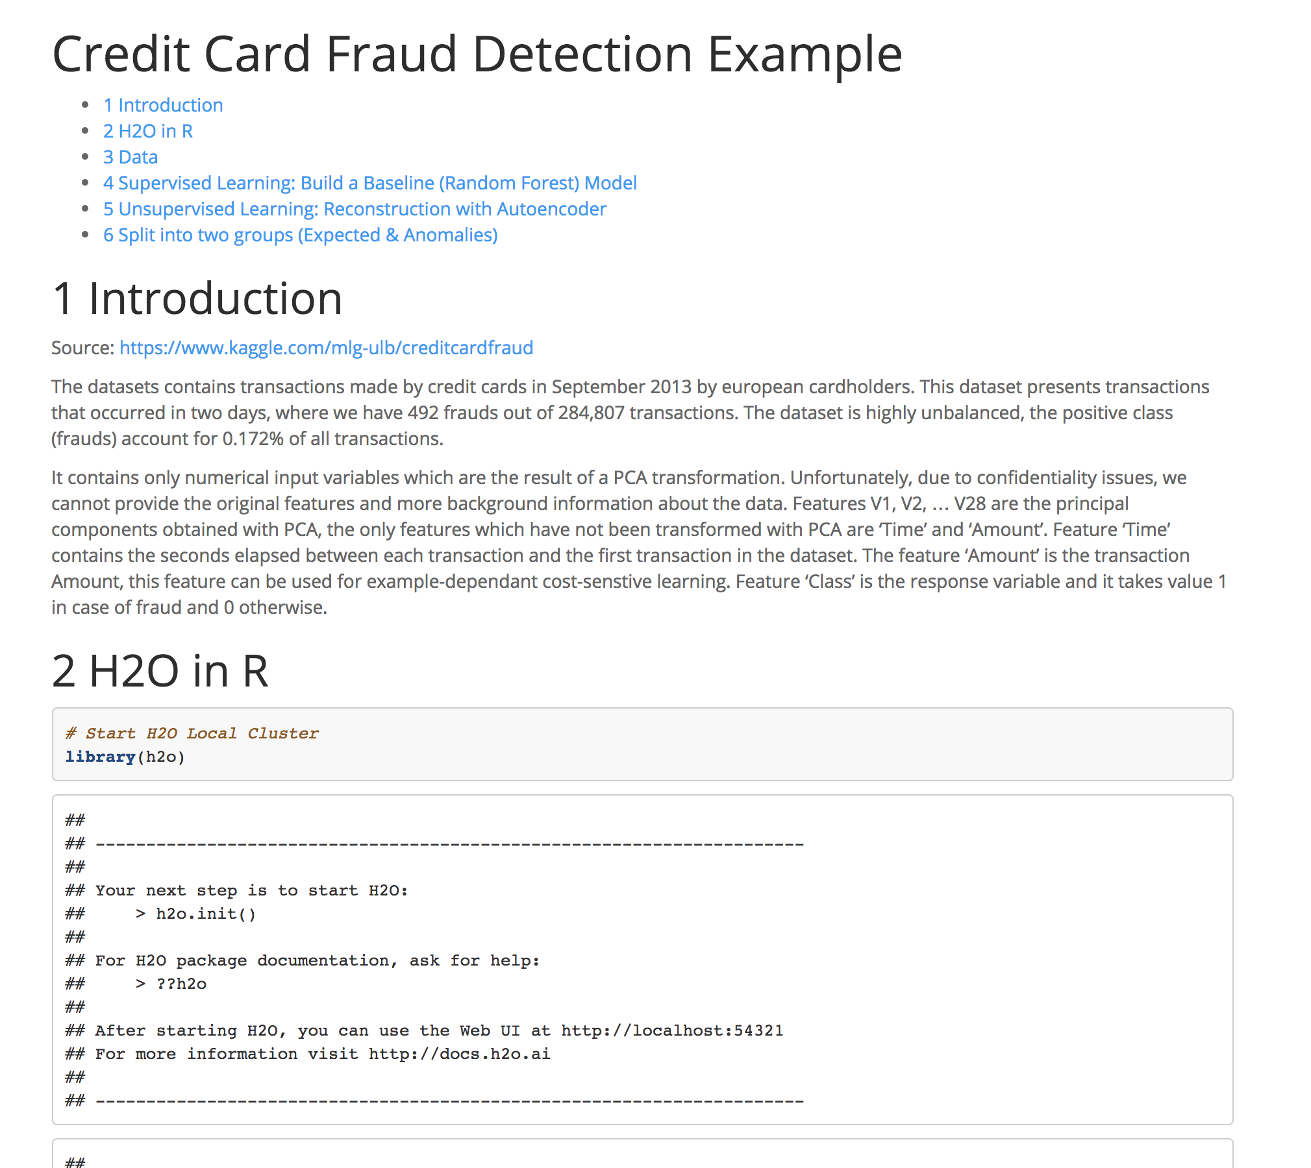

Code: credit_card_example.Rmd
HTML output: credit_card_example.html

