Slide 1
STM32 RTOS를 활용한
엘리베이터
사용 스택
STM32 RTOS, Multi-threading, GPIO Control

Slide 2
DEMO VIDEO
YOUTUBE LINK 어딘가..

Slide 3
HARDWARE LIST
STM32F429ZI
18x2 I2C_LCD
8x8 DOT MATRIX
STEP MOTOR
STEP MOTOR DRIVER (ULN2003)
PHOTO INTERRUPTER

Slide 4
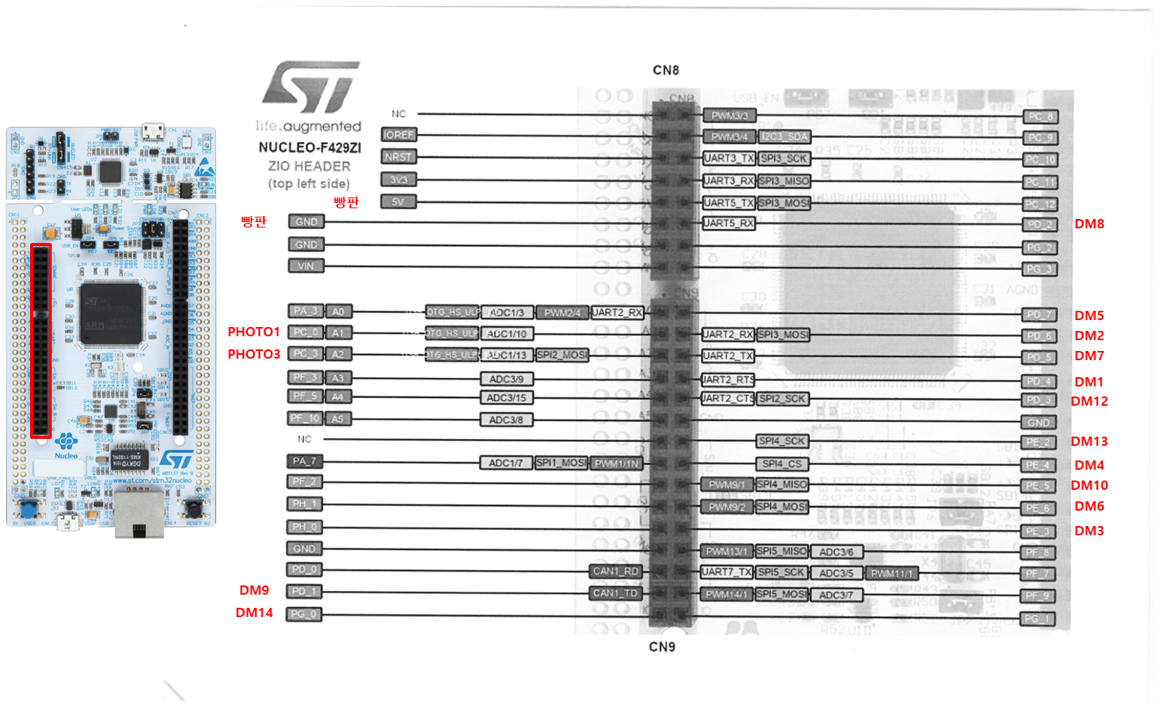
HW Schematic

Slide 5
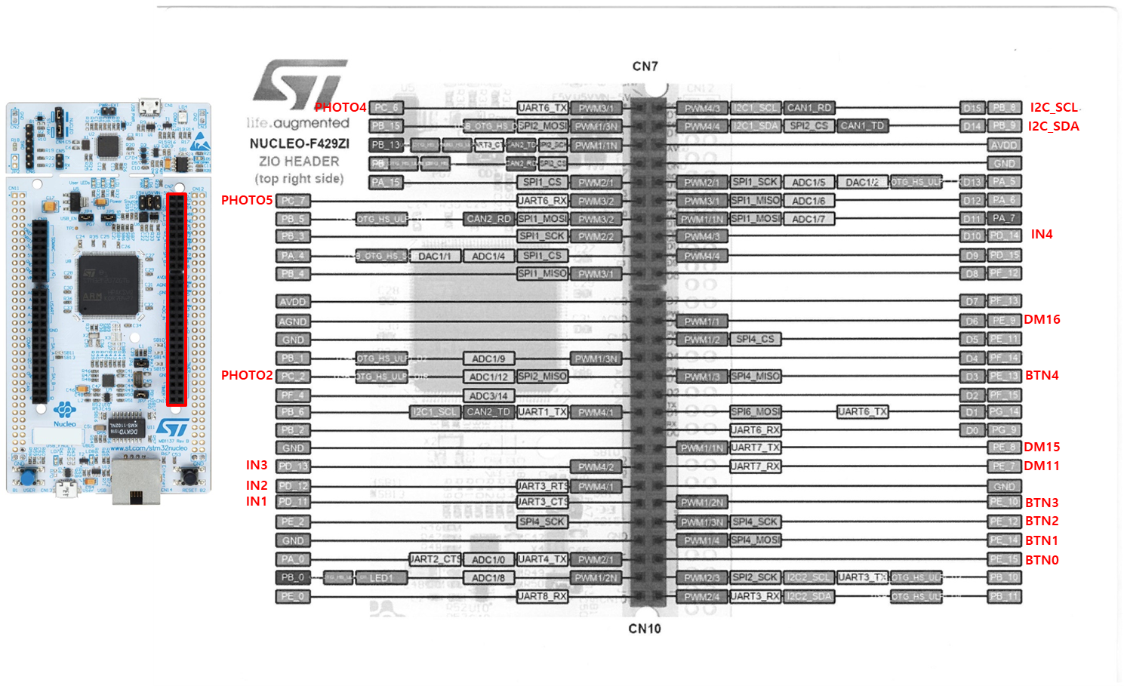
HW Schematic

Slide 6
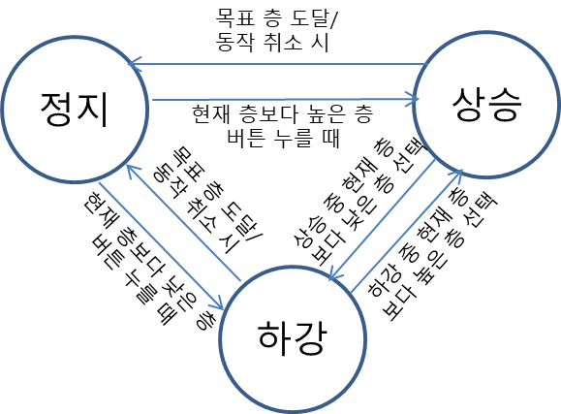
FSM

Slide 7
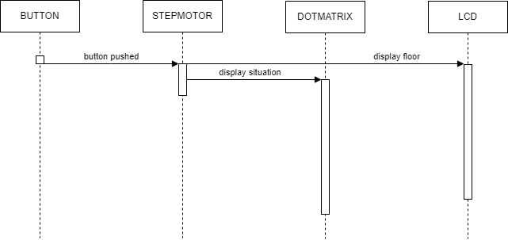
Sequence Diagram

