Slide 1
STM32 RTOS를 활용한 엘리베이터
사용 스택
STM32 RTOS, Multi-threading, GPIO Control

Slide 2
DEMO VIDEO
https://youtu.be/MbwQFMftpic

Slide 3
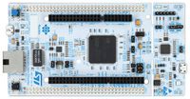
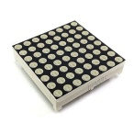
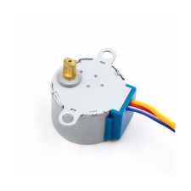
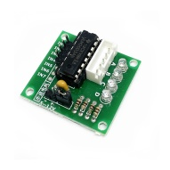
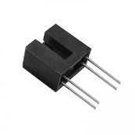
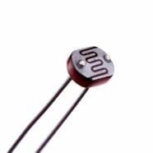
HARDWARE LIST
STM32F429ZI
1602 LCD (CN0133)
8x8 DOT MATRIX (1088BS)
STEP MOTOR (28BYJ-48)
STEP MOTOR DRIVER (ULN2003)
PHOTO INTERRUPTER (ES92B4)
CDS cell (GL 5537)

Slide 4
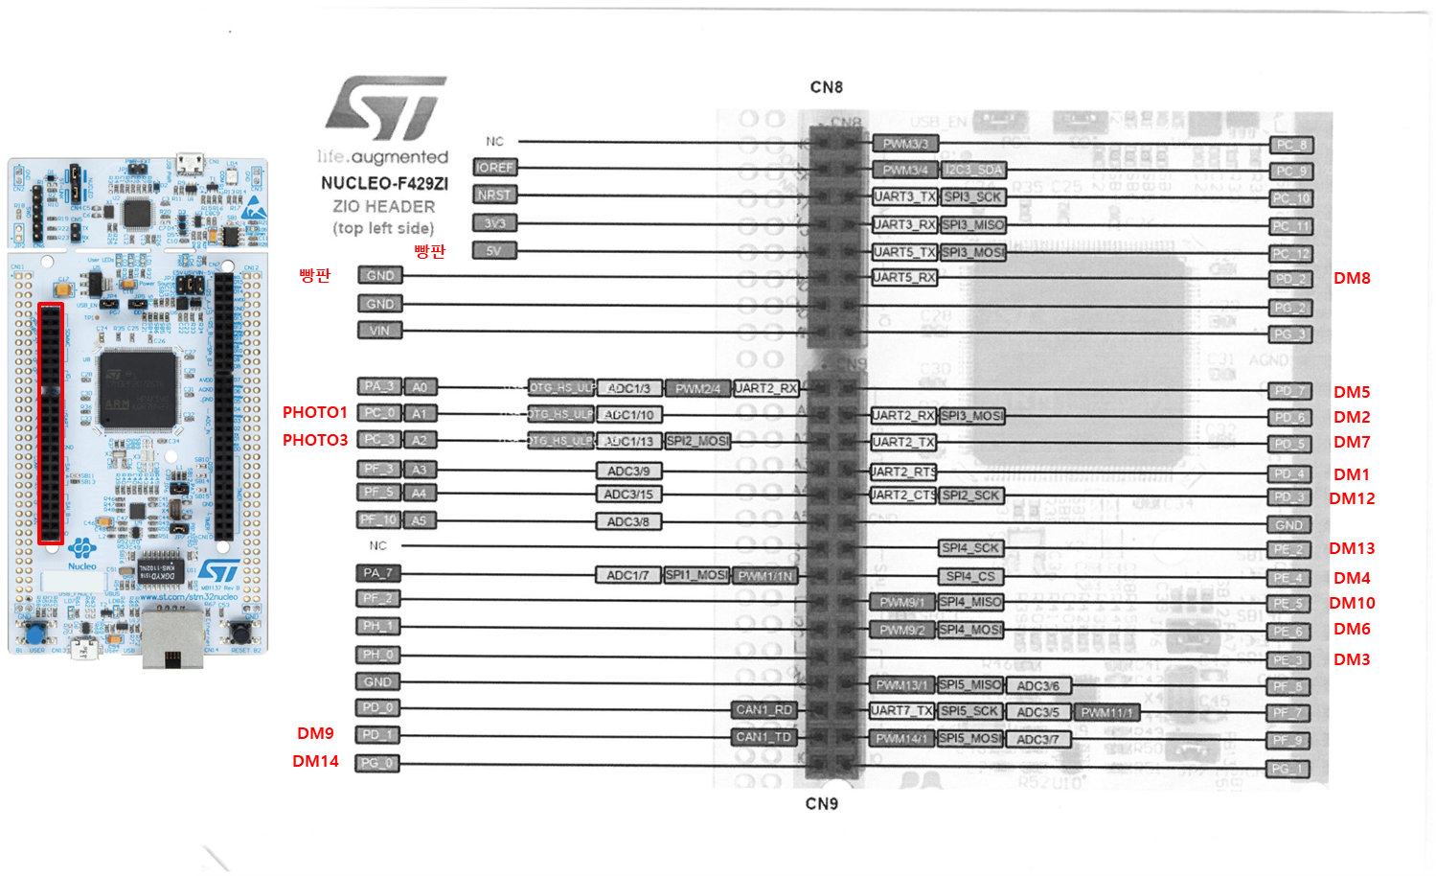
HW Schematic

Slide 5
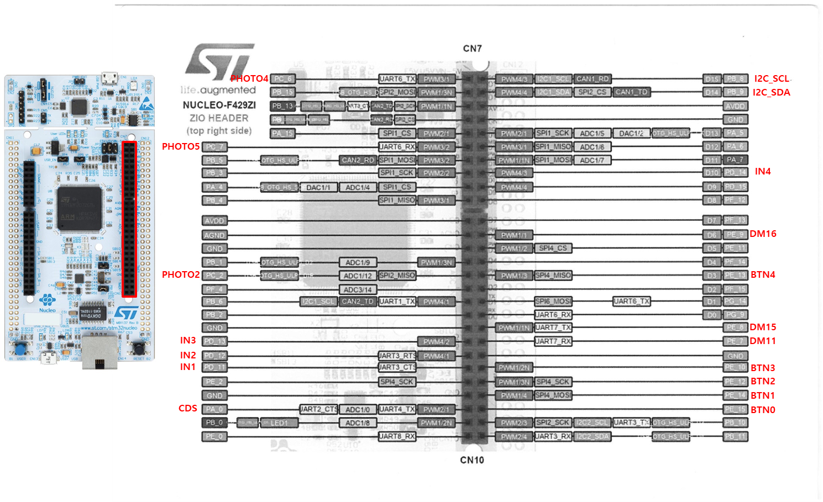
HW Schematic

Slide 6
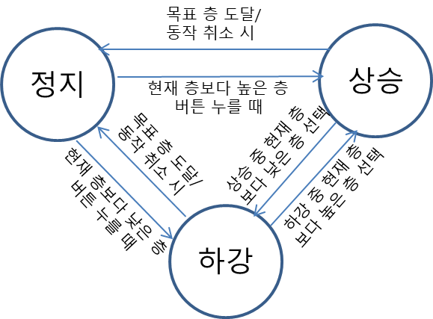
FSM

Slide 7
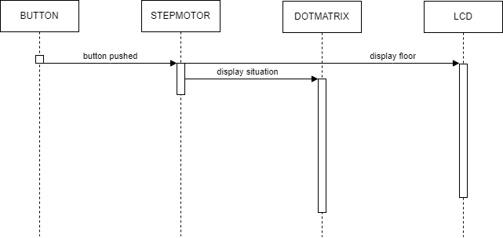
Sequence Diagram

Slide 8
Github
https://github.com/woochang0110/STM32_Elevator

