Slide 1
Social Network Analysis Tools
for Computational Scientists
Sarah Strong and Ainsley Lawson
May 2009

Slide 2
The Idea
Using e-mail logs, Subversion history and Trac bug reports, we will construct a tool that will:
  Visualize the social network between programmers
  Visualize the code dependencies in their software
  Identify experts for each area of the software
  Identify social relationships that should be developed in order to improve productivity

Slide 3
The Research
A reasonable graph of the social network of a workplace can be constructed using a company's e-mail logs. [1]
Similarly, a graph of the relationship between software components can be constructed using Subversion history. [2]
[1]
[2] W. D. Weber, ”Change Sets versus Change Packages: Comparing Implementations of Change-Based SCM”, Seventh International Workshop on Software Configuration Management, 1997, pp. 25-35.

Slide 4
The Research
Software component ”experts” can be identified from Subversion history. [3]
The efficiency and productivity of a group of developers is improved when their social network is congruent with the architecture of the software. [4]
[3] A. Mockus, J. Herbsleb, ”Expertise Browser: A Quantitative Approach to Identifying Expertise”, International Conference on Software Engineering, Orlando, Florida, 2002, pp. 503-512.
[4] M. Cataldo, et al., "Identification of Coordination Requirements: Implications for the Design of Collaboration and Awareness Tools”, ACM Conference on Computer Supported Cooperative Work, Banff, Alberta, Canada, 2006, pp. 353-362.

Slide 5
Existing Tools
A number of tools have already been developed that accomplish one or more of the goals we are working towards
Some notable tools:
  Ariadne
  Expertise Browser
  Tesseract

Slide 6
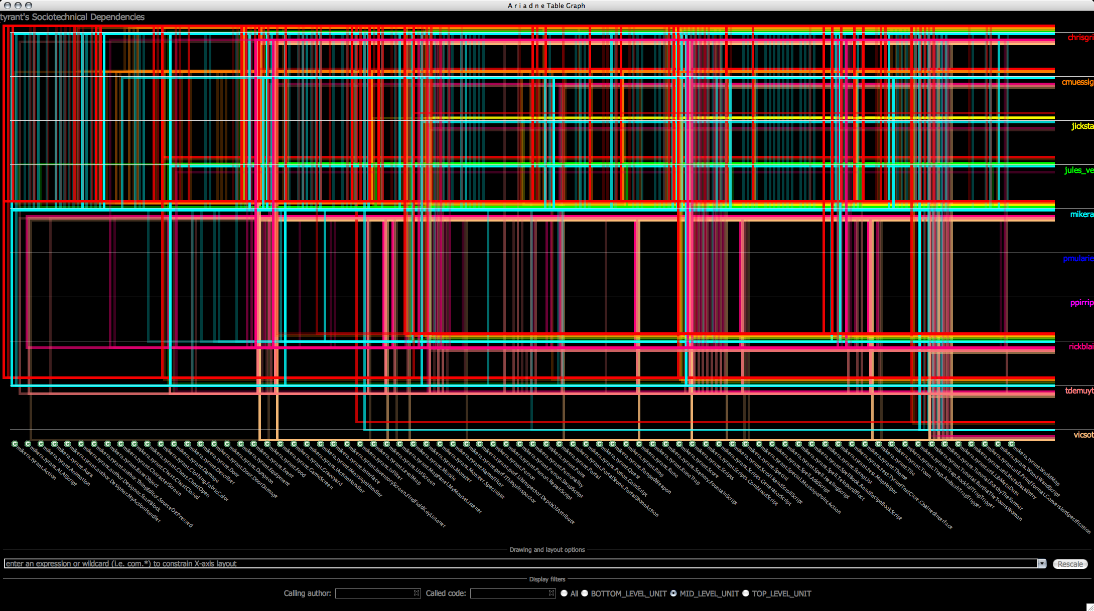
Ariadne
Java plug-in for Eclipse
Uses software dependencies and code authorship information to construct a graph of social dependencies

Slide 7
Expertise Browser
Uses repository change data to determine who should be considered "experts" on specific sections of code
  An edit to the code indicates some level of expertise on that part of the code
  Level of expertise depends on amount and size of the changes made
Also identifies experts for certain programming languages, overall releases of the software, and certain types of bugs.

Slide 8
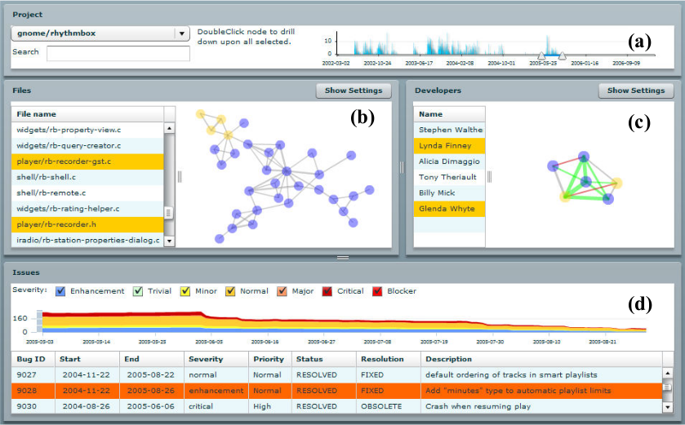
Tesseract
Very similar to
what we are trying
to accomplish
Compares the
social network
between
programmers with the technical network between code components, using e-mail and repository data

Slide 9
Tesseract
Files are considered related if they are frequently changed together
People are considered to be technically related if they have edited the same or related code
The social network is constructed through data about e-mail frequency

Slide 10
Problems with Existing Tools
No integration of social data from e-mail logs or mailing lists (Tesseract, excepted)
Tools are separate applications, and not integrated into the software that the developers are already using
  Require too much effort to use

Slide 11
Problems with Existing Tools
Interfaces are complicated, unattractive, and hard to understand
Some tools are more ”administrative”, giving general overviews
  WorldView, Workplace Actvitiy Viewer
  Not useful to the actual developers

Slide 12
The Plan
Make an easy-to-use Trac plug-in
  The programmers at the Hadley Center are already using a system built on Trac
  The plug-in should integrate easily into their existing practices, and require little effort to use
Method of graph construction similar to Tesseract's
  Social network: use e-mail, mailing lists, bug reports
  Technical network: use Subversion history

Slide 13
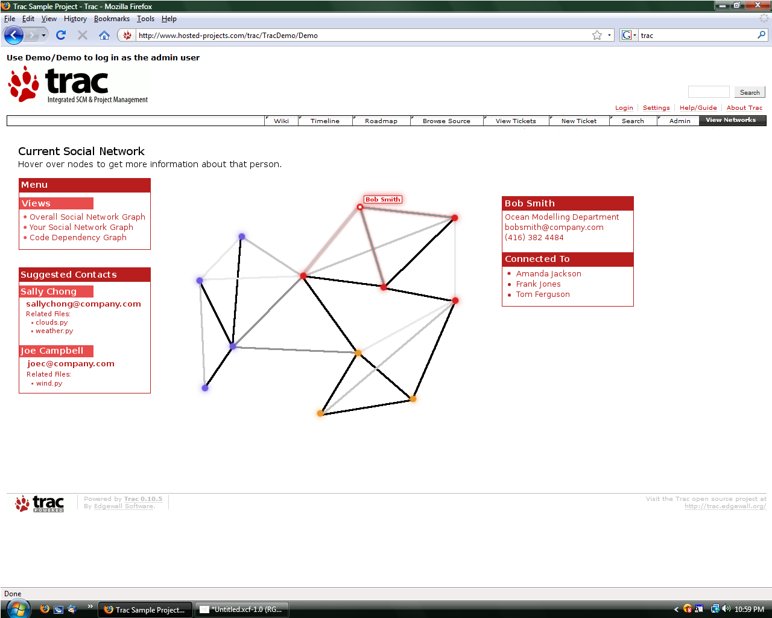
Sample Interface

Slide 14
Features
Views of different graphs
  Overall social network
  Personal social network
  Code dependencies
Ability to find experts for code
  Lists experts for files when you hover over them in the code dependency graph
  Ability to search for experts based on file name

Slide 15
Features
A ”Who should I be talking to?” box that suggests social contacts
”Manager's View” that points out where social connections should be made to improve productivity

Slide 16
Assessment
Use open source projects to test our tool
Talk to people working on the project to find out if our social network graph is accurate
Once completed, get feedback from developers on the usefulness of our tool, and how we can improve it

