Slide 1
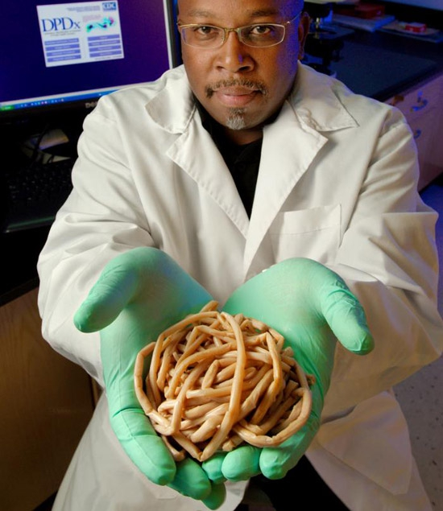
Welcome to
FISH 406:
Parasite Ecology
Bob
Bell

Slide 2
FISH 406
Parasite Ecology
Autumn 2025
Instructor: Dr. Chelsea Wood
TAs: Gabby Commisso and
Connor Whalen

Slide 3
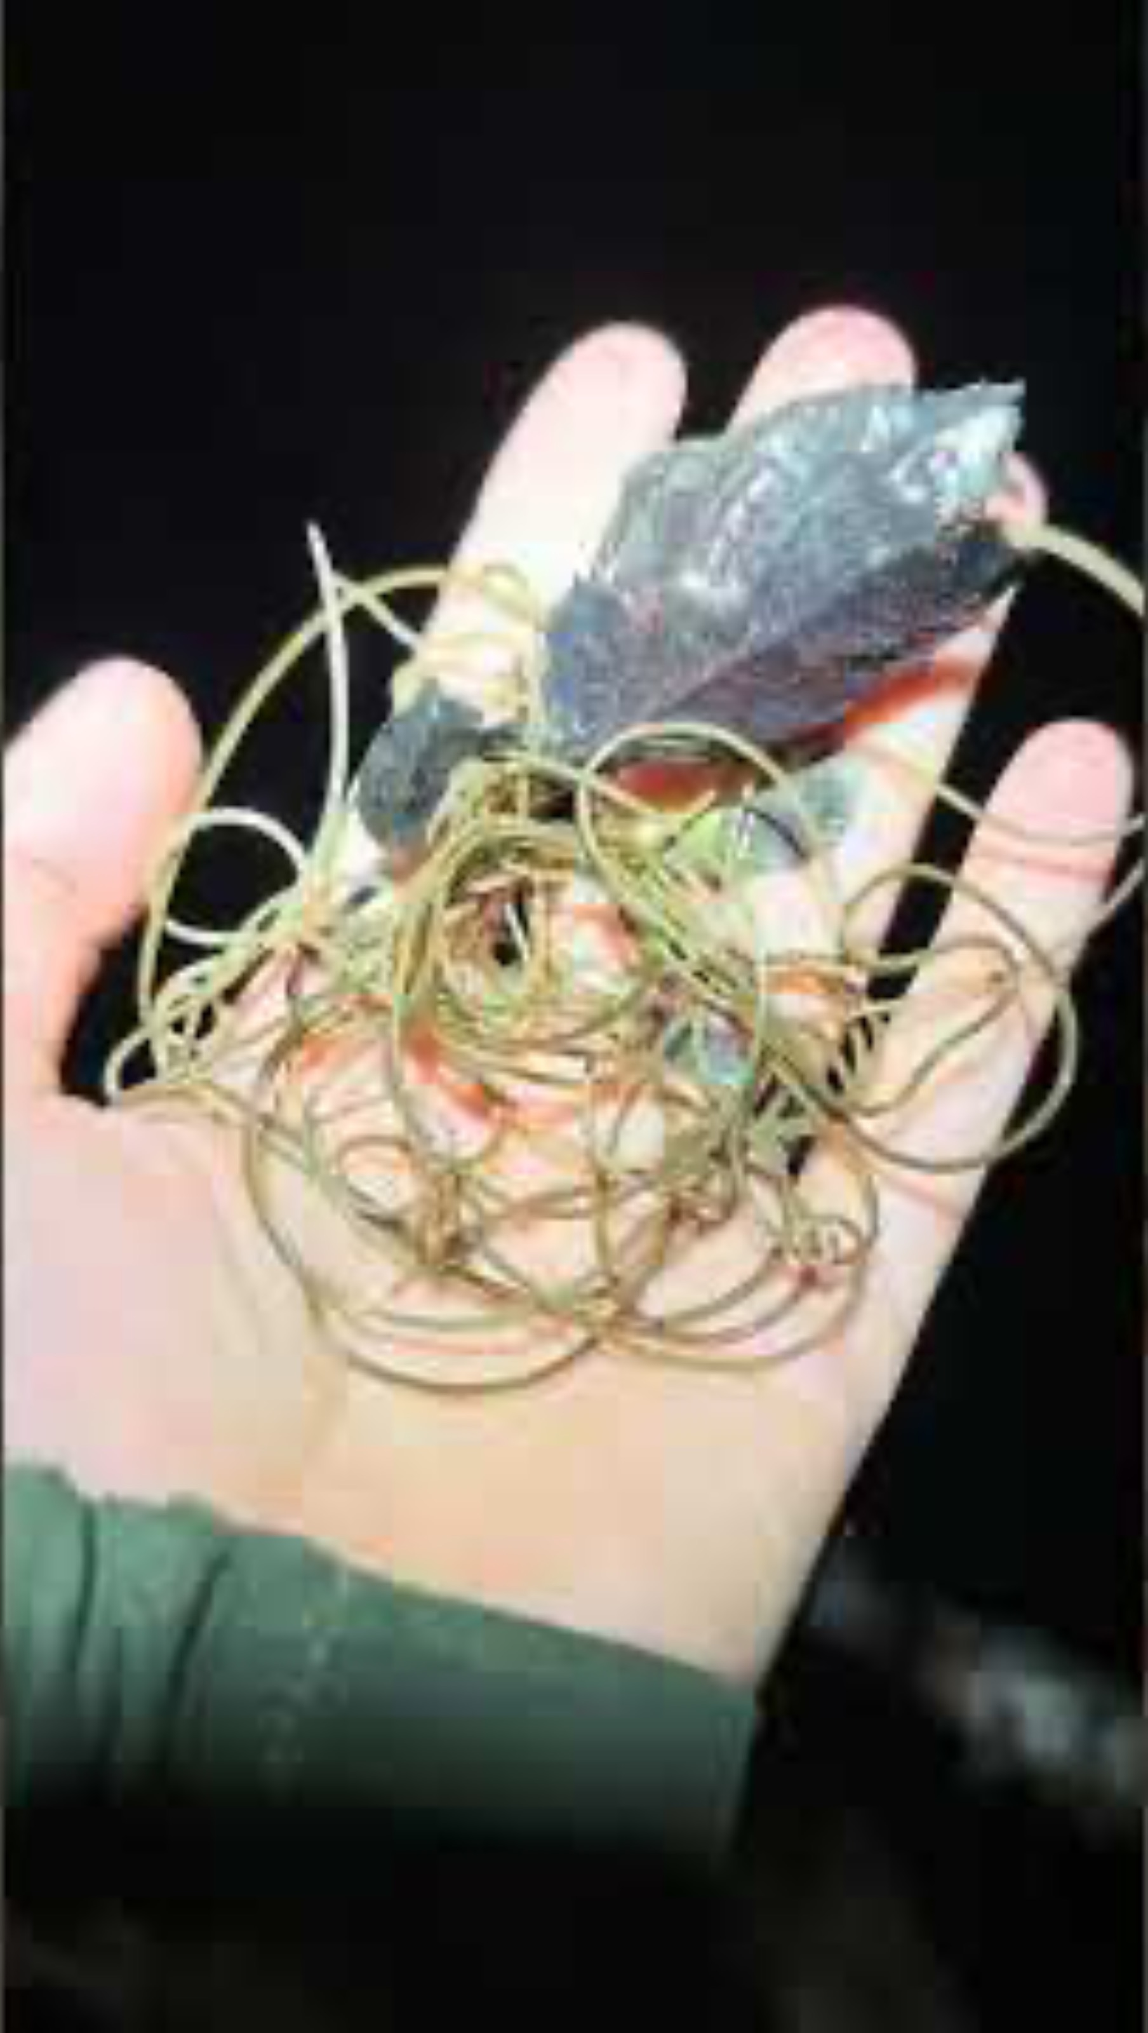

Slide 4
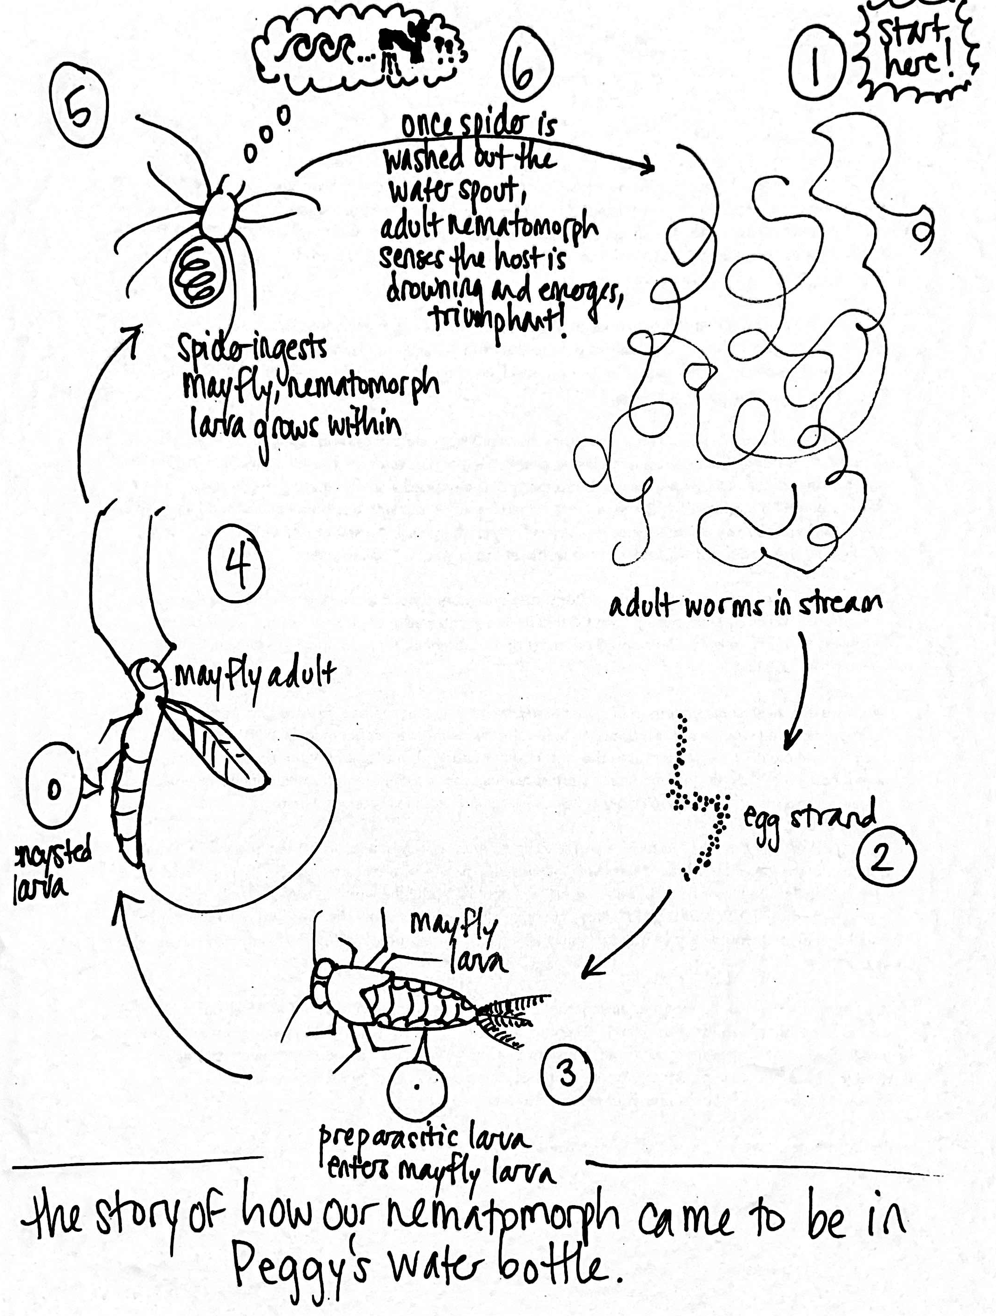

Slide 5
Who are you?

Slide 6
Course website:
https://wood-lab.github.io/fish_406

Slide 7
Course Canvas page:
https://canvas.uw.edu/courses/1829825

Slide 8
class norms
growth mindset
respect and support one another
actively listen
contribute
ask questions
monitor air time

Slide 9
let’s dive in…
Bob
Bell

Slide 10
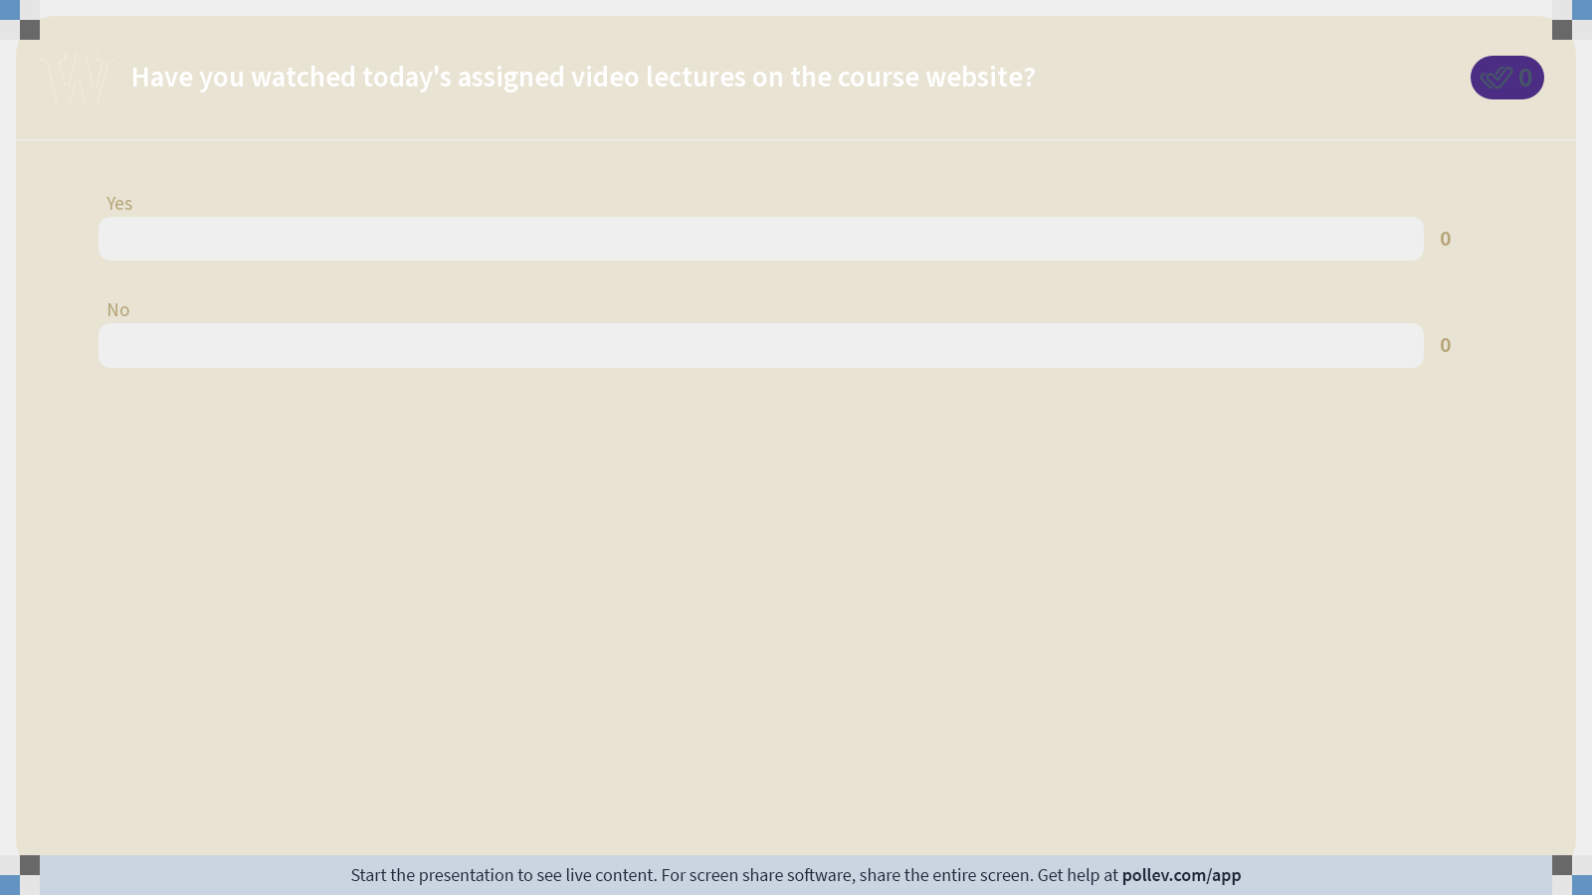
Notes:
Do not modify the notes in this section to avoid tampering with the Poll Everywhere activity. More info at polleverywhere.com/support Have you watched today's assigned video lectures on the course website?
https://www.polleverywhere.com/multiple_choice_polls/C5Mf4wqoOzxgPhTX3YZyj?state=opened&flow=Default&onscreen=persist

Slide 11
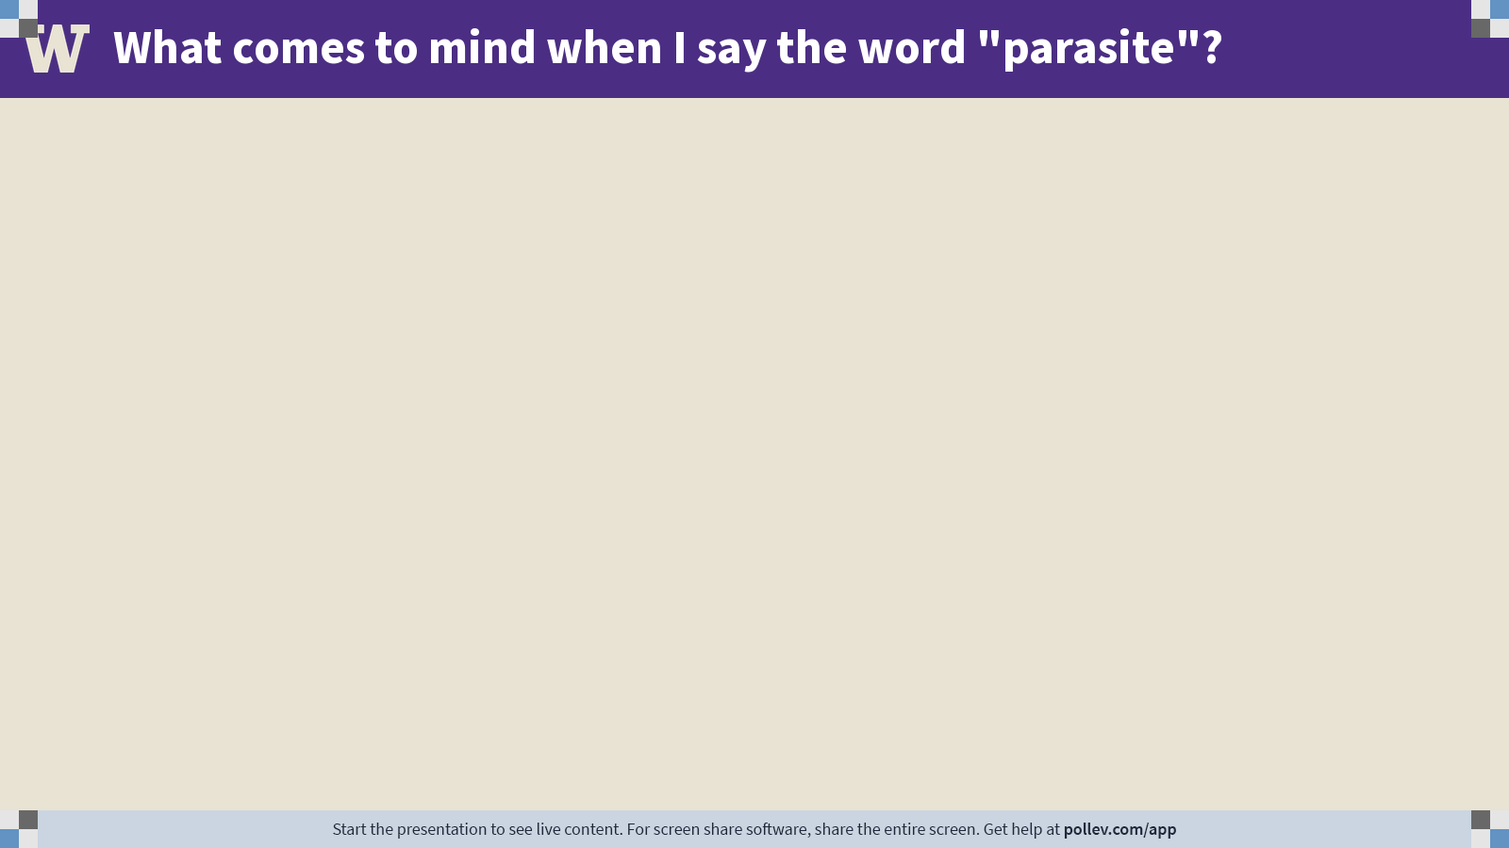
Notes:
Do not modify the notes in this section to avoid tampering with the Poll Everywhere activity. More info at polleverywhere.com/support What comes to mind when I say the word "parasite"?
https://www.polleverywhere.com/free_text_polls/n8mRsosII42qUWMLxN3aH

Slide 12
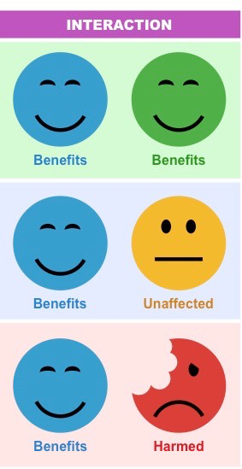
parasites on the spectrum of symbiosis
Parasites are not the only organisms that live in intimate and durable relationships with their hosts.
The class will be split into groups.
Each group will be assigned one kind of symbiont: parasites, commensals, or mutualists.
Generate as many examples of the assigned symbiont as you can.
Each person should assume one role:
Note-taker (in Google doc)
Timekeeper
Reporter
Collaborate with your group to come up
with as many examples as you can.
Notes:
https://docs.google.com/document/d/1Kk92IApqR0dqP8pjU8KjXSjuFePxToeInctn_EKyqx0/edit?usp=sharing

Slide 13
Take the Qualtrics survey!

Slide 14
Welcome to
FISH 406:
Parasite Ecology
Bob
Bell

