Slide 1
Class 11: Nematodes 2

Slide 2

Q1. hookworm’s resurgence
For a long time after the Rockefeller Institute’s intervention in the US South, we thought that hookworm had been vanquished in this country. We were wrong. Why is hookworm on the rise again in the US South?
Ponder on your own (3 m), develop an answer with your group (4 m), then share with the class (5 m).

Slide 4
Q2. sushi worms
Like hookworms, some sushi worms are on the rise – but probably not for the same reasons. Why is Anisakis spp. increasing in abundance?
Ponder on your own (3 m), develop an answer with your group (4 m), then share with the class (5 m).

Slide 5
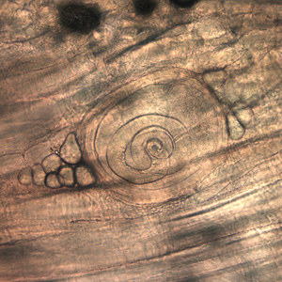
Q3. pathology of Trichinella spiralis
Trichinella spiralis is one of the most-feared human parasites, mostly because it does one thing that most other helminth parasites do not do. What is that thing? And what other parasite species are equally dreadful?
Ponder on your own (3 m), discuss with a partner (4 m), then share with the class (5 m).

Slide 6
Class 11: Nematodes 2

