Slide 1
Class 19: Nematomorphs and acanthocephalans

Slide 2
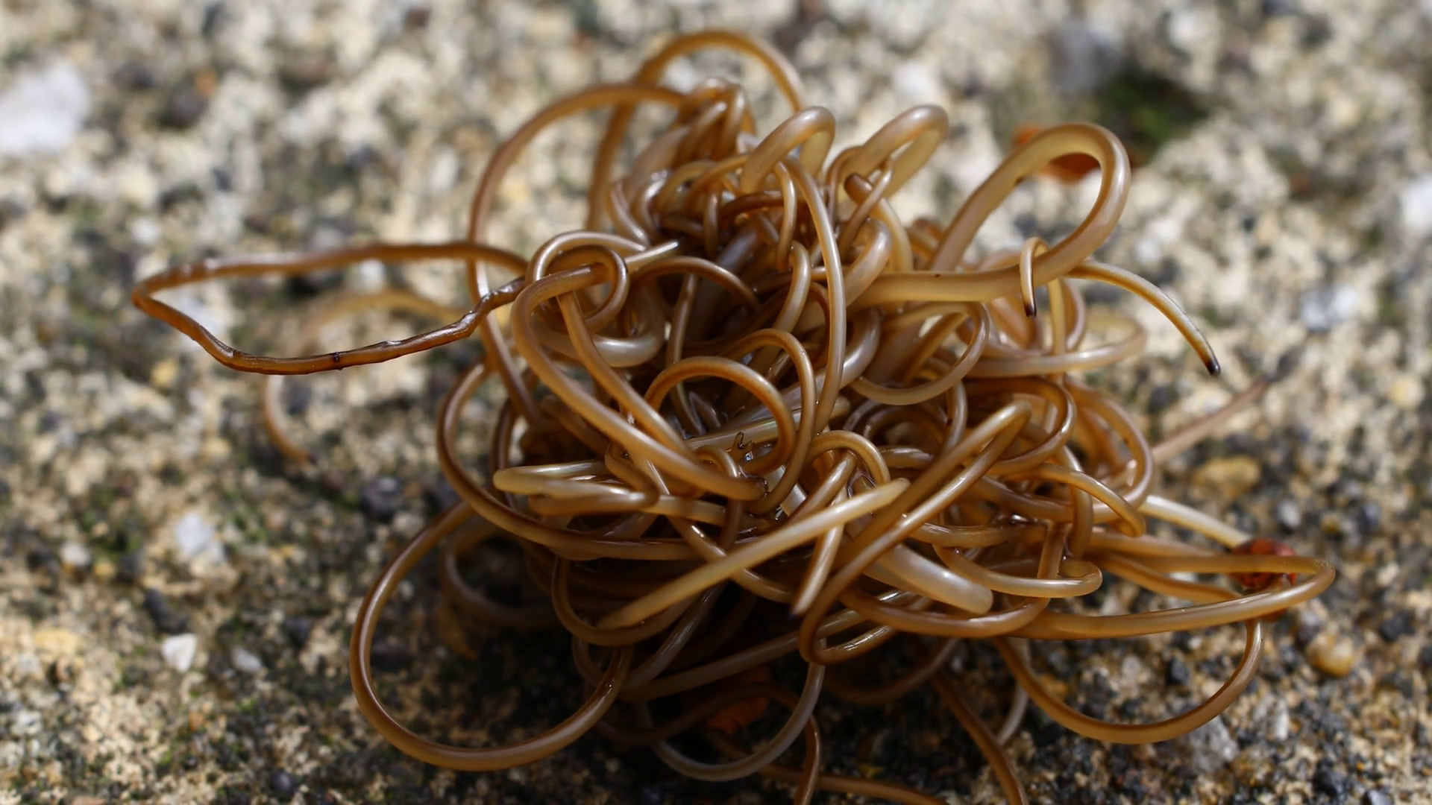

Q1. the evolution of behavioral manipulation
At this point, we’ve learned about many manipulative parasites. But in what contexts is manipulation most likely to evolve? What are the conditions that you think might lead to the evolution of behavioral manipulation?
Ponder on your own (2 m), discuss with your group
(3 m), then share with the class (7 m).

Slide 3
Q2. The nematomorph life cycle spans terrestrial and freshwater environments – a tricky needle to thread! Can you think of other parasites that do the same?

Slide 4
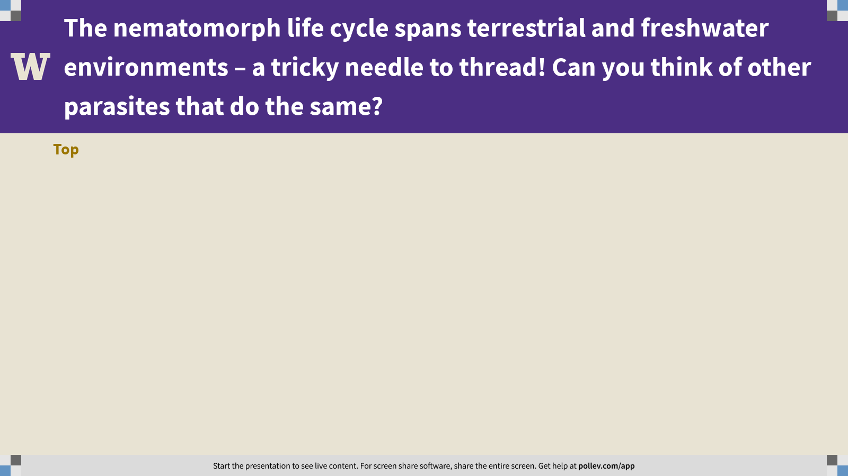
Notes:
The nematomorph life cycle spans terrestrial and freshwater environments – a tricky needle to thread! Can you think of other parasites that do the same?
https://www.polleverywhere.com/discourses/zEYTLmIgMAfERshhP1kFm

Slide 5
Q3. nematomorphs: saviors of endangered trout?
In Sato et al. 2012, you learned about an experiment to estimate the energy contribution of nematomorphs to stream ecosystems. But no experiment is perfect. How would you make this study better?
Ponder on your own (2 m), discuss with your group
(3 m), then share with the class (7 m).

Slide 6
Class 19: Nematomorphs and acanthocephalans

