Slide 1
Class 13: Nematodes 4

Slide 2

Q1. why are there so many parasites in Africa?
At this point in the course, we’ve discussed a dozen or so parasites that are found primarily in sub-Saharan Africa. Why do there seem to be so many parasite species in Africa?
Write on your own (3 m), hone a final answer with your group (4 m), then share with the class (5 m).

Slide 3
Q2. Onchocerca volvulus declines in abundance as deforestation increases, setting up a “win-lose” outcome for people and nature. Mega bummer. Can you think of other parasites where there is instead a ”win-win” outcome? That is, situations where conserving biodiversity leads to reductions in transmission of a parasite?

Slide 4
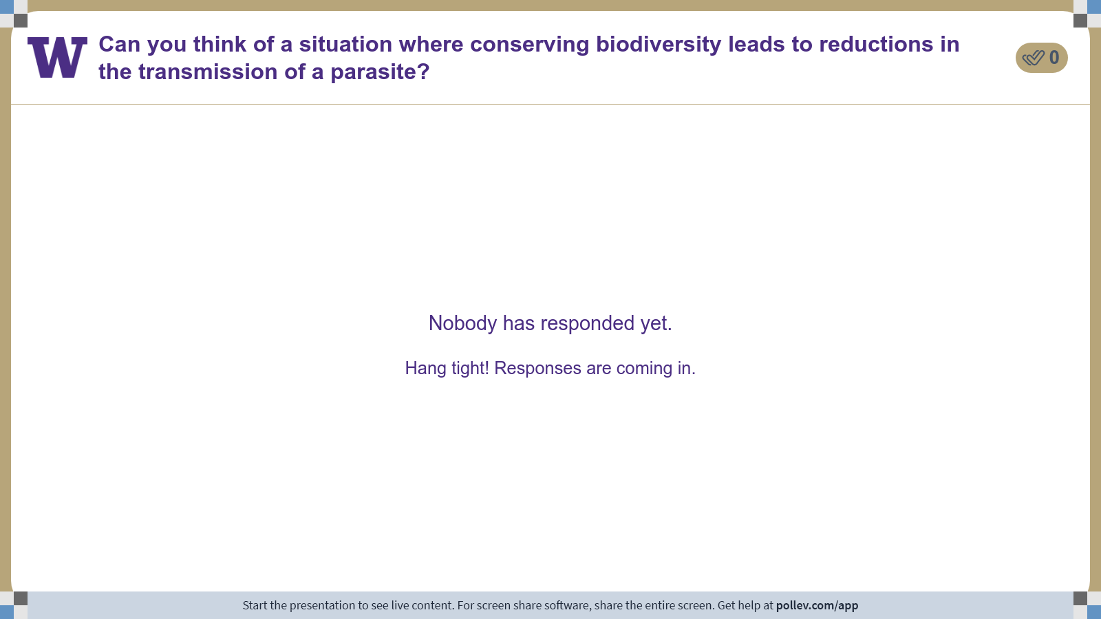
Notes:
Do not modify the notes in this section to avoid tampering with the Poll Everywhere activity. More info at polleverywhere.com/support Can you think of a situation where conserving biodiversity leads to reductions in the transmission of a parasite?
https://www.polleverywhere.com/discourses/v8gpj6SsDMacqfeLvR63Y

Slide 5
Q3. design a study to reveal one parasite’s history
At this point in the course, we’ve discussed several parasites that were introduced into Latin America from Africa during the Atlantic slave trade. What we haven’t talked about is the evidence for this.
How would you test whether Onchocerca volvulus was introduced into Latin America via the Atlantic slave trade?
Write on your own (3 m), hone a final answer with your group (4 m), then share with the class (5 m).

Slide 6
Class 13: Nematodes 4

