Slide 1
Class 10: Nematodes 1

Slide 2
Q1. The geohelminths have been co-evolving with humans for a long, long time. What are some cultural practices that might have arisen because they protect human populations against geohelminth infections?

Slide 3
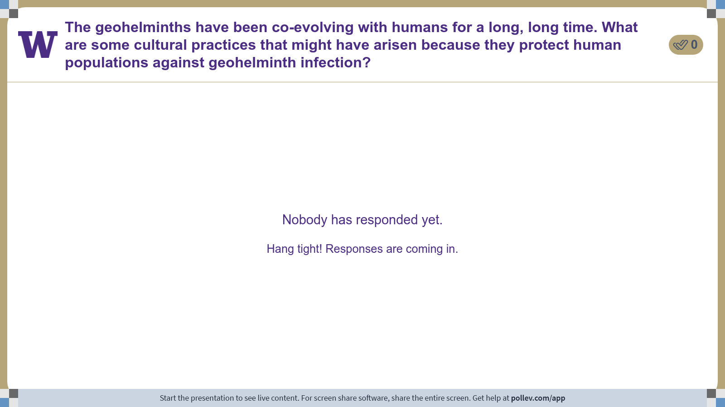
Notes:
Do not modify the notes in this section to avoid tampering with the Poll Everywhere activity. More info at polleverywhere.com/support The geohelminths have been co-evolving with humans for a long, long time. What are some cultural practices that might have arisen because they protect human populations against geohelminth infection?
https://www.polleverywhere.com/discourses/LTuvUnJLBJFADVdDdLxTI

Slide 4
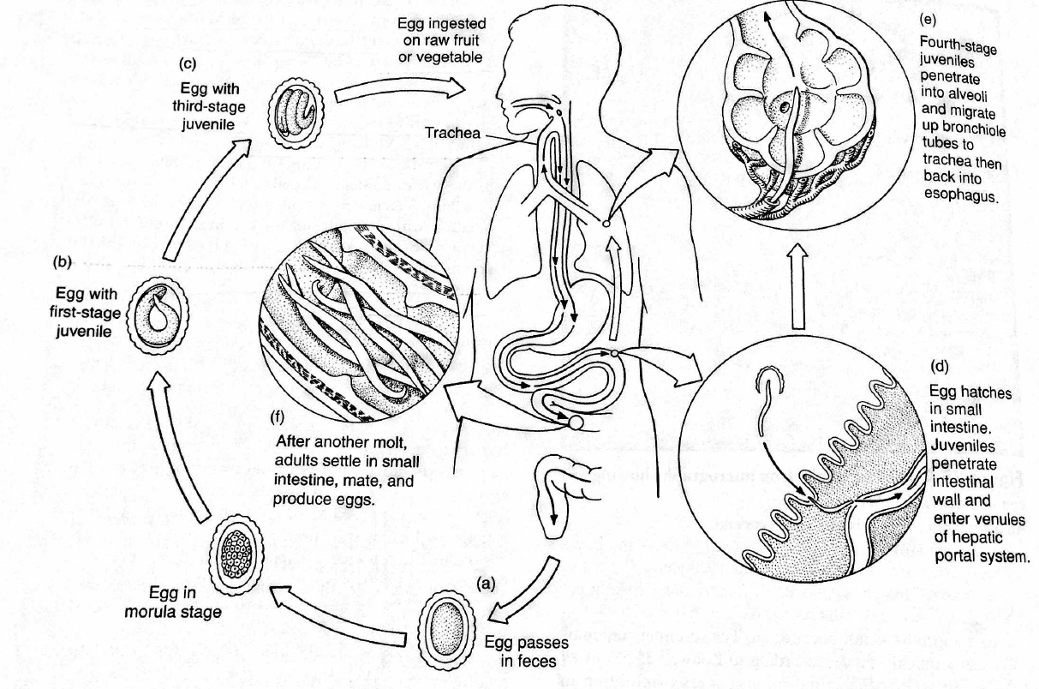

Slide 5

Q2. the life cycle of Ascaris lumbricoides
The life cycle of Ascaris lumbricoides is counterintuitive in the extreme. Why on Earth does this intestinal parasite leave the intestine to make a long and seemingly pointless migration through the circulatory system?
Ponder on your own (3 m), discuss with your group (5 m), then share with the class (5 m).

Slide 7
Q3. Ascaris eggs are tough because of their thick mammilated layer. What are some of the conditions that Ascaris eggs can survive that might kill other parasite eggs?

Slide 8

Notes:
Do not modify the notes in this section to avoid tampering with the Poll Everywhere activity. More info at polleverywhere.com/support Ascaris eggs are tough because of their thick mammilated layer. What are some of the conditions that Ascaris eggs can survive that might kill other parasite eggs?
https://www.polleverywhere.com/free_text_polls/mgHRf1ghW7CBPpWzHrX9X

Slide 9
Q4. pathology of Trichuris trichiura
Trichuris trichiura doesn’t take blood from its host, but its pathology can be severe nonetheless, due to the damage it causes to the intestinal epithelium. Why is damage to the intestinal epithelium bad? List as many reasons as you can.

Slide 10
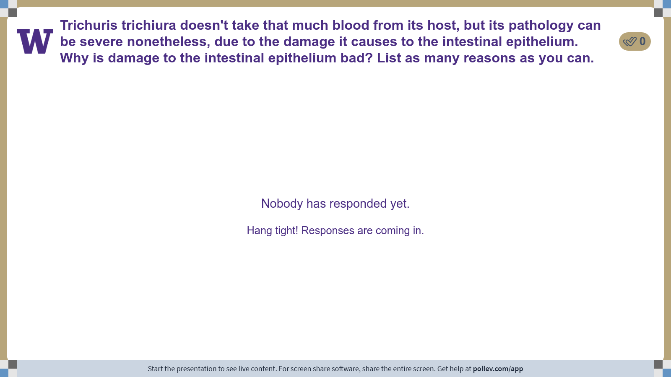
Notes:
Do not modify the notes in this section to avoid tampering with the Poll Everywhere activity. More info at polleverywhere.com/support Trichuris trichiura doesn't take that much blood from its host, but its pathology can be severe nonetheless, due to the damage it causes to the intestinal epithelium. Why is damage to the intestinal epithelium bad? List as many reasons as you can.
https://www.polleverywhere.com/discourses/r3QPrLFthhjdUo0RhoMMF

Slide 11
Class 10: Nematodes 1

