Slide 1
Class 12: Nematodes 3

Slide 2
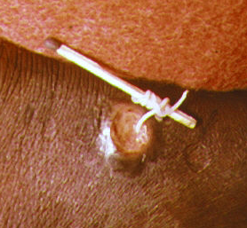

Q1. why does an aquatic parasite exist in a desert?
Dracunculus medinensis is filarial nematode with a copepod intermediate host. Shouldn’t it exist in a place with more copepods… or really, anywhere but a desert? Why does it exist in some of the driest parts of Africa?
Write on your own (3 m), hone a final answer with your group (4 m), then share with the class (5 m).

Slide 3
Q2. During World War II, many American soldiers stationed in the Pacific theater feared lymphatic filariasis more than they feared Japanese bombing raids. If you were the commander of an American naval base at that time and place, what measures would you have put in place to protect against transmission?

Slide 4
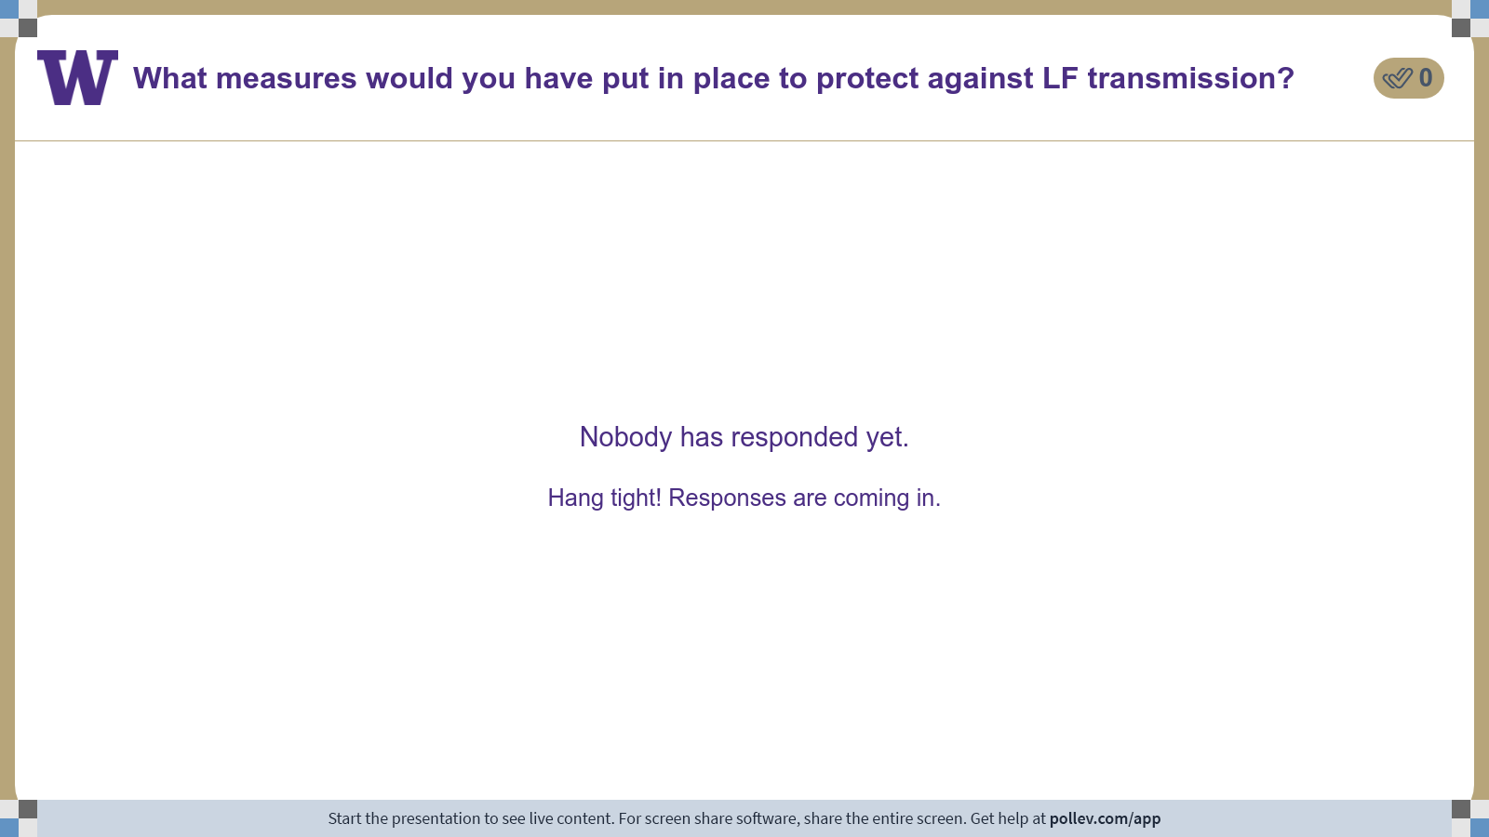
Notes:
Do not modify the notes in this section to avoid tampering with the Poll Everywhere activity. More info at polleverywhere.com/support What measures would you have put in place to protect against LF transmission?
https://www.polleverywhere.com/discourses/oI4gPMkToAhAFAKFma6Sx

Slide 5
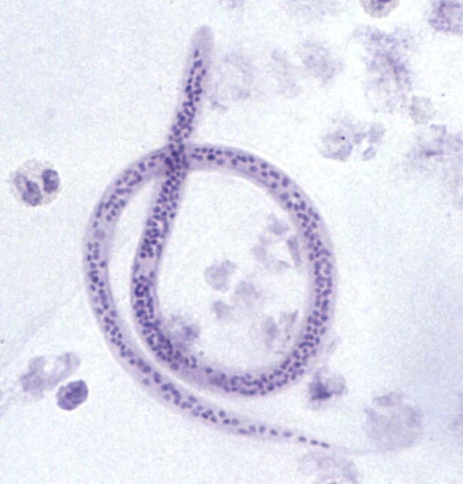
Q3. periodicity in filarial nematode distribution
Like many filarial nematodes, microfilariae of Wuchereria bancrofti can control where they hang out in the human lymph system, and only emerge into peripheral circulation at optimal times for transmission. But what is that optimal time for transmission?
Ponder on your own (3 m), discuss with a partner (4 m), then share with the class (5 m).

Slide 6
Class 12: Nematodes 3

