Slide 1
Class 21: The apicomplexan Toxoplasma gondii

Slide 2
Q1. What are some specific customs, practices, foods, or behaviors that could put you at risk of Toxoplasma gondii infection?

Slide 3
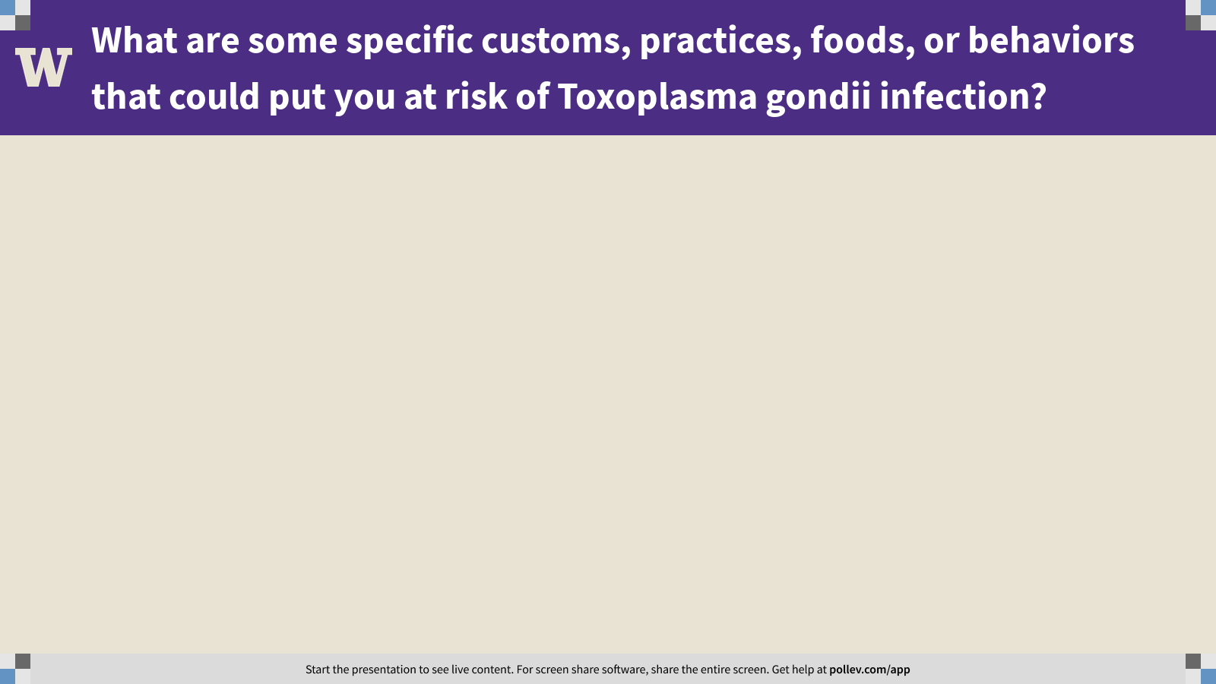
Notes:
What are some specific customs, practices, foods, or behaviors that could put you at risk of Toxoplasma gondii infection?
https://www.polleverywhere.com/free_text_polls/wtU6YYEgO7Ug2nylYx9jJ

Slide 4
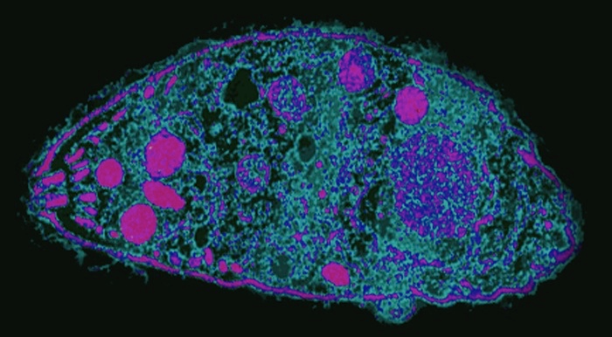
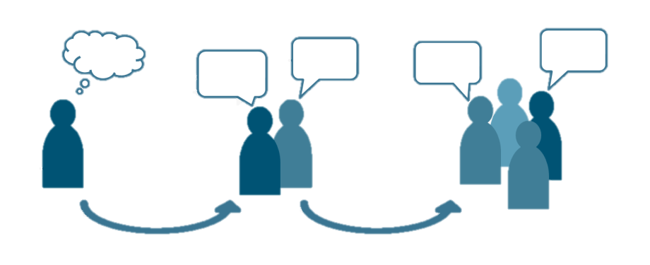
Q2. behavioral manipulation?
The online lectures presented evidence that infection by Toxoplasma gondii changes human behavior. But WHY does it do this? Was the parasite selected to manipulate human behavior? Or is something else going on?
Ponder on your own (3 m), discuss with your group
(3 m), then share with the class (7 m).

Slide 5
Toxoplasma gondii is a major problem for southern sea otter conservation. But who is to blame: big cats or domestic cats? Design a study that would give you the info you need to assign blame and design a control strategy that would mitigate the flow of oocysts from cats to otters.
Q3. blame game
Ponder on your own (3 m), discuss with your group
(3 m), then share with the class (7 m).

Slide 6
Class 21: The apicomplexan Toxoplasma gondii

