Slide 1
Class 18: Arthropods 3

Slide 2
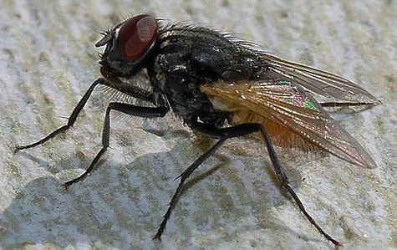
Order Diptera (flies)
Family Muscidae
common house fly
synanthropic
not vectors, but do transport parasites
how?
hairy
sticky foot pads
love human food and human poo
move easily between indoor and outdoor

Slide 3
Q1. Given what you know about parasites transmitted by contact with feces, what human diseases do you think might be transmitted when house flies visit human food?

Slide 4
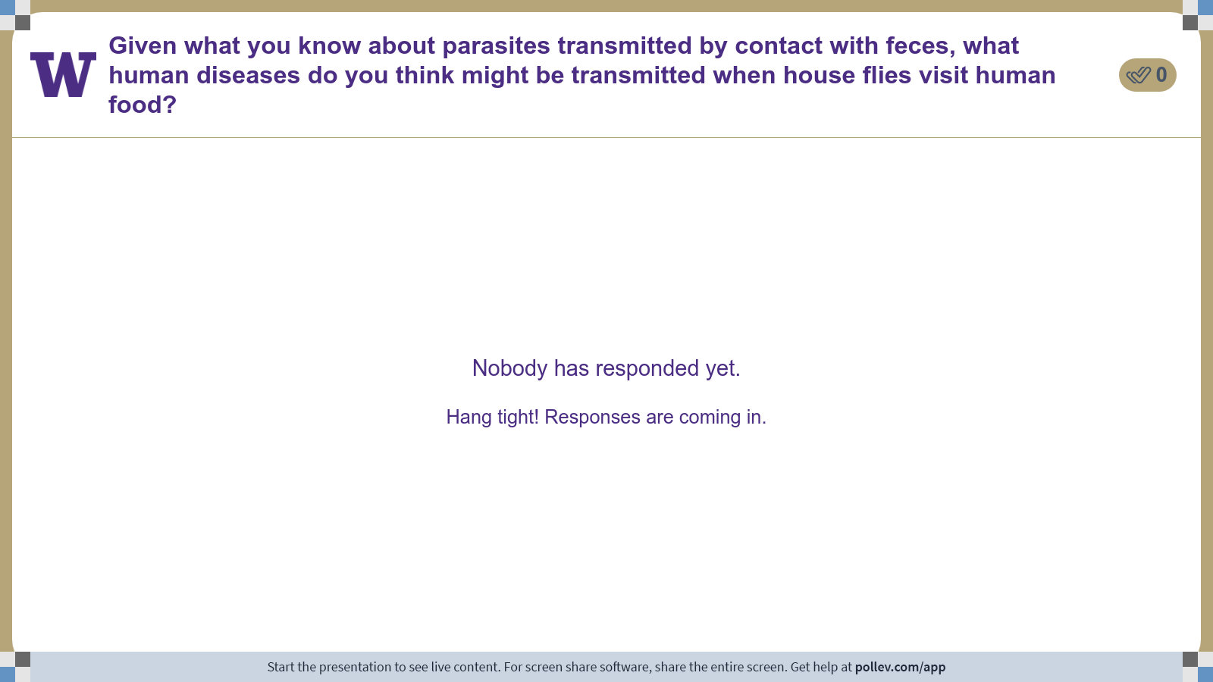
Notes:
Do not modify the notes in this section to avoid tampering with the Poll Everywhere activity. More info at polleverywhere.com/support Given what you know about parasites transmitted by contact with feces, what human diseases do you think might be transmitted when house flies visit human food?
https://www.polleverywhere.com/discourses/yFGR56I4k9Fvt2SrSqSvt

Slide 5
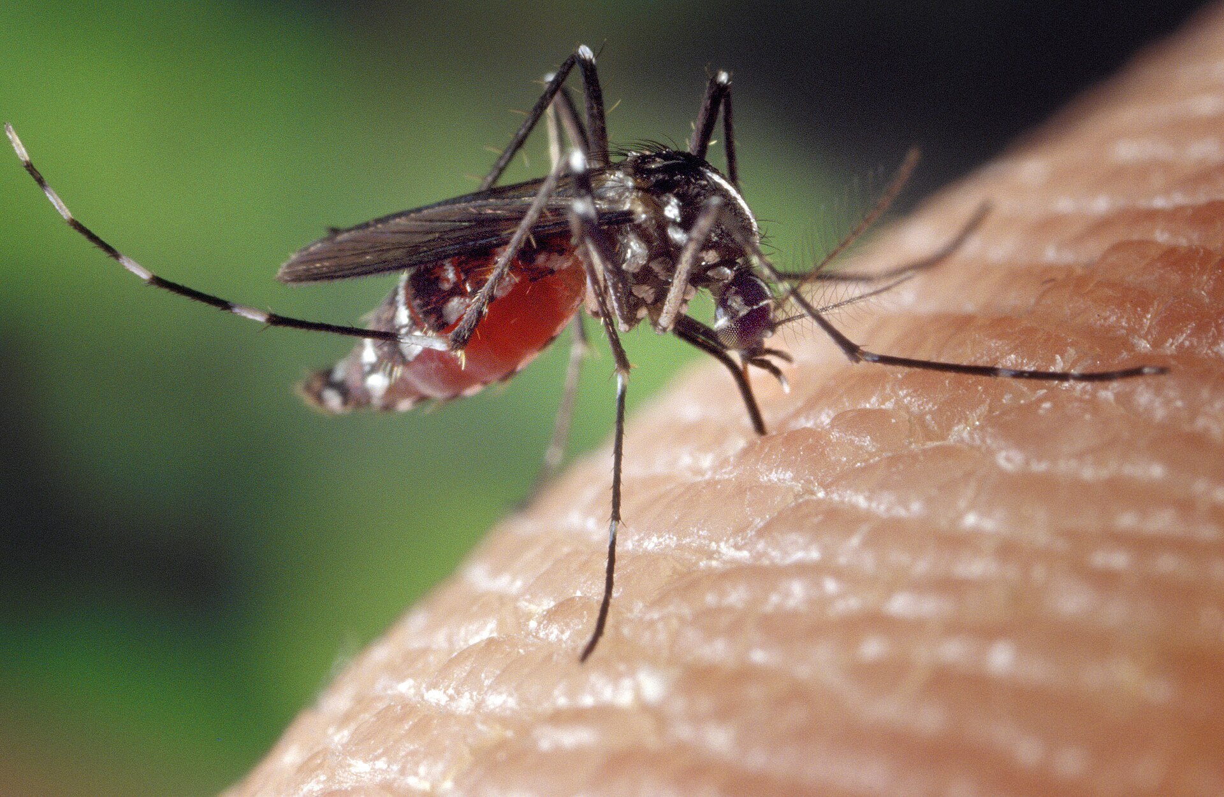

Q2. mosquito control
Imagine that you work for the Washington State Department of Health and imagine that the Asian tiger mosquito (an invasive species that can vector dengue, Zika, and chikungunya) arrives in Seattle. You are tasked with developing a response.
What do you do?
How will you know whether your approach is working?
Ponder on your own (4 m), discuss with your group
(6 m), then share with the class.

Slide 6
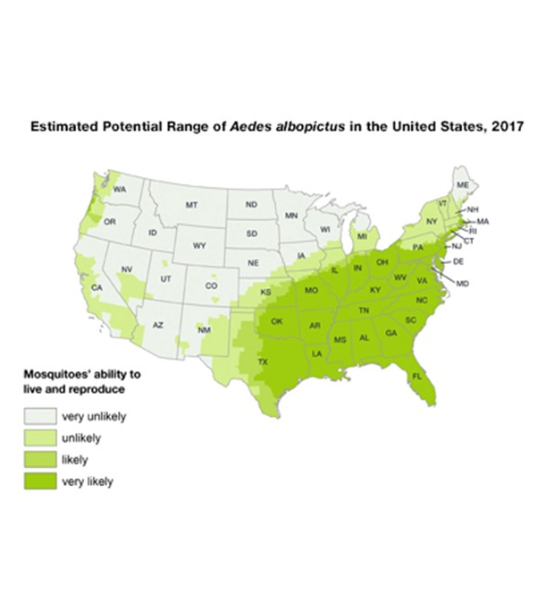
CDC

Slide 7
Q2. mosquito control
Imagine that you work for the Washington State Department of Health and imagine that the Asian tiger mosquito (an invasive species that can vector dengue, Zika, and chikungunya) arrives in Seattle. You are tasked with developing a response.
What do you do?
How will you know whether your approach is working?
Ponder on your own (4 m), discuss with your group
(6 m), then share with the class.

Slide 8
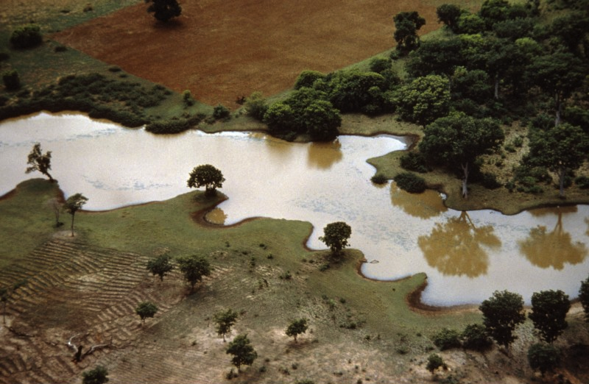
Q3. ecology of onchocerciasis
You are in charge of a forest restoration project in East Africa. Your job is to make sure that there are no negative human health consequences of this restoration project. How do you proceed?
Ponder on your own (4 m), discuss with your group
(6 m), then share with the class.

Slide 9
Class 18: Arthropods 3

