Slide 1
Class 15: Introduction to the arthropods

Slide 2
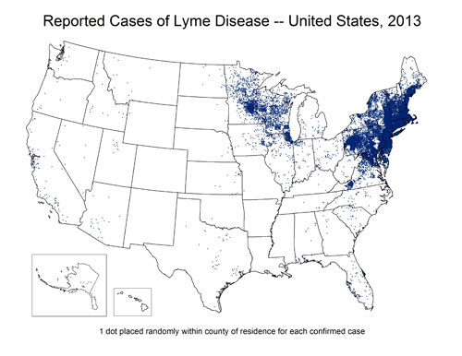

Q1. why is Lyme disease increasing in the US?
Lyme is now the most common vector-borne disease in North America, and the number of cases rises every year. Why??
Ponder on your own (3 m), discuss with your group
(4 m), then share with the class (5 m).

Slide 3
Q2. Micropredators are not parasites, and parasites are not micropredators. For each of the taxa that follow, decide: is it a micropredator or a parasite?

Slide 4

Notes:
Mosquito
https://www.polleverywhere.com/multiple_choice_polls/vjbNmi6kF7dtLLe6pw3o8?flow=Default&onscreen=persist

Slide 5

Notes:
Tick
https://www.polleverywhere.com/multiple_choice_polls/PQ3rm4XTz3wLU2sjPXf8B?flow=Default&onscreen=persist

Slide 6

Notes:
Body louse
https://www.polleverywhere.com/multiple_choice_polls/Ea7qNwU60hjsFocjTRzj8?flow=Default&onscreen=persist

Slide 7

Notes:
Deer fly
https://www.polleverywhere.com/multiple_choice_polls/J5mY1d2c8G8x3H7wL6mHA?flow=Default&onscreen=persist

Slide 8
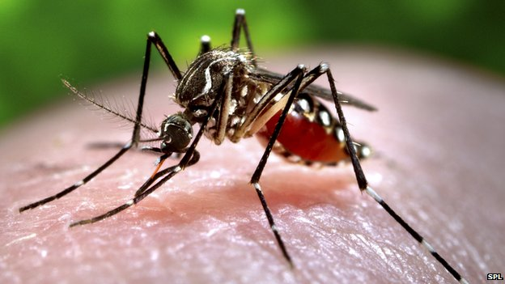
Q3. why are are so many micropredators also vectors?
Lots of micropredators serve as vectors for filarial nematodes like Onchocerca volvulus, bacteria like the Lyme disease spirochaete, protozoans like the one that causes malaria, or viruses like West Nile. Why do micropredators have to be such jerks? Can’t they just take their bloodmeal and leave it at that? Why add insult to injury?
Write on your own (5 m), share with a partner (5 m), then share with the class (5 m).

Slide 9
Class 15: Introduction to the arthropods

